Slide 1
Deep Generative Models A Survey
Jianfei Chen

Slide 2
Overview
Discriminative models: p(y | x)
Generative models: p(x) （unlabeled data）
p(x, y) （labeled data）
Applications
Data generation
Semi-supervised learning:
learn p(x_unlabeled) p(x_labeled, y_labeled)
train p(x | y), and generate more data
Challenges
p(x) is significantly more difficult to model than p(y | x)
More complicated data (finite vs infinite)
Higher dimensionality (sample complexity)
More parameters (encoding labels vs encoding images)
Computational challenges: 100x slower

Slide 3
Roadmap
Generative Models
Tractable Models
PixelCNNs
Flows
VAEs
RealNVP
Glow
Flow++
VAE-IAF
PixelSnail
GANs
WGAN
LSGAN
SNGAN
SAGAN
BigGAN
PixelCNN++
VQVAE
IWAE

Slide 4
Tractable Models
VAE
Flow
PixelCNN

Slide 5
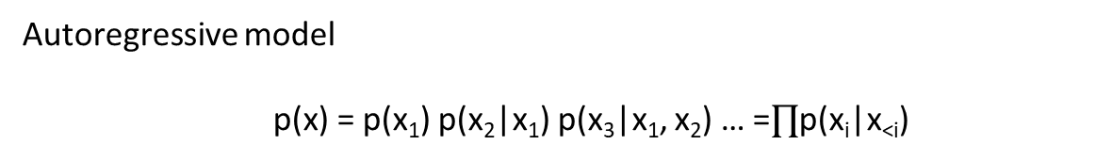
PixelCNN: Row LSTM
Layer
Row
x₀
x₁
x₂
x₃
Autoregressive model
p(x) = p(x₁) p(x₂|x₁) p(x₃|x₁, x₂) … =$∏$p(x_{i}|x_{<i})
Oord, Aaron van den, Nal Kalchbrenner, and Koray Kavukcuoglu. "Pixel recurrent neural networks." arXiv preprint arXiv:1601.06759 (2016).

Slide 6
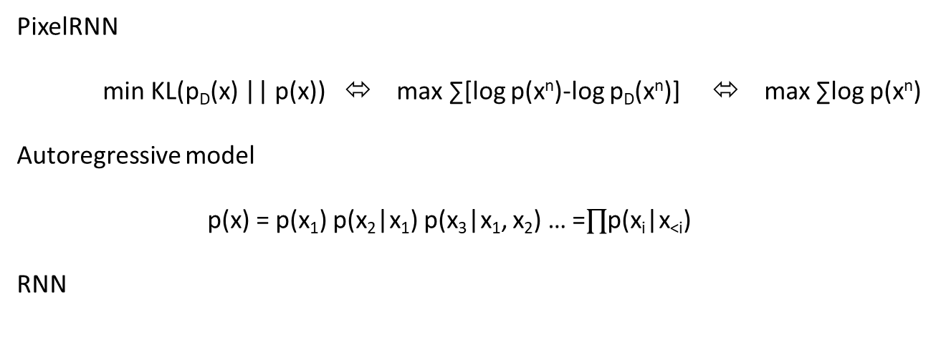
PixelCNN
PixelRNN
min KL(p_{D}(x) || p(x)) ⬄ max ∑[log p(x^{n})-log p_{D}(x^{n})] ⬄ max ∑log p(x^{n})
Autoregressive model
p(x) = p(x₁) p(x₂|x₁) p(x₃|x₁, x₂) … =$∏$p(x_{i}|x_{<i})
RNN
1-D seq
x₁
x₂
x₃
x₄
2-D grid
cell
cell
cell
cell
x₀
Oord, Aaron van den, Nal Kalchbrenner, and Koray Kavukcuoglu. "Pixel recurrent neural networks." arXiv preprint arXiv:1601.06759 (2016).

Slide 7
PixelCNN
CNN
CNN
CNN
CNN
Autoregressive model
p(x) = p(x₁) p(x₂|x₁) p(x₃|x₁, x₂) … =$∏$p(x_{i}|x_{<i})
Oord, Aaron van den, Nal Kalchbrenner, and Koray Kavukcuoglu. "Pixel recurrent neural networks." arXiv preprint arXiv:1601.06759 (2016).

Slide 8
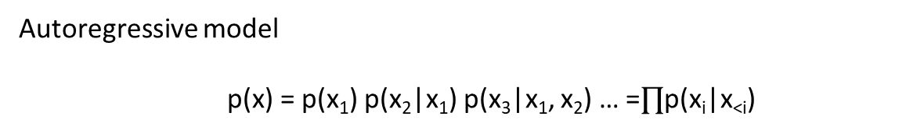
Masked convolution
kernel
1 | 1 | 1
1 | 0 | 0
0 | 0 | 0
CNN
Pro
fast training
fairly powerful
Con
slow sampling（pixel-by-pixel）
sensitive to order
Autoregressive model
p(x) = p(x₁) p(x₂|x₁) p(x₃|x₁, x₂) … =$∏$p(x_{i}|x_{<i})
Oord, Aaron van den, Nal Kalchbrenner, and Koray Kavukcuoglu. "Pixel recurrent neural networks." arXiv preprint arXiv:1601.06759 (2016).

Slide 9
Flows
Change-of-variables formula
p(x)dx = p(u)du ⬄ p(x)=p(u) |du/dx|
Four key ingredients
p(u) （normal distribution）
u=u(x)
x=x(u)
|du/dx|
u
NN
x

Slide 10
Flows
p(x)dx = p(u)du ⬄ p(x)=p(u) |du/dx|
Four key ingredients
p(u) （normal distribution）
u=u(x)
x=x(u)
|du/dx|
Compute p(x)
Compute u = u(x), and |du/dx|
Compute p(u)
p(x)=p(u) |du/dx|
Sampling
Draw u~p(u)
Compute x = x(u)
training
testing
training

Slide 11
Affine coupling layer
x = affinecoupling(u)
u1, u2 = split(u)
s, t = nn(u2)
x1 = u1
x2 = u2 * exp(s) + t
x = concat(x1, x2)
log|du/dx| = -sum(s)
u = affinecoupling⁻¹(x)
x1, x2 = split(x)
s, t = nn(x2)
u1 = x1
u2 = (x2 – t) / exp(s)
u = concat(u1, u2)
Residual structure

Slide 12
Invertible 1*1 conv
x = invertible1x1conv(u)
For each r, c
x(r, c) = Wu(r, c)
log |du/dx| = -log |W|
u = invertible1x1conv⁻¹(x)
For each r, c
u(r, c) = W⁻¹x(r, c)

Slide 13
Generative flows
Four key ingredients
p(u) （normal distribution）
u=u(x)
x=x(u)
|du/dx|
u
AffineCoupling
Invertible1x1Conv
Intractable |du/dx|
Intractable x=x(u), Variational dequantization
Invertible 3x3 conv
AffineCoupling
Dinh, Laurent, Jascha Sohl-Dickstein, and Samy Bengio.
"Density estimation using real nvp." arXiv preprint arXiv:1605.08803 (2016).
Kingma, Durk P., and Prafulla Dhariwal.
"Glow: Generative flow with invertible 1x1 convolutions."
Advances in Neural Information Processing Systems. 2018.
Invertible1x1conv
Chen, Ricky TQ, et al.
"Residual Flows for Invertible Generative Modeling." arXiv preprint arXiv:1906.02735 (2019).
AffineCoupling
Ho, Jonathan, et al. “
Flow++: Improving flow-based generative models with variational dequantization and architecture design."
arXiv preprint arXiv:1902.00275 (2019).
Invertible1x1conv
x
Hoogeboom, Emiel, Rianne van den Berg, and Max Welling.
"Emerging convolutions for generative normalizing flows." arXiv preprint arXiv:1901.11137 (2019).

Slide 14
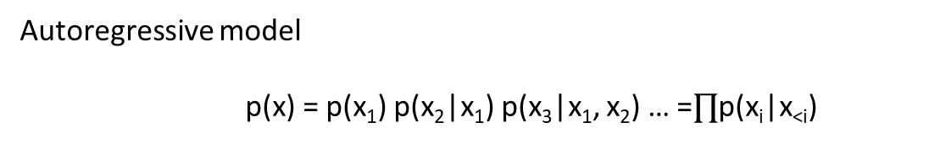
PixelCNN is a flow
Autoregressive model
p(x) = p(x₁) p(x₂|x₁) p(x₃|x₁, x₂) … =$∏$p(x_{i}|x_{<i})
For example
p(x_{i}|x_{<i})=N(mu(x_{<i}), sigma(x_{<i}))
xi = mu(x_{<i}) + exp(logsigma(x_{<i})) * u_{i}, where u_{i}~N(0, I)
inverse ui = (xi – mu(x_{<i})) / exp(logsigma(x_{<i}))
u->x: slow
x->u: fast
Change-of-variables formula
p(x)dx = p(u)du ⬄ p(x)=p(u) |du/dx|

Slide 15
VAE
min KL(p_{D}(x) || p(x)) ⬄ max ∑[log p(x^{n})-log p_{D}(x^{n})] ⬄ max ∑log p(x^{n})
Introducing latent variable z
p(x, z) = p(x|z) p(z)
log p(x) = ∑_{z} log p(x, z) >= E_{qz}[log p(x, z) – log q(z|x)]
Reparameterization trick
Let q(z|x) = q(u) |du/dz|
where z=z(u, x)
ELBO=E_{qu}[log p(x, z(u, x)) – log q(u) – log |du/dz|]
Kingma, Diederik P., and Max Welling. “
Auto-encoding variational bayes." arXiv preprint arXiv:1312.6114 (2013).

Slide 16
VAE
Reparameterization trick
Let q(z|x) = q(u) |du/dz|
where z=z(u, x)
ELBO=E_{qu}[log p(x, z(u, x)) – log q(u) – log |du/dz|]
p(z) = N(0, I)
p(x|z) = N(mu(z), sigma(z))
q(u) = N(0, I)
z(u, x) = mu(x) + u * sigma(x)
mu(z)
sigma(z)
mu(x)
sigma(x)
P-net
q-net
z
x

Slide 17
VAE-IAF
z
p(z) = N(0, I)
p(x|z) = N(mu(z), sigma(z))
q(u) = N(0, I)
z(u, x) = mu(x) + u * sigma(x)
mu(x)
sigma(x)
q-net
mu(z)
sigma(z)
x
u
Kingma, Durk P., et al. "Improved variational inference with inverse autoregressive flow."
Advances in neural information processing systems. 2016.

Slide 18
VAE-IAF
z
AffineCoupling
p(z) = N(0, I)
p(x|z) = N(mu(z), sigma(z))
q(u) = N(0, I)
z(u, x) = mu(x) + u * sigma(x)
x(u, z) = mu(z) + u * sigma(z)
Invertible1x1conv
mu(x)
sigma(x)
q-net
mu(z)
sigma(z)
x
u
Flows are VAE-IAFs with 0-dim z

Slide 19
VQVAE
x
VAE
z
PixelCNN
u
van den Oord, Aaron, and Oriol Vinyals. "Neural discrete representation learning." Advances in Neural Information Processing Systems. 2017.

Slide 20
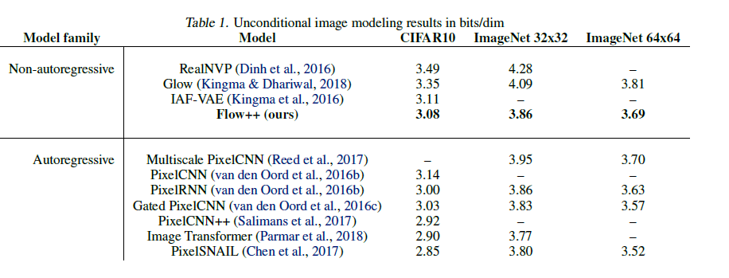
Current state-of-the-art

Slide 21
Roadmap
Generative Models
Tractable Models
PixelCNNs
Flows
VAEs
RealNVP
Glow
Flow++
VAE-IAF
PixelSnail
GANs / fGAN
Stable Training
PixelCNN++
VQVAE
IWAE
SNGAN
Stronger gradients
WGAN
LSGAN
TTUR
Better architecture
SAGAN

Slide 22
GANs
z
x=g(z)
Minimize some divergence between p_{D}(x) and p(x)=p(G(z))
Implicit probability distributions
Can draw samples from
Cannot evaluate density
Non-invertible transformations / Marginal distribution / Data distribution
Difficulties
min KL(p_{D}(x) || p(x)) ⬄ max ∑[log p(x^{n})-log p_{D}(x^{n})] ⬄ max ∑log p(x^{n})
Sampling from p_{D}
Density of p(x)
Goal: minimize from divergence between distributions without density

Slide 23
Density ratio estimator
z
x=g(z)
Task:
p(x) and q(x) are implicit probability distributions
Can we estimate p(x)/q(x)?
Classifier
max_{D} E_{p}[log D(x)] + E_{q}[log (1-D(x))]
Solution (in functional space)
D(x) = p(x) / (p(x) + q(x))
=> p(x) / q(x) = D(x) / (1- D(x))
KL(p_{D} || p) = Ep_{D}[log (p_{D}(x)/p(x))] = Ep_{D}[log D(x) – log(1-D(x))]
Optimize density ratio estimator:
max_{D} E_{p}[log D(x)] + E_{q}[log (1-D(x))]
Optimize generator:
min_{G} Ep_{D}[log D(x) – log(1-D(G(z)))]

Slide 24
GAN
z
x=g(z)
Jensen-Shannon divergence (symmetric)
JSD(p || q) = KL(p || (p+q/2)) + KL(q || (p+q)/2)
D(x) = p(x) / (p(x) + q(x)) => log D(x) = log p – log (p+q)
=> log (1-D(x)) = log q – log (p+q)
JSD(p || q) = Ep[log p – log(p+q) + log 2] + Eq[log q – log (p+q) + log 2]
= log 4 + Ep[log D] + Eq[log (1-D)]
Optimize density ratio estimator:
max_{D} E_{p}[log D(x)] + E_{q}[log (1-D(G(z)))]
Optimize generator:
min_{G} Ep_{D}[log D(x)] + E_{q}[log(1-D(G(z)))]
GAN objective:
min_{G} max_{D} Ep_{D}[log D(x)] + E_{q}[log(1-D(G(z)))]
Game theoretic interpretation

Slide 25

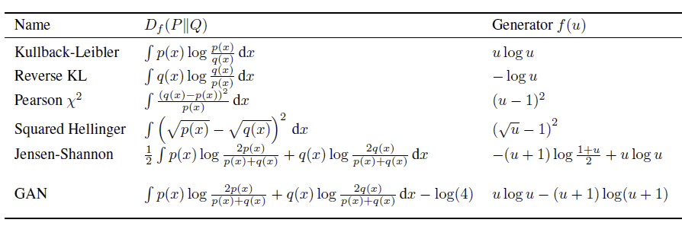
f-GANs
Adversarial training for any f-divergence
f-GAN: Training Generative Neural Samplers using Variational Divergence Minimization

Slide 26
Integral probability metrics (IPM)
D(P, Q) = sup_{f∈F} |E_{p}[f(x)] – E_{q}[f(x)]|
Critic function
GANs as IPM minimization
min_{G} max_{D} |E_{pD}[D(x)] – E_{q}[D(G(z))]|
On Integral Probability Metrics, φ-Divergences and Binary Classification

Slide 27
Integral probability metrics (IPM)
D(P, Q) = sup_{f∈F} |E_{p}[f(x)] – E_{q}[f(x)]|
Maximum mean discrepancy (MMD)
F = {f: ||f||_{H} <= 1}
MMD²(P, Q) = E_{x~p, y~p}[k(x, y)] + E_{x~q, y~q}[k(x, y)] - 2E_{x~p, y~q}[k(x, y)]
Wasserstein distance (optimal transport)
F = {f: ||f||_{L} <= 1}
W(P, Q) = min_{μ} ∫cost(x, y) μ(x, y) dxdy
s.t. ∫ μ(x, y) dx = p(y)
∫ μ(x, y) dx = p(x)
Transportation cost
Transportation plan
References
A Kernel Two-sample test
Wasserstein GAN
3. Generalization and Equilibrium in Generative Adversarial Nets (GANs)

Slide 28
Comparing various divergences
Forward KL
Reverse KL
KL(p || q) = Ep[log p – log q]
Is ∞ when p(x)≠0 and q(x)=0
Learns support(q)>=support(p)
KL(q || p) = Eq[log q – log p]
Is ∞ when p(x)=0 and q(x)≠0
Learns support(q)<=support(p)
Jensen-Shannon
Wasserstein
JSD(p, q) = KL(p || (p+q)/2) +
KL(q || (p+q)/2)
Can be used even when
support(p) ∩ support(q) = ∅
But cannot reflect their distance
W(P, Q) = min_{μ} ∫cost(x, y) μ(x, y) dxdy
s.t. ∫ μ(x, y) dx = p(y)
∫ μ(x, y) dx = p(x)
Can reflect the distance
Take this message with caution! It doesn’t say anything to generalization!
Generalization and Equilibrium in Generative Adversarial Nets (GANs)

Slide 29
Problem: saturation
min_{G} max_{D} Ep_{D}[log D(x)] + E_{q}[log(1-D(G(z)))]
D(x) = p(x) / (p(x) + q(x))
High dimensional distributions
With high probability D(x)≈0 (q>>p) or D(x)≈1 (p>>q)
D(x) = sigmoid(f(x))
(log sigmoid(f(x)))’f = 1-sigmoid(f(x)) = 1-D(x)
(log (1-sigmoid(f(x)))’f = -sigmoid(f(x)) = -D(x)
gradient = E_{pD}[1-D(x)] + E_{q}[-D(G(z))]
p>>q, D(x)=1
q>>p, D(x)=0

Slide 30
WGAN
W(P, Q) = min_{μ} ∫cost(x, y) μ(x, y) dxdy
s.t. ∫ μ(x, y) dx = p(y)
∫ μ(x, y) dx = p(x)
min_{G} max_{D, s.t. Lipschitz(D)<=1} |E_{pD}[D(x)] – E_{q}[D(G(z))]|
No saturation problem due to the linear output of the critic
Weight clipping to enforce Lipschitz constraint
Use optimizer without momentum (RMSProp)
5 critic updates / 1 generator update

Slide 31
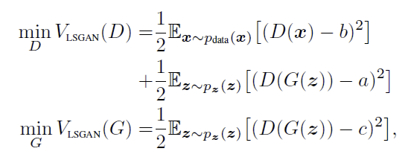
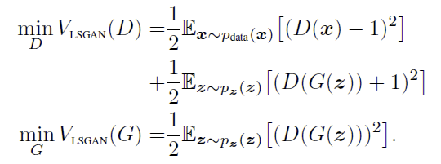
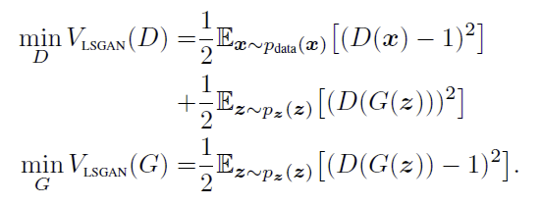
Least squares GAN
Do regression instead of classification
Minimizes Pearson chi-squared distance

Slide 32
Problem: instable training
If generator >> discriminator
Discriminator has no learning signal
If discriminator >> generator
Generative has no learning signal
Approximation: a few steps instead of convergence
min_{G} max_{D} Ep_{D}[log D(x)] + E_{q}[log(1-D(G(z)))]

Slide 33


Spectral Normalization
Prevent the discriminator to be too strong
Controls Lipschitz constant for WGAN
Reference:
SPECTRAL NORMALIZATION FOR GENERATIVE ADVERSARIAL NETWORKS

Slide 34
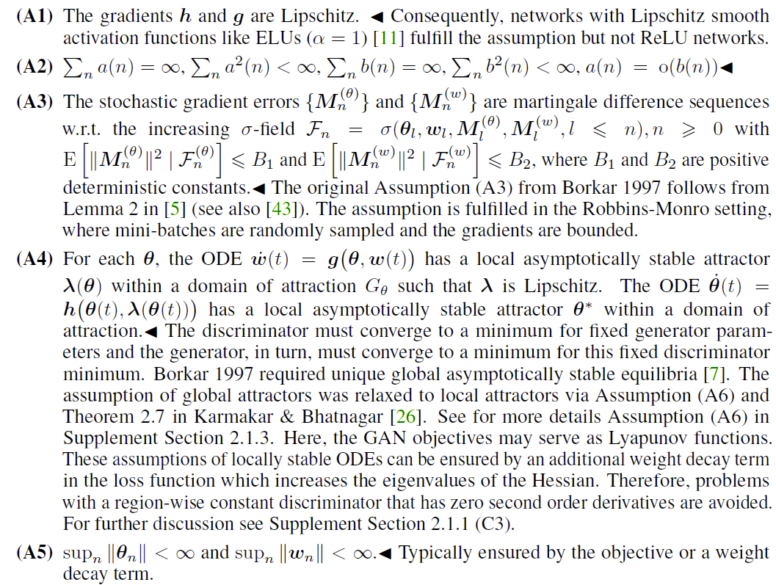
Two time-scale update rule
Always 1 generator update
/ 1 discriminator update
Reference:
GANs Trained by a Two Time-Scale Update Rule Converge to a Local Nash Equilibrium

Slide 35
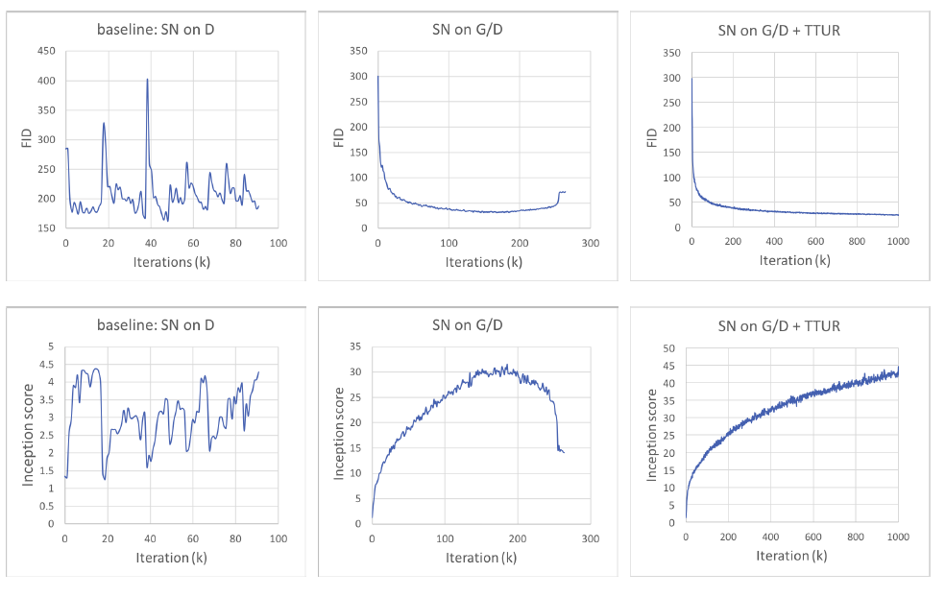
Experiments

Slide 36
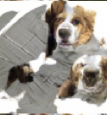
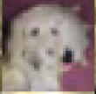
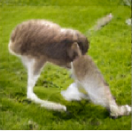
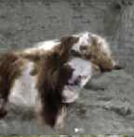
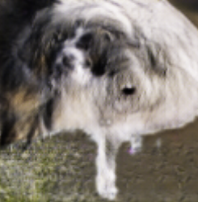
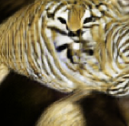
Dogs with 6 eyes
“The new techniques enable GANs to learn recognizable features of animals, such as fur, eyes, and noses, but these features are not correctly combined to form an animal with realistic anatomical structure.”

Slide 37
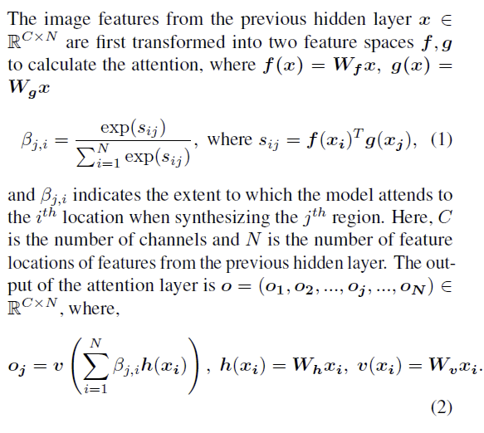
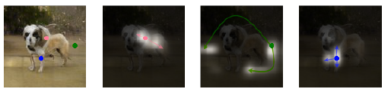
Self attention GAN

Slide 38
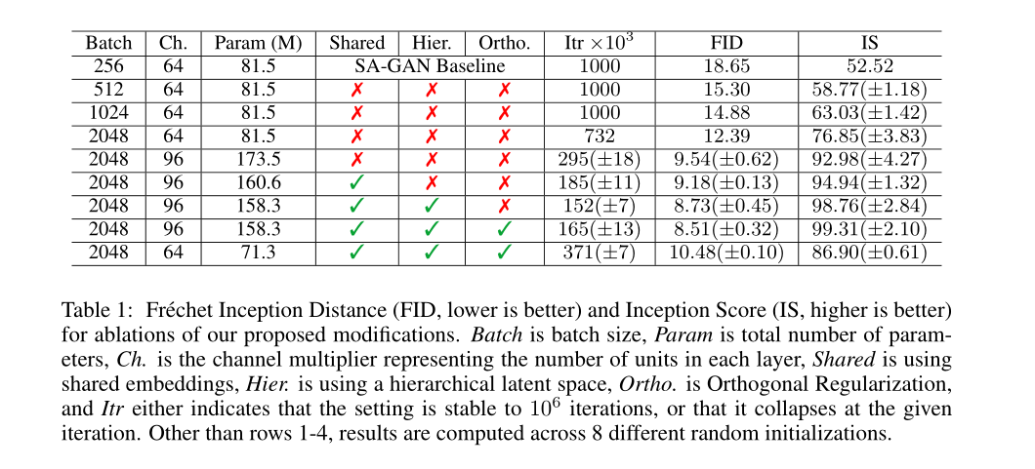
BigGAN

Slide 39
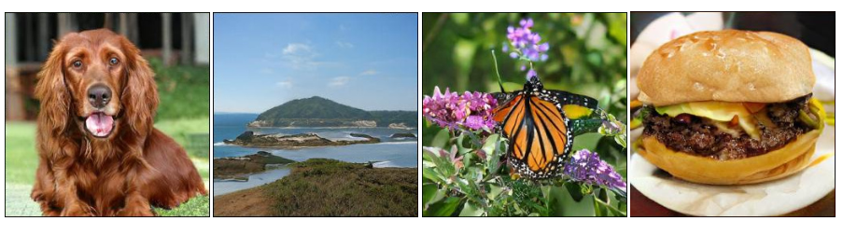
BigGAN

