Slide 1
Project 3 (15 puzzle)
By Forrest Wong , Andres Amado, Umme Faheema

Slide 2
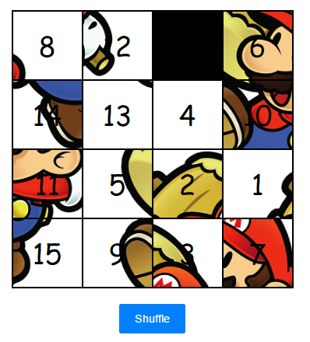
Overview
Build a puzzle of 15 tile using JavaScript
User will get a jumbled puzzle of 15 tile and using the mouse in order to move, user will have to solve it.
The shuffle button under the puzzle will re shuffle the puzzle for the users.
Before a move is made, the code will check if the tile is adjacent to the blank tile or not.

Slide 3
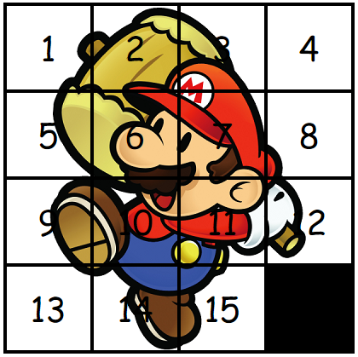
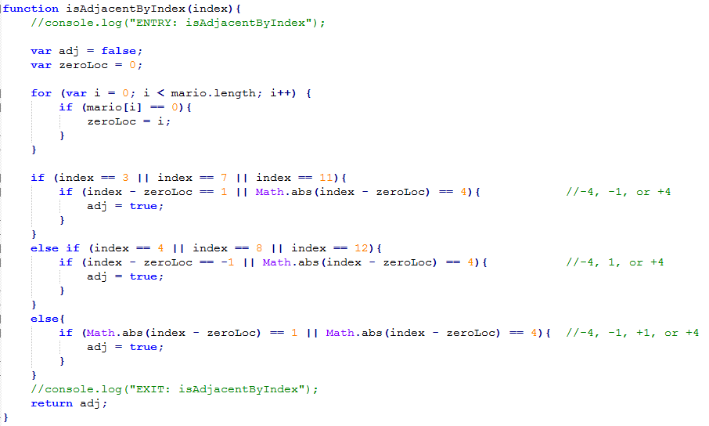
Code snippet

Slide 4
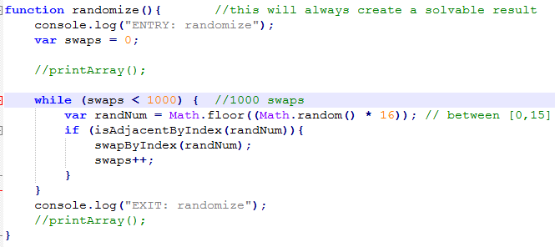
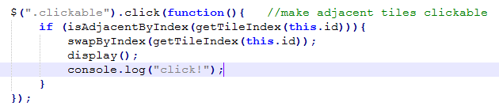
Code snippet

Slide 5
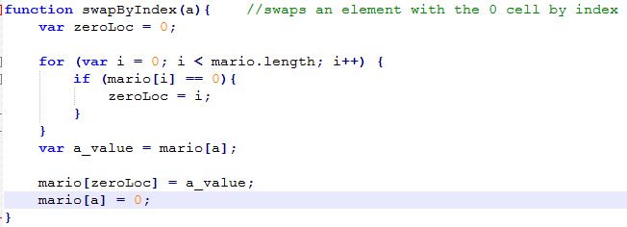
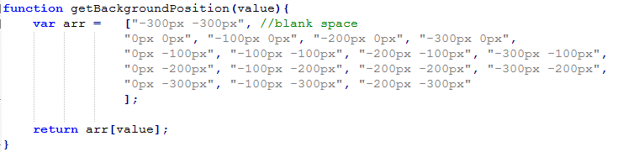
Code snippet

Slide 6
DEMO

Slide 7
Q&A

