Slide 1


High-level Language Programming Project Final Report
Future Technology College
Defendants:
Zhu Juntong，Liu Jing，Wang Ziqi，
Jiang Siqing，Liang Bohai，Feng Ziheng
Mentor: Zhang HuaiDong

Slide 2
Project Completion Status
Introduction
Research Methodology and Approach
Key Technologies and Practical Challenges
Content
UI interface
Summary

Slide 3
Project Completion Status

Slide 4


Project Completion Status. division of labor
朱峻桐
Designed the Character hierarchy and implemented compare With() methods.
刘静
Developed the main menu (Page 1 Main Menu) and difficulty control logic.
汪子淇
Built the CSV parser and data loading module (Player Data Storage).

Slide 5
Project Completion Status. division of labor
蒋思卿
Implemented the core game logic for Page 3 GuessLOL and Page 4 GuessCS.
梁博海
Created the hero guessing module(Page 5 GuessHero) and attribute comparison output.
冯子恒
Configured CMake for cross-platform build and integrated Qt resources.

Slide 6
Project Completion Status
Phases of Mission | Period | Planned Completion | Actual Completion
Determining the topic and submit the proposal | 2025.03.24-2025.03.30 | Survey interesting topics and submit the project proposal. | Completed on 2025.03.28
Designing the overall architecture and class hierarchy | 2025.03.31-2025.04.06 | Define base classCharacterand derived classes (Player,LOLPlayer,CSPlayer,Hero). | Completed on 2025.04.05
Implementing core class methods and polymorphic comparison logic | 2025.04.07-2025.04.13 | DevelopcompareWith()methods and attribute comparison logic. | Completed on 2025.04.12
Designing CSV data parsing module | 2025.04.14-2025.04.20 | ImplementparseCSVLine()and file reading functions (readLOLPlayers(),readCSPlayers()). | Completed on 2025.04.19
Implementing game logic and state management | 2025.04.21-2025.04.27 | FinalizegameStatestructure and difficulty control logic. | Completed on 2025.04.26
Developing main window and page navigation | 2025.04.28-2025.05.04 | Integrate all pages usingQStackedWidget. | Completed on 2025.05.03
Developing UI pages (Page1MainMenu,Page2ChoosePlayerType) | 2025.05.05-2025.05.11 | Design GUI layouts in Qt Designer for main menu and player type selection. | Completed on 2025.05.10
DevelopingPage3GuessLOLandPage4GuessCSpages | 2025.05.12-2025.05.18 | Implement UI and input validation for LOL/CS guessing pages. | Completed on 2025.05.17
DevelopingPage5GuessHeropage | 2025.05.19-2025.05.21 | Create hero guessing page with attribute display. | Completed on 2025.05.20
Integrating UI and core logic | 2025.05.22-2025.05.24 | Connect signals/slots and finalize page transitions. | Completed on 2025.05.23
Testing and debugging | 2025.05.25-2025.05.27 | Conduct unit tests and cross-platform validation. | Completed on 2025.05.26
Finalizing report and documentation | 2025.05.28-2025.05.30 | Polish documentation and generate the final report. | Completed on 2025.05.29

Slide 7
Introduction

Slide 8
Introduction. Project Background
Motivation
The project combines OOP principles with GUI development using Qt, aiming to practice C++ skills and explore role-based game design.
Objectives
Implement a multi-page GUI application supporting multiple game modes, enable dynamic difficulty levels, and ensure cross-platform compatibility.
Scope
Design a hierarchical class structure, integrate CSV data handling for dynamic game content, and configure the project for cross-platform deployment using CMake.

Slide 9
Research Methodology and Approach

Slide 10
Research Methodology and Approach
Object-Oriented Design
Design a hierarchical class structure (Character → Player → LOLPlayer, CSPlayer, Hero) to enable runtime polymorphism and encapsulation.
Data-Driven Development
Implement CSV data parsing to dynamically load game content. The custom parseCSVLine() function handles complex data entries.
Cross-Platform Configuration
Use CMake to configure the project for multiple platforms (Windows, Linux, macOS, Android) to ensure compatibility and ease of deployment.

Slide 11
Research Methodology and Approach
Modular Design
Break down the application into modular components (e.g., main menu, game logic, CSV parser). Each module is developed independently and integrated using Qt's signal/slot mechanism.
Signal-Slot Communication
Implement signal/slot connections for seamless navigation and state management. For example, guessPlayerClicked() signals transition to the guessing page.
Testing and Validation
Conduct unit tests for core functions (e.g., compareWith(), parseCSVLine()) and validate the application on all target platforms to ensure functionality and robustness.

Slide 12
Key Technologies and Practical Challenges

Slide 13
Key Technologies and Practical Challenges
Polymorphic Comparison
Implement polymorphic comparison logic using a base class Character with a pure virtual function compareWith(). Derived classes override this function to compare specific attributes.
CSV Parsing Algorithm
Develop a custom CSV parsing algorithm (parseCSVLine()) to handle quoted fields and embedded commas. This ensures accurate data loading and robust error handling.
Signal-Slot Navigation
Use Qt's signal/slot mechanism for event-driven communication. Signals like guessPlayerClicked() and slots in the Widget class manage page transitions and game state updates.

Slide 14
Key Technologies and Practical Challenges
Type Safety in Comparisons
Ensure type safety by using dynamic_cast to verify the compatibility of compared objects. This prevents runtime errors and ensures accurate comparisons.
Error Handling in Data Loading
Implement comprehensive error handling to manage malformed CSV files. The system displays error messages instead of crashing, ensuring robustness.
Cross-Platform Build Configuration
Address platform-specific issues by configuring CMake to detect Qt version differences and set target properties. This ensures seamless deployment across all supported platforms

Slide 15
UI
Interface

Slide 16
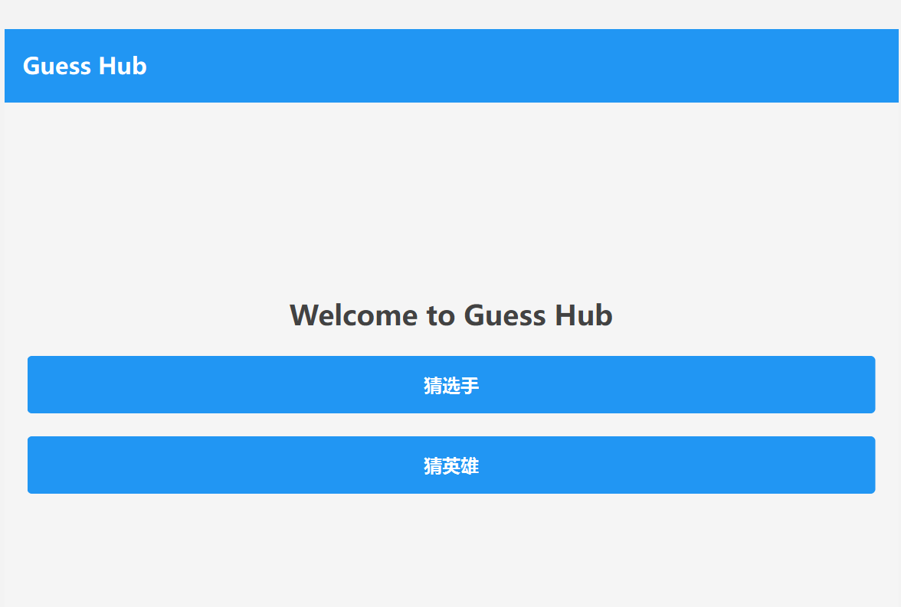
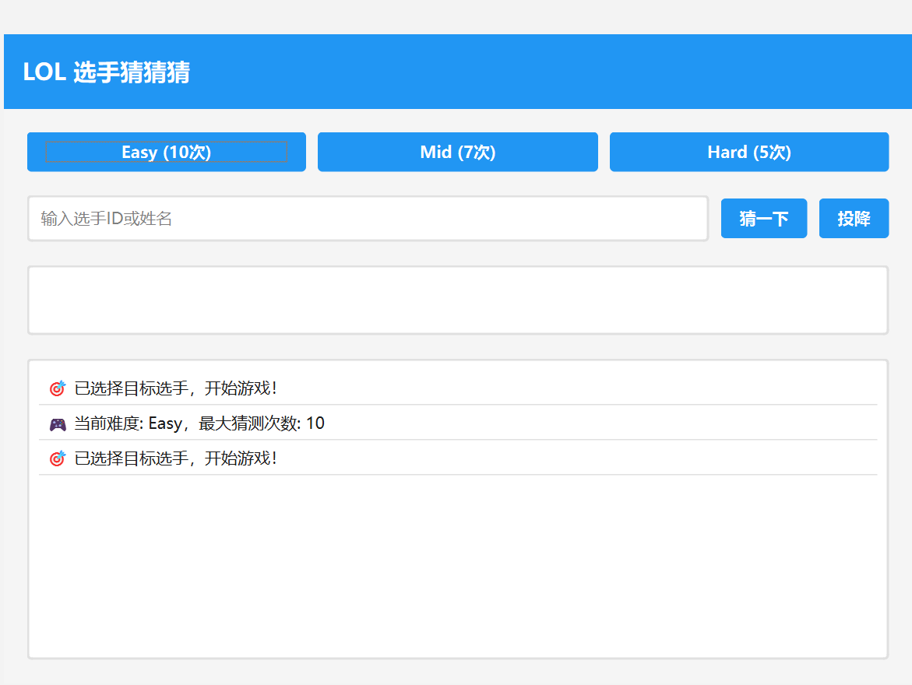
Overall

Slide 17
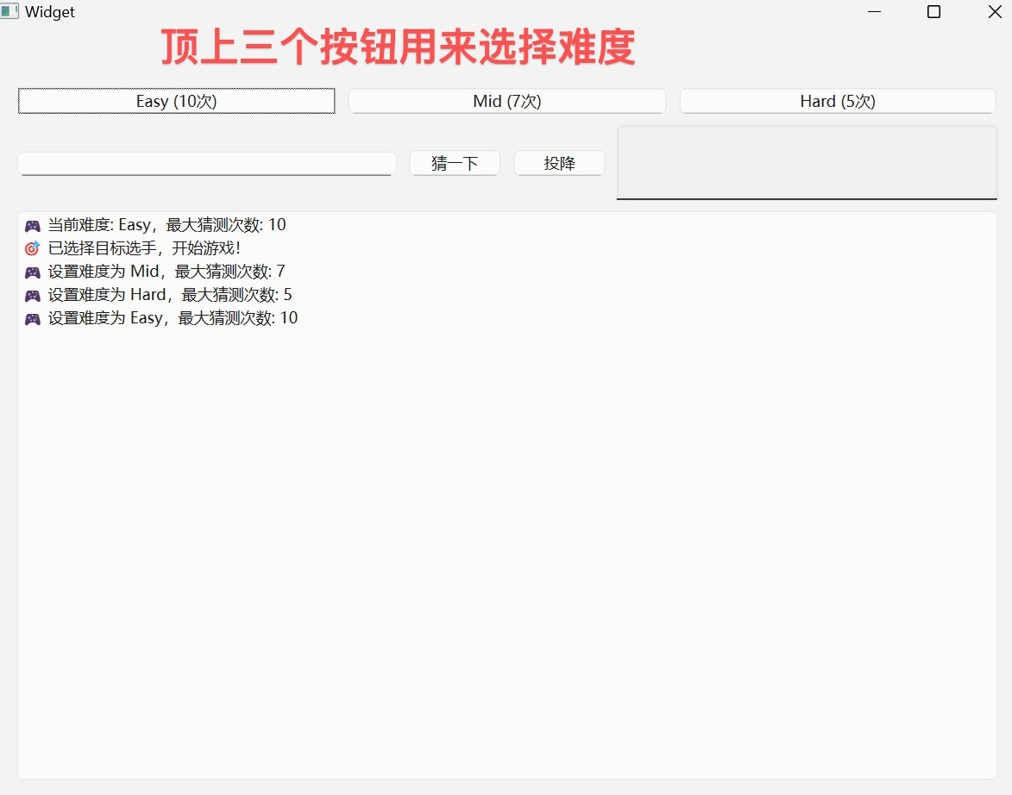
Our UI
The three buttons at the top of the interface are used to select the difficulty level.

Slide 18
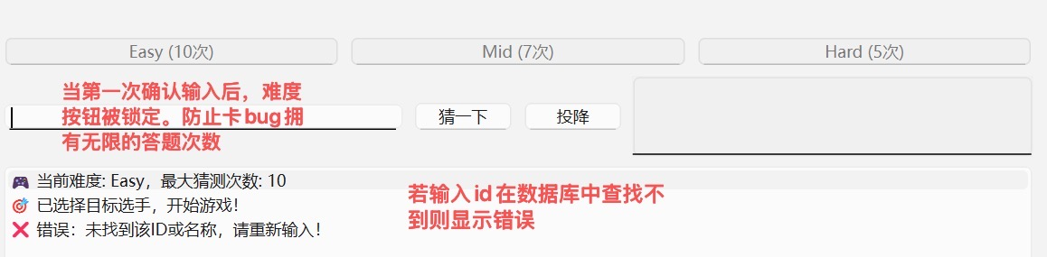
Our UI
When the input is confirmed for the first time, the difficulty button is locked to prevent card bugs and has unlimited answer times.
If the input ID cannot be found in the database, an error will be displayed.

Slide 19
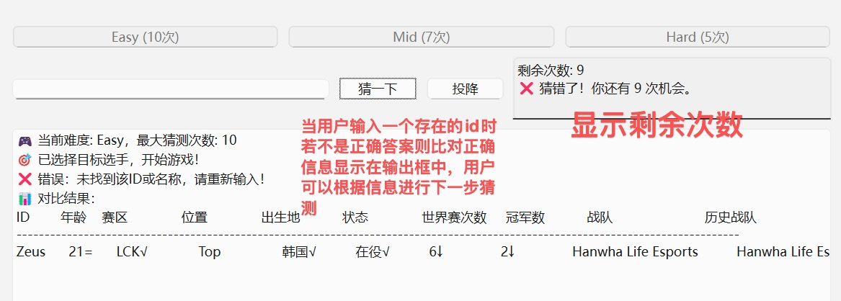
Our UI
Display remaining times
When the user inputs an existing ID, if the answer is not correct, the correct information will be compared and displayed in the input box, and the user can make the next guess based on the information.

Slide 20
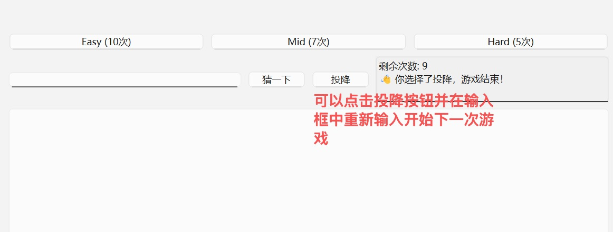
Our UI
You can click the surrender button and re-enter in the input box to start the next game.

Slide 21
Testing Report
Function testing
System testing

Slide 22
Function testing
Polymorphic comparison logic: By comparing all test cases, the LOL/CS/hero attributes are correctly compared.
Page navigation:
All pages are switched normally, and the signal slot is connected correctly.
CSV parsing:
Successfully processed data containing quoted fields and commas, with effective exception handling.
Function testing
Difficulty system:
The attempt limit takes effect, and the input box is disabled after reaching the limit.

Slide 23
System testing
Windows 11：
✅ Through, there are no compatibility issues.
Ubuntu 22.04：
✅ Through, the compilation runs normally.
System testing
macOS Ventura：
✅ Through, the application bundle is functioning properly.
Android 13：
⚠️ Partially approved, touch interaction needs to be optimized.

Slide 24
Summary
Skills Acquired
Suggestions for Improvement

Slide 25
Skills Acquired
Object-Oriented Programming (OOP)
Applied key principles such as inheritance, encapsulation, and polymorphism.
Used pure virtual functions (e.g., compareWith() to enforce runtime polymorphism.
Ensured data protection through proper encapsulation of class members.
Qt Framework
Built a multi-page GUI application with QStackedWidget for page management.
Used Qt’s signal/slot mechanism to implement responsive UI behavior.
Designed interfaces using Qt Designer and integrated .ui files with C++.
Cross-Platform Development
Configured CMake to support both Qt5 and Qt6.
Successfully deployed the application on Windows, Linux, macOS, and Android.

Slide 26
Suggestions for Improvement
UI Enhancement
-Add animations or transitions to improve user interaction.
-Support responsive design to better adapt to various screen sizes.
Performance Optimization
-Cache frequently accessed data to reduce file I/O.
-Use multithreading to handle intensive tasks like CSV parsing.
Data Expansion
-Include more game types (e.g., Dota, mobile games).
-Enable dynamic CSV updates without restarting the application.

Slide 27
THANKS!

