Slide 1
Charles Hancock
Force Ives

Slide 2
2spooky
Charles Hancock
A tense, restricted top-down zombie shooter.

Slide 3
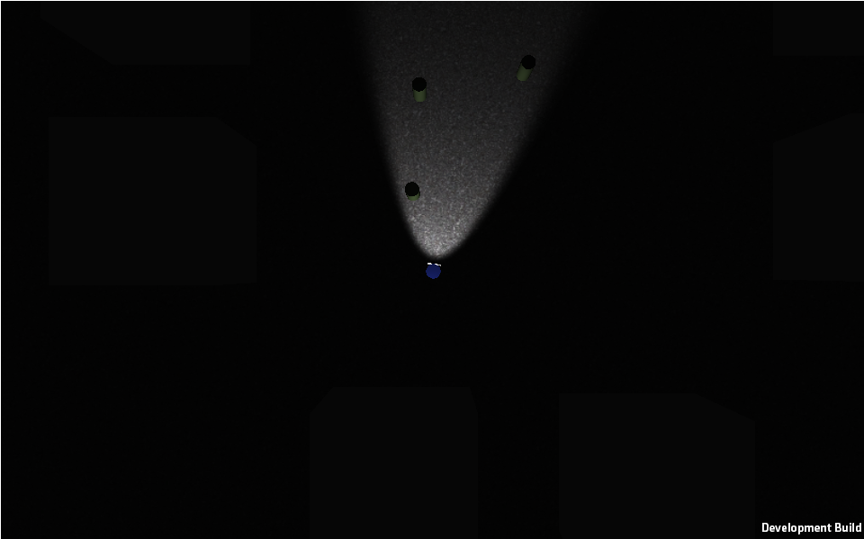
Remove freedoms, find tensions.
Restrict sight, movement, shooting
Suddenly, it’s scarier.

