Slide 1
Protecting Modern Applications, APIs, and MCP Services with FortiWeb
Hands-on Training Lab | FortiWeb 8.0.5
Notes:
Welcome participants. This lab is a hands-on walkthrough of FortiWeb protecting web apps, APIs, and MCP services.

Slide 2
Agenda
Getting started
01
Provision Azure, deploy with Terraform, and access the lab through Guacamole.
Application delivery
02
Review load balancing, SSL/TLS offloading, and content routing already in place.
Protect the stack
03
Web attacks, ML anomaly detection, API security, MCP, and bots.
Operate and wrap up
04
Investigate logs, tune policies, troubleshoot, and recap the lab journey.
Notes:
Walk the four lab movements. Emphasize that Ch 2 is review-only and Ch 8 is optional.

Slide 3
Learning Objectives
What you will be able to do by the end of this lab
Deploy
Deliver
Stand up a complete FortiWeb lab with Terraform and access it through Guacamole.
Explain how virtual servers, SSL offloading, and content routing publish multiple apps.
Protect web
Learn behavior
Block SQL injection, XSS, command injection, and protocol abuse with a Web Protection Profile.
Train FortiWeb Machine Learning and detect requests that deviate from the Juice Shop baseline.
Secure APIs
Protect MCP
Discover PetStore endpoints, learn an API schema, and block mapped API attacks.
Apply protocol-aware MCP Security with no learning phase and inspect AI tool traffic.
Stop bots
Operate
Layer biometrics, thresholds, known bots, and ML bot detection on Juice Shop.
Use Attack, Traffic, and Event logs to investigate, tune, and troubleshoot.

Slide 4
Lab Journey
Deploy → deliver → protect → learn → secure APIs, MCP, and bots → operate
1
2
3
4
5
6
7
8
Getting Started
App Delivery
Common Attacks
ML Anomalies
API Security
MCP Protection
Bot Mitigation
Operations
Deploy & access
VS, SSL, routing
Signatures & WPP
HMM + SVM
PetStore ML
AI tool traffic
Known + threshold
Logs & tuning
A
Review first
B
Traffic tool
C
Evidence
Ch 2 configuration is already built. Do not change it unless directed.
The FortiWeb Lab Traffic Launcher accelerates learning and attack campaigns.
Every chapter ends in Traffic or Attack logs so you can prove the control worked.
Classroom notes
• Provisioning takes several minutes — submit your email once. Do not click Provision multiple times.
• Terraform deploy is about 25–40 minutes after Cloud Shell is ready. Keep Cloud Shell open until Apply complete.
• Chapter 8 is optional and reuses events from earlier chapters — no new traffic campaign is required.

Slide 5
Chapter 1 Getting Started
Provision, deploy, and access the lab
Notes:
Allow 40 minutes for Azure provisioning plus 25–40 minutes for Terraform.

Slide 6
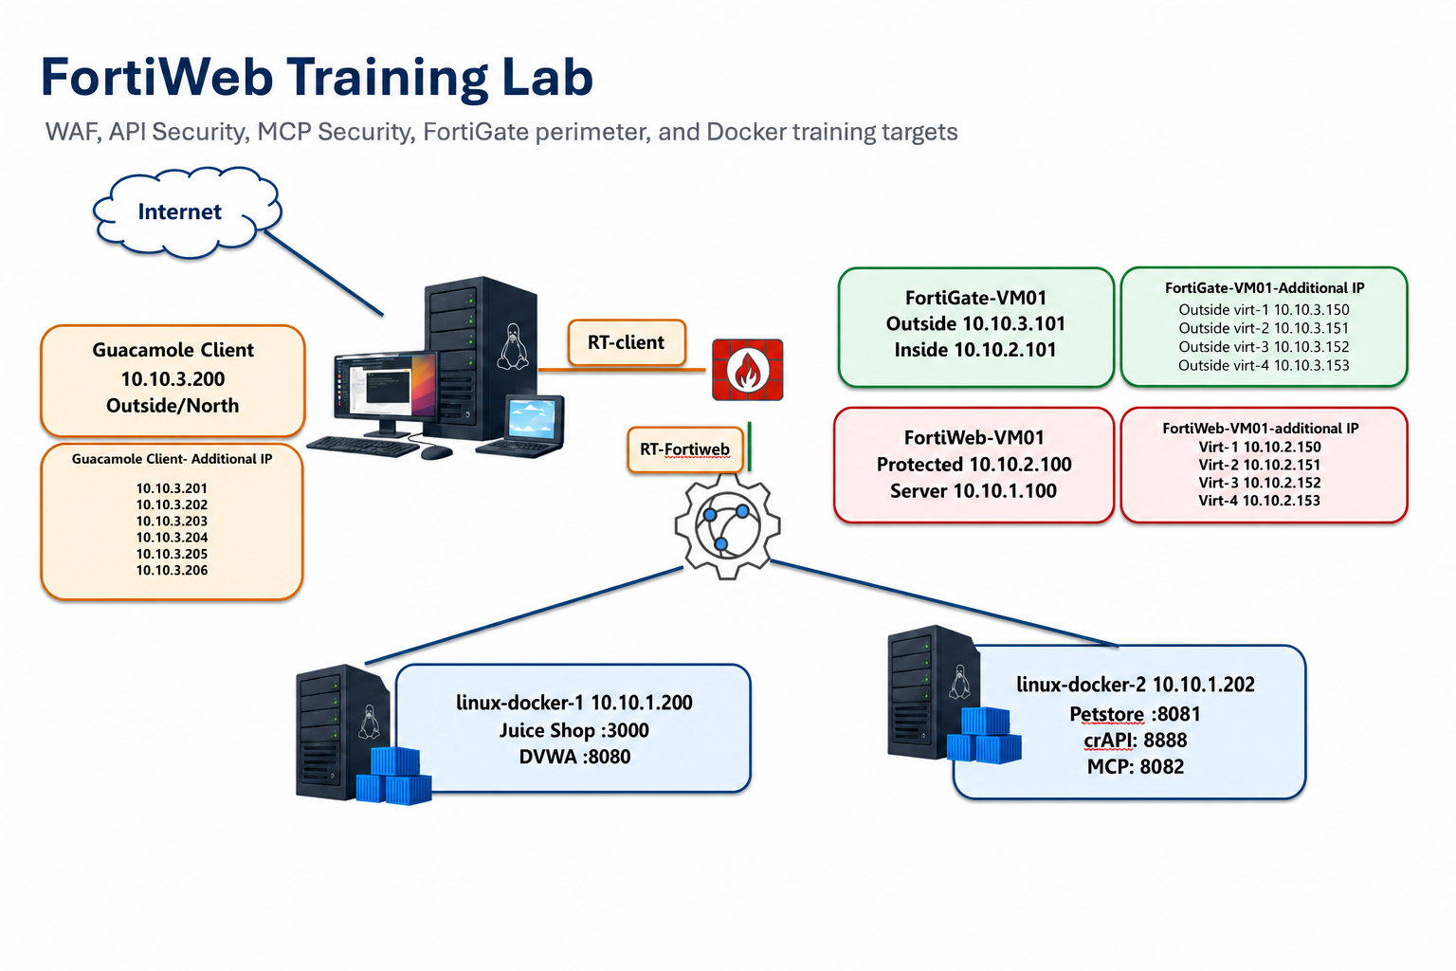
Lab Architecture
Guacamole jump host, FortiGate perimeter, FortiWeb, and Docker targets
Notes:
Point out the traffic path: student → Guacamole → FortiGate → FortiWeb → Docker apps (Juice Shop, DVWA, PetStore, MCP).

Slide 7
Lab Components
Key addresses you will use throughout the day
Component | Role | Key addresses
Guacamole | Student jump host | 10.10.3.200 (+ .201–.206)
FortiGate-VM01 | Perimeter firewall | Outside 10.10.3.101 Inside 10.10.2.101
FortiWeb-VM01 | WAF / API / MCP protection | Protected 10.10.2.100 Server 10.10.1.100
linux-docker-1 | Juice Shop, DVWA | 10.10.1.200
linux-docker-2 | PetStore, crAPI, MCP | 10.10.1.202
1
Guacamole
2
FortiWeb
3
Targets
Browser jump host for FortiWeb, FortiGate, apps, and the traffic tool.
Reverse proxy in the path of every web, API, and MCP request.
Intentionally vulnerable apps used to generate and validate detections.

Slide 8
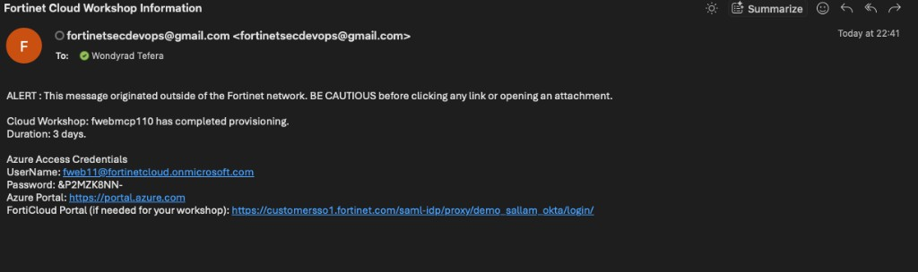
Provision the Azure Environment
Submit your email once — wait for the workshop credentials message
• Enter your email and click Provision. The form returns a blank box with no other confirmation.
• Provisioning can take several minutes. Do not submit multiple times.
• When complete you receive Azure portal credentials for a unique resource group.
• Use the assigned lab user even if you have your own Azure account.
• Resource groups follow <username>-mcp201-workshop.

Slide 9
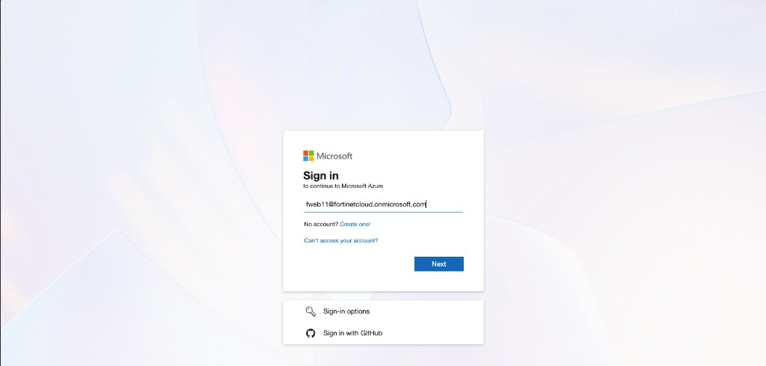
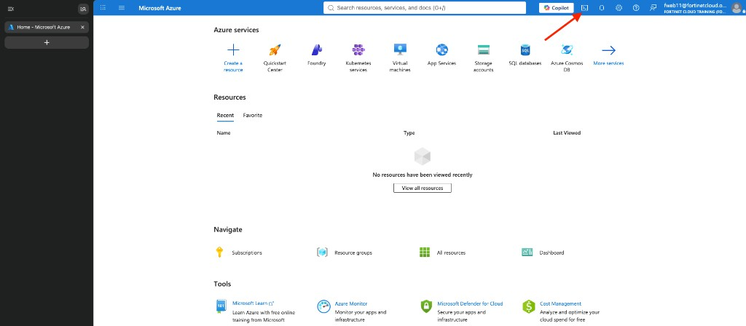
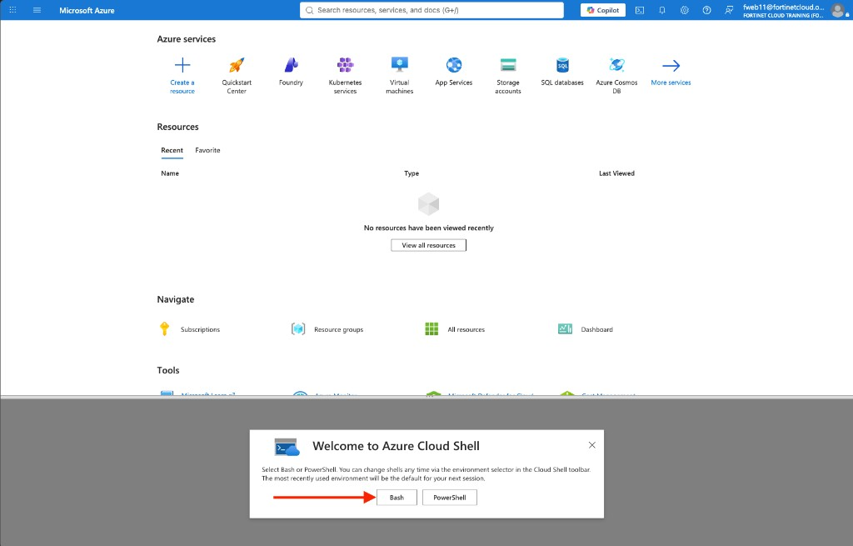
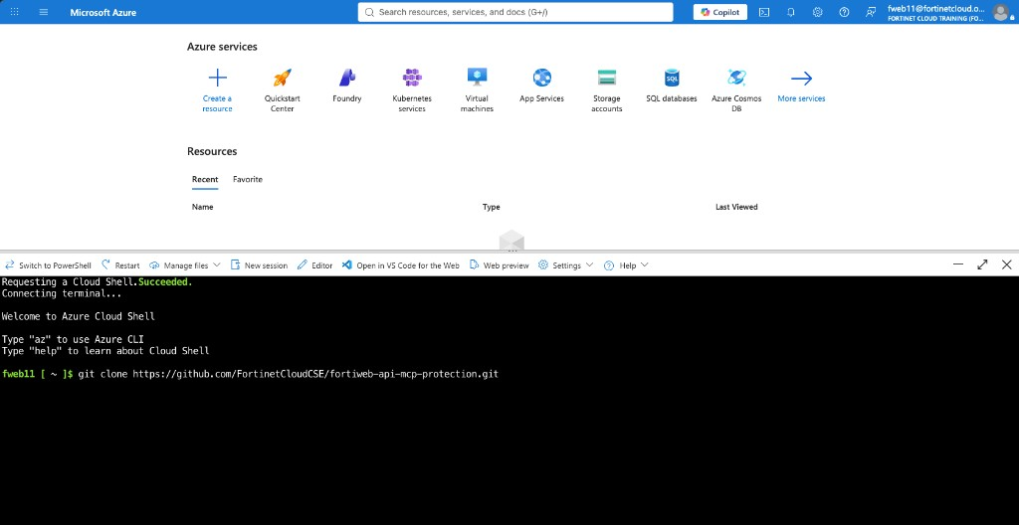
Deploy with Azure Cloud Shell
Sign in → Bash Cloud Shell → clone the repo → run deploy-lab.sh
Sign in with the provisioned lab user
Open Cloud Shell from the portal toolbar
Select Bash, not PowerShell
Clone the workshop repository

Slide 10
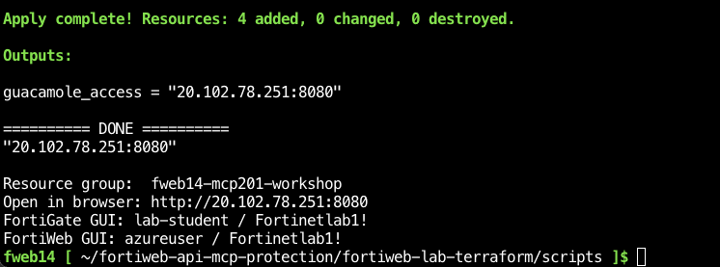
Run the Lab Initialization Script
The script names the resource group from whoami and applies four Terraform phases
• cd fortiweb-api-mcp-protection/fortiweb-lab-terraform/scripts
• chmod +x deploy-lab.sh && ./deploy-lab.sh
• Phases: 00-foundation → 01-appliances → 02-lab-vms → 03-routes.
• Keep Cloud Shell open. If the session drops, re-run the script.
• When Apply complete appears, copy guacamole_access — you need that URL next.
• Allow about 25–40 minutes after Cloud Shell is ready.

Slide 11
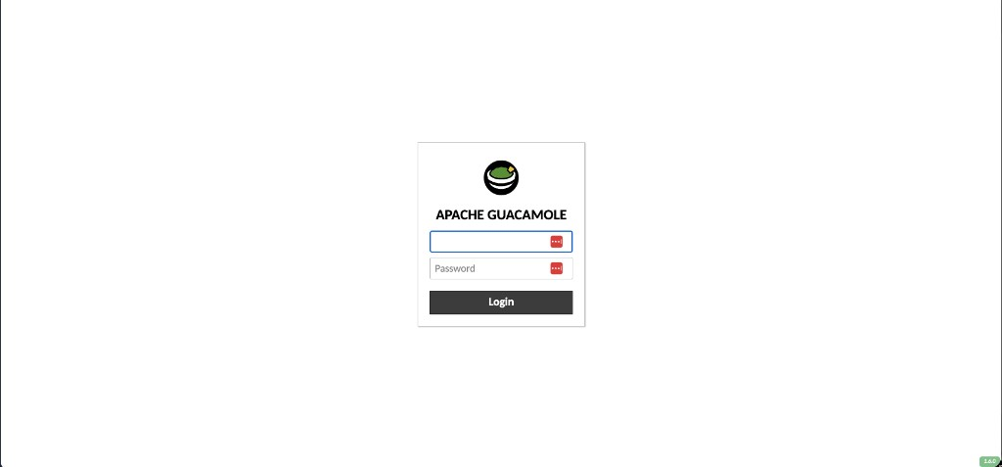
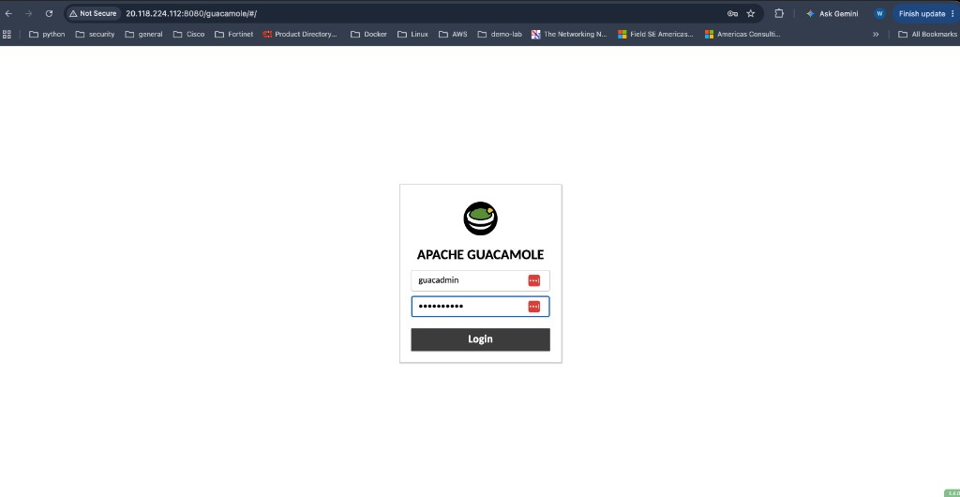
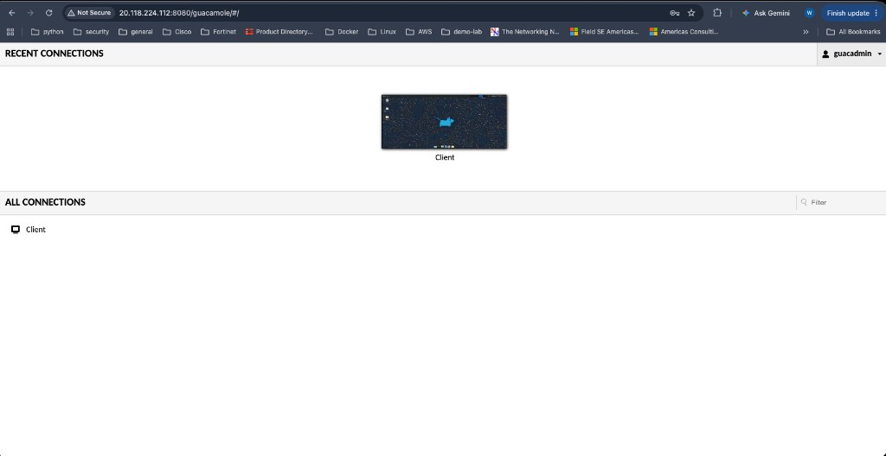
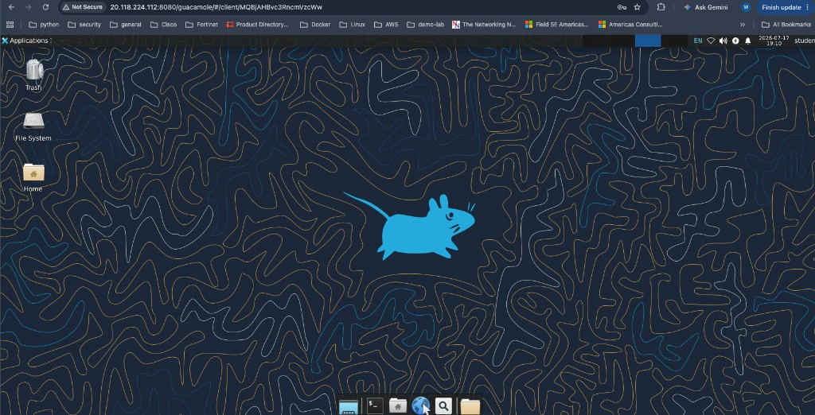
Access the Lab through Guacamole
http://<public-ip>:8080/guacamole/#/ • guacadmin / Fortinet1!
Open the Guacamole login page
Sign in with the lab Guacamole account
Click the Client connection
Linux desktop is your working environment

Slide 12
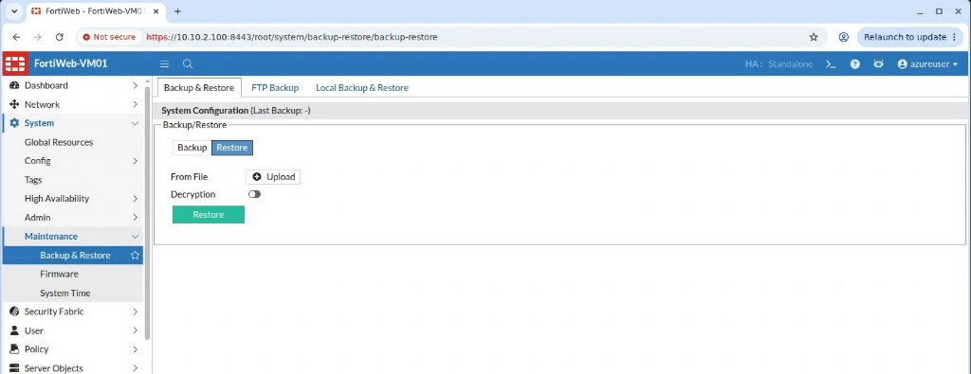
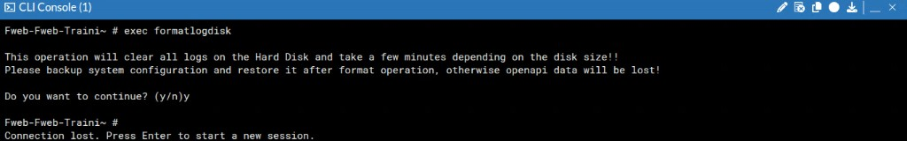
Restore the FortiWeb Training Configuration
Upload fwb_system_no_defaults.conf, then format the log disk
• Download the FortiWeb 8.0.5 config to ~/Downloads on the Guacamole desktop.
• Browse to https://10.10.2.100 and sign in as azureuser / Fortinetlab1!
• System → Maintenance → Backup & Restore → Restore → Upload the conf file.
• After restart, sign in as Fortilab / Fortinetlab1! (the login changes).
• CLI Console → exec formatlogdisk then confirm with y. FortiWeb restarts again.
• Use Chrome bookmarks for FortiWeb, FortiGate, Juice Shop, DVWA, Swagger UI, and MCP.

Slide 13
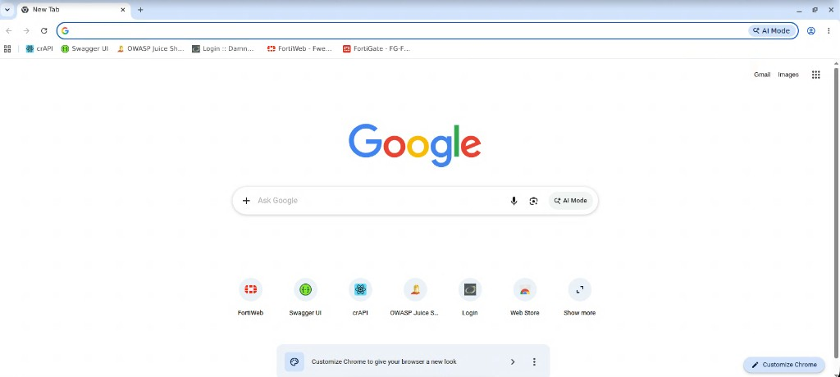
Lab Credentials and Bookmarks
Use these only inside the isolated training environment
System | Username | Password / notes
Guacamole | guacadmin | Fortinet1!
FortiWeb (before restore) | azureuser | Fortinetlab1!
FortiWeb (after restore) | Fortilab | Fortinetlab1!
FortiGate | lab-student | Fortinetlab1!
• Accept self-signed certificate warnings for FortiWeb and FortiGate.
• Paste into Guacamole via Ctrl+Option+Shift (macOS) or Ctrl+Alt+Shift (Windows) → Clipboard.
• Do not reuse these credentials outside the lab.

Slide 14
Chapter 2 Application Delivery
Review-only — the configuration is already built
Notes:
Do not have students change VS, pools, certificates, or routing unless you explicitly ask.

Slide 15
FortiWeb as an Application Delivery Platform
Security sits in the same path as load balancing, SSL offload, and content routing
Load balancing
Virtual servers, server pools, health checks, and persistence publish one or more backends.
SSL/TLS offloading
FortiWeb terminates HTTPS, inspects cleartext, then opens a separate backend connection.
Content routing
Host and URL rules publish Juice Shop, DVWA, PetStore, and MCP on shared virtual IPs.
Hands-on in this chapter is observation: open the existing Virtual Server, Server Pool, certificate, and HTTP Content Routing objects. Confirm how juiceshop.fortiweblab.local and dvwa.fortiweblab.local share infrastructure while remaining separate applications.

Slide 16
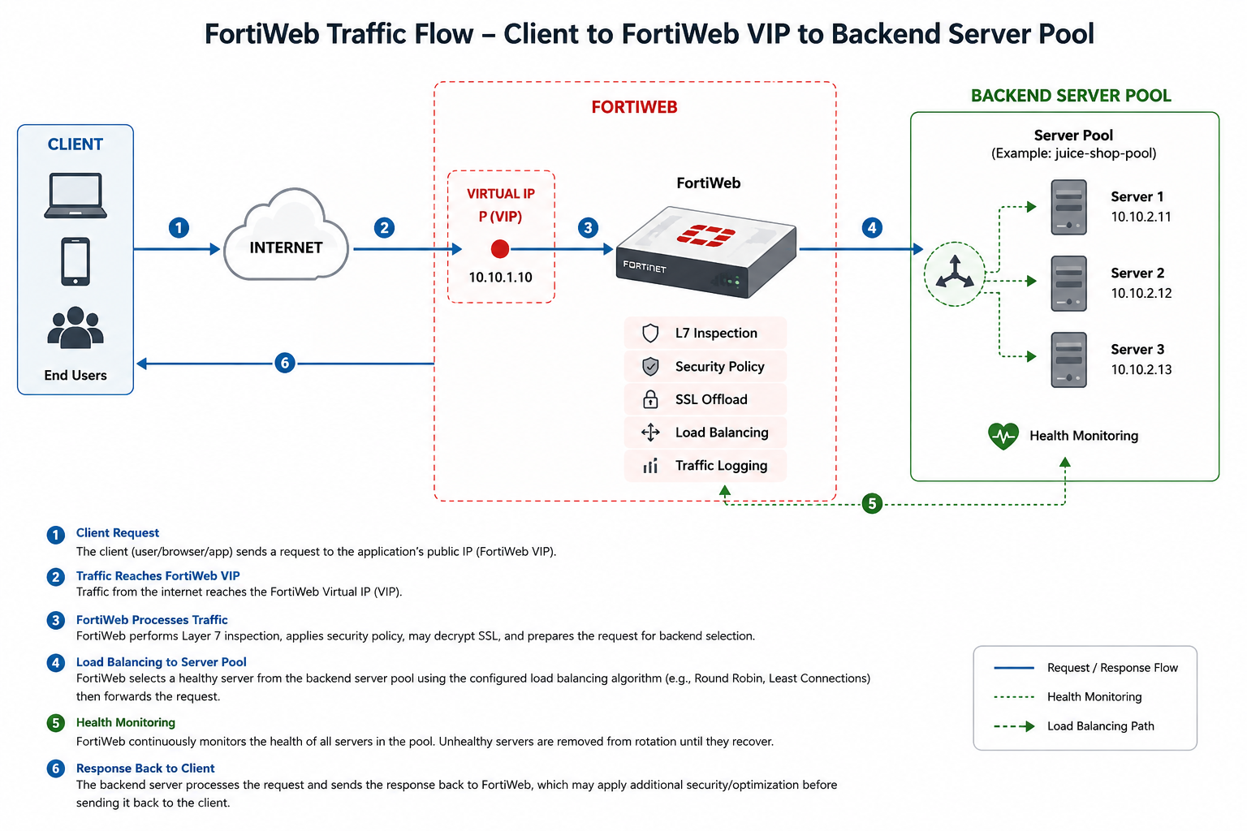
Load Balancing
Client → virtual server → server pool → healthy backend member
• Virtual server: IP and interface where FortiWeb accepts client traffic.
• Server pool: one or more backend application servers.
• Health check: skip members that fail availability tests.
• Persistence (sticky sessions) keeps a client on the same member when the app stores local state.
• Open Server Objects → Server → Virtual Server and Server Pool, then match them in the Server Policy.

Slide 17
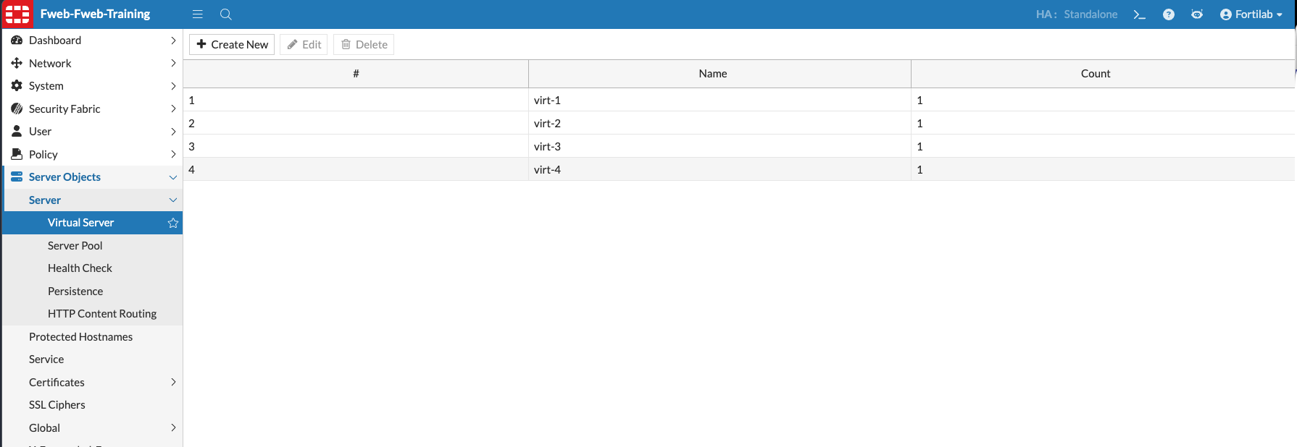
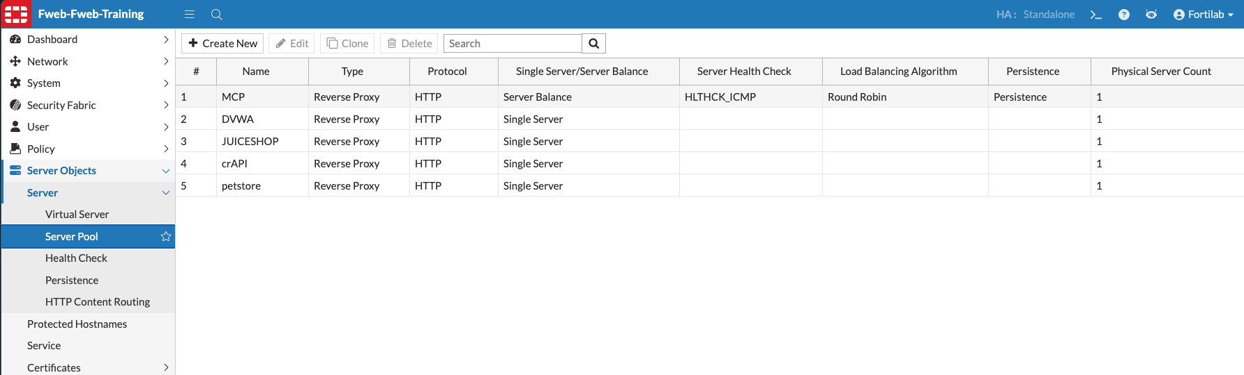
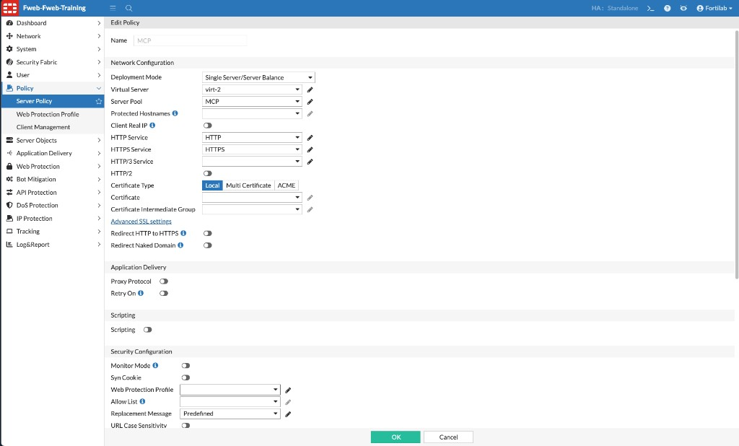
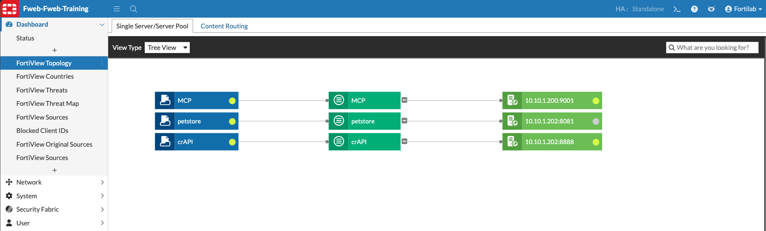
Review Virtual Servers and Server Pools
Confirm the MCP and application pools that later chapters will protect

Slide 18
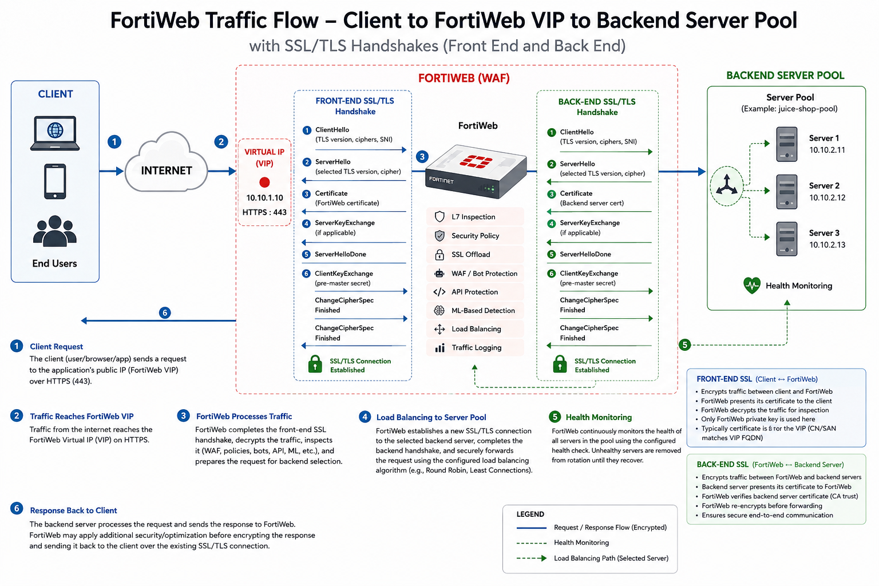
SSL/TLS Offloading
FortiWeb is the TLS server to the client and the TLS client to the backend
• In Reverse Proxy mode FortiWeb presents the Server Policy certificate and decrypts the request.
• Inspection of WAF, API, MCP, and bot controls requires this decrypted view.
• Review Server Objects → Certificates → Local and the certificate chain on the Server Policy.
• Backend communication can stay HTTP or use a separate TLS session.
• Do not replace lab certificates unless the instructor asks.

Slide 19
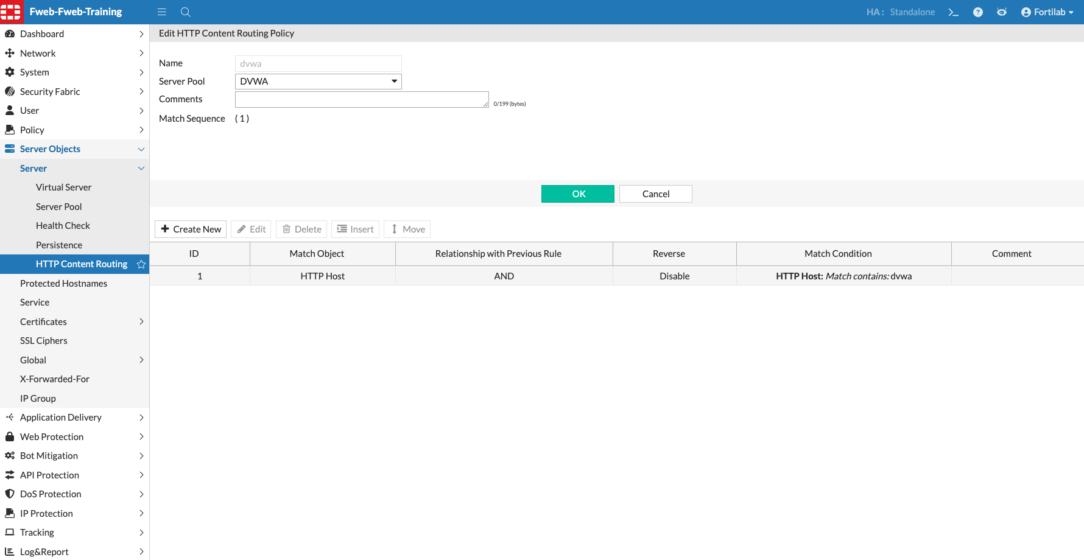
HTTP Content Routing
One virtual IP, many applications — host header selects the server pool
• Juice Shop and DVWA share a virtual server; the Host header chooses the pool.
• Open Server Objects → Server → HTTP Content Routing and inspect the dvwa rule.
• Later you will attach Web Protection Profiles to these routing entries — not to a new VIP.
• PetStore and MCP use their own server policies and host names.
• Routing is already correct. Your job is to understand the traffic path before adding security.

Slide 20
Chapter 3 Common Attacks
Baseline → Web Protection Profile → attack traffic → logs

Slide 21
Web Application Threats
First observe an unprotected app, then apply a profile and watch detections
SQL Injection
Cross-Site Scripting
Command Injection
Manipulate queries through unsanitized input.
Inject script that runs in another user’s browser.
Execute operating-system commands via application fields.
Path Traversal
Protocol abuse
Cookie / client-side
Read files outside the web root.
Invalid methods, oversized headers, and HTTP constraint violations.
Weak session IDs and missing security headers.

Slide 22
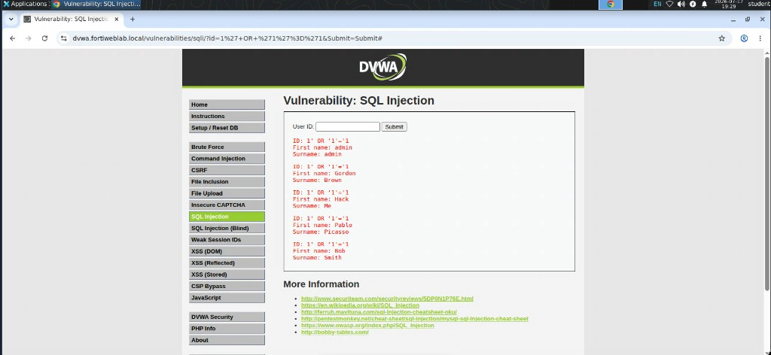
Exercise 3.1 — Baseline Application Testing
Attack DVWA before a Web Protection Profile is applied
• Open DVWA from the Chrome bookmarks on the Guacamole desktop.
• Run a simple SQL injection and command-injection payload on the vulnerable pages.
• Confirm the application returns data or command output — nothing is blocking yet.
• This baseline is the control: later Attack Logs should show the same techniques denied.
• Do not run these tests against any system outside this lab.

Slide 23
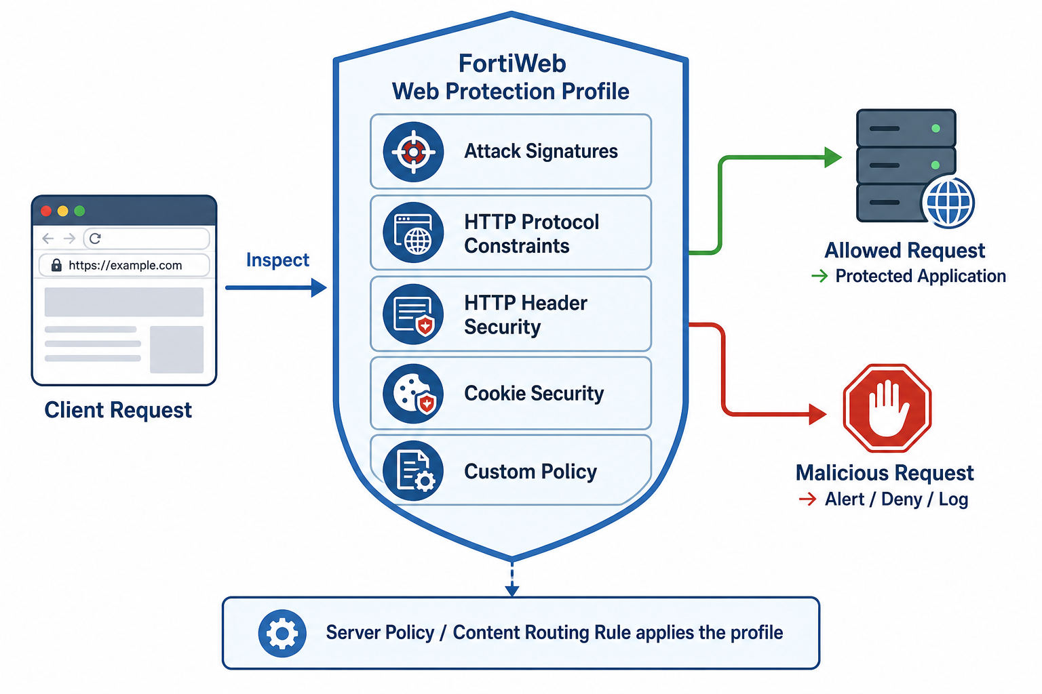
Exercise 3.2 — Web Protection Profile
A profile groups signatures, protocol constraints, headers, and cookie security
• Create profile DVWA rather than enabling each feature on the server policy.
• Attach Signature Protection, HTTP Protocol Constraints, X-Forwarded-For, HTTP Header Security, and Cookie Security.
• Lab policies were cloned from Standard Protection and renamed DVWA so you can select them quickly.
• Assign the profile on the dvwa HTTP Content Routing rule — the same object you reviewed in Chapter 2.
• Save the juiceshop-DVWA server policy after the routing entry is updated.

Slide 24
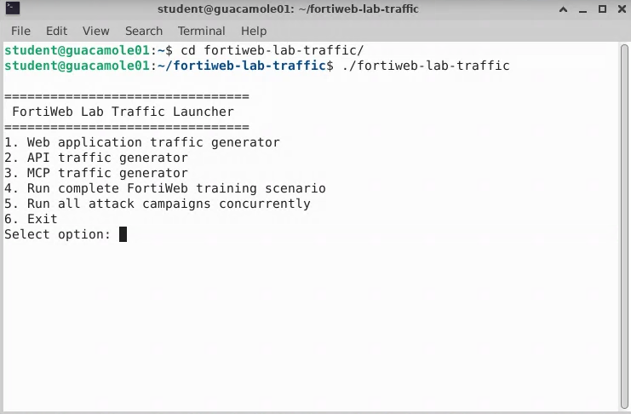
Exercise 3.3 — Generate Attack Traffic
FortiWeb Lab Traffic Launcher maps attacks onto the correct DVWA pages
• On the Guacamole desktop open a terminal: student@guacamole01.
• cd ~/fortiweb-lab-traffic && ./fortiweb-lab-traffic
• Choose the web application generator, then the DVWA mapped-attacks campaign.
• Let the run finish — do not kill the process early.
• Exercise 3.4 is log review; you do not need to click every DVWA page by hand.

Slide 25
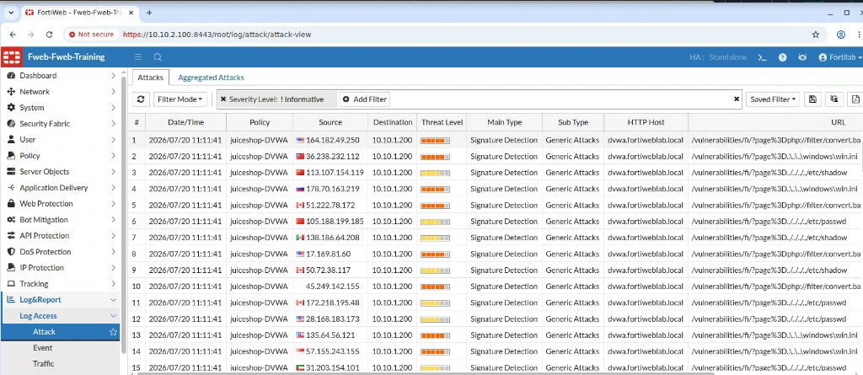
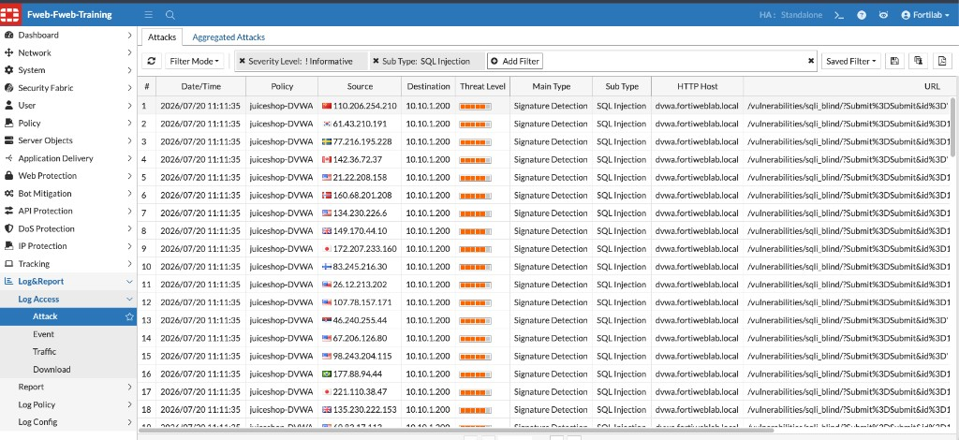
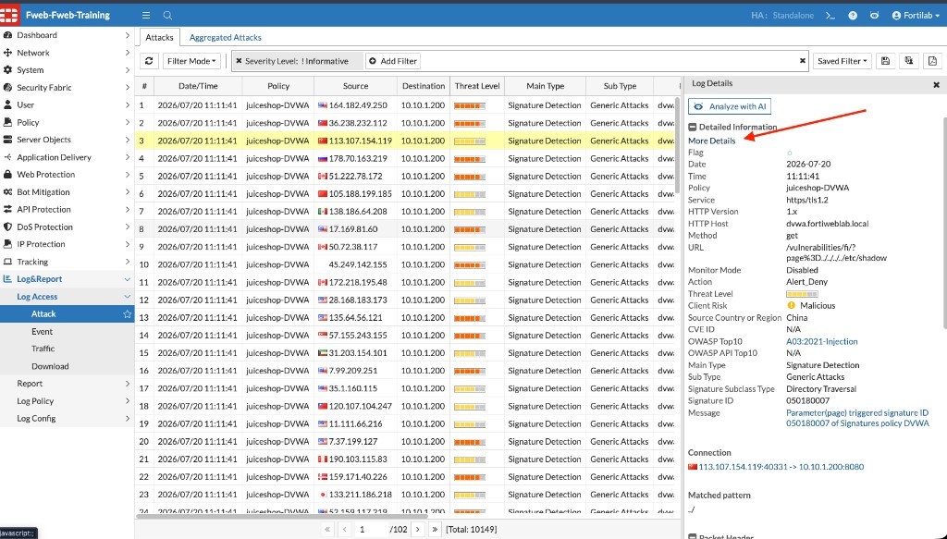
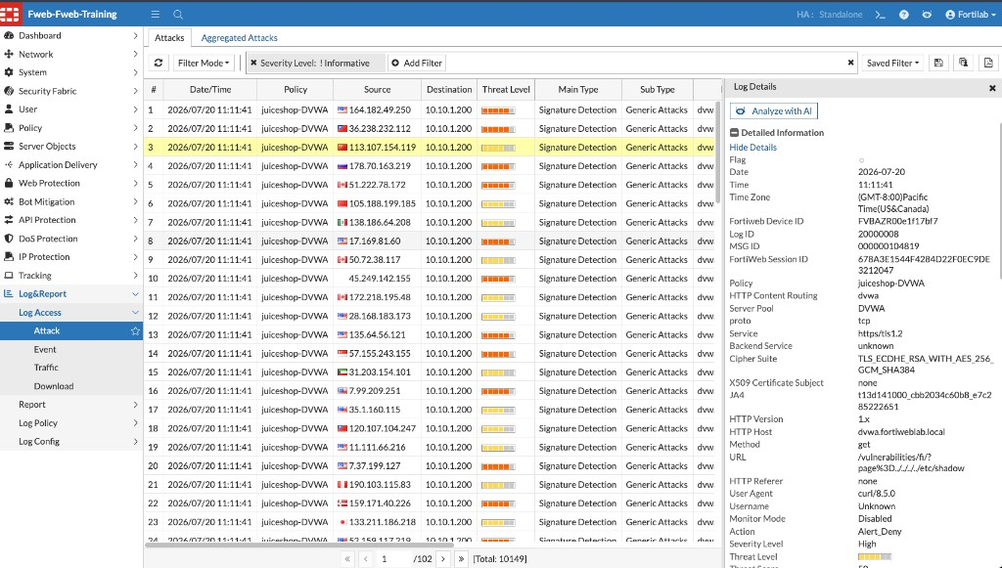
Exercise 3.4 — Review Blocking Actions
Attack Log shows the protection, action, and payload that fired
Notes:
Have students filter Sub Type = SQL Injection, open one Directory Traversal event, and point out Analyze with AI.

Slide 26
Chapter 4 ML Anomaly Detection
Signatures ask “is this known?” — ML asks “is this normal?”

Slide 27
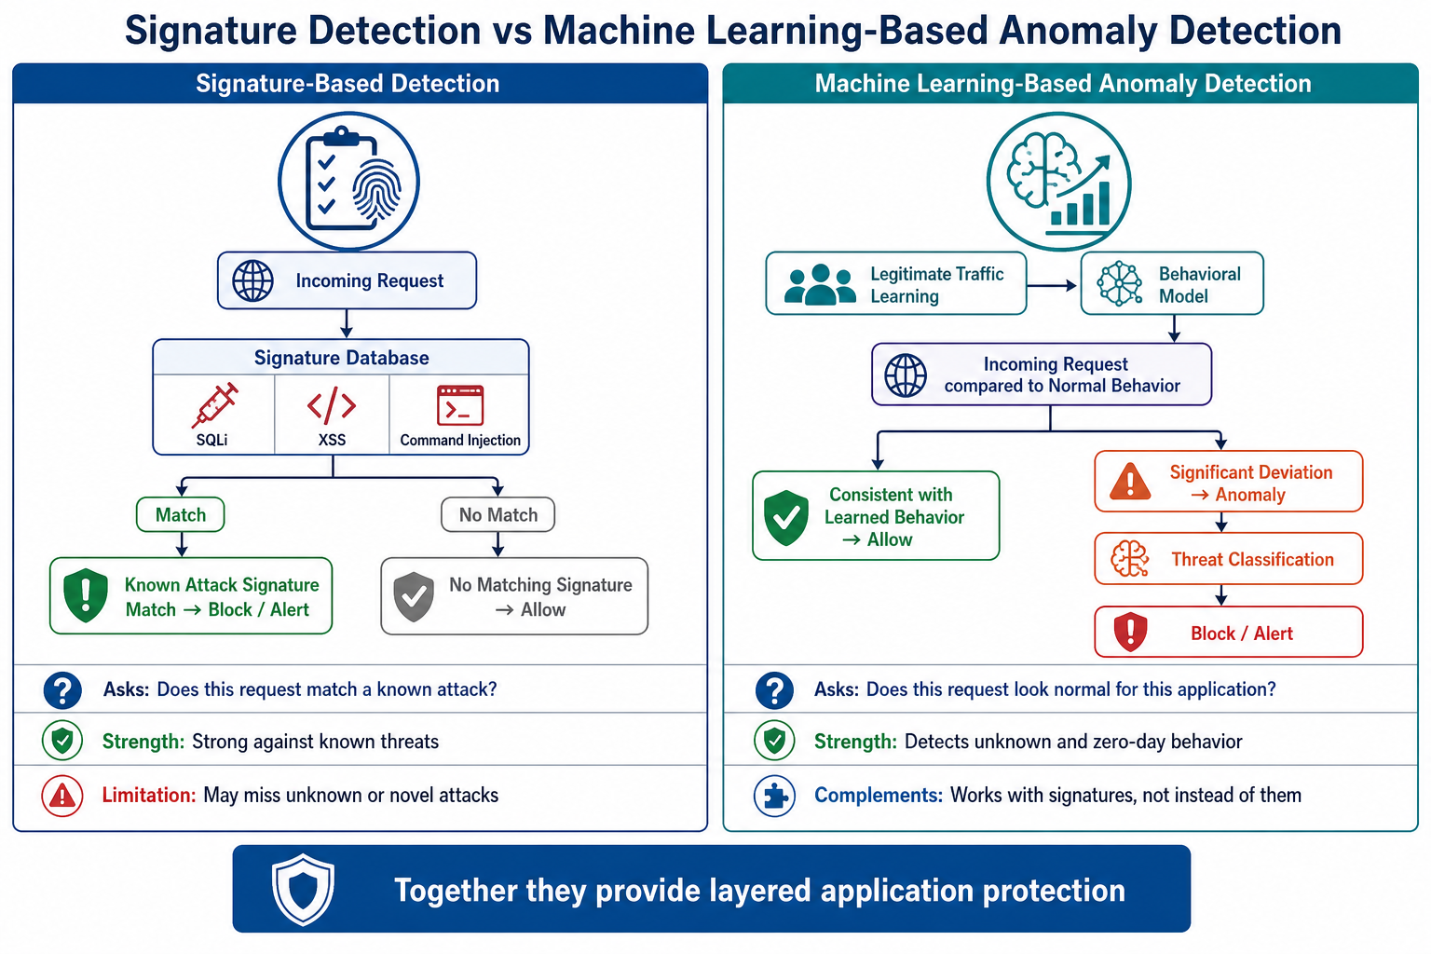
Signatures vs Machine Learning
Known attacks still matter — ML adds coverage for unseen techniques

Slide 28
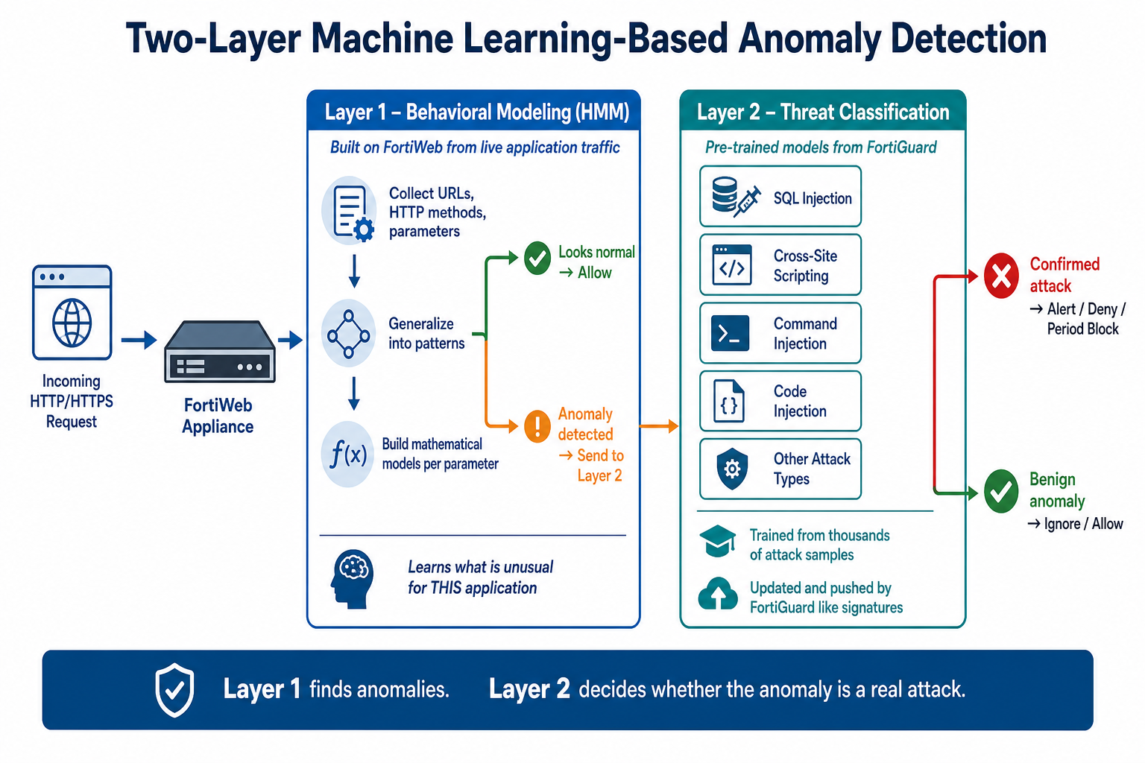
Two-Layer Anomaly Detection
Layer 1 learns this app. Layer 2 classifies whether an anomaly is a threat.
Notes:
HMM models URLs, methods, and parameter patterns. FortiGuard SVM models decide attack vs benign anomaly.

Slide 29
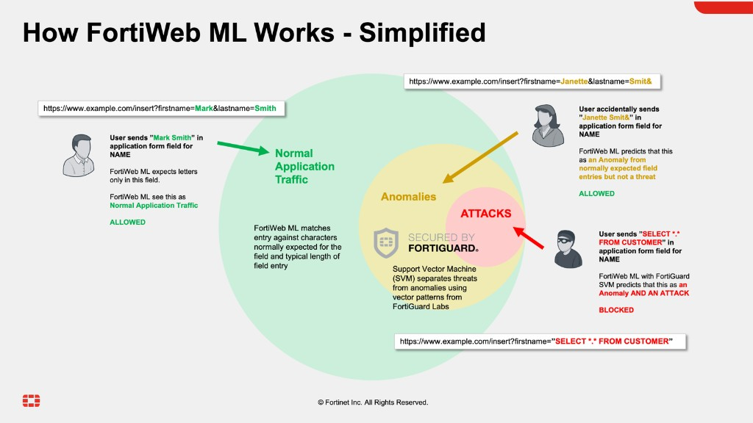
How FortiWeb ML Classifies Traffic
Normal traffic is allowed. Benign anomalies are allowed. Confirmed attacks are blocked.
Input | Result
firstname=Mark | Allowed — matches letters/length
firstname=Janette&… | Allowed — unusual, not a threat
firstname="SELECT *…" | Blocked — anomaly and attack
• Action in this lab: Alert & Deny.
• False-positive control comes from Layer 2, not from turning ML off.

Slide 30
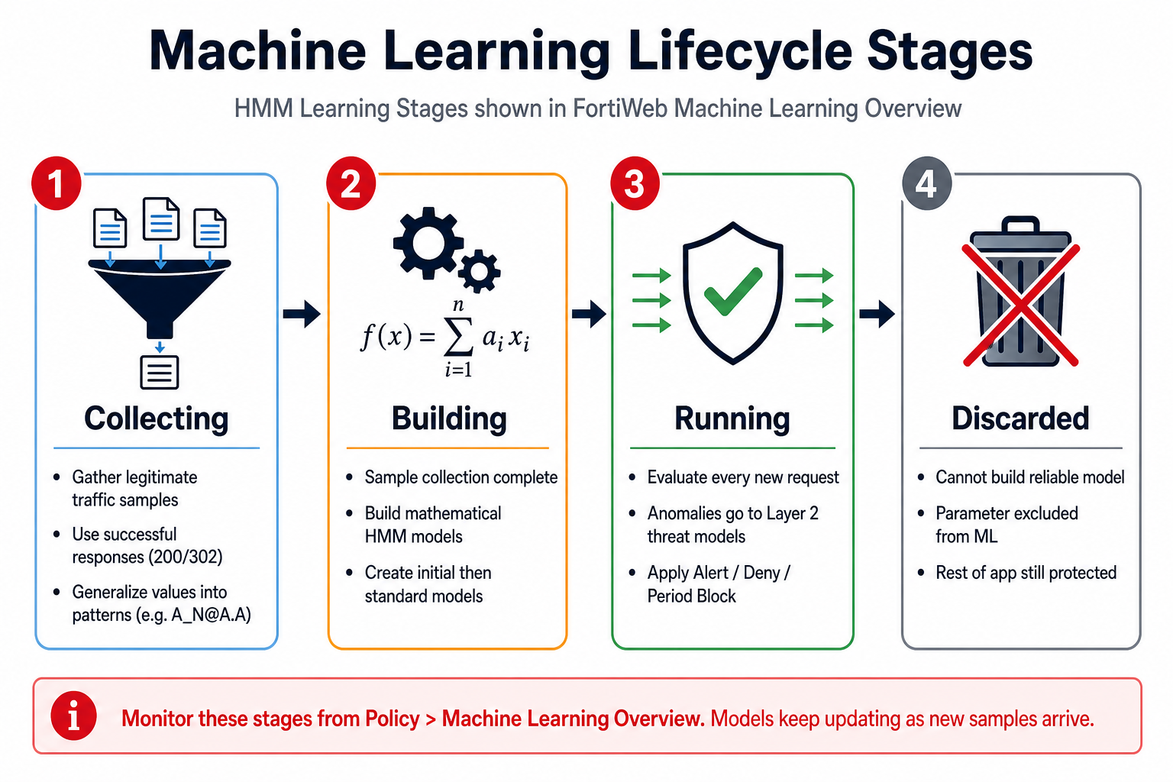
Machine Learning Lifecycle
Collecting → Building → Running. Discarded parameters are excluded from the model.

Slide 31
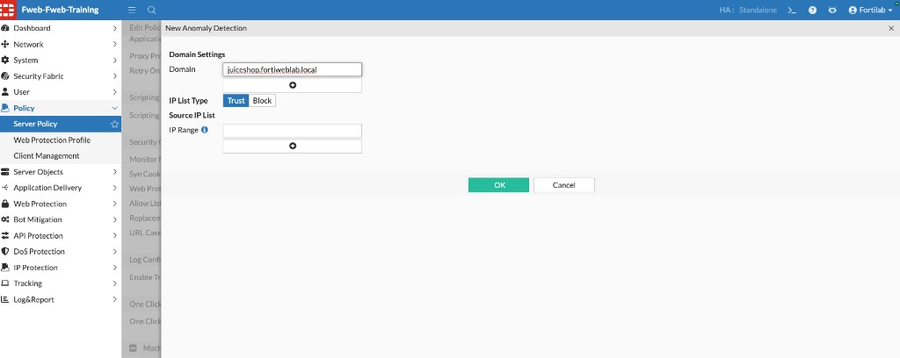
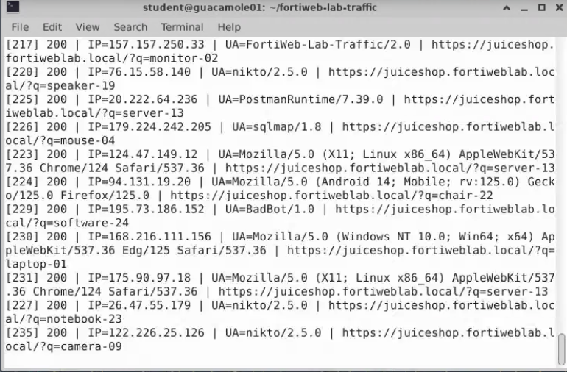
Exercises 4.1–4.2 — Configure and Train
Create Anomaly Detection for Juice Shop, lower lab sample counts, then run Standard ML training
• Edit the juiceshop-DVWA server policy and create Anomaly Detection for juiceshop.fortiweblab.local.
• Set Action to Alert & Deny.
• In CLI, reduce sample-count thresholds so a classroom run can reach Running in minutes.
• Launch the traffic tool → web application generator → Standard ML training (~2,000 realistic Juice Shop requests).
• Production learning normally takes days of live traffic. The launcher is a lab accelerator, not a production pattern.

Slide 32
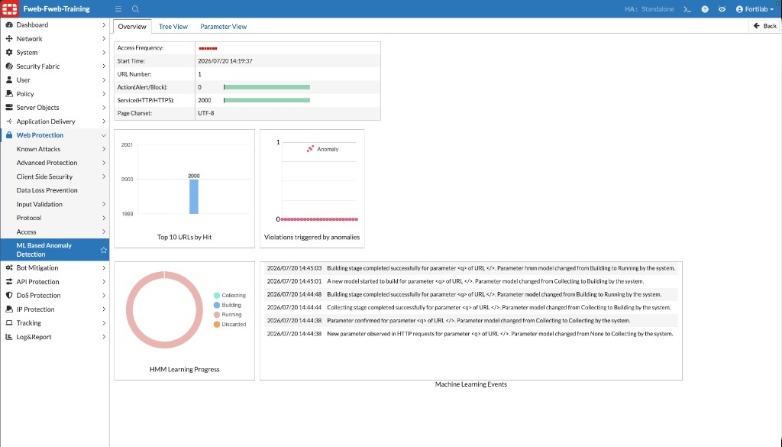
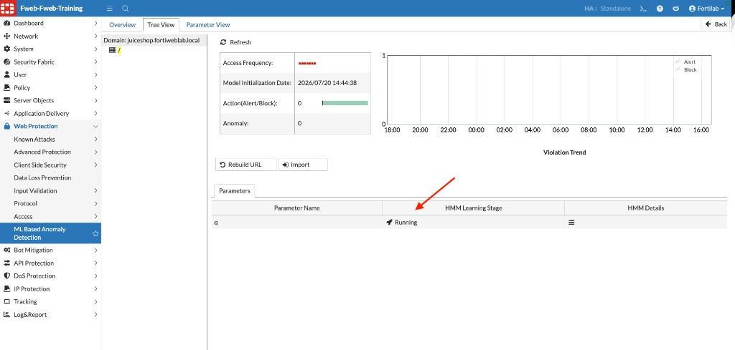
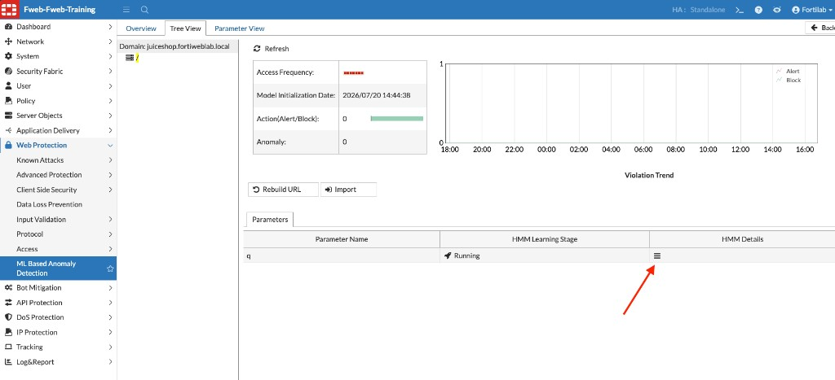
Exercises 4.3–4.4 — Verify and Attack
Running parameters are enforced. Unexpected Juice Shop traffic should now appear in Attack Logs.
• Overview: HMM Learning Progress in Running.
• Tree View and Parameter View confirm modeled URLs and parameters.
• Then run the unexpected/attack campaign and filter Attack Logs for Machine Learning.

Slide 33
Chapter 5 API Security
Discover, learn, and protect the PetStore REST API

Slide 34
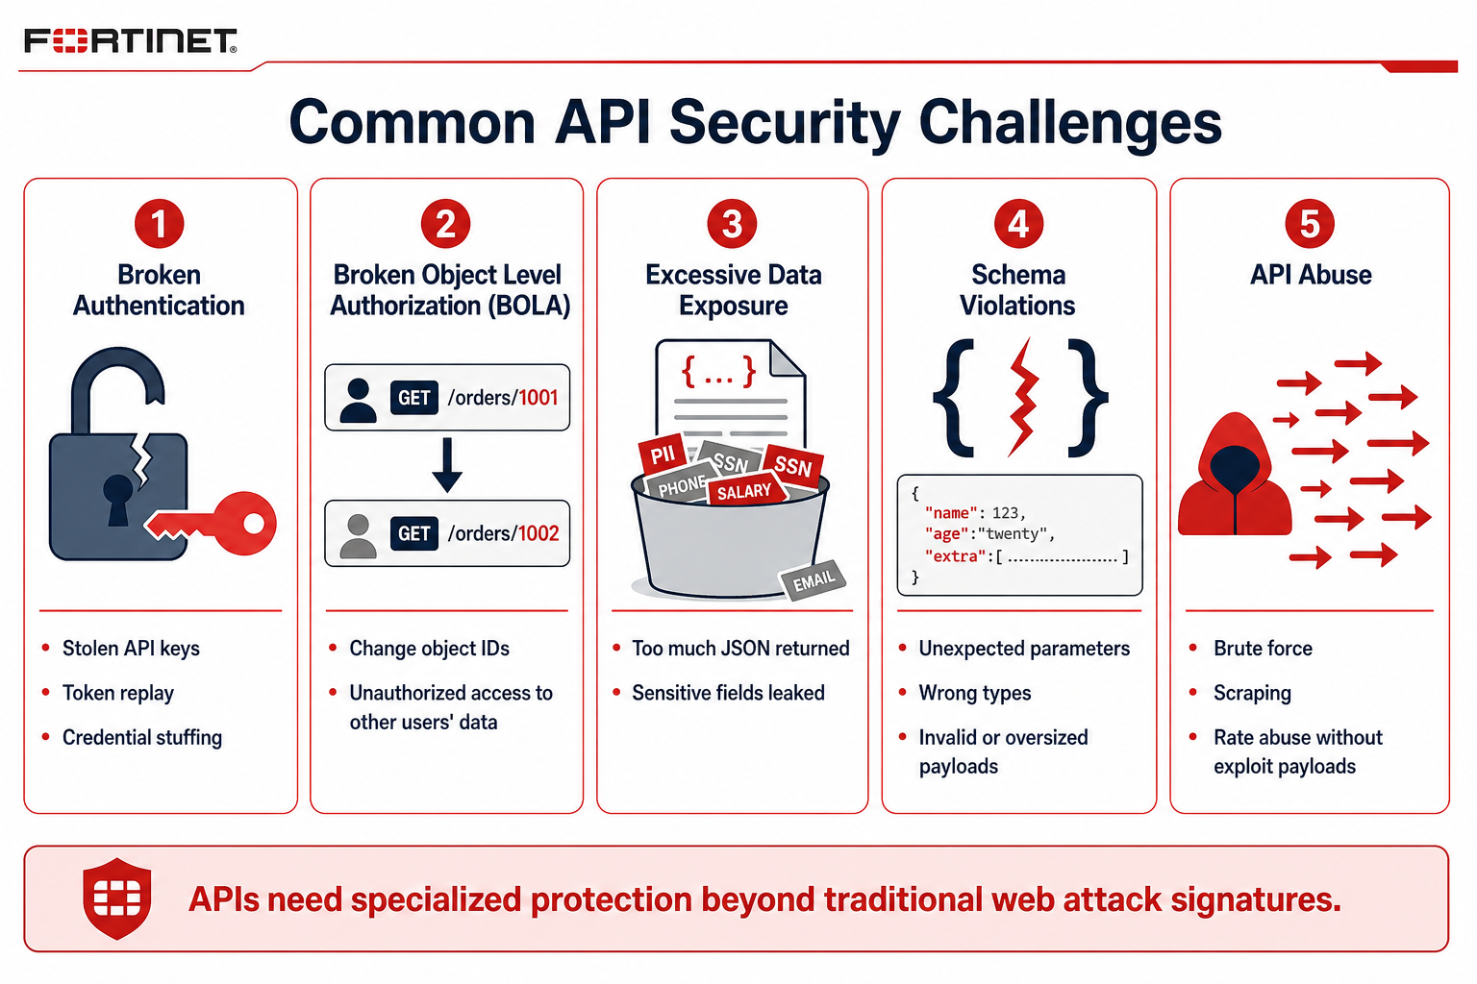
Why APIs Need Specialized Protection
APIs expose business logic as JSON — not HTML pages
• Broken authentication and stolen tokens
• Broken Object Level Authorization (BOLA)
• Excessive data exposure in JSON
• Schema violations and malformed payloads
• Abuse: stuffing, scraping, rate attacks
• FortiWeb combines discovery, OpenAPI validation, learned schema, and ML threat detection.

Slide 35
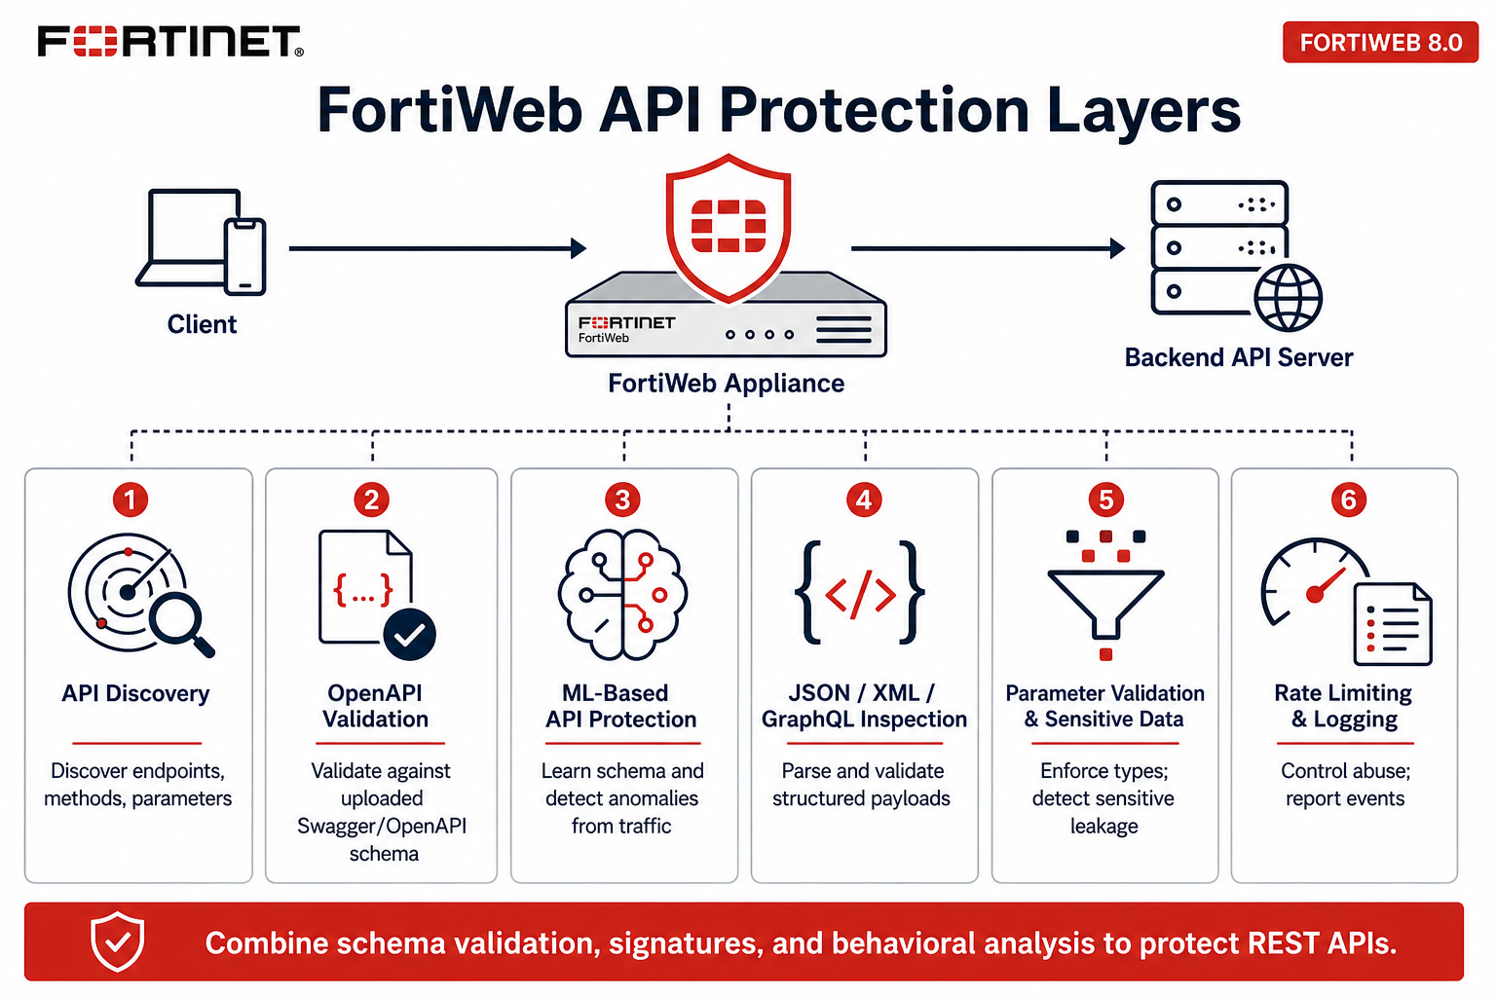
FortiWeb API Protection Layers
Discovery + schema + ML — not signatures alone

Slide 36
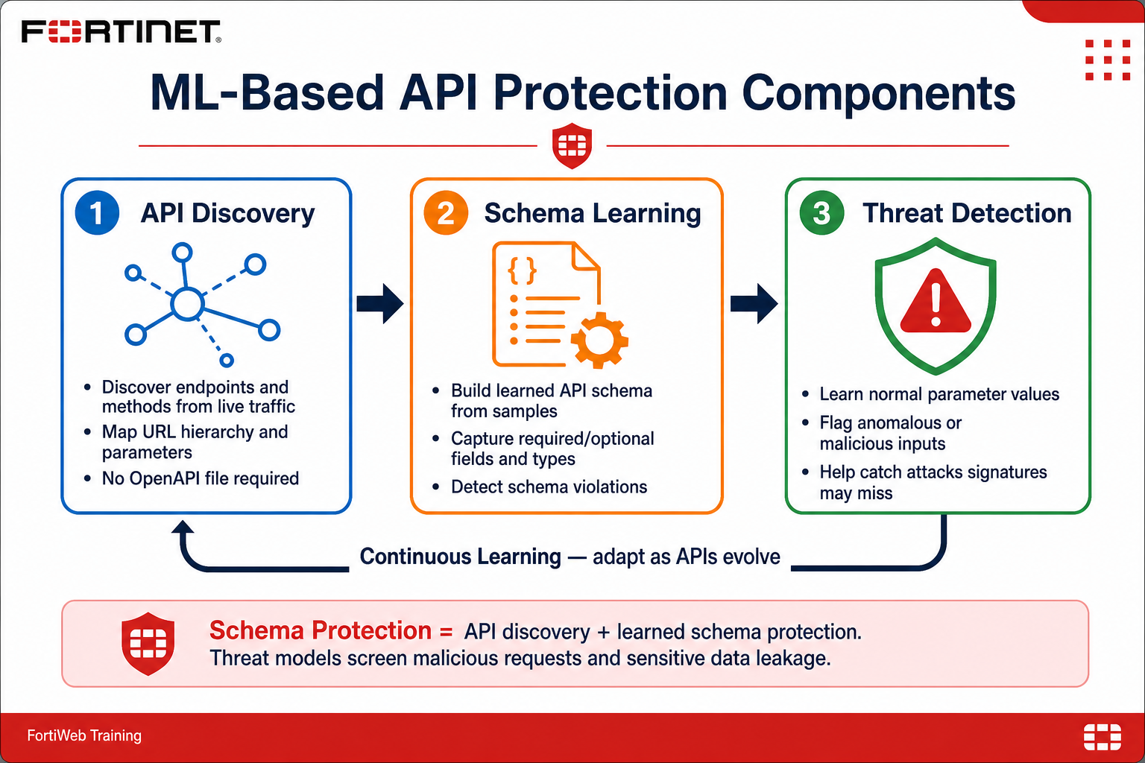
ML-Based API Protection
Three functions: discover endpoints, learn schema, detect anomalous values

Slide 37
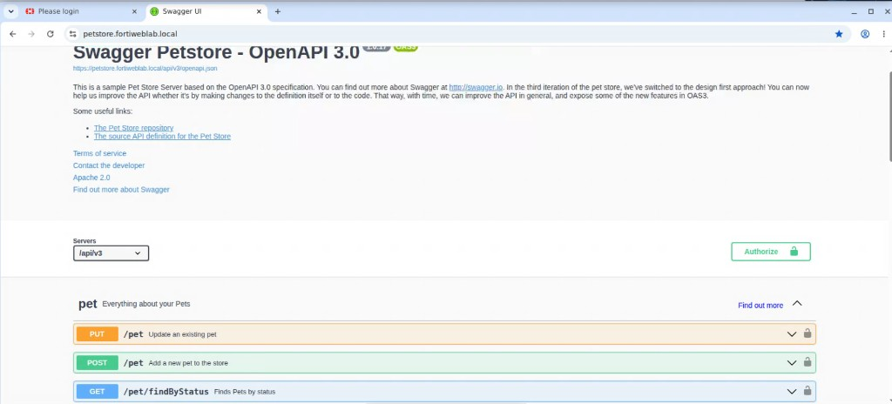
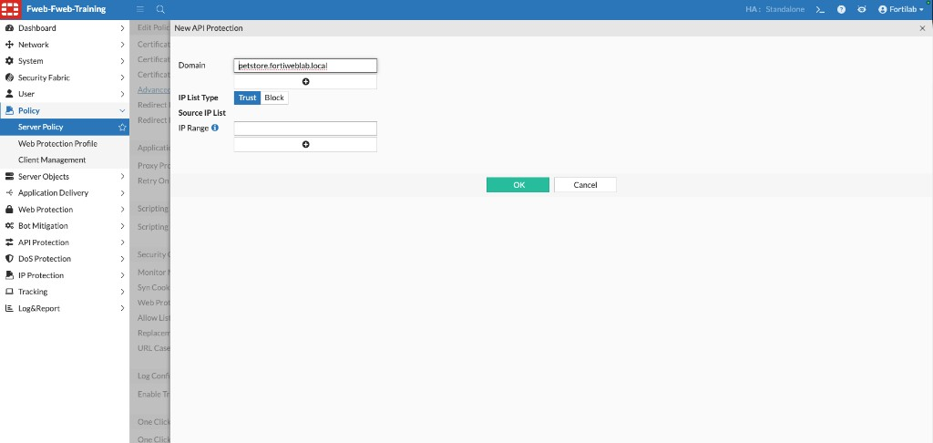
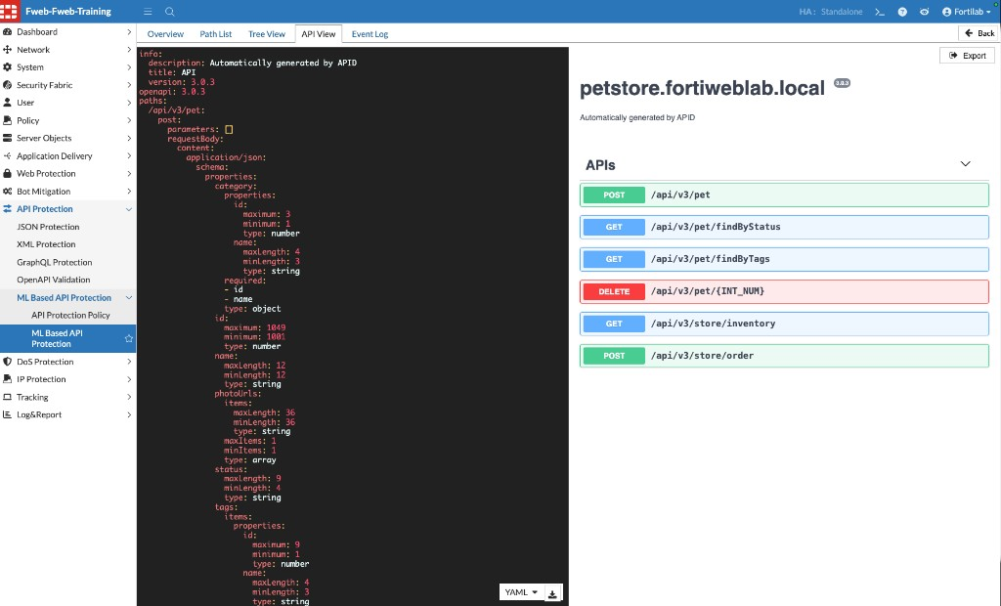
Exercises 5.1–5.2 — Explore and Learn PetStore
Swagger UI first, then enable API Protection and run PetStore ML Learning
• Bookmark: https://petstore.fortiweblab.local
• Try GET /pet/findByStatus and POST /store/order.
• Set Schema Protection and Threat Detection to Alert & Deny.
• Wait until API View shows discovered endpoints and Event Log shows model running.

Slide 38
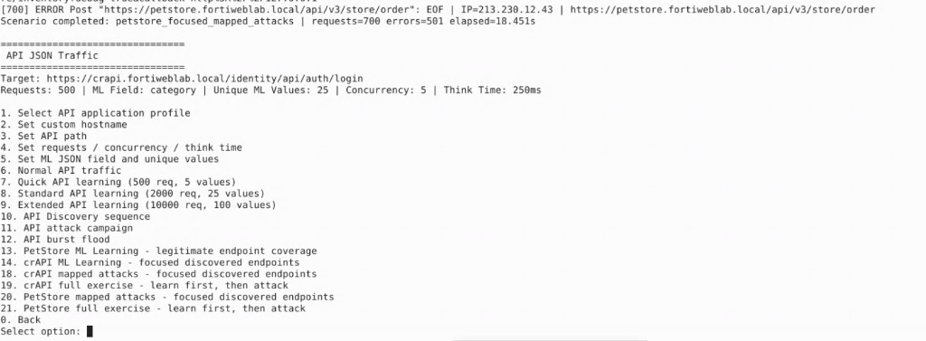
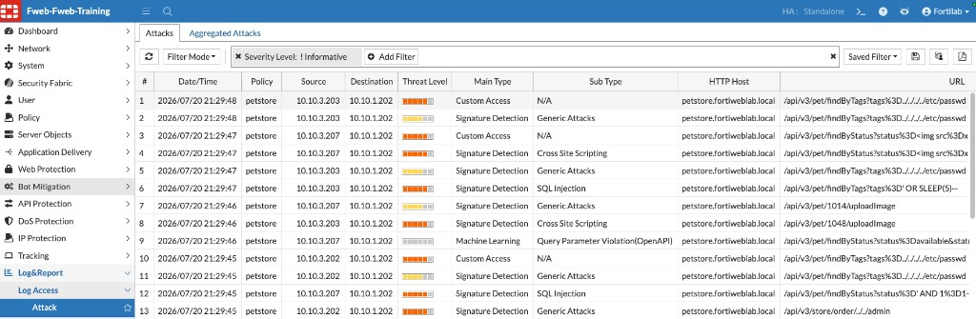
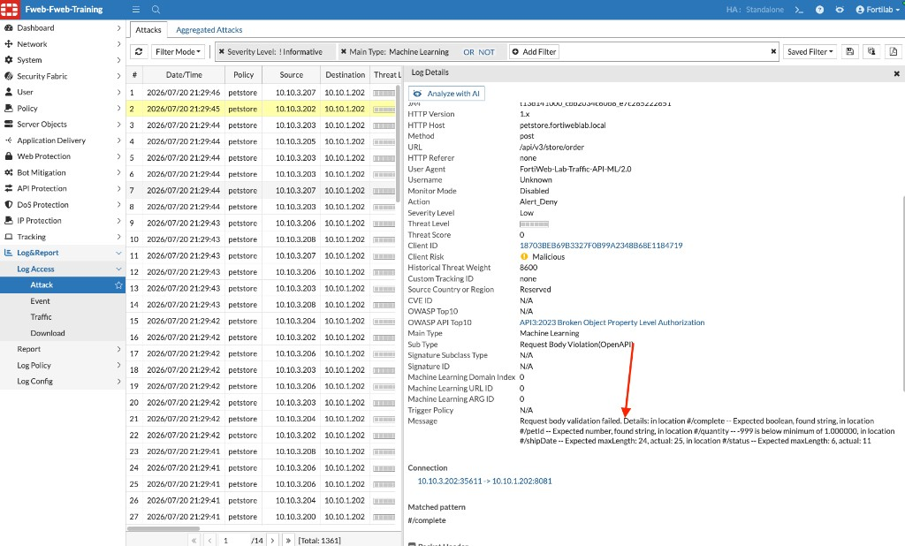
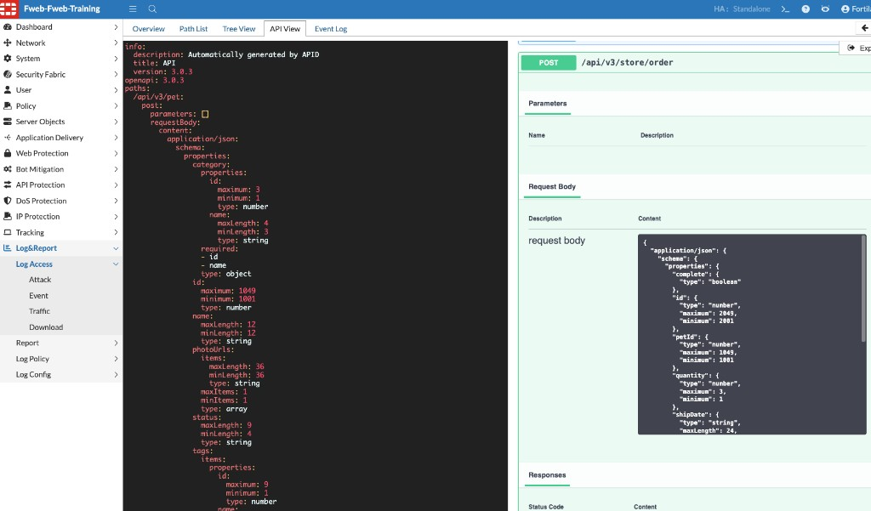
Exercises 5.3–5.4 — Launch API Attacks and Review Logs
Mapped PetStore attacks produce signature and Machine Learning detections

Slide 39
Chapter 6 MCP Protection
Protocol-aware security for AI tool traffic — no learning phase required

Slide 40
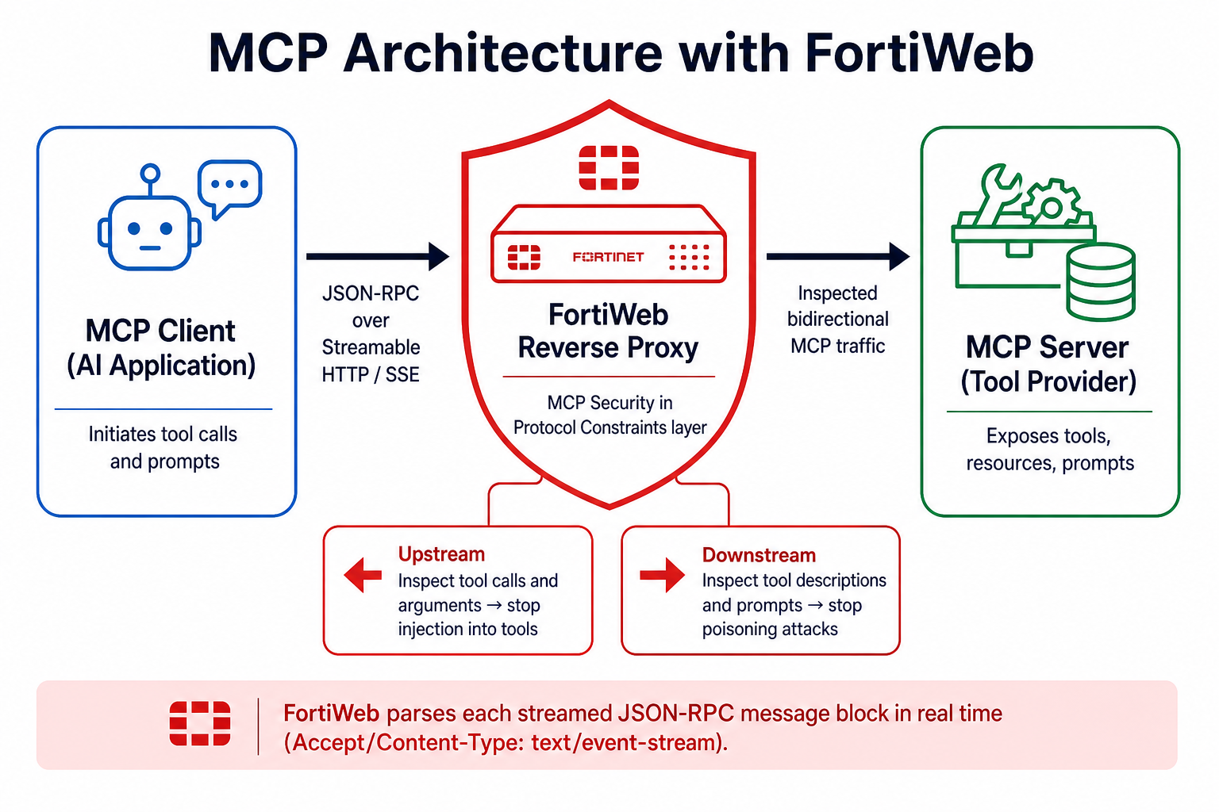
Model Context Protocol Architecture
MCP client → FortiWeb → MCP server tools
Notes:
MCP standardizes how AI apps call tools over Streamable HTTP / SSE JSON-RPC.

Slide 41
Why MCP Security Matters
Tools can reach files, data, and enterprise services. Prompts can steer those tools.
Prompt injection / poisoning
Unauthorized tool use
Injection in arguments
Malicious instructions in prompts, tool descriptions, or arguments.
Tool enumeration and calls the user should not be allowed to make.
SQLi, XSS, command injection, and path traversal inside params.arguments.
Schema violations
Abuse & exfiltration
Immediate enforcement
Malformed JSON-RPC, missing fields, wrong types, oversized payloads.
Excessive tool calls and attempts to pull sensitive data.
Unlike ML chapters, MCP Security protects as soon as the policy is applied.

Slide 42
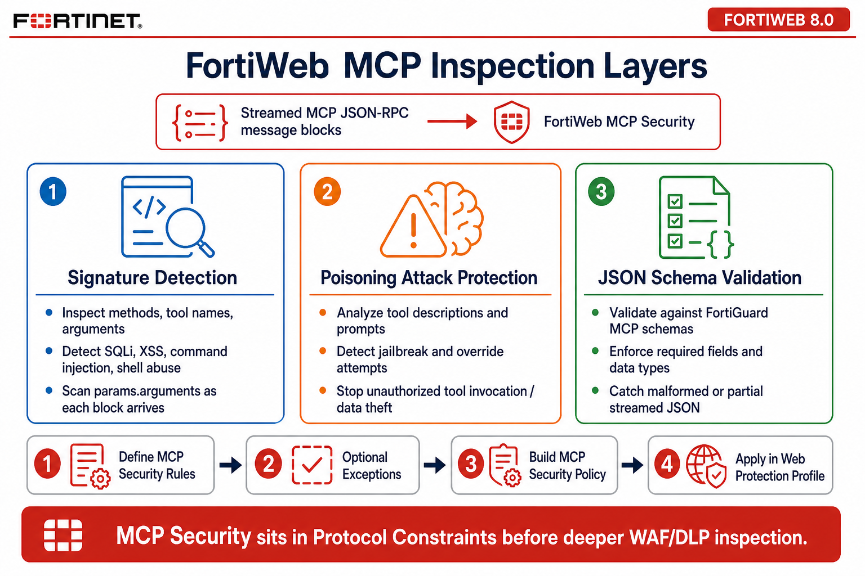
FortiWeb MCP Inspection Layers
Signatures + prompt poisoning + JSON schema validation on Streamable HTTP / SSE

Slide 43
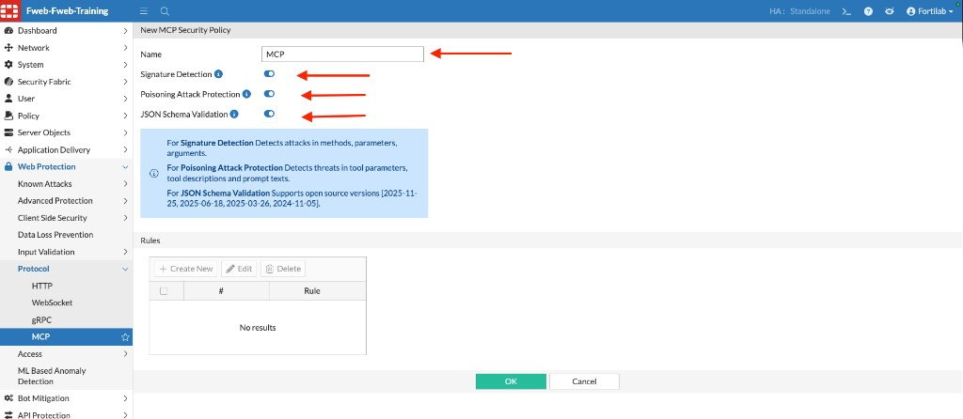
Exercise 6.1 — Configure MCP Security
Rule → policy (Signature, Poisoning, JSON Schema) → Web Protection Profile → server policy
• Create an MCP Security Rule for the lab MCP path.
• Create an MCP Security Policy and enable Signature Detection, Prompt Poisoning Protection, and JSON Schema Validation.
• Add the rule to the policy.
• Create a Web Protection Profile that references MCP Security.
• Assign that profile on the MCP server policy and enable Traffic Log.
• Protection is live immediately — do not wait for a learning state.

Slide 44



Exercise 6.2 — Legitimate MCP Traffic
Use the AI Agent student view to call weather, time, inventory, currency, and calculator tools
• Confirm the protected path is connected.
• Instructor scenario should be Normal / ACTIVE.
• Traffic Log: MCP posts to mcp.fortiweblab.local/mcp.
• Capture the session ID — useful when you correlate Attack Logs next.

Slide 45




Exercise 6.3 — Launch MCP Attacks
Instructor scenarios: command attack, SQL injection, invalid schema, oversized payload
Instructor scenario control
Command attack blocked
SQL injection blocked
Invalid schema — null tool result

Slide 46

Exercise 6.4 — Review MCP Attack Logs
Alert_Deny events should show MCP policy hits for XSS, SQLi, and related tool arguments
• Open Log&Report → Log Access → Attack and filter on the MCP policy.
• Match timestamps to the instructor scenarios you just ran.
• Open SQL Injection and XSS details — payloads live in MCP tool parameters.
• Traffic Log still shows the MCP POST; Attack Log explains why it was denied.
• Reset instructor mode to Normal when you finish so later chapters see a clean agent.

Slide 47
Chapter 7 Bot Mitigation
Layered detection: biometrics, thresholds, known bots, and ML

Slide 48

Legitimate vs Malicious Bots
Nearly half of internet traffic is automated — not all of it should be blocked

Slide 49
FortiWeb Bot Mitigation Methods
No single engine covers every bot — the lab stacks four controls on Juice Shop
Biometrics-based
Threshold-based
Known Bots
Mouse, keyboard, touch, focus, and scroll events distinguish humans from scripts.
Rate, scanning, crawling, and scraping patterns.
FortiGuard classifies Known Good, Likely Good, and Malicious bots.
ML-based bot detection
Bot deception
Lab expectation
Models normal client behavior and spots anomalous automation.
Hidden client-side traps for automated clients (concept; not the primary lab signal).
Known Bots and Threshold findings are the main events in a short classroom run.

Slide 50

Exercise 7.1 — Configure Bot Mitigation
Build juiceshop biometrics, threshold, known-bots, then a Bot Mitigation Policy and WPP
• Create Biometrics, Threshold, and Known Bots objects named for juiceshop.
• Combine them in Bot Mitigation Policy juiceshop.
• Create Inline Protection Profile juiceshop with that policy.
• Assign the profile on the juiceshop content-routing entry of juiceshop-DVWA.
• Optionally enable ML Bot Detection on the same server policy.
• Save the policy before generating traffic.

Slide 51



Exercises 7.2–7.3 — Generate and Review Bot Traffic
Option 6 = realistic browsing baseline. Option 13 = bot campaign.
• Browsing should be 200 in Traffic Log.
• Bot run: Known Bots (for example masscan) and Threshold / Content Scraping.
• Map each event to the engine that produced it before changing thresholds.

Slide 52
Chapter 8 Operations & Logging
Optional chapter — reuse events from earlier labs

Slide 53

FortiWeb Log Types
Log&Report → Log Access → Attack, Event, or Traffic
• Attack Log: which protection detected the request and what action was taken.
• Traffic Log: request flow, host, URL, and response status.
• Event Log: admin activity, configuration changes, updates, and ML lifecycle messages.
• Investigation order: confirm the Traffic Log row, then open the matching Attack Log, then change the smallest justified setting.
• Retest both legitimate and malicious traffic after every change.

Slide 54






Investigate Across Web, API, and MCP
Same workflow, different protections — always identify the exact sensor before tuning

Slide 55

Tune Policies with Evidence
Prefer a scoped exception over disabling a signature globally
• Open a Signature Detection event and note the Signature ID.
• Use the log details action menu — do not guess from the summary row.
• If a false positive is confirmed, add a narrowly scoped URL exception.
• Never turn off an entire category to fix one path.
• Document the change and retest the original attack plus a legitimate request.

Slide 56

Exercise 8.4 — Troubleshooting Challenge
A DVWA login returns 404. Find where the request stopped before changing policy.
• Verify DNS, host name, and that the browser reached the virtual server.
• Traffic Log: does FortiWeb see the request, and what status did it return?
• Attack Log: Threshold Based Detection / Content Scraping is a common lab cause.
• FortiView Topology and the Status dashboard rule out pool and license issues.
• Make the smallest justified change, then retest.

Slide 57
Lab Summary
What you deployed, protected, and proved

Slide 58
What You Accomplished
A complete path from Terraform deploy to evidence-based operations
Ch 1
Deployed the Azure lab and restored FortiWeb 8.0.5.
Ch 2
Mapped virtual servers, SSL offload, and content routing.
Ch 3
Blocked common attacks on DVWA with a Web Protection Profile.
Ch 4
Trained Juice Shop ML and enforced Alert & Deny on anomalies.
Ch 5
Discovered PetStore APIs and blocked mapped API attacks.
Ch 6
Protected MCP tool calls with signatures, poisoning, and schema checks.
Ch 7
Separated human browsing from known bots and scrapers.
Ch 8
Investigated Attack/Traffic/Event logs and practiced scoped tuning.

Slide 59
Key Takeaways
Carry these patterns back to real FortiWeb deployments
Security in the delivery path
Profiles over one-off rules
Load balancing and TLS offload are how inspection happens — not a separate box beside the app.
Web Protection Profiles keep signatures, protocol, bot, and MCP controls reusable per application.
Learn what normal looks like
MCP is immediate
ML for apps and APIs catches techniques that signatures do not yet describe.
AI tool traffic is JSON-RPC. Enable protocol-aware MCP Security; do not wait for a learning window.
Prove it in logs
Tune narrowly
Every control is incomplete until Traffic and Attack logs show allow vs deny with the right sensor name.
Exceptions should be URL- and signature-specific. Broad disables recreate the baseline you started with.

Slide 60
Thank you
Protecting Modern Applications, APIs, and MCP Services with FortiWeb
Hands-on Training Lab | FortiWeb 8.0.5
Notes:
Point students to the GitHub Pages lab guide for step-by-step procedures.

