Slide 1





Robot configuration when starting, with motor rotation positive direction
$$z$$
$$θ_{4}$$
$$θ_{3}$$
$$θ_{2}$$
$$x$$

Slide 2
$$θ_{4}$$
$$θ_{3}$$
$$θ_{2}$$

Slide 3

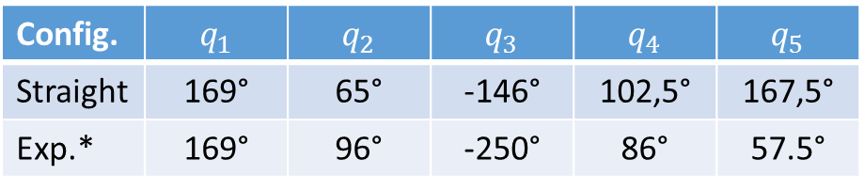




























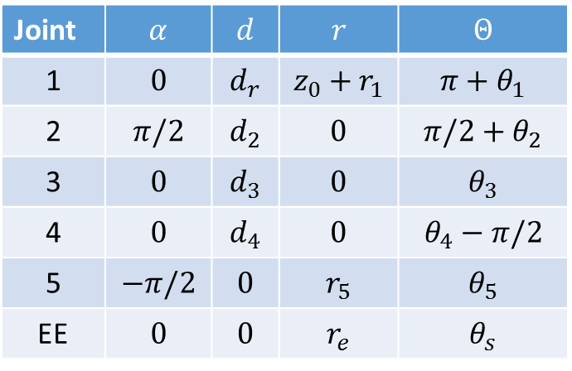




$$r_{e}$$
Denavit Hartenberg and youBot conventions
Straight configuration
$$θ_{5}$$
Config. | $$q_{1}$$ | $$q_{2}$$ | $$q_{3}$$ | $$q_{4}$$ | $$q_{5}$$
Straight | 169° | 65° | -146° | 102,5° | 167,5°
Exp.* | 169° | 96° | -250° | 86° | 57.5°
$$θ_{4}$$
$$r_{5}$$
$$z$$
$$offset$$
*Starting configuration during the experiments
User side
$$r_{e}$$
$$d_{4}$$
WRONG CONVENTION
$$θ_{3}$$
$$𝒪_{5}$$
Denavit Hartenberg parameters, in Khalil - Kl. conv.
$$r_{5}$$
Joint | $$α$$ | $$d$$ | $$r$$ | $$Θ$$
1 | $$0$$ | $$d_{r}$$ | $$z_{0}+r_{1}$$ | $$π+θ_{1}$$
2 | $$π/2$$ | $$d_{2}$$ | $$0$$ | $$π/2+θ_{2}$$
3 | $$0$$ | $$d_{3}$$ | $$0$$ | $$θ_{3}$$
4 | $$0$$ | $$d_{4}$$ | $$0$$ | $$θ_{4}−π/2$$
5 | $$−π/2$$ | $$0$$ | $$r_{5}$$ | $$θ_{5}$$
EE | $$0$$ | $$0$$ | $$r_{e}$$ | $$θ_{s}$$
$$θ_{4}^{i}$$
$$d_{4}$$
$$𝒪_{4}$$
$$θ_{3}^{i}$$
$$d_{3}$$
$$d_{3}$$
$$d_{2}$$
$$𝒪_{3}$$
$$θ_{2}$$
$$𝒪_{1}$$
$$θ_{2}^{i}$$
$$r_{1}$$
$$𝒪_{2}$$
$$d_{2}$$
z
$$z_{0}+r_{1}$$
$$z_{i}$$
$$z_{0}$$
$$d_{r}=0$$
$$x_{i}$$
$$θ_{i}=q_{i}−offset$$
$$θ_{1}$$
x
y
$$x$$

Slide 4












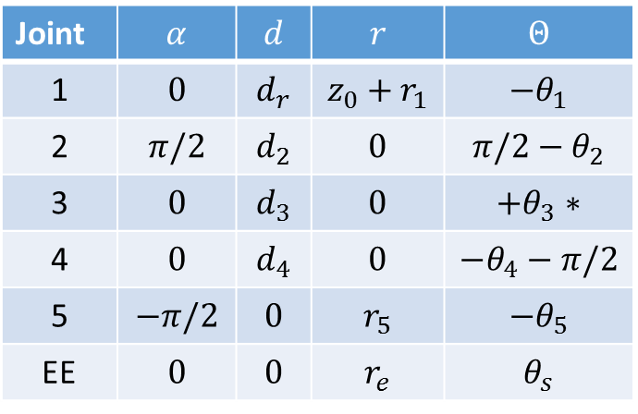
$$r_{e}$$
Denavit Hartenberg and youBot conventions
Straight configuration
$$θ_{5}$$
Config. | $$q_{1}$$ | $$q_{2}$$ | $$q_{3}$$ | $$q_{4}$$ | $$q_{5}$$
Straight | 169° | 65° | -146° | 102,5° | 167,5°
Exp.* | 169° | 96° | -250° | 86° | 57.5°
$$r_{5}$$
$$θ_{4}$$
$$z$$
$$offset$$
*Starting configuration during the experiments
User side
$$r_{e}$$
$$d_{4}$$
$$𝒪_{5}$$
$$θ_{3}$$
Denavit Hartenberg parameters, in Khalil - Kl. conv.
$$r_{5}$$
Joint | $$α$$ | $$d$$ | $$r$$ | $$Θ$$
1 | $$0$$ | $$d_{r}$$ | $$z_{0}+r_{1}$$ | $$−θ_{1}$$
2 | $$π/2$$ | $$d_{2}$$ | $$0$$ | $$π/2−θ_{2}$$
3 | $$0$$ | $$d_{3}$$ | $$0$$ | $$+θ_{3}∗$$
4 | $$0$$ | $$d_{4}$$ | $$0$$ | $$−θ_{4}−π/2$$
5 | $$−π/2$$ | $$0$$ | $$r_{5}$$ | $${−θ}_{5}$$
EE | $$0$$ | $$0$$ | $$r_{e}$$ | $$θ_{s}$$
$$𝒪_{4}$$
$$θ_{4}^{i}$$
$$d_{4}$$
$$θ_{3}^{i}$$
$$d_{3}$$
$$𝒪_{3}$$
$$d_{3}$$
$$d_{2}$$
$$θ_{2}^{i}$$
$$𝒪_{1}$$
$$θ_{2}$$
$$𝒪_{2}$$
$$d_{2}$$
$$r_{1}$$
z
$$z_{0}+r_{1}$$
$$z_{i}$$
$$z_{0}$$
$$d_{r}=0$$
$$x_{i}$$
$$θ_{i}=q_{i}−offset$$
$$θ_{1}$$
x
y
* Dans la convention ROS, négatif aussi
$$x$$

Slide 5
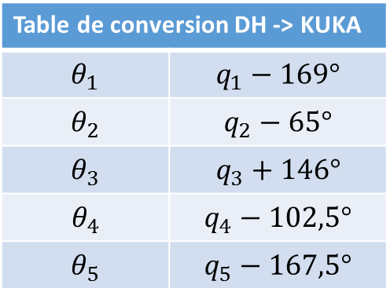
Caractéristiques YouBot
Table de conversion DH -> KUKA
$$θ_{1}$$ | $q_{1}−169°$
$$θ_{2}$$ | $q_{2}−65°$
$$θ_{3}$$ | $q_{3}+146°$
$$θ_{4}$$ | $q_{4}−102,5°$
$$θ_{5}$$ | $q_{5}−167,5°$
Cinématique
Répétabilité : 0,1mm
Précision encodeur moteur : 4000/tour
joint2 : 0,00058°
joint3 : 0,0009°
joint4 : 0,0013°
Communication
Type : EtherCat
Délais : (jitter) 25 um
Durée cycle < 1ms

