Slide 1
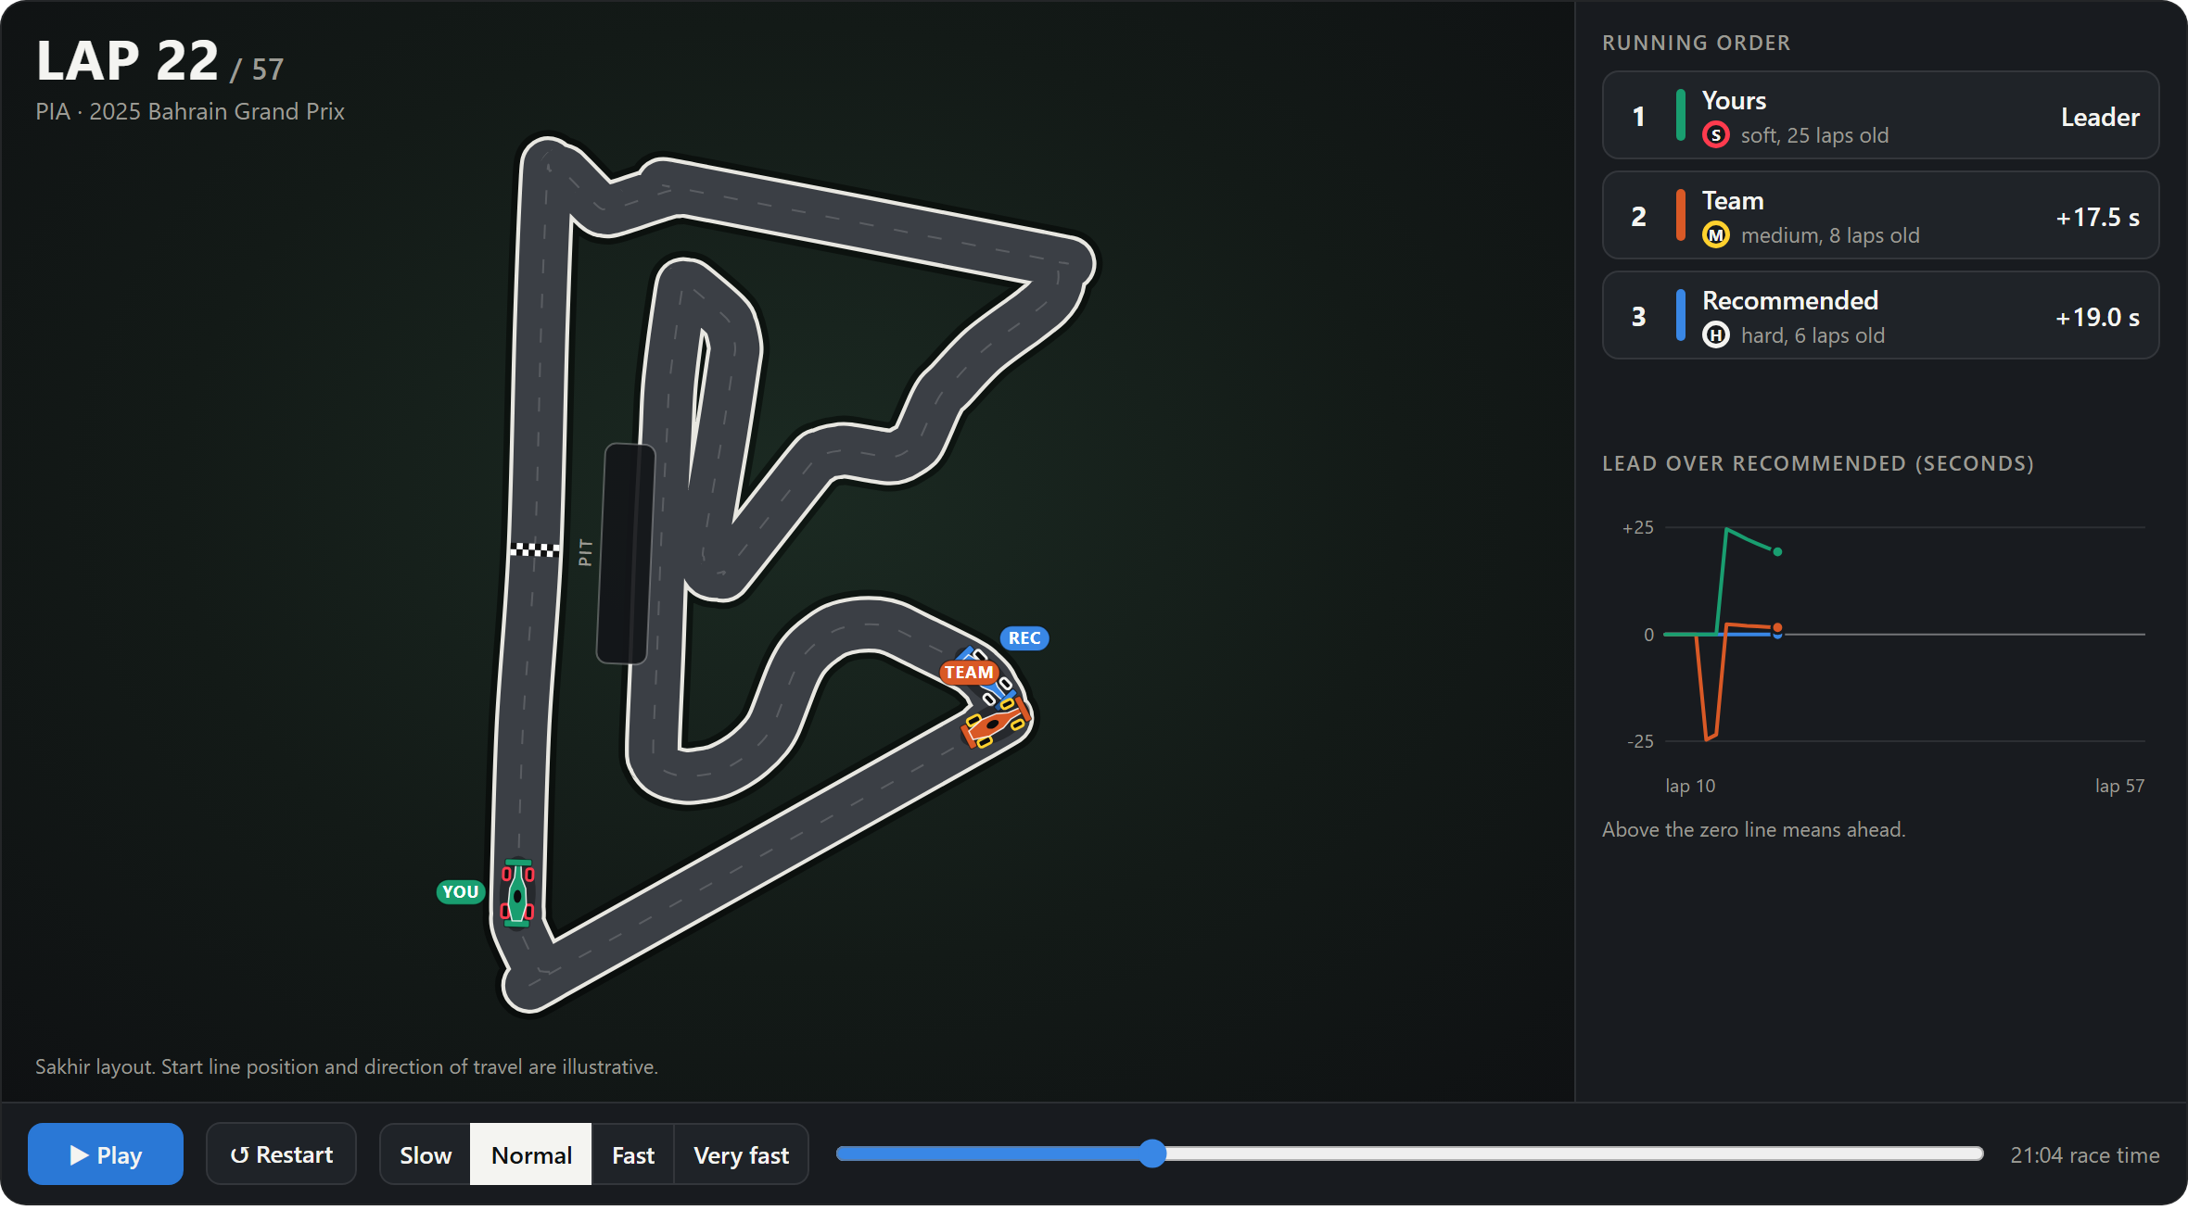
PREDICTIVE MODELLING · COURSE PROJECT
Can a model call the pit stop?
A race strategy simulator built on real Formula 1 lap data, 2022–2025
Notes:
This project asks whether a lap-time model, given only the first few laps of a race, can predict the rest of it well enough to choose a pit strategy. The image is the simulator we built on top of the model.

Slide 2
THE ANSWER FIRST
Race time is predictable; the exact pit lap is not
0.57%
2.2×
65%
8 laps
Race-time error for the strategy really used: 24 s over a race of about 70 minutes
Lower race-time error than constant pace: 24 s instead of 55 s
Recommended number of stops matches the team's
Average distance between the recommended first pit lap and the team's
Good strategies differ by about 2 seconds. That is smaller than the model's own error, so it can rank races, not pit laps.
F1 Race Strategy Simulator
2
Notes:
Lead with the result. The model predicts total race time to about half a percent, less than half the error of assuming constant pace. But the recommended first pit lap is on average 8 laps from what the team did. The reason is on the last line: good strategies differ by a couple of seconds, and that is inside the model's error.

Slide 3
DATA
Real race laps, split by season
Split | Seasons | Dry races | Laps used
Train | 2022, 2023 | 35 | 24,039
Validation | 2024 | 19 | 15,332
Test | 2025 | 21 | 15,844
Why split by season
Laps from one race share the same track, weather and car. A random split puts the same race on both sides and overstates accuracy.
Splitting by season means the model is always tested on races it has never seen.
2022–2025 is one set of technical rules, so the cars are comparable.
The 2025 season was used once, after the model was chosen.
Source: FastF1. 92 races downloaded; 12 wet races dropped; 5 had no usable laps after cleaning.
Only clean laps are modelled: green flag, dry tyres, no pit entry or exit, within 4% of the driver's median pace.
F1 Race Strategy Simulator
3
Notes:
Data comes from the FastF1 library: lap times, tyre compound, tyre age, track status and weather. 92 races were downloaded; 12 wet races were dropped and 5 had no usable laps. The split is by season, not random, because laps in the same race are strongly correlated. A random split would leak the race into both sides.

Slide 4
TARGET AND INPUTS
Predict the change in pace, not the lap time
TARGET
Tyre age
Compound
delta % =
100 × (lap time ÷ baseline − 1)
Laps completed on the current set
Soft, medium or hard
Baseline = median of the driver's first clean laps (up to 8, between laps 2 and 12).
It is known a few laps into the race, so predicting later laps from it uses no future information.
Example: at a 90 s baseline, a lap predicted at +1.2% is 91.08 s.
Fuel burned
Race progress
Share of race distance since the baseline
Share completed, and race length
Baseline conditions
Circuit
Tyre and track temperature when pace was set
Venue, as a category
F1 Race Strategy Simulator
4
Notes:
Absolute lap time is mostly the circuit and the car, which the model cannot know for a future race. So each lap is expressed relative to the driver's own baseline pace from their first clean laps. That baseline is known early in the race, so there is no leakage. Every input on the right is known in advance for any hypothetical strategy, which is what lets the model act as a simulator.

Slide 5
MODEL COMPARISON
Small boosted trees narrowly beat linear regression
Validation RMSE, seconds per lap (2024 season)
What the comparison shows
Gradient boosting: 0.80 s per lap, selected.
Linear regression: 0.82 s. The gap is about 3%.
Assuming pace never changes: 1.55 s.
Trees with 31 leaves fitted race-specific noise and lost to linear regression. Trees with 4 leaves won.
F1 Race Strategy Simulator
5
Notes:
Six candidates were compared on the 2024 validation season. The two naive references are at the bottom. Gradient boosting won, but only by about 3% over plain linear regression. Our first boosted model, with 31-leaf trees, actually lost to linear regression because it fitted race-specific noise. Shrinking the trees to 4 leaves fixed that.

Slide 6
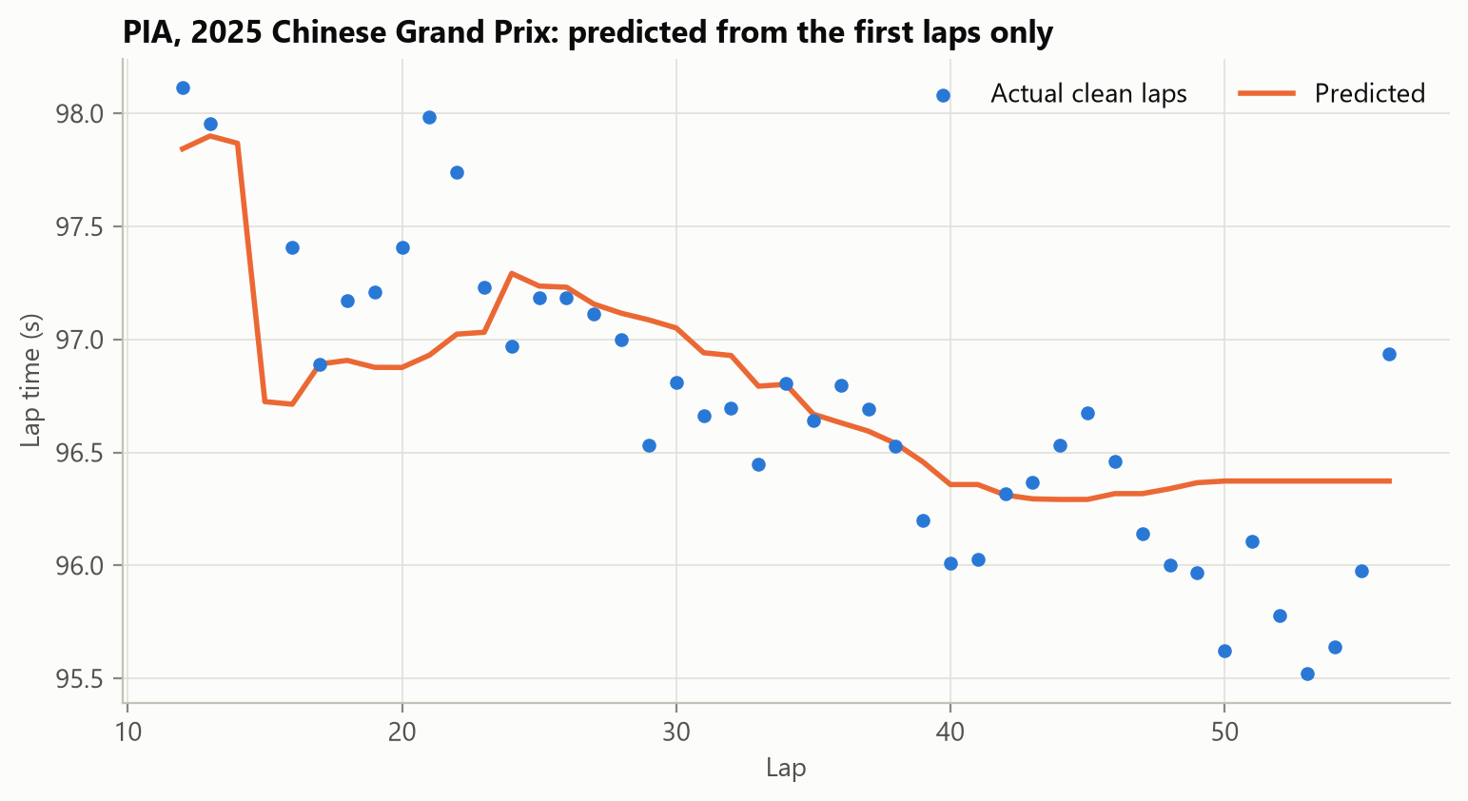
TEST SEASON
On the unseen 2025 season the lap error is nearly halved
0.83 s
1.56 s
Lap error (RMSE) with the model
Lap error assuming constant pace
Where the error sits (R² = 0.44)
Driver over a whole race: 0.55% of pace. Shifts every strategy equally.
Stint within a race: 0.44%. This is what separates strategies.
Single lap: 0.65%. Mostly averages out.
One driver's race, predicted from their first clean laps only.
F1 Race Strategy Simulator
6
Notes:
The selected model was refitted on 2022 to 2024 and run once on 2025. Error drops from 1.56 to 0.83 seconds per lap. R squared is 0.44: traffic, driver management and track evolution are not in the data. The error splits into three levels. Only the stint-level part separates strategies; the driver-level part shifts all strategies for that driver equally. The chart is one driver's race predicted from their first laps only.

Slide 7
SIMULATOR
Turning the model into a race simulator
1
2
3
4
5
Tyre plan
Predict laps
Add pit loss
Search
Uncertainty
Compound and tyre age for every lap of a strategy
Model output scaled by the driver's baseline pace
Median green-flag loss at that circuit in past seasons
Every one-stop plan and a grid of two-stop plans
Random races drawn from stint and lap error
Rules the search enforces
At least two dry compounds in the race
Every stint at least 5 laps long
No stint longer than tyres were seen to last at that circuit
F1 Race Strategy Simulator
7
Notes:
The model becomes a simulator in five steps. For any strategy we lay out which tyre is on the car and how old it is on every lap, predict each lap, add the circuit's pit-loss time per stop, and sum. We search every one-stop strategy and a grid of two-stop strategies, then draw random races from the model's measured error to show the spread. The search obeys three rules.

Slide 8
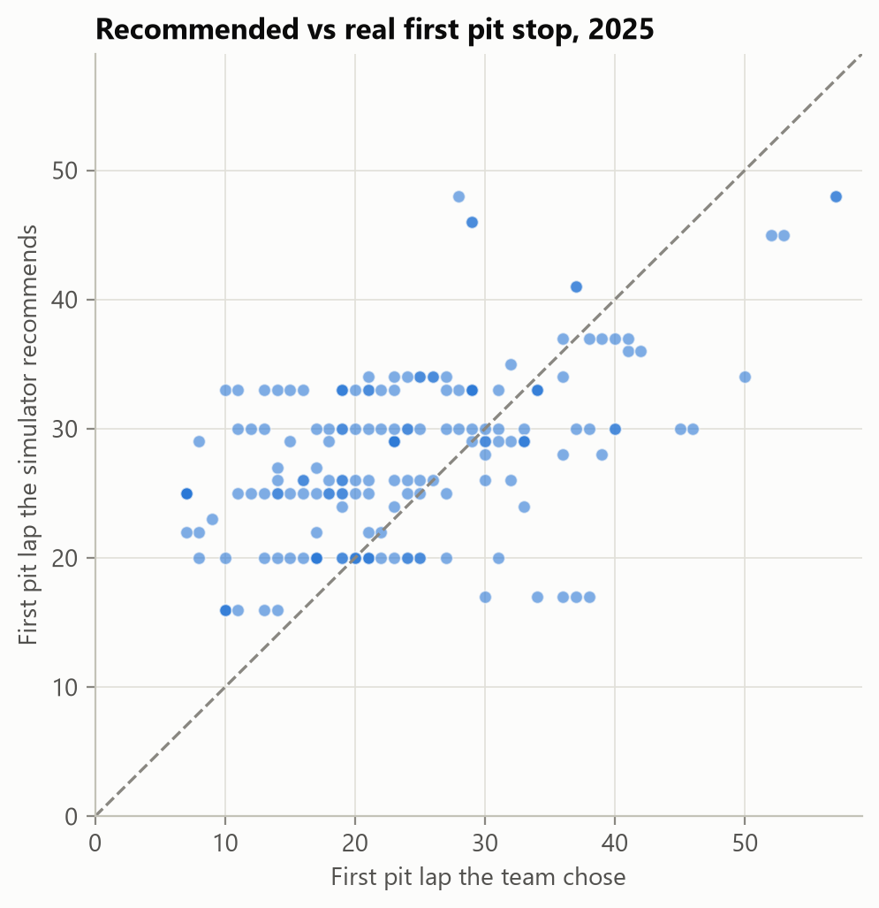
BACKTEST
Checked against 182 real driver-races from 2025
Race-time error (MAE), seconds
65%
same number of stops as the team
8.0 laps
average distance of the first pit lap
26%
of first pit laps within 3 laps
60 driver-races that stayed under green flags.
F1 Race Strategy Simulator
8
Notes:
We ran the simulator for every top-ten finisher in the dry 2025 races. Race time could be checked on the 60 driver-races that stayed fully green, because safety cars are not modelled. There the error is 24 seconds against 55 with no model. The scatter compares the recommended first pit lap with the team's: points far from the diagonal are disagreements, and most recommendations are later than the team's stop.

Slide 9
DEMO
The simulator as an animated race
1
Three strategies race
Recommended, the team's real one, and your own
2
Tyres and stops are visible
Wheel colour is the compound; cars use the pit box
3
Live running order
Gaps, tyre age and a lead chart, lap by lap
4
Random races
Each run draws from the model's measured error
Circuit outlines are real. Start-line position and direction of travel are illustrative.
F1 Race Strategy Simulator
9
Notes:
This is the app. The same driver runs three strategies at once on the real circuit outline: the recommended one, the team's real one, and one the user sets. Wheel colour is the tyre compound, cars drive into the pit box during a stop, and the panel shows live gaps. A random mode draws one possible race from the model's error, so the finishing order can change between runs. Switch to the live app here.

Slide 10
LIMITATIONS
Why the pit lap is hard, and what would fix it
1
Survivorship in tyre data
2
No traffic or track position
Long stints are only seen when the tyres lasted, so old tyres look better than they are and stops come out too late.
Teams stop early to undercut a rival or rejoin in clear air. The simulator only finds the fastest plan in clean air.
3
No safety cars or weather
4
Gains are inside the error
These decide many real races. Race time could only be checked on races that stayed green.
Good strategies differ by about 2 s; stint-level error alone is larger. The team's choice is a reference, not proven best.
Next: add safety-car scenarios, separate the three compounds better, and model traffic.
F1 Race Strategy Simulator
10
Notes:
Four limits explain the gap to the teams. Long stints only appear in the data when the tyres held up, so the model is optimistic about old tyres and recommends later stops. Teams stop early for track position, which we do not model. Safety cars decide many races. And the gains between good strategies are inside the model's error. The next steps follow directly from these.

Slide 11
CONCLUSION
An accurate model is not yet a decision
Lap time: 0.83 s error on an unseen season, about half the error of constant pace.
Race time: within 0.57% for the strategy really used.
Pit lap: the choice the simulator exists for turns on differences of about 2 seconds, which the model cannot resolve.
Validate a model at the level of the decision it will be used for.
Notes:
The lesson for predictive modelling: pointwise accuracy and even system-level accuracy were both good, but the decision needs a finer resolution than the model has. Accuracy has to be judged at the level of the decision. Questions.

