Slide 1
Student Industrial Work Experience Scheme (SWIES) Presentation
What is SIWES?
A bridge between academic theory and practical industry skills.
My Placement
Software & Hardware Lab, Federal University of Petroleum Resources Effurun.
Duration:
23rd June – 5th December 2025.
Ogbodogbo Fortune Onajite
Computer Science, FUPRE
Software & Hardware Lab, Federal University of Petroleum Resources Effurun
Internship Period: 23 June – 5 December 2025

Slide 2
Introduction
What is SIWES?
A bridge between academic theory and practical industry skills.
My Placement
Software & Hardware Lab, Federal University of Petroleum Resources Effurun.
Duration:
23rd June – 5th December 2025.

Slide 3



My Learning Rotations
Web Development
Hardware & Systems
Networking

Slide 4













Software Development: Skills & Tools
Todo List
BMI Calculator
HTML
CSS
Python
JavaScript
Express
A web app to track daily tasks
Python script to calculate the BMI of a person
Frontend
Backend
Database
Practices

Slide 5
Mini-Projects
BMI Calculator
Todo List
Python
HTML
CSS
JavaScript
Express
Python script to calculate the BMI of a person
A web app to track daily tasks

Slide 6
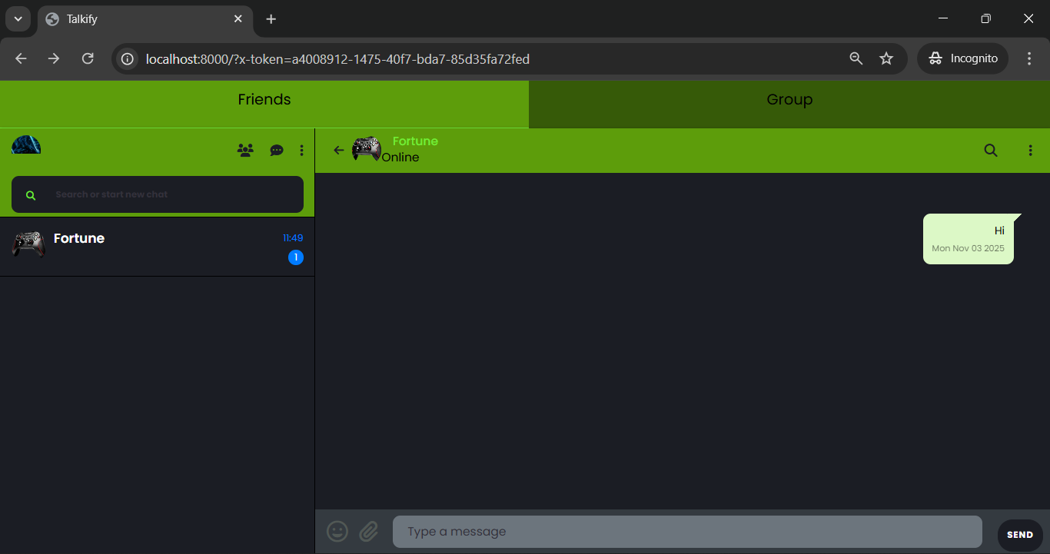
Capstone Project: A Real-Time Chat Application
Features
User Auth
1-on-1 & Group Chats
Friend System
Live Updates
Goal: To create a cohesive platform that integrated everything I had learned

Slide 7
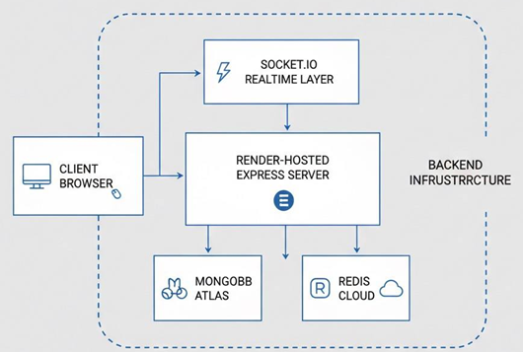
Talkify - Architecture & Skills
Skills Gained
Backend/API Design
Real-Time Systems
NoSQL Data Modeling

Slide 8
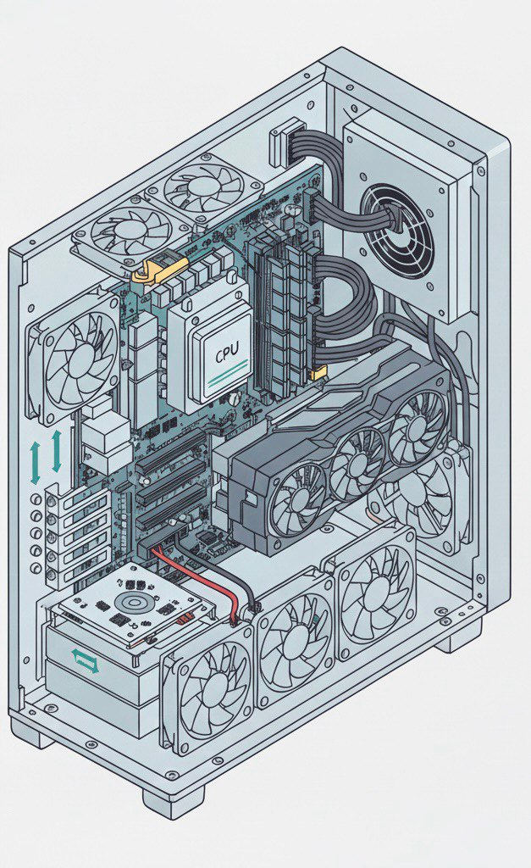
Hardware: Assembly & Component Identification
Components: CPU, RAM, Storage, Fans, Expansion slots, PSU

Slide 9
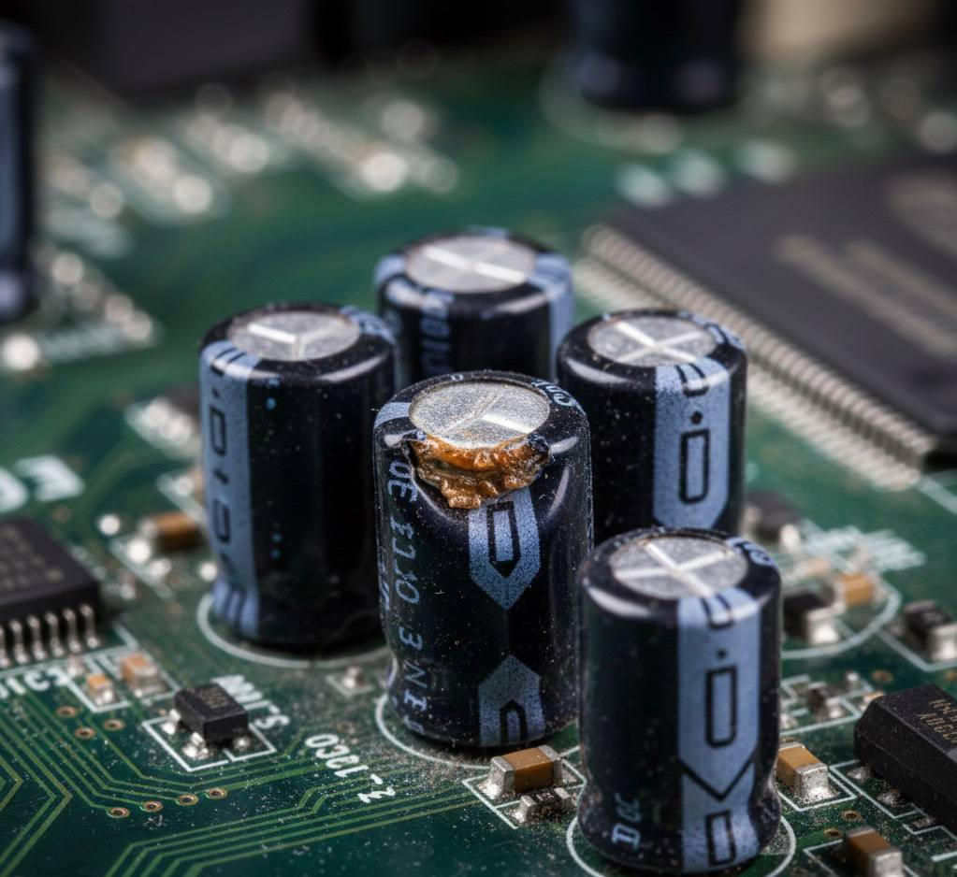
Hardware: Diagnostics & Troubleshooting
Troubleshooting Techniques:
Diagnostic Techniques
CMOS Management
Physical Inspection

Slide 10
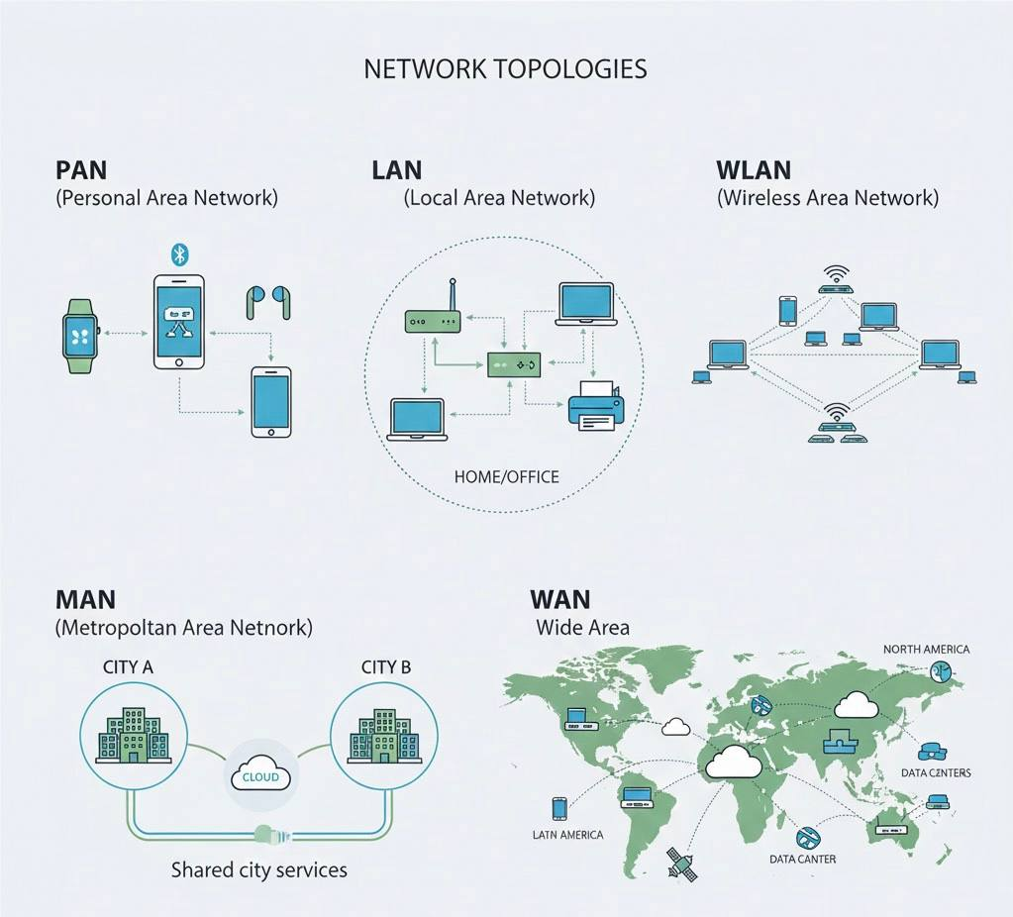
Networking
Tools | Purpose
ifconfig | View Interface config
ping | Test Connectivity
netcat | Check open ports

Slide 11
Bridging Theory with Practice
Academic Course | Practical Application
CSC 212 | In-depth practical knowledge of Computer Hardware
CSC 222 | Applied the theory knowledge to design the system architecture of my project
CSC 313 | Designed a performant database with indexing

Slide 12
Thank You
https://www.fortunecodes.tech

