Slide 1
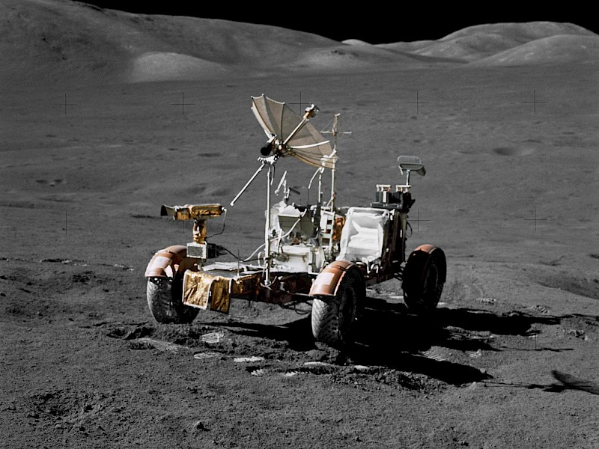
Abandoned but
not Forgotten
An interactive storybook about NASA's discarded equipment
on the Moon and Mars
For school-age readers · Ages 9–13 · Team SCENE
NASA Space Apps Challenge 2026 · Best Use of Storytelling
Apollo 17 Lunar Roving Vehicle, still parked on the Moon. Photo: NASA (Apollo 17).
1 / 7

Slide 2
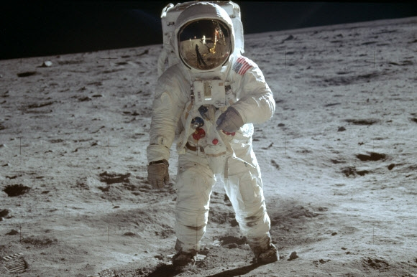
THE IDEA
Left behind — on purpose, and by accident
Since the 1960s, NASA has left hardware all across the solar system.
This book tells its story in 6 chapters — one machine per chapter.
Every chapter follows the same four beats:
Meet it → Its job → Goodbye → What it still tells us.
Apollo 11 astronaut Buzz Aldrin on the Moon, 1969. Photo: NASA (Neil Armstrong).
2 / 7

Slide 3
MOON CHAPTERS
The Moon: a rover and two mirrors
Apollo 17 Lunar Roving Vehicle — the car that never came home.
It drove about 36 km across the Moon, then stayed there.
Moon mirrors (retroreflectors) still answer our lasers after 50+ years.
Try it in the book: fire the laser and watch it come back.
The Moon is drifting away from Earth by about 3.8 cm a year —
the mirrors are how we know.
The Apollo 17 rover, parked alone on the Moon. Photo: NASA (Apollo 17).
3 / 7

Slide 4
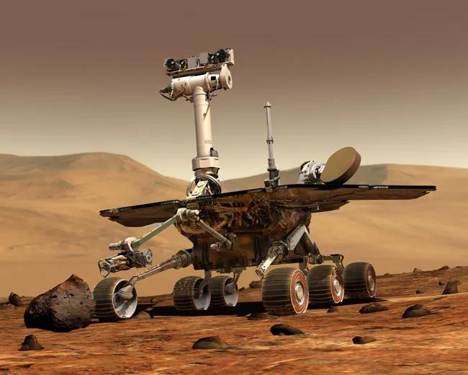
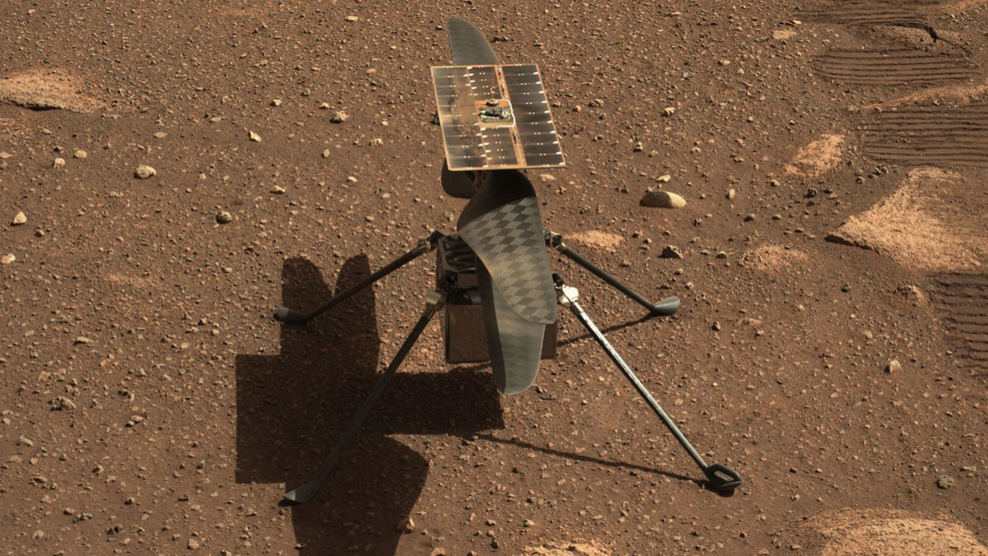
MARS CHAPTERS
Mars: two machines that outlived their plans
Opportunity — planned for 90 sols, ran for 5,111 sols.
It travelled 45.16 km and ended on 13 February 2019.
Drag the timeline slider in the book to follow its whole journey.
Ingenuity — 5 flights planned, 72 flights completed.
The little helicopter ended in January 2024.
Illustration of a Mars Exploration Rover.
Ingenuity on Mars. Photo: NASA / JPL-Caltech.
4 / 7

Slide 5
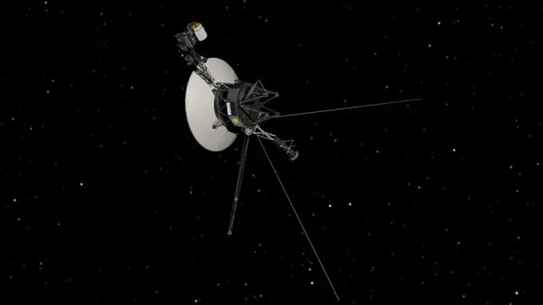
DEEP SPACE + SMALL THINGS
Still travelling — and the small things
Voyager 1 & 2 and Pioneer 10 are still travelling through deep space.
They left carrying messages, and they are not coming back.
The small-things shelf: flags, boots, golf balls —
and 96 bags left on the Moon.
Nothing here is rubbish. Everything left behind still tells a story.
Artist's concept of Voyager in deep space. Illustration based on NASA's Voyager design.
5 / 7

Slide 6
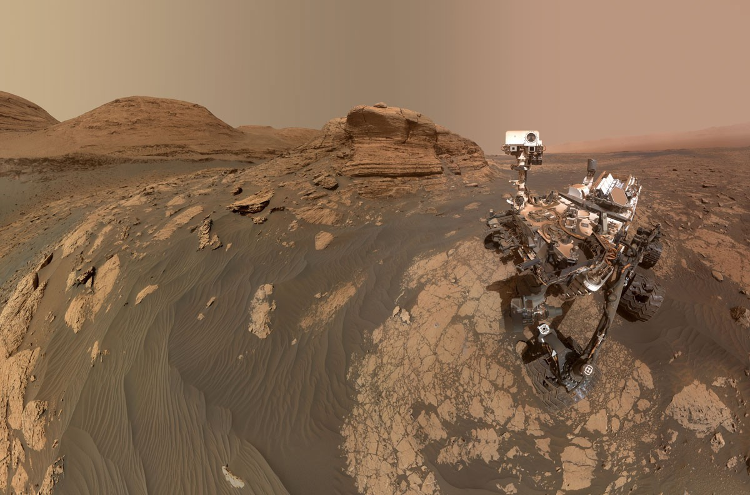
HOW IT PLAYS
A book a judge can read alone
Flip through the pages — no meeting or guide needed.
Fire the laser at the Moon mirrors.
Slide through Opportunity's whole mission on the timeline.
Take the quiz at the end and check the fact-check page.
9 pages, built for readers aged 9–13.
Curiosity's selfie on Mars — still working, not abandoned. Photo: NASA.
6 / 7

Slide 7
READ IT
The storybook is live now
forward123giruji.github.io/scene-storybook/
Every fact in the book is checked against NASA sources,
listed on the fact-check page inside the book.
Team SCENE · NASA Space Apps Challenge 2026
7 / 7

