Slide 1
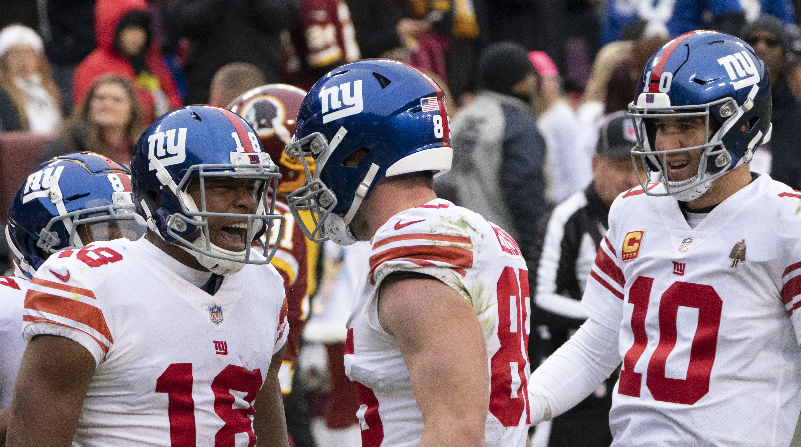
Ball Carrier Vision
Path Optimization
Team: Oh Saquon You See

Slide 2
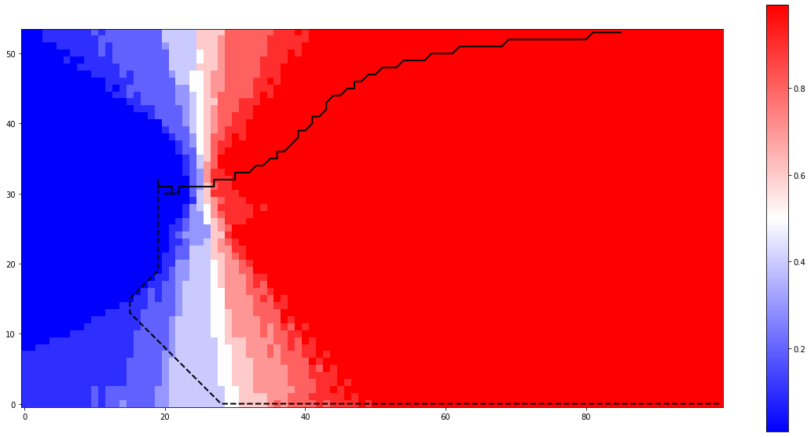
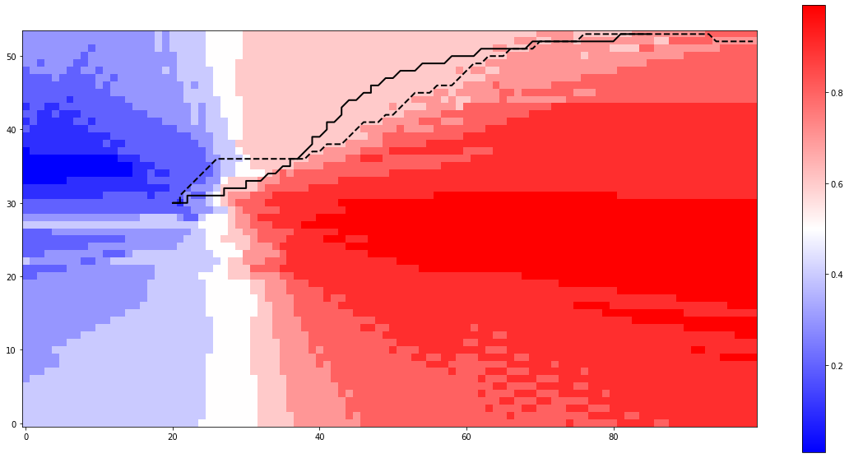
Introduction – Ball Carrier Vision
Optimized Path at Different Timesteps
OhSaquonYouSee the Optimal Path?
Ball Carrier vision can change drastically throughout the play depending on how the defense opens up and covers the field. In the example to the left, it can be seen that in the initial moments of the play there is a clear distinction of which team covers which part of the field. The solid line shows Saquon Barkley's movements as he moves through the defense in the rest of the play. The dotted line shows the optimal path calculated to avoid risk and maximize distance at the initial moments of the play. As the play moves on and the defense opens up, the optimal path is then seen exploiting the regions where there is a lower probability of encountering a defensive player. This confirms Saquon Barkley's run as the path taken that minimizes the chance of encountering a defensive player.
Ball Carrier Vision Metric Score: 1.51
HOW IT WORKS
The Path Optimization algorithm aims to find the "best" path from the ball carrier to the endzone on a specific play.
At each time step the algorithm recalculates the optimal path to maximize distance while taking the lowest amount of risk
The risk is recalculated at each time step as well by an underlying Space Ownership model that assigns probabilities to each space on the field. These probabilities indicate how likely it is that the space can be covered by an offensive player or a defensive player.
Ball Carrier Vision Metric is calculated based on actual yards gained and level of risk relative to optimal path. Lower score indicates ball carrier took optimal path
Ball Carrier Vision Metric Score: 1.02
NYG (Blue) vs. DAL (Red): Pre-handoff (top) Post-handoff (down). x After handoff, DAL field ownership weakens at left-field, which both pathfinding model (dotted) and Saquon exploits

Slide 3



Solution Architecture
The solution architecture streamlines ETL and leverages AWS Sagemaker for both modeling and visualization. AWS Quicksight was substituted for visualization to limit the steps required in evaluating, re-training, maintaining, and deployment of the solution.
The architectural design maintains scalability through query optimization and trigger calls improving resource usage and cost to compute. Due to the size and nature of the data, the instance size needs to be larger than the current instance.
S3
S3 serves as the data and script warehouse. NFL Source data stored here is queried through AWS Glue jobs containing custom Python scripts. The outputs of the script are stored as tables in the ohsaquonuc bucket folder and subsequently used to create the tables for modeling within AWS Sagemaker
AWS Glue
The solution leverages Glue’s job and crawler functionality to run Python scripts containing SQL code that query the S3 bucket. Due to difficulty with league roster data, player weight data is scraped from Pro-Football-Reference. Triggers are used to set off crawlers to add table metadata.
*Due to the security restriction of uploading third party files to the S3 bucket, we were prevented from building to full streamlined capacity. Setting up the jobs without the proper files triggers errors, so only a proposed solution could be put forward. Appendix A lays out the approach for full automation. For the project, Athena was used to query and create tables as opposed to an AWS Glue Job with an existing script
AWS Sagemaker
AWS Sagemaker houses the Jupyter Notebooks used to build and train the Space Ownership model, run the data pipeline, and feed the path optimization algorithm. Scripts are run in a specified order laid out in the Appendix

Slide 4
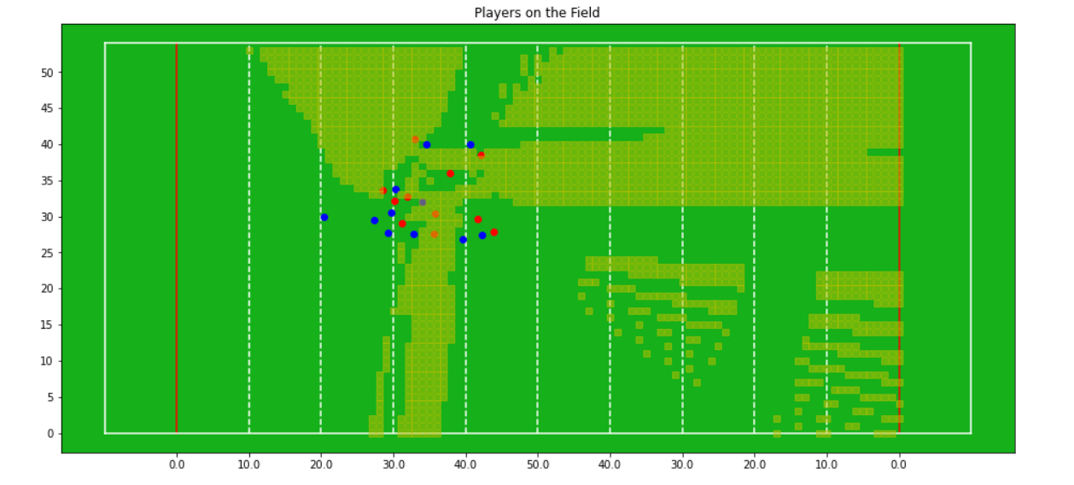
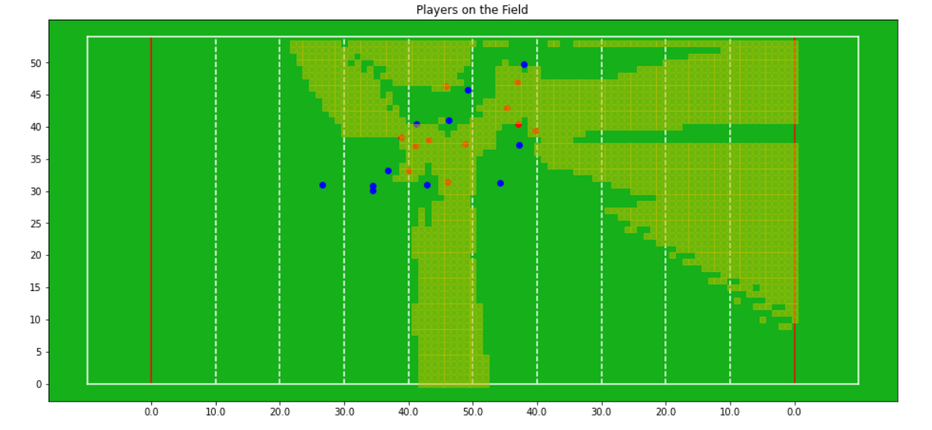
Space Ownership
Space Ownership on the field refers to which team is likely to cover which areas on the field. Ownership on the field can be described by considering many factors. In recent studies, researchers have proposed a Space Ownership model to allocate points on the field to either offense or defense. A previously proposed Space Ownership model from cutting edge research was used to simulate times on the NextGen data for a new, more powerful Space Ownership Neural Network. The previously proposed Space Ownership model considers factors such as distance from the player to the point, speed of the player, and angle of the player.
Fig 1:
Consisting of two hidden layers with 64 nodes and 32 nodes respectively, the Space Ownership Neural Network effectively learns the NextGen data to predict the time it takes for each player to reach each point on the field at a specified time.
The new Neural Network was built by considering at each time step:
Distance from player to every possible point on the field
Directional acceleration of the player
Angle of the players body
Height of the player
Weight of the player
The data used to train the Neural Network is a combination of NextGen data, NFL ScrapR data, and simulated data.
The Neural Network has a loss (Mean Square Error) of 0.0043; therefore, it is a strong predictor of space ownership.
Initially, the space in this play highlighted by the red circle is owned by the defense near the beginning of the play (Fig 1).
As Saquon beats the defensive player that came down to tackle, he gains space ownership of the area as seen in the highlighted red circle (Fig 2).
Legend:
Blue Pt = Offense Player
Red Pt = Defense Player
Yellow Area = Defensive Coverage
Fig 2:
Notes:
Exploring the Impact for Data Analysts & Coaches or Exploring the Impact for Game Preparation and Coaching
Is there another benefit & impact here so I can use future applications in the next slide (maybe Aid coaches in play calling?)

Slide 5

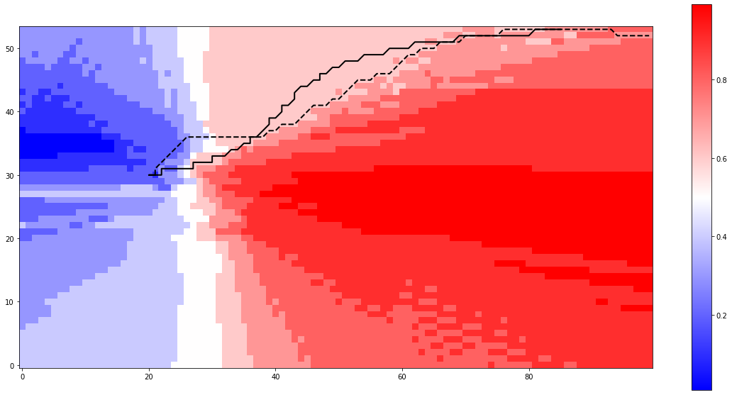

Path Optimization
Using outputs from the Space Ownership Model, we use the Dijkstra Search Algorithm to find the quickest path that exploits as much owned space as possible, i.e. path that maximizes yardage, while minimizing risk. The resulting optimal path is then compared against the actual path taken by the ball carrier to determine the Ball Carrier Vision Metric, measured at specified times
BALL CARRIER VISION METRIC
Ratio of Actual Path Risk Score over Optimal Path Risk Score – i.e. How riskier was the ball carrier’s actual path over the optimal path?
By specifying specific points in a play, metric can be further broken down to Initial Move Vision Metric (pre-handoff) and Second Move Metric (after-handoff)
MODEL IN ACTION
Figure shows field at handoff during NYG (blue) vs DAL (red), when Saquon rushed for 59 yards.
Saquon’s actual path and model’s optimal path (dash line) converge, showing that Saquon took a near-optimal path.
Saquon scores 1.02 on the Ball Carrier Vision Metric, indicating Saquon took minimal risk during the rush
Figure: NYG vs DAL, Week 1 of 2019. Play: S.Barkley up the middle pushed ob at DAL 23 for 59 yards

Slide 6



Impact
Designed to be flexible while maintaining niche and valuable insights, this solution aims to bring data driven insights to multiple stakeholders across the organization. By bringing together geospatial NextGen data, NFL ScrapR data, cutting edge research in football analytics, latest machine learning and optimization techniques this solution can effectively improve decisions made revolving around ball carriers in the NFL. The solution improves how organizations can evaluate ball carriers and track the performance for ball carriers throughout their careers. This evaluation metric solution can directly play a role in multiple areas of interest such as creating effective visualizations for geospatial field coverage analyses, designing load management plans for players, deciding when and how to offer contract extensions, evaluating prospects during recruiting/scouting.
STAKEHOLDER | DATA ANALYSTS/SPORTS SCIENTISTS | COACHES | FRONT OFFICE
IMPACT | Determining the space ownership and optimal path for ball carriers can effectively reduce time for data analysts and sports scientists aiming to evaluate player performance. The proposed solution enables: Quick access to simulated data for ball carriers Intuitive visualizations for analysts looking to gather insights about players on the field Formalized metrics to supplement further analyses on player performance Accurate and efficient models that can be applied to a wide range of analyses | Optimal path for a ball carrier and defensive coverage on the field go hand in hand. With the proposed solution, coaches will be able to accurately assess multiple factors in a matter of seconds: Where are the holes in the defensive coverage and how can they be exploited What options open up to the ball carrier as the defense changes the ball carrier's vision How does the defensive coverage change the ball carrier's vision | Front office activities can take many different forms. Whether it be scouting/recruiting, contract extensions, or trades, the proposed solution provides adaptable insights: Scouting/Recruiting – How often is a ball carrier able to adjust to defensive coverage Contract Extension – Is this player improving their ball carrier vision or are they deteriorating (historical tracking of a player's ball carrying metric)
Notes:
Exploring the Impact for Data Analysts & Coaches or Exploring the Impact for Game Preparation and Coaching
Is there another benefit & impact here so I can use future applications in the next slide (maybe Aid coaches in play calling?)

Slide 7
Appendix

Slide 8
Appendix A: ETL Process
As mentioned in the Solution Architecture slide, environmental limitations prevented file upload and disrupted the ability to full streamline the ETL.
Below is a proposed solution to automate the ETL process
AWS S3
Store Scripts and Table Data
Contains the Python script that uploads tracking data and scrapes player weights
AWS Glue
Streamline ETL with Jobs and Crawlers
AWS Glue leverages jobs that can be set off by triggers with its workflow capability to run scripts on a timed basis
AWS Sagemaker
Build, Train, and Deploy Models
AWS Sagemaker’s Jupyter IDE maintains the notebook that creates and trains the space ownership model to be fed to the path optimization algorithm.
Contains the table data and acts as the trigger to set off an AWS Glue Crawler to store metadata and make available for query into Sagemaker
These jobs take an existing Python script that creates the aforementioned data and then sends the data to S3 for the Crawler to use
Using the model’s .predict() method call, new data can be fed in and easily extracted and operationalized
If cost is of concern, users can leverage AWS Athena to query the data in multiple iterations. This is what we used given limitations. See Appendix B
Notes:
Exploring the Impact for Data Analysts & Coaches or Exploring the Impact for Game Preparation and Coaching
Is there another benefit & impact here so I can use future applications in the next slide (maybe Aid coaches in play calling?)

Slide 9
Appendix B: Athena and Sagemaker Query Step-By-Step
As mentioned in Appendix A, due to environmental constraints we used AWS Athena to run queries and create data on the fly. The queries in Athena are saved as a text file in the Github submission. The graphic below shows queries that run sequentially, however, queries in the top graphic can run at the same time as those in the bottom.
Initial Tracking Data
Home_tracking and away_tracking
Adding PlayIDs and for Runs and Passes
Nflscrapr_data
Tracking_playid_w_playtype
Final table product
Weight and Height Scraper.py (then uses Crawler to ad to S3, this is in Jupyter notebook run in Sagemaker)
Tracking_data_weight_nulls
Years need to be changed for all tables as load times for multiple years will timeout
Balltracking_data
Tracking_ball_and_player_data
Tracking_data_pre_weights
Weightand_height_averages
All_tracking_data
Notes:
Exploring the Impact for Data Analysts & Coaches or Exploring the Impact for Game Preparation and Coaching
Is there another benefit & impact here so I can use future applications in the next slide (maybe Aid coaches in play calling?)

Slide 10
Appendix C: Model Visuals
Saquon Barkley
Legend:
Blue Pt = Offense Player
Red Pt = Defense Player
Yellow Area = Defensive Coverage
Defensive Player
This figure shows the initial to mid timesteps of the play. Here Saquon has taken the ball and is proceeding to move up the field. The defense was able to read the play and quickly brought down a player to pick up Saquon as he was breaking out. Note the entire area in the red circle is covered by the defense currently. This area in the red circle shows that the defense is able to cover this entire area better than the offense..
Notes:
Exploring the Impact for Data Analysts & Coaches or Exploring the Impact for Game Preparation and Coaching
Is there another benefit & impact here so I can use future applications in the next slide (maybe Aid coaches in play calling?)

Slide 11
Appendix D: Model Visuals
Saquon Barkley
Legend:
Blue Pt = Offense Player
Red Pt = Defense Player
Yellow Area = Defensive Coverage
Defensive Player
This figure shows the late timesteps of the play. Here Saquon has beaten the player that the defense brought down to cover him. Since Saquon beat the player and is progressing up field he gains ownership of the area in the red circle that previously was being covered by the defense. The defensive player who had coverage in that area got beat by Saquon and lost his angular advantage and angular acceleration advantage to cover the area in the red circle. Now the defensive player is trailing and trying to catch up to Saquon who's momentum is greater towards the circled area. This contributed to Saquon overtaking the ownership of the area in that circle and increasing his vision.
Notes:
Exploring the Impact for Data Analysts & Coaches or Exploring the Impact for Game Preparation and Coaching
Is there another benefit & impact here so I can use future applications in the next slide (maybe Aid coaches in play calling?)

Slide 12
Appendix E: Model Visuals
Legend:
Blue = Offense Ownership
Red = Defense Ownership
White = Contest Ownership
Solid Line = Actual Path
Dash Line = Optimal Path
Figure: NYG vs DAL, Week 1 of 2019. Play: S.Barkley up the middle pushed ob at DAL 23 for 59 yards
Space Ownership and Actual/Optimal Paths on Pre-handoff field
Ball Carrier Metric Score: 1.51
Notes:
Exploring the Impact for Data Analysts & Coaches or Exploring the Impact for Game Preparation and Coaching
Is there another benefit & impact here so I can use future applications in the next slide (maybe Aid coaches in play calling?)

Slide 13
Appendix E: Model Visuals
Legend:
Blue = Offense Ownership
Red = Defense Ownership
White = Contest Ownership
Solid Line = Actual Path
Dash Line = Optimal Path
Figure: NYG vs DAL, Week 1 of 2019. Play: S.Barkley up the middle pushed ob at DAL 23 for 59 yards
Space Ownership and Actual/Optimal Paths on Post-handoff field
Ball Carrier Metric Score: 1.02
Notes:
Exploring the Impact for Data Analysts & Coaches or Exploring the Impact for Game Preparation and Coaching
Is there another benefit & impact here so I can use future applications in the next slide (maybe Aid coaches in play calling?)

Slide 14
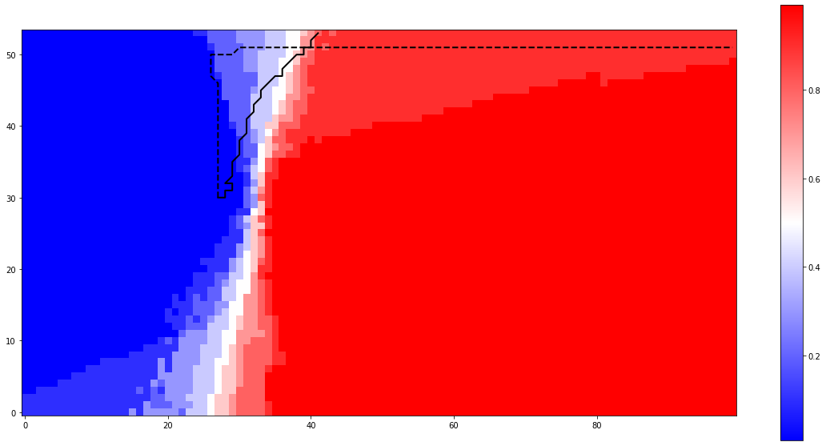
Appendix E: Model Visuals
Legend:
Blue = Offense Ownership
Red = Defense Ownership
White = Contest Ownership
Solid Line = Actual Path
Dash Line = Optimal Path
Figure: NYG vs TB, Week 3 of 2019. Play: (Shotgun) D.Jones pass short left to S.Barkley to NYG 30 for 6 yards (M.Edwards).
Space Ownership and Actual/Optimal Paths on Post-handoff field
Ball Carrier Metric Score: 3.35
Notes:
Exploring the Impact for Data Analysts & Coaches or Exploring the Impact for Game Preparation and Coaching
Is there another benefit & impact here so I can use future applications in the next slide (maybe Aid coaches in play calling?)

Slide 15
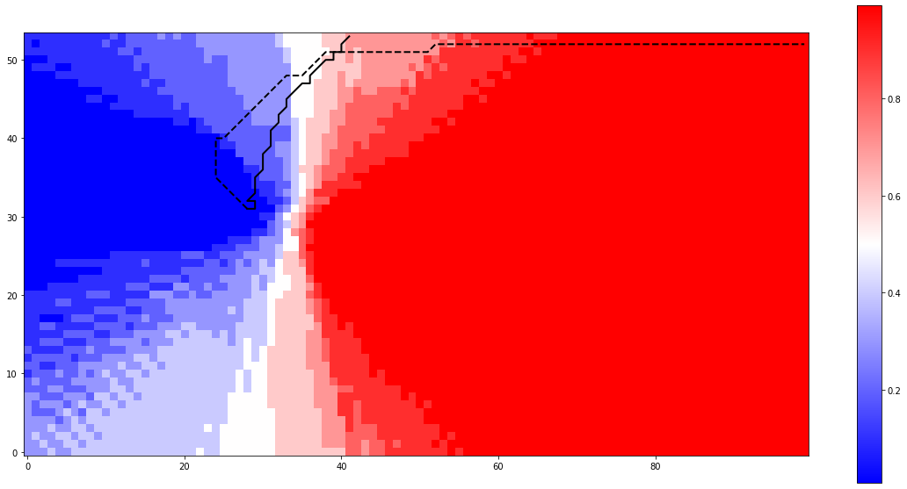
Appendix E: Model Visuals
Legend:
Blue = Offense Ownership
Red = Defense Ownership
White = Contest Ownership
Solid Line = Actual Path
Dash Line = Optimal Path
Figure: NYG vs TB, Week 3 of 2019. Play: (Shotgun) D.Jones pass short left to S.Barkley to NYG 30 for 6 yards (M.Edwards).
Space Ownership and Actual/Optimal Paths on Post-handoff field
Ball Carrier Metric Score: 1.21
Notes:
Exploring the Impact for Data Analysts & Coaches or Exploring the Impact for Game Preparation and Coaching
Is there another benefit & impact here so I can use future applications in the next slide (maybe Aid coaches in play calling?)

Slide 16
Appendix F: Research Paper
A Trajectory Planning Algorithm for Quantifying Space Ownership in Professional Football; Kyle Burris, January 2019; https://github.com/burrisk/Big-Data-Bowl/blob/93184a92c3a56bcaae9582e3e9b8221c37358e2b/Paper/NFL_Space_Creation.pdf
Notes:
Exploring the Impact for Data Analysts & Coaches or Exploring the Impact for Game Preparation and Coaching
Is there another benefit & impact here so I can use future applications in the next slide (maybe Aid coaches in play calling?)

