Slide 1
LLRP Commander
User Guide
June, 2009

Slide 2
Content
Install the Eclipse Plug-In
Setup Emulator Environment
Manage Reader
View Message History
Create New Messages with the Message Wizard
Assemble Messages in Graphical Editor
Edit Messages in XML Editor
View Messages in Binary Format
Send Messages

Slide 3
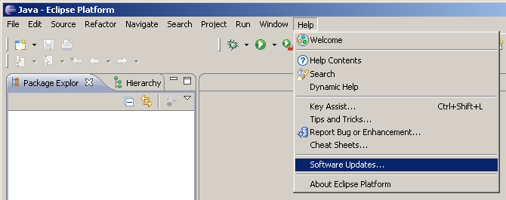
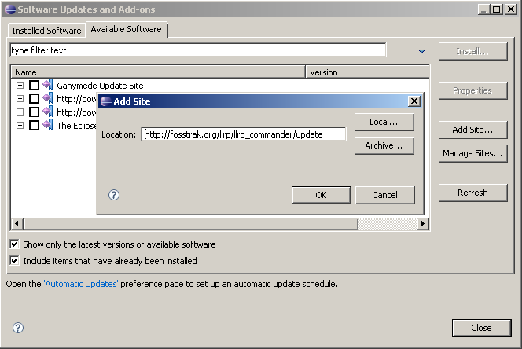
Installation via Eclipse update manager
1. Open Eclipse update manager
2. Add new update site:
“http://fosstrak.org/llrp/llrp_commander/update“

Slide 4
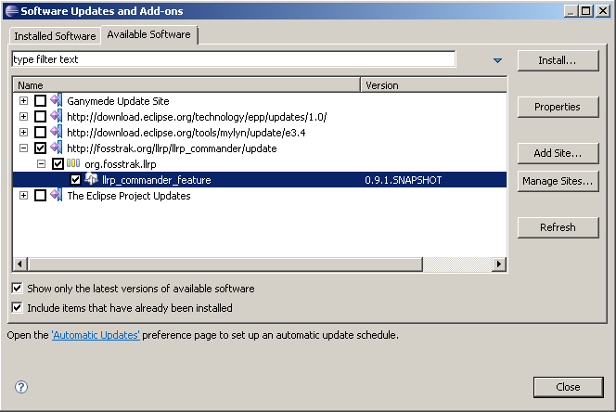
Installation via Eclipse update manager (cont‘d)
3. Select the LLRP Commander
and press „Install“
4. Follow the installation instructions.
Please restart Eclipse when the update manager proposes to do so.

Slide 5
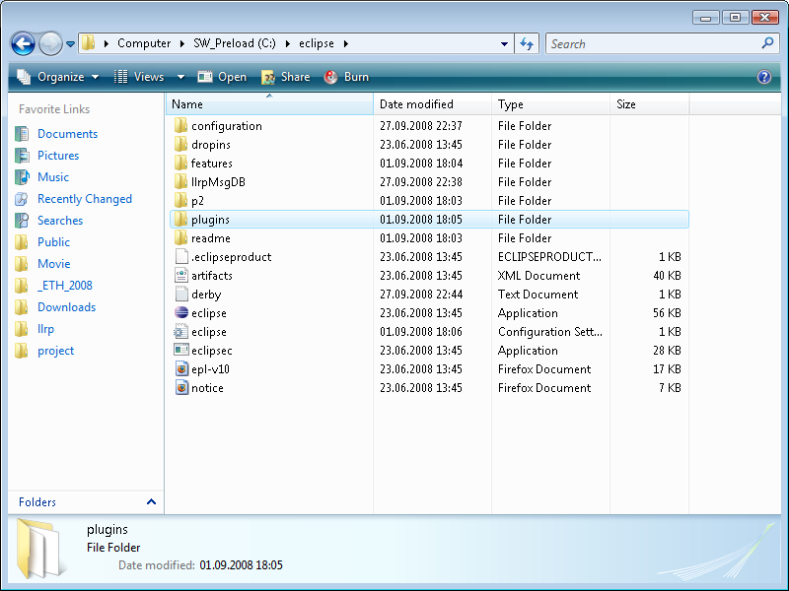
Manual Installation
Prerequisites:
Java 1.5
Eclipse >= 3.3.0
Installation of the LLRP Commander:
Download llrp_commander_<VERSION>.zip from
http://maven-repository. fosstrak.org/releases/org/fosstrak/llrp
Extract the zip file into the subfolder „plugins“ of Eclipse‘s home directory.

Slide 6
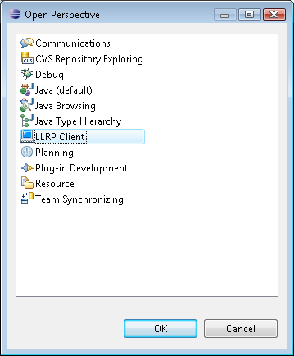
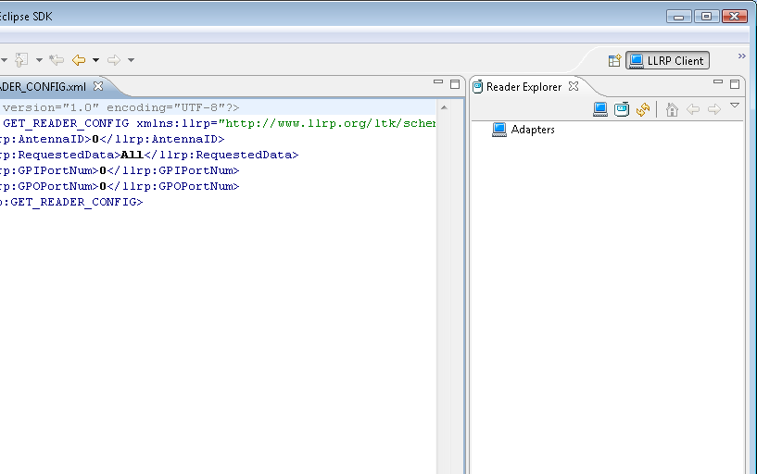
Start Eclipse and open “LLRP Commander” perspective

Slide 7
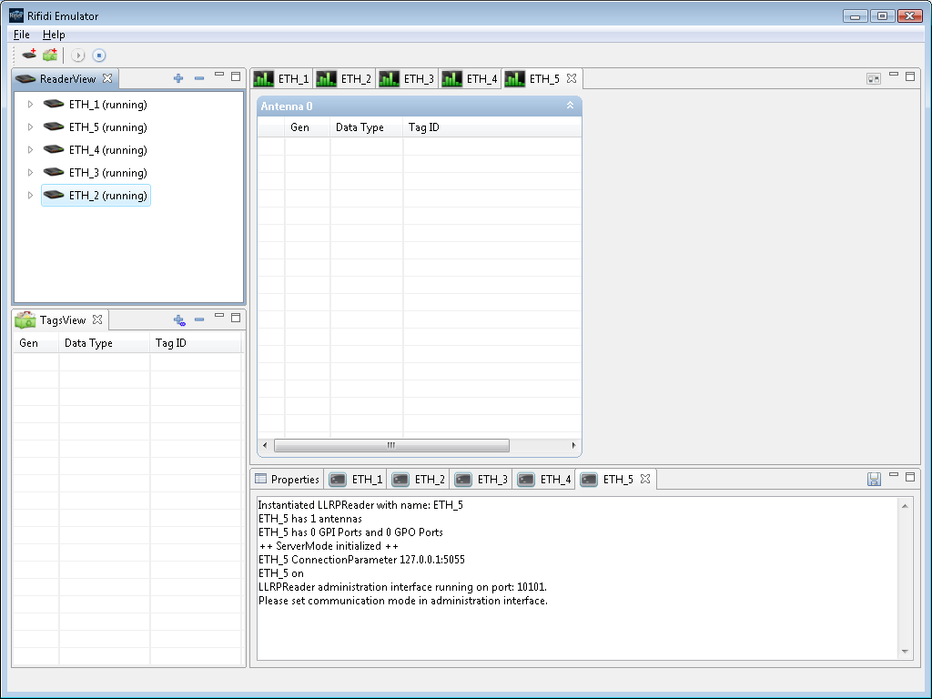
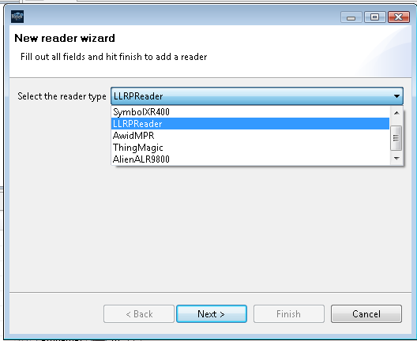
Setup Rifidi Emulator
If you don’t have a Hardware RFID Reader available, you can test the LLRP Commander with the Rifidi Software Reader:
Setup the Rifidi Emulator via http://www.rifidi.org/
Create a reader of type „LLRPReader“ and set it to „running“.

Slide 8
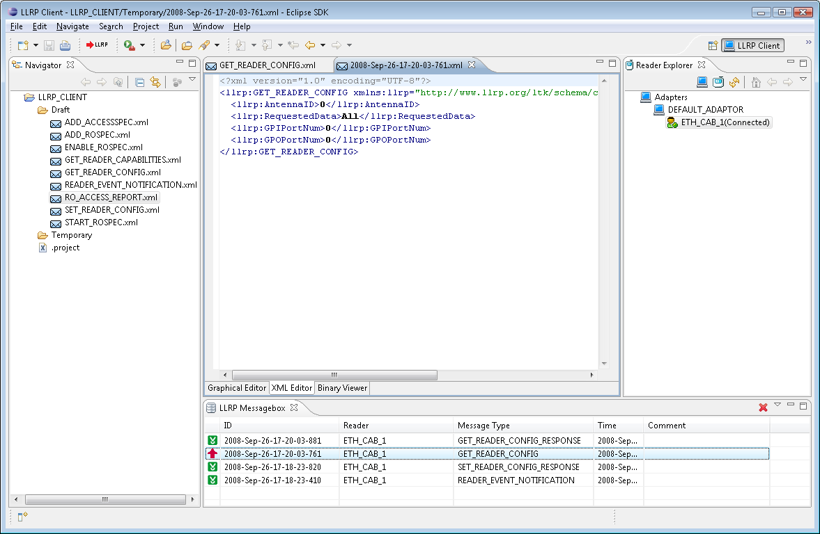
LLRP Commander Perspective
4. Reader Explorer
2. Multi-Page Editor
1. Project Navigator
3. Message Box

Slide 9
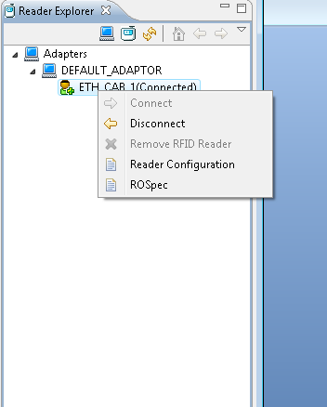
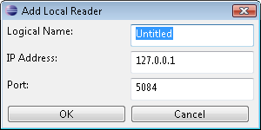
Reader Management
Context Menu
Status (Connected/Disconnected) Indicator

Slide 10
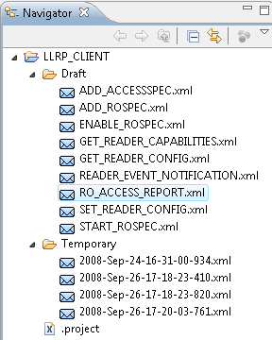
Project Navigator
The LLRP commander needs a Eclipse project to store editable messages. You can either define a specific project in the Preference Page, or use the default “LLRP_CMDR” project folder.
The LLRP commander automatically generates two folders for the project folder:
Draft: to hold the pre-built sample LLRP message files;
Temporary: to hold the incoming message files when users load them from the repository.
When you modify the files in the “Temporary” folder, the changes will not be written to the Repository. In addition, if you purge the JavaDB, the files under “Temporary” folder will not be removed.
Every time Eclipse starts up, the “Health Check” can detects whether the project exists or the folder structure is corrupted. If yes, you can easily recover it by the “Auto Fix” function.

Slide 11
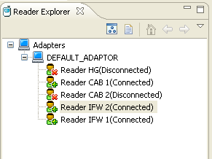
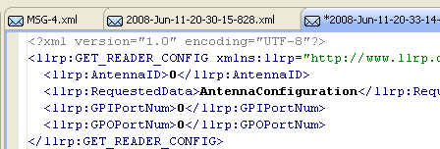
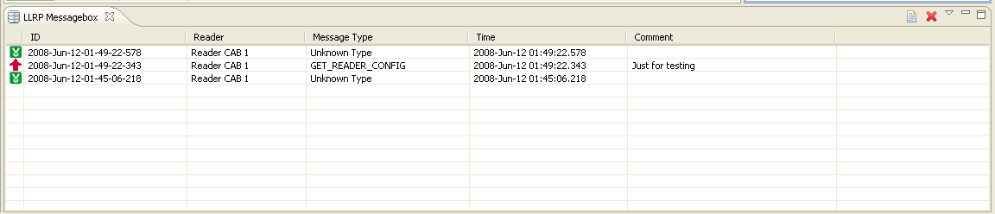
View Message History
Double-Click Message Item to load the message to editor.
Click on a specific reader to filter the Message list.
Request/Response Indicator

Slide 12
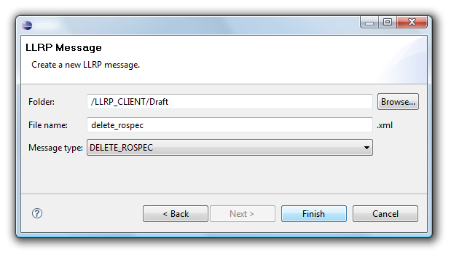
“New LLRP Message” Wizard
The “New LLRP Message” wizard assists you in creating new LLRP messages from scratch. To start the wizard choose File/New/Other…/LLRP/LLRP Message.
After pressing “Finish” a new message of the selected type will be created in the specified folder with the given file name. The message will have all fields initialized by default values and all mandatory parameters set. It will be automatically opened in the editor where you can adapt it to your needs.

Slide 13
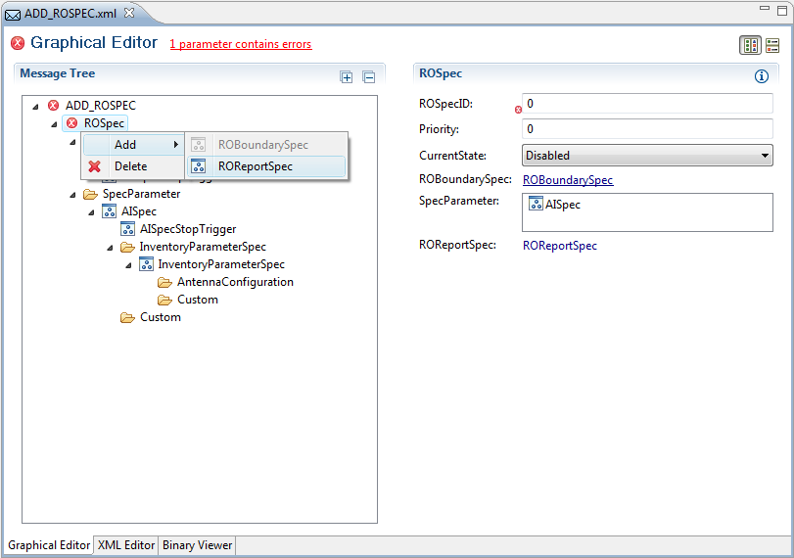
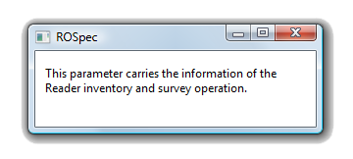
Graphical Editor
Expand all tree elements.
Set vertical or horizontal orientation.
Click on hyperlink to jump to the invalid parameter.
Collapse all tree elements.
Move mouse over error icon to get information on why the field value is invalid.
Right-click on a tree element to delete it or to add new sub-parameters.
Show information about the parameter.

Slide 14
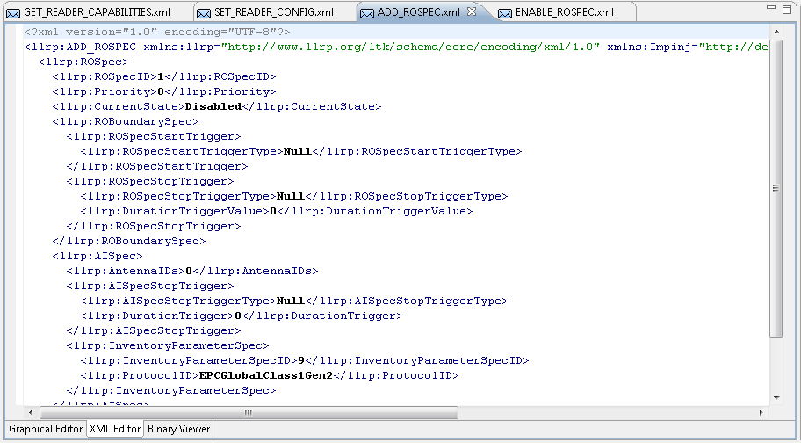
XML Message Editor

Slide 15
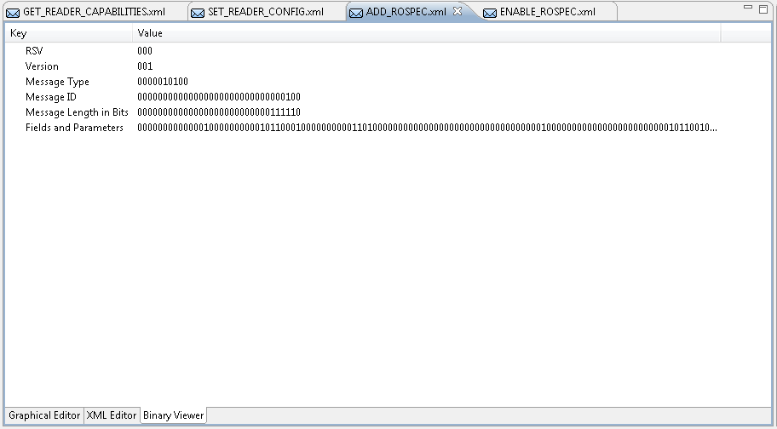
Binary Viewer

Slide 16
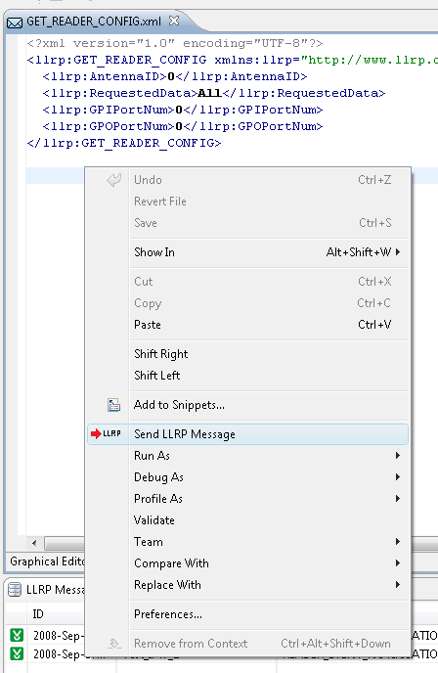
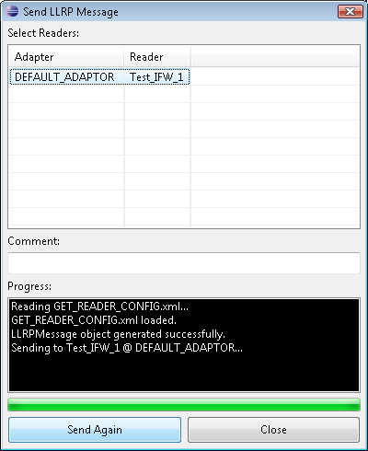
Send Messages
To send a message, proceed as follows:
Open the message in the editor.
Click on “Send LLRP Message” in the context menu of the xml editor/binary viewer or on the “Send LLRP Message” icon in the toolbar.
All connected readers are listed here. You can select multiple readers to send the message to multiple readers simultaneously.
You can see the sending progress here (Text and Percentage)

