Slide 1
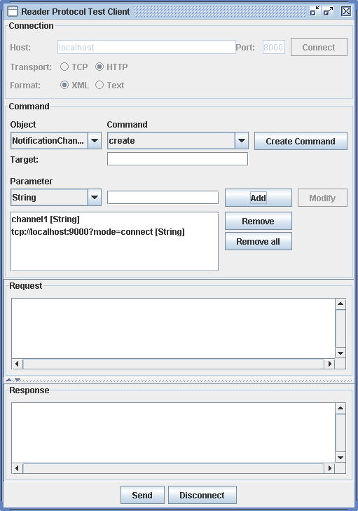
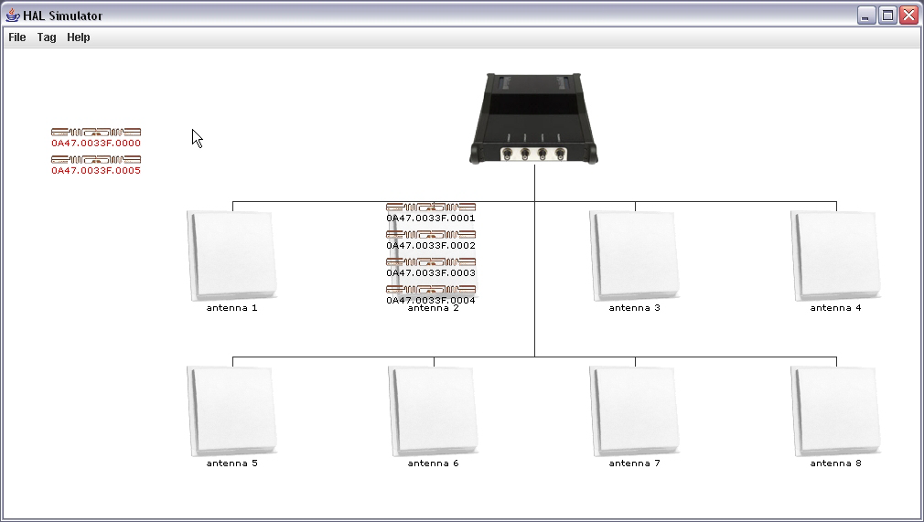
JAVA INTERFACE TO SIMPLIFY COMMUNICATION WITH READER
// init handshake
Handshake handshake = new Handshake();
handshake.setTransportProtocol(Handshake.HTTP);
handshake.setMessageFormat(Handshake.FORMAT_XML);
// get reader device
readerDevice = ReaderDeviceFactory.getReaderDevice(HOST,
PORT, handshake);
TEST CLIENT
WITH
GRAPHICAL USER
INTERFACE
Reader Proxy
Reader Test Client
TCP/HTTP
TCP/HTTP
XML/
Text
XML/
Text
TCP/HTTP
Reader
Filtering, Event Generation, Synchronous/Asynchronous Data Dissemination as specified in EPCglobal Reader Protocol
Softronica
Feig
Hitachi
…
Simulator
BUILT-IN SUPPORT FOR READERS NOT SUPPORTING THE EPCGLOBAL READER PROTOCOL YET
BUILT-IN SIMULATOR FRAMEWORK

