Slide 1

基於AXI-4界面的安全雜湊演算法
SHA-3的IP設計與驗證
The Design and Verification of an IP for Secure Hash Algorithm SHA-3 with AXI-4 Interface
研究生：洪綺妤
指導教授：林銘波 博士
中華民國 110 年 8 月 25 日

Slide 2
O
大綱
UTLINE
01
Motivation
05
Simulation and Results
02
Related Work
06
Conclusions and Future Work
03
Architecture
References
07
04
Implementation

Slide 3
PART
01
Motivation

Slide 4





01
Motivation
Cryptography
Cryptography
Darth
H
MD5
SHA-1、2、3
Hash
E
Morse Code
Encoding
S
DES
AES
Symmetric
A
Asymmetric
RSA
Alice
4
Bob
Notes:
接下來先講一下密碼學，上面這個是Alan，它要將一明文傳送給David，然而在傳送過程中Neri出現並且進行攔截，在把被修改過的資料傳給David ，此時David 收到的資料就會有錯誤。
為了防止這種情況發生，在重要文件上就會進行加密，但是加密系統只能保證資料的安全性，無法保證資料的完整性，也就是說一個盒子給他一把鑰匙可以保證它的安全，但你不曉得你打開時候裝在裡面的東西是否跟一開始裝在裡面的東西一樣，因此確認資料的完整性也很重要。

Slide 5
01
Motivation
Message Authentication
Authentication
Source A
Destination B
1
M
M
M
H
E
D
H
H
H
Compare
K
E(K, [M || H(M)])
K
Source A
Destination B
M
M
2
H
K
Compare
H
D
H
E
M || E(K, H(M))
K
5
Notes:
明明與明文串連後進行加密，解密後進行資料的驗證
對稱加密紙加密了雜湊值，這個方法可以減少負擔不需保密的明文，但依樣可以確認資料完整性

Slide 6
01
Motivation
Message Authentication
Authentication
Source A
Destination B
3
M
M
H
S
H
S
H
Compare
M || [H(M || S)]
Source A
Destination B
4
M
M
M
H
E
D
S
H
S
H
H
Compare
M || [H(M || S)]
E(K, [M || H(M || S)])
M || [H(M || S)]
K
K
6
Notes:
為明文加上雙方持有的機密值進行雜湊函數的運算後再串上明文，因為機密值本身並未公開，因此第三方無法進行截取及產生錯誤的消息。
為方法(三)的進階版，會對串聯明文與雜湊值後的資料進行對稱加密
本篇論文將做雜湊函數那一個部分，其它部分可以讓使用者依照想選擇的加密演算法去做加密。

Slide 7
PART
Related Work
02
Secure Hash Algorithm ( SHA )
Advanced eXtensible Interface ( AXI )

Slide 8
02
Related Work
Secure Hash Algorithm
SHA
In 2007, NIST solicited new algorithms.
In 2012, it was announced that the KECCAK algorithm won.
In 2018, officially published by NIST.
SHA-3
In 2017, it was Declared breached.
SHA-1
1993
1995
2001
2015
SHA-0
The cycle after the release was withdrawn by the NSA.
The predecessor of SHA-1.
SHA-2
There are currently no obvious weaknesses.
The algorithm is still basically similar to SHA-1.
8
Notes:
SHA-3 的家族成員分了兩種如圖2-2所示，四個加密雜湊函數、兩個可擴展輸出函數。加密雜湊函數與可擴展輸出函數的差別在於前者是選擇好哪一個雜湊容量後就決定好輸出的長度；後者是可以決定輸出的長度，而輸入的明文長度則一樣都是沒有限制的

Slide 9
02
Related Work
Secure Hash Algorithm
SHA-3
Cryptographic hash functions
SHA3-224
SHA3-256
SHA3-384
SHA3-512
Extendable-output functions (XOF)
SHAKE128
SHAKE256
SHA-3
9
Notes:
SHA-3 的家族成員分了兩種如圖2-2所示，四個加密雜湊函數、兩個可擴展輸出函數。加密雜湊函數與可擴展輸出函數的差別在於前者是選擇好哪一個雜湊容量後就決定好輸出的長度；後者是可以決定輸出的長度，而輸入的明文長度則一樣都是沒有限制的

Slide 10
02
Related Work
Secure Hash Algorithm
SHA-3
Characteristics of the hash function:
Weak collision resistant
Strong collision resistant
Variable
size
+
One-way property
+
+
+
Pseudo-
randomness
A function that is strong collision resistant is also weak collision resistant, but the reverse is not necessarily true.
A function can be strong collision resistant but not one-way property and vice versa.
A function can be one-way property but not weak collision resistant and vice versa.
10
Notes:
任意長度的明文輸入、可變長度的雜湊值輸出。
原像防禦（Preimage resistant）為單向性( one-way property )，即無法利用雜湊值回推明文的內容。
弱碰撞防禦（Second preimage resistant或weak collision resistant )：就是給定一個明文m1時，很難找到另一個明文m2，它們的雜湊值是相同的。
強碰撞防禦(Collision resistance或strong collision resistant)：就是很難找到兩個不同的明文m1和m2，使得h (m1) = h (m2) 它們的雜湊值是相同的。
假亂數性（Pseudorandomness）
強抗恐怖的功能也是弱抗性的，但很快就開始了。
一個函數可以是強抗暴的，但不是單向屬性，反之亦然。
一個函數可以是單向屬性，但不是弱抗負面性，反之亦然。

Slide 11
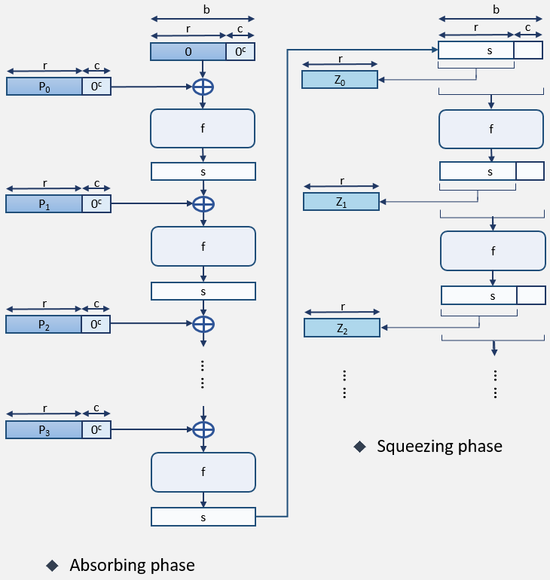
02
Related Work
Sponge Construction
SHA-3
11
Notes:
接下來要介紹海綿結構
海綿結構分成兩個階段，第一個是吸收階段，另一個為擠壓階段
會將訊息分成好幾塊，並依序處理，每個迭代後與新的明文進行XOR在迭代一次，最後會產生出雜湊值。

Slide 12

02
Related Work
Sponge Construction
SHA-3
k $×$ r bits
n bits
message
pad
r bits
r bits
r bits
r bits
P₀
P₁
P₂
… …
P_{k-1}
input
l bits
r bits
r bits
r bits
Z₀
Z₁
Z₂
… …
Z_{j-1}
output
12
Notes:
由圖中可以看到明文被切割成好幾個大小為R的區塊，而最後一塊不族R的區塊會使用填補得方法進行填補，等一下為講解PAD的方法

Slide 13
02
Related Work
Sponge Construction
SHA-3
A measure of the achievable level of security.
Ex: SHA3-384
c ( Capacity )
b ( 1600 bits )
01
02
03
r ( Bitrate )
b ( Width )
r ( 832 bits ) c ( 768 bits )
c ( 768 bits )
The size of the message when it is divided into blocks.
KECCAK-p the number of required width bits for replacement.
P₀
000 …00
13
Notes:
R 為每個輸入區塊的大小，叫做彼特率
C可以用來衡量兒全性的容量
B為KECCAK-p 替換所需的寬度位數。

Slide 14
02
Related Work
KECCAK-p
SHA-3
Parameters:
Word construction:
The number of iterations of internal replacement and permutation.
Can be any integer.
Five permutation and permutation mapping steps are composed.
n_{r} ( Round )
Step mapping
A
B
01
02
03
b ( Width )
State
Rnd
KECCAK-p the number of required width bits for replacement.
The number of rounds in KECCAK-p.
The updated number of b bits is called the state.
b | 25 | 50 | 100 | 200 | 400 | 800 | 1600
w | 1 | 2 | 4 | 8 | 16 | 32 | 64
l | 0 | 1 | 2 | 3 | 4 | 5 | 6
14
Notes:
要被置換、排列的字串的固定長度，稱為b。
內部被置換、排列的迭代次數，稱為 n _{r} (回合)。
b 可以為{ 25 , 50, 100, 200, 400, 800, 1600 }。
n _{r} 可以為任意整數。
Rnd 表示在KECCAK-p裡的回合數。
映射步驟（Step mapping）：表示五個置換、排列的映射步驟組成。
狀態（State）：每一次置換、排列更新後的B個位元組為STATE，初此狀態為0

Slide 15

02
Related Work
KECCAK-p
SHA-3
KECCAK
Defaults:
c = 1024 bits
r = 576 bits
b = 1600 bits
y
z
x
state
Step mapping:
$θ$ ( Theta )
$ρ$ ( Rho )
$π$ ( Pi )
$χ$ ( Chi )
$ι$ ( Iota )
plane
slice
sheet
row
column
lane
15
bit
Notes:
狀態數組是意圖
Keccak定義之默認值
步驟有五個
更新後的B個位元組為STATE，初此狀態為0

Slide 16
02
Related Work
KECCAK-p
SHA-3
W-1
W-2
.
.
.
3
2
1
0
z
Encryption type | 224 | 256 | 384 | 512
Message Digest Size | 224 | 256 | 384 | 512
Message Size | Unlimited | Unlimited | Unlimited | Unlimited
b | 1600 | 1600 | 1600 | 1600
Capacity: c | 448 | 512 | 768 | 1024
Bitrate: r ( Block Size ) | 1152 | 1088 | 832 | 576
Word Size | 64 | 64 | 64 | 64
Number of Rounds | 24 | 24 | 24 | 24
Strong Collision Resistant | 2¹¹² | 2¹²⁸ | 2¹⁹² | 2²⁵⁶
Weak Collision Resistant | 2²²⁴ | 2²⁵⁶ | 2³⁸⁴ | 2⁵¹²
2
1
0
4
3
y
3 4 0 1 2
x
16
Notes:
更新後的B個位元組為STATE，初此狀態為0

Slide 17
02
Related Work
Padding
SHA-3
…
message
pad
Simple padding:
The filling method is to pad10(0*).
Multi-rate padding:
The filling method is to pad10(0*)1.
…
r bits
r bits
…
P_{k-2}
P_{k-1}
17

Slide 18
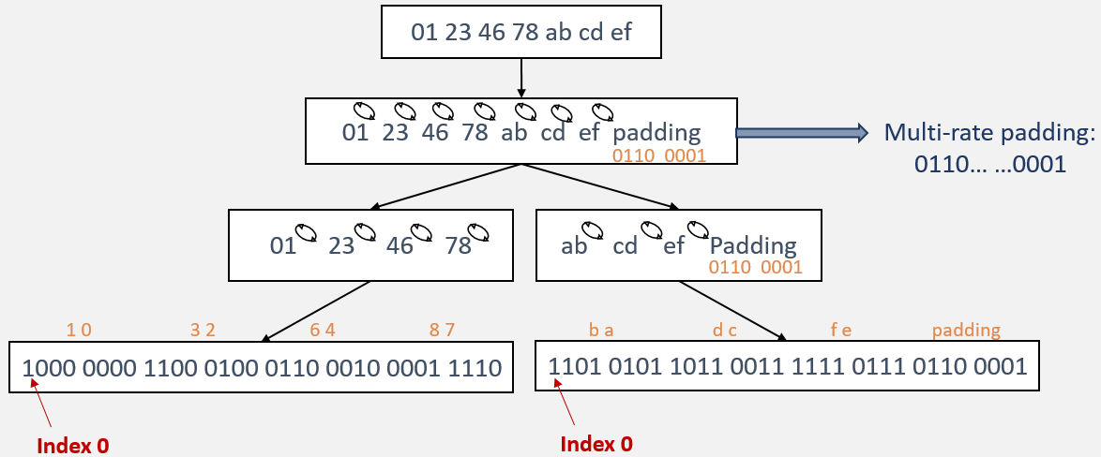
02
Related Work
Multi-Rate Padding
SHA-3
Method 1
18
Notes:
更新後的B個位元組為STATE，初此狀態為0

Slide 19
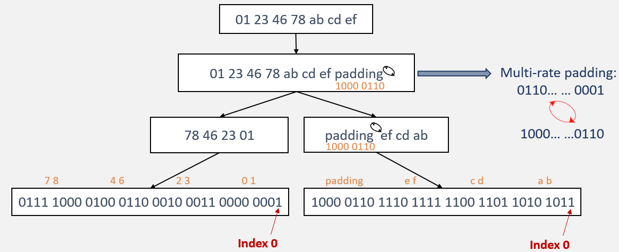
02
Related Work
Multi-Rate Padding
SHA-3
Method 2
19
Notes:
更新後的B個位元組為STATE，初此狀態為0

Slide 20
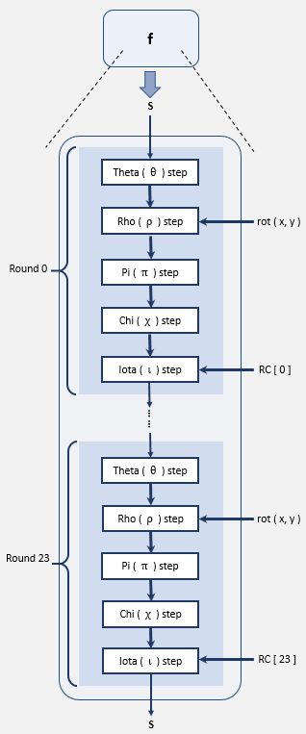

02
Related Work
Iteration Function f
SHA-3
Rnd ( A，i_{r} ) = $ι ( χ ( π ( ρ ( θ \left(A\right) ) )$ )，i_{r} )
Iterative function:
Number of processing bits: 1600 bits
Processing matrix: 5×5×64
f function rounds: 24 rounds
5 steps per round
20
Notes:
更新後的B個位元組為STATE，初此狀態為0

Slide 21





02
Related Work
Iteration Function f
SHA-3
Theta
Substitution
Pi
Permutation
Iota
Substitution
$$ρ$$
$$χ$$
$$θ$$
$$π$$
$$ι$$
Rho
Permutation
Chi
Substitution
21

Slide 22
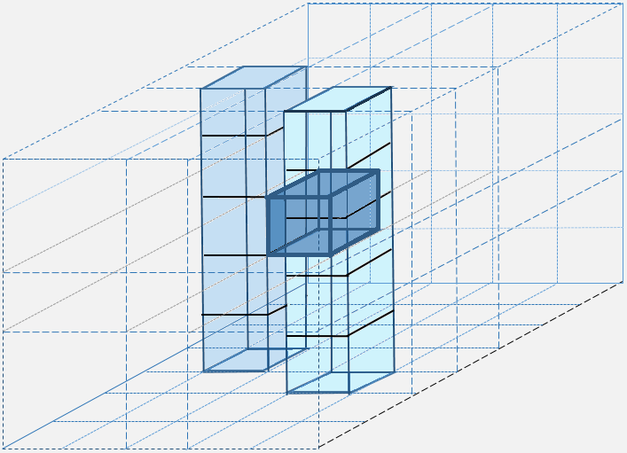




02
Related Work
Iteration Function f
SHA-3
1 Theta $θ$
H [ x, z ] = A [ x,0,z ] A [ x,1,z ] A [ x,2,z ] A [ x,3,z ] A [ x,4,z ]
D [ x, z ] = H [ (x-1)mod 5, z ] H [ (x+1)mod 5, (z-1)mod w ]
A’ [ x, y, z ] = A [ x, y, z ] D [ x, z ]
y
z
22
x
Notes:
更新後的B個位元組為STATE，初此狀態為0

Slide 23
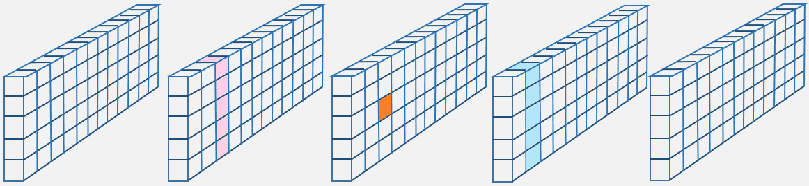



02
Related Work
Iteration Function f
SHA-3
1 Theta $θ$
y
z
23
x
Notes:
更新後的B個位元組為STATE，初此狀態為0

Slide 24
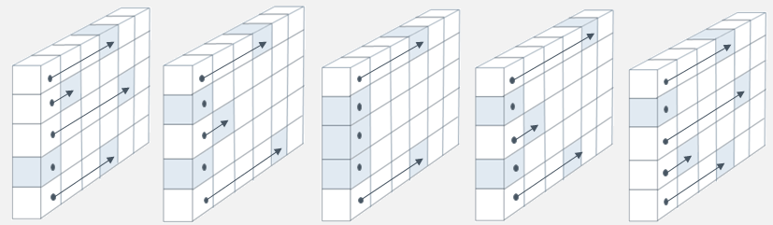

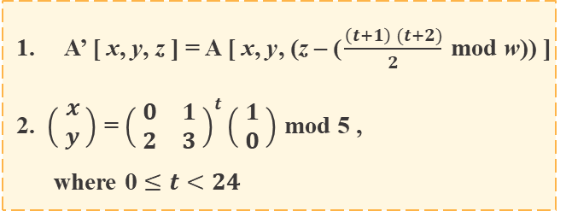
02
Related Work
Iteration Function f
SHA-3
2 Rho$ρ$
y
z
x
 | x = 3 | x = 4 | x = 0 | x = 1 | x = 2
y = 2 | 153 | 231 | 3 | 10 | 171
y = 1 | 55 | 276 | 36 | 300 | 6
y = 0 | 28 | 91 | 0 | 1 | 190
y = 4 | 120 | 78 | 210 | 66 | 253
y = 3 | 21 | 136 | 105 | 45 | 15
A’ [ x, y, z ] = A [ x, y, (z – ($\frac{\left(t+1\right) (t+2)}{2}$ mod w)) ]
2. $\left( \begin{matrix}x \\ y\end{matrix} \right)$ = ${\left( \begin{matrix}0 & 1 \\ 2 & 3\end{matrix} \right)}^{t}\left( \begin{matrix}1 \\ 0\end{matrix} \right)$ mod 5 ,
where 0 $≤t<24$
24
Notes:
更新後的B個位元組為STATE，初此狀態為0

Slide 25
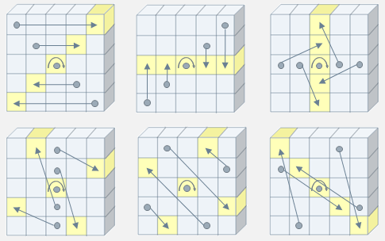

02
Related Work
Iteration Function f
SHA-3
3 Pi$π$
y
z
x
A’ [ x, y, z ] = A [ (x + 3y)mod 5, x, z ]
25
Notes:
更新後的B個位元組為STATE，初此狀態為0

Slide 26

02
Related Work
Iteration Function f
SHA-3
4 Chi $χ$
y
z
x
A’ [ x, y, z ] = A [ x, y, z ] ( ( not ( A [ (x+1) mod 5, y, z ] ) ) · A [ (x+2)mod 5, y, z ] )
26
Notes:
更新後的B個位元組為STATE，初此狀態為0

Slide 27

02
Related Work
Iteration Function f
SHA-3
5 Iota$ι$
A ‘ [ 0, 0, z ] = A [ 0, 0, z ] RC [ z ]
Round | Constant | Round | Constant
0 | 0000_0000_0000_0001 | 12 | 0000_0000_8000_808B
1 | 0000_0000_0000_8082 | 13 | 8000_0000_0000_008B
2 | 8000_0000_0000_808A | 14 | 8000_0000_0000_8089
3 | 8000_0000_8000_0000 | 15 | 8000_0000_0000_8003
4 | 0000_0000_0000_808B | 16 | 8000_0000_0000_8002
5 | 0000_0000_8000_0001 | 17 | 8000_0000_0000_0080
6 | 8000_0000_8000_8081 | 18 | 0000_0000_0000_800A
7 | 8000_0000_0000_8009 | 19 | 8000_0000_8000_000A
8 | 0000_0000_0000_008A | 20 | 8000_0000_8000_8081
9 | 0000_0000_0000_0088 | 21 | 8000_0000_0000_8080
10 | 0000_0000_8000_8009 | 22 | 0000_0000_8000_0001
11 | 0000_0000_8000_000A | 23 | 8000_0000_8000_8008
27
Notes:
更新後的B個位元組為STATE，初此狀態為0

Slide 28
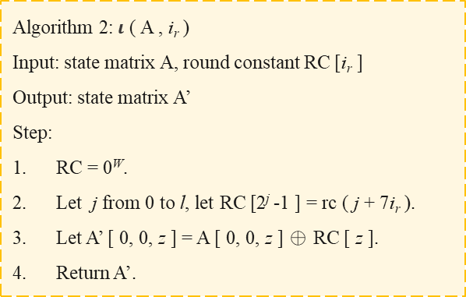
02
Related Work
Iteration Function f
SHA-3
5 Iota$ι$
Algorithm 1: rc (t)
Input: integer t
Output: rc (t) the bit value of the round constant
Step:
If the factor of t divided by 255 is 0, 1 is returned.
Let R = 1000_0000.
Let i divide from 1 to t by 255,
R = 0 || R;
R [ 0 ] = R [ 0 ] ⊕ R [ 8 ];
R [ 4 ] = R [ 4 ] ⊕ R [ 8 ];
R [ 5 ] = R [ 5 ] ⊕ R [ 8 ];
R [ 6 ] = R [ 6 ] ⊕ R [ 8 ];
R = Trunc₈ [R];
Return R [ 0 ].
Algorithm 2:$ι$ ( A , i_{r} )
Input: state matrix A, round constant RC [i_{r} ]
Output: state matrix A’
Step:
RC = 0^{W}.
Let j from 0 to l, let RC [2^{j} -1 ] = rc ( j + 7i_{r} ).
Let A’ [ 0, 0, z ] = A [ 0, 0, z ] ⊕ RC [ z ].
Return A’.
28
Notes:
更新後的B個位元組為STATE，初此狀態為0

Slide 29
02
Related Work
Advanced eXtensible Interface
AXI
AXI
It supports unaligned data transmission.
It supports out-of-order transactions.
It is one-way channel structure.
01
02
03
04
05
06
It can read and write at the same time, and supports multiple data exchanges.
Only the first address is needed in the transmission of burst data.
The address (control) channel and data channel of the bus are independent.
29
Notes:
可以同時進行讀取和寫入的動作，支援多項數據交換。
支援不對齊的數據傳輸。
在突發數據的傳送時只需要第一個位址。
支援亂序交易。
匯流排的位址(控制)通道、數據通道是獨立的。
單向通道結構。

Slide 30
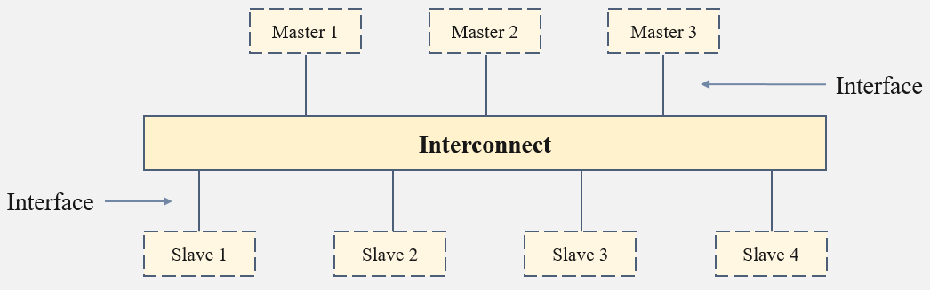
02
Related Work
Advanced eXtensible Interface
AXI
01
Write address channel:
AWVALID、AWADDR、AWREADY
02
Write data channel:
WVALID、WDATA、WSTRB、WREADY
03
Write response channel:
BVALID、BRESP、BREADY
04
Read address channel:
ARVALID、ARADDR、ARREADY
05
Read data channel:
RVALID、RDATA、RREADY、RRESP
30
Notes:
更新後的B個位元組為STATE，初此狀態為0

Slide 31
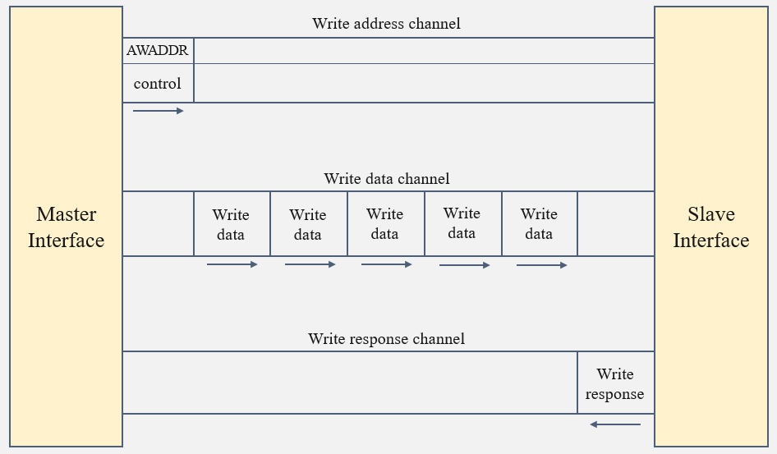
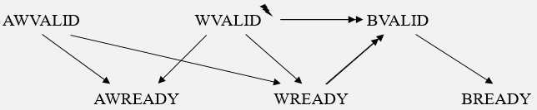
02
Related Work
Advanced eXtensible Interface
AXI
31
Notes:
寫通道握手信號的時序關係如上圖3-4，其中一個箭頭指向的訊號代表可以在箭頭的起點訊號觸發前或觸發後觸發，
而雙箭頭指向的訊號則需要等箭頭起點的訊號觸發後才可以觸發，

Slide 32
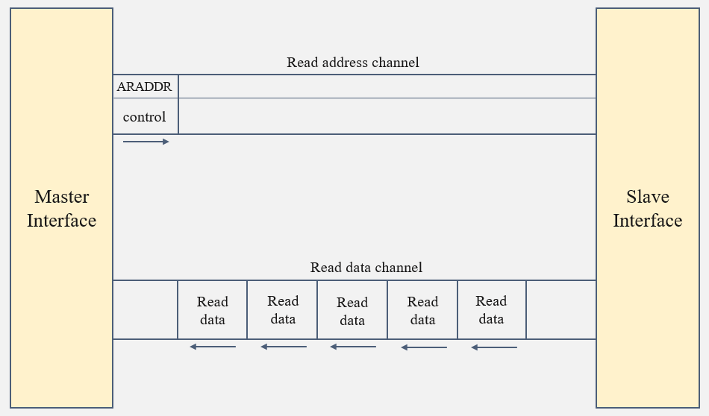
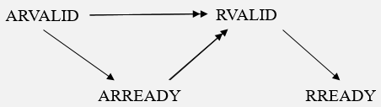
02
Related Work
Advanced eXtensible Interface
AXI
32
Notes:
更新後的B個位元組為STATE，初此狀態為0

Slide 33
02
Related Work
Advanced eXtensible Interface
AXI
Burst
Transaction order
FIXED:
The addresses used in the burst process are all fixed.
Normal:
Wait for an address transaction to complete before proceeding to the next transaction.
00
1
INCR:
The addresses used in the burst process increase.
Outstanding:
Multiple unfinished transaction addresses can be sent, which can improve system performance.
01
2
10
WRAP:
Loopback burst, operation is similar to INCR.
Out of order:
Can complete the faster address transaction first, without waiting for the previous transaction to complete.
3
Interleaving:
The written data can be interleaved, and the interleaved written data from transactions with different ID values can be accepted.
4
33
Notes:
FIXED：突發的過程中使用的位址都是固定的，此模式適合用於對某個固定位址進行多次更新，例如讀寫FIFO。
INCR：此類型是最常使用的，增量突發，突發過程中位址遞增，增加的幅度為AxSIZE給定的長度決定，支持長度最高為256，適合用於通過位址映射( mapped memory )的儲存模式，例如RAM。
WRAP：回環突發，操作與INCR類似，會在高位址的邊界處繞回到低位址處，傳輸的位址和傳輸的大小對齊，支持長度有2、4、8、16。
常交易 ( Normal )：等一個位址交易完成了在進行下一個交易，如圖3-6所示。
預傳輸交易 ( Outstanding )：可以傳送多個未完成的交易位址，可以提高系統性能性，如圖3-7所示。
亂序交易 ( Out_of_order )：可以先完成較快的位址交易，不必等待前面的交易完成，此交易減少了延遲對系統的影響，如圖3-8所示。
交錯交易 ( Interleaving )：寫入得資料可以交錯，可以接受來自不同ID值的交易交錯的寫入資料，如圖3-9所示。

Slide 34
PART
Architecture
03
Design considerations
Design analysis

Slide 35
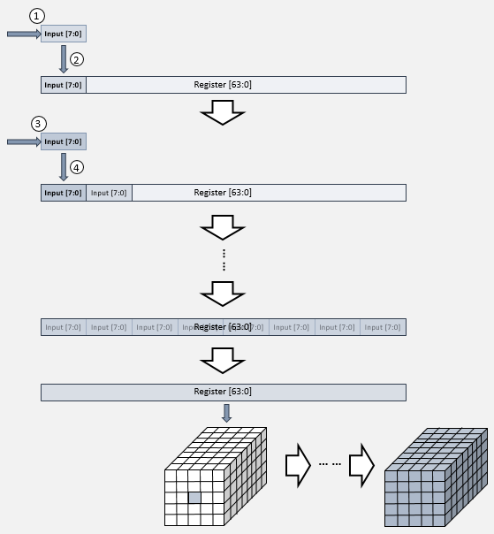
03
Architecture
Block
considerations
35

Slide 36
03
Architecture
Block
considerations
considerations
y
4
3
2
1
0
z
63
.
.
.
.
.
.
1
0
Two-dimensional
x 0 1 2 3 4
[63:0] s x_y
Register
BLOCK
[63:0] s[0:4] [0:4]
y
4
3
2
1
0
z
63
.
.
.
1
0
Three-dimensional
One-dimensional
x 0 1 2 3 4
36
Notes:
更新後的B個位元組為STATE，初此狀態為0

Slide 37

03
Architecture
Theta
considerations
considerations
...
Memory
...
rdata
$$θ$$
...
…
Register
z
63
62
.
.
.
4
3
2
1
0
x 0 1 2 3 4
pre_theta
37

Slide 38



03
Architecture
Rho、Pi、Chi
considerations
considerations
$$ρ$$
$$χ$$
Replace one by one in order.
If the data are not changed together, it needs to be very careful; otherwise, wrong data might be obtained when calculating.
$$π$$
SHA-3
Combine Rho and Pi.
38

Slide 39
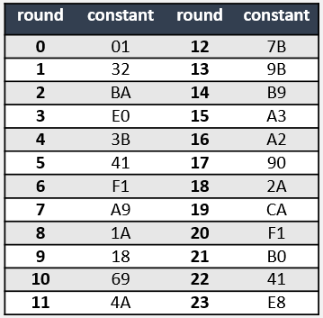

03
Architecture
Iota
considerations
considerations
Look-up table (little)
Look-up table (big)
$$ι$$
Condense the 64-bit round constant into an 8-bit value.
The round constant of each round is fixed, so it can be directly obtained from the look-up table.
Every time a round constant is calculated, it must be substituted 7 times, with each running from 1 to t, so it takes a lot of clock cycles.
Calculation
39

Slide 40
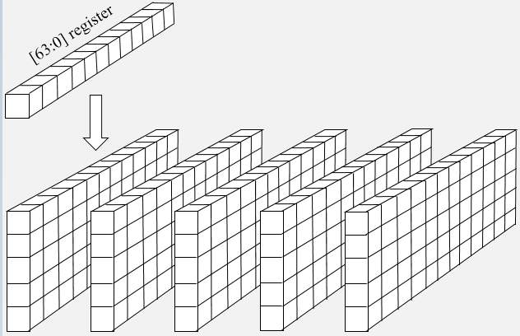
First、Second edition
03
Architecture
Block
Design analysis
40

Slide 41
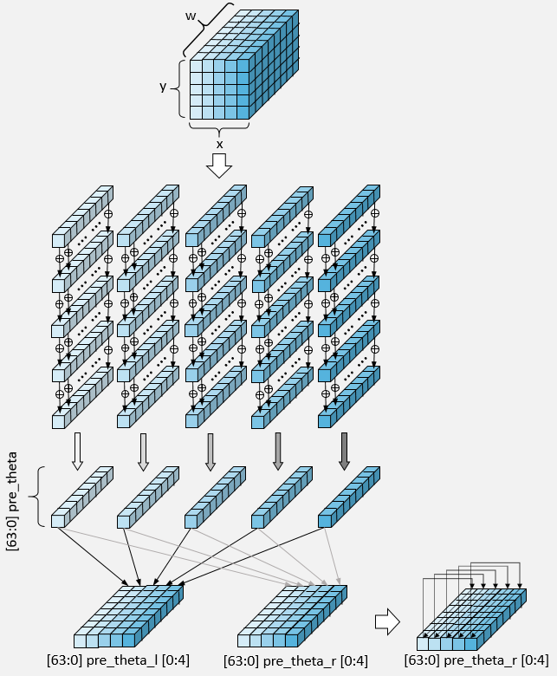
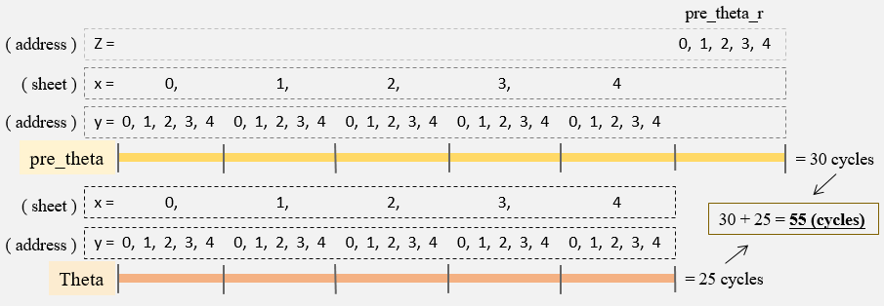
First edition
03
Architecture
Theta
Design analysis
41

Slide 42
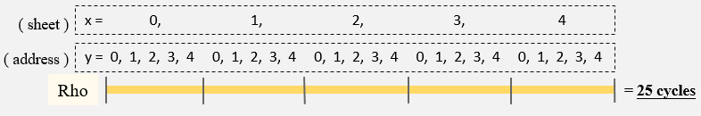
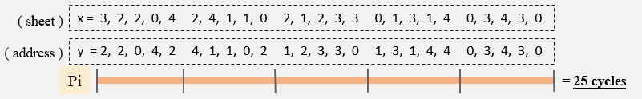
First edition
03
Architecture
Rho、Pi
Design analysis
Rho
Pi
42

Slide 43
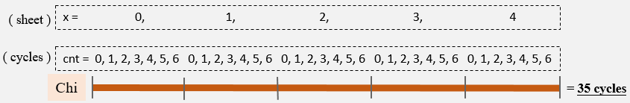
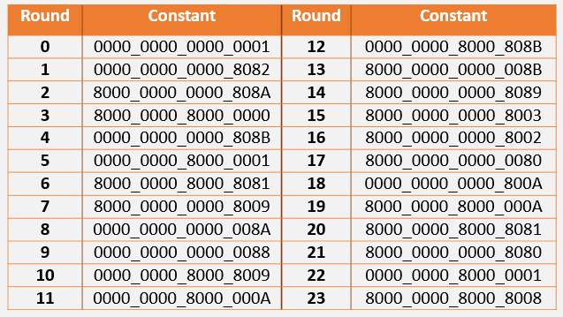
First edition
03
Architecture
Chi、Iota
Design analysis
Chi
Iota
43

Slide 44
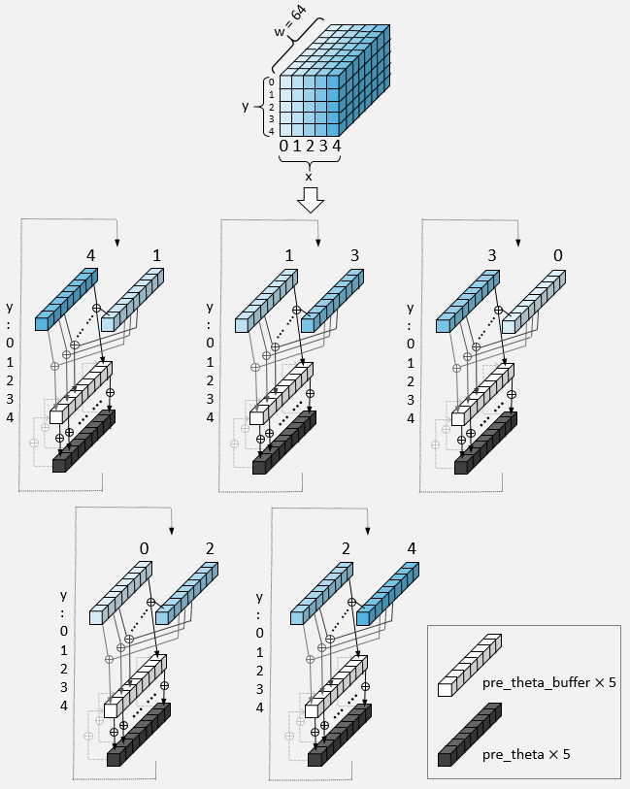
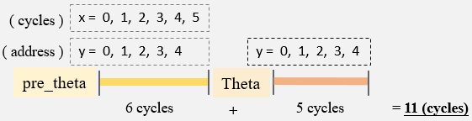
Second edition
03
Architecture
Theta
Design analysis
44

Slide 45
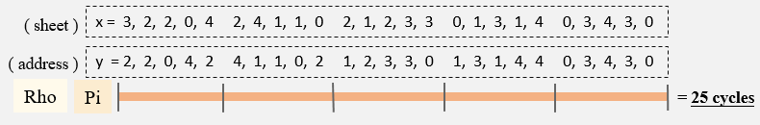
Second edition
03
Architecture
Rho、Pi
Design analysis
Rho
Pi
45

Slide 46

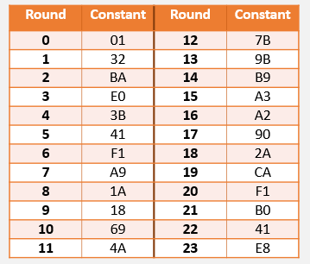
Second edition
03
Architecture
Chi、Iota
Design analysis
Design analysis
Chi
Iota
46

Slide 47
03
Architecture
Third edition
Design analysis
Iteration
Third edition
Block
Theta
...
y
4
3
2
1
0
z
63
.
.
.
.
.
.
1
0
Rho、Pi
.
.
.
.
.
Chi
x 0 1 2 3 4
[63:0] s x_y
Round Iteration
Iota
47

Slide 48
03
Architecture
Number of Clock Cycles
Comparison
 | Theta | Rho | Pi | Chi | Iota | Sum (one round) | All
First edition | 59 | 27 | 26 | 36 | 3 | 151 | 3,624
Second edition | 13 | 13.5 | 13.5 | 7 | 3 | 50 | 1,200
Third edition | 0.2 | 0.2 | 0.2 | 0.2 | 0.2 | 1 | 24
 | First edition | Second edition | Third edition
Reduction | 1 | 302 % | 5,000 %
48

Slide 49
03
Architecture
Frequency & Area
Comparison
 | Virtex 5 | Virtex 6 | Virtex7
First edition | N/A | 128.2 MHz | 196.1 MHz
Second edition | N/A | 135.1 MHz | 181.8 MHz
Third edition | 208.3 MHz | 222.2 MHz | 285.7 MHz
 | Virtex 5 | Virtex 6 | Virtex 7
First edition | N/A | 1,024 slices | 1,579 slices
Second edition | N/A | 1,015 slices | 1,124 slices
Third edition | 1,317 slices | 1,125 slices | 1,010 slices
49

Slide 50

03
Architecture
$$Throughput$$
Comparison
 | SHA-3 | First edition | Second edition | Third edition
Virtex 5 | 224 | N/A | N/A | 10.00 Gbps
 | 256 | N/A | N/A | 9.44 Gbps
 | 384 | N/A | N/A | 7.22 Gbps
 | 512 | N/A | N/A | 5.00 Gbps
Virtex 6 | 224 | 40.8 Mbps | 129.7 Mbps | 10.67 Gbps
 | 256 | 38.5 Mbps | 122.5 Mbps | 10.07 Gbps
 | 384 | 29.4 Mbps | 93.7 Mbps | 7.70 Gbps
 | 512 | 20.4 Mbps | 64.9 Mbps | 5.33 Gbps
Virtex 7 | 224 | 62.3 Mbps | 174.5 Mbps | 13.71 Gbps
 | 256 | 58.9 Mbps | 164.8 Mbps | 12.95 Gbps
 | 384 | 45.0 Mbps | 126.1 Mbps | 9.90 Gbps
 | 512 | 31.7 Mbps | 87.3 Mbps | 6.86 Gbps
50

Slide 51
PART
Implementation
04
Overall structure
AXI-4 structure
SHA-3 structure

Slide 52
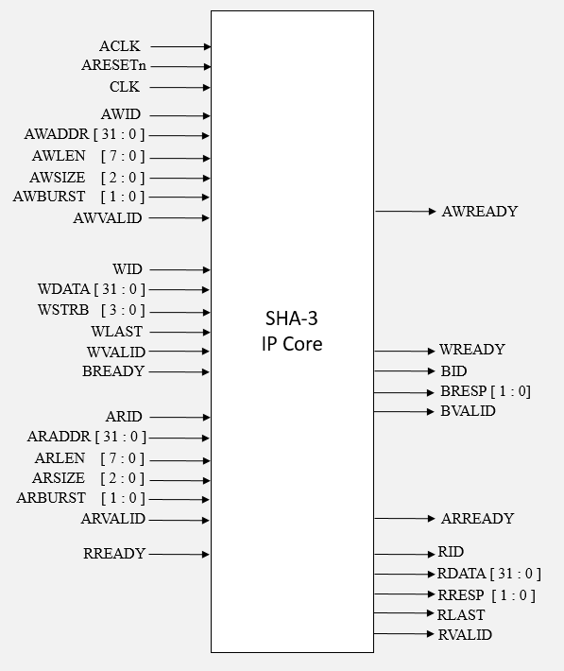
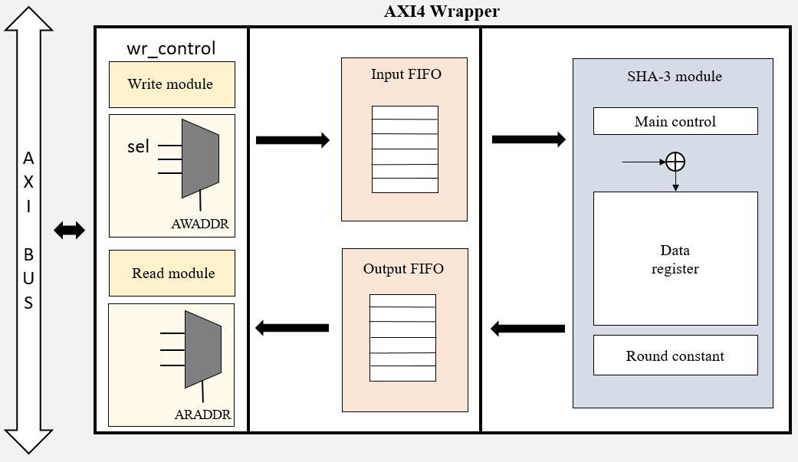
04
Implementation
AXI-4 SHA-3 IP
Overall structure
52

Slide 53
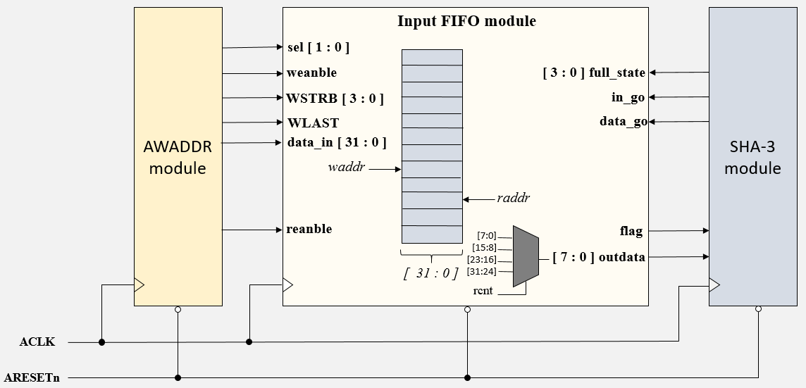
04
Implementation
AXI-4 Input FIFO
AXI-4 structure
53

Slide 54
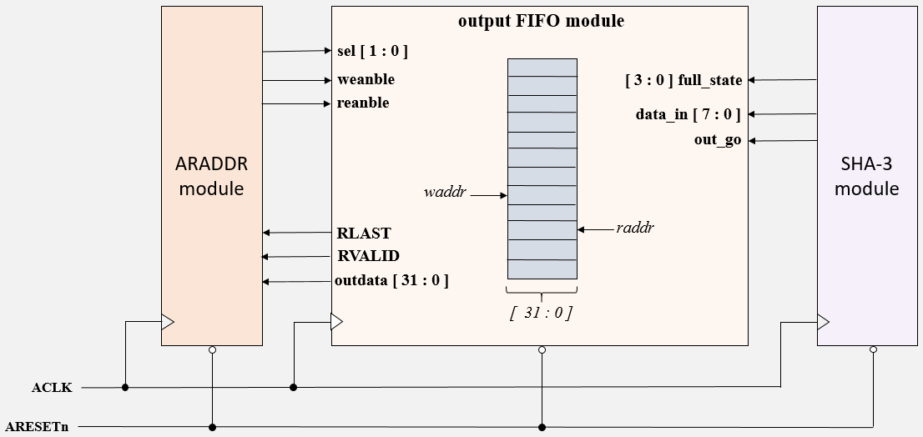
04
Implementation
AXI-4 Output FIFO
AXI-4 structure
54

Slide 55
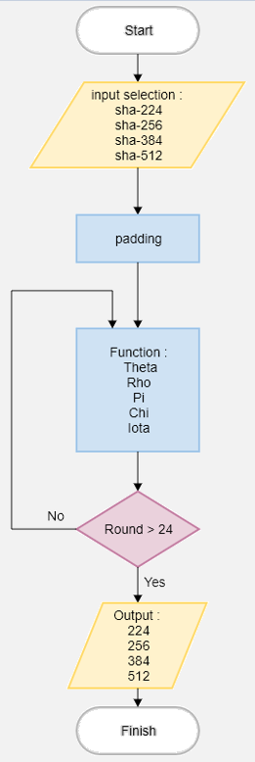
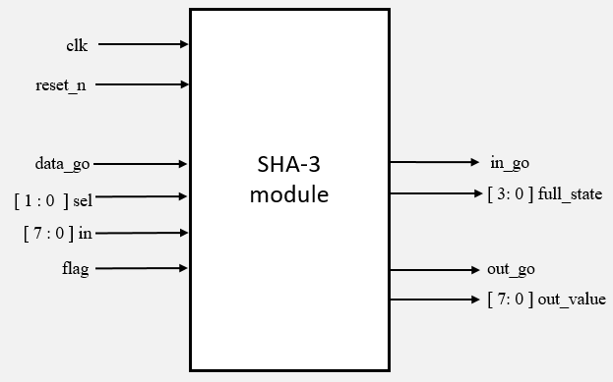
04
Implementation
SHA-3 Module
SHA-3 structure
55

Slide 56
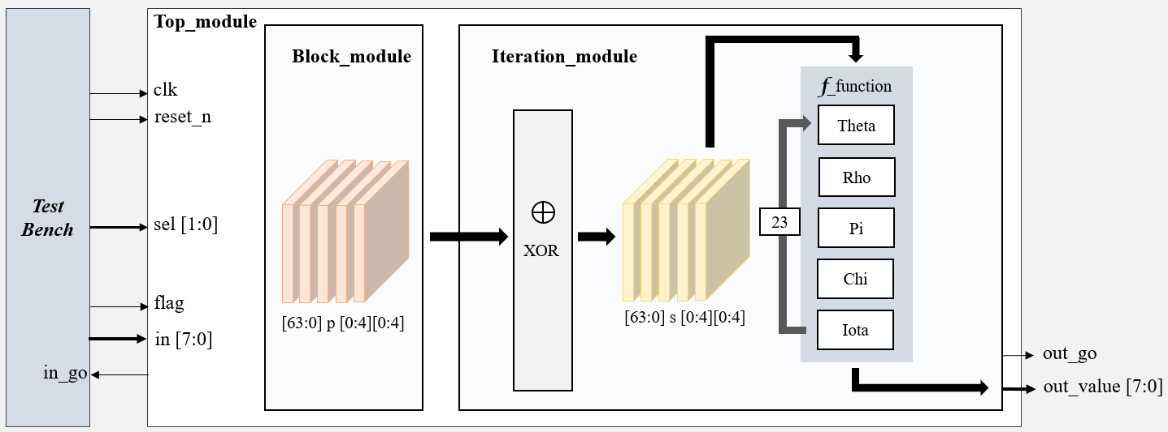
First、Second edition
04
Implementation
SHA-3 Module
SHA-3 structure
56

Slide 57
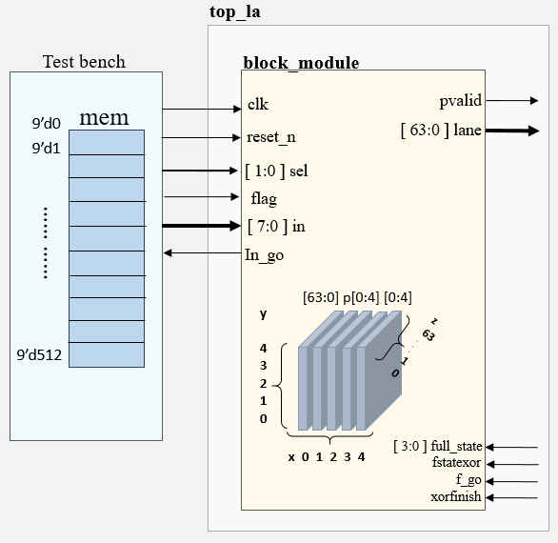
First、Second edition
04
Implementation
Block Module
SHA-3 structure
57

Slide 58
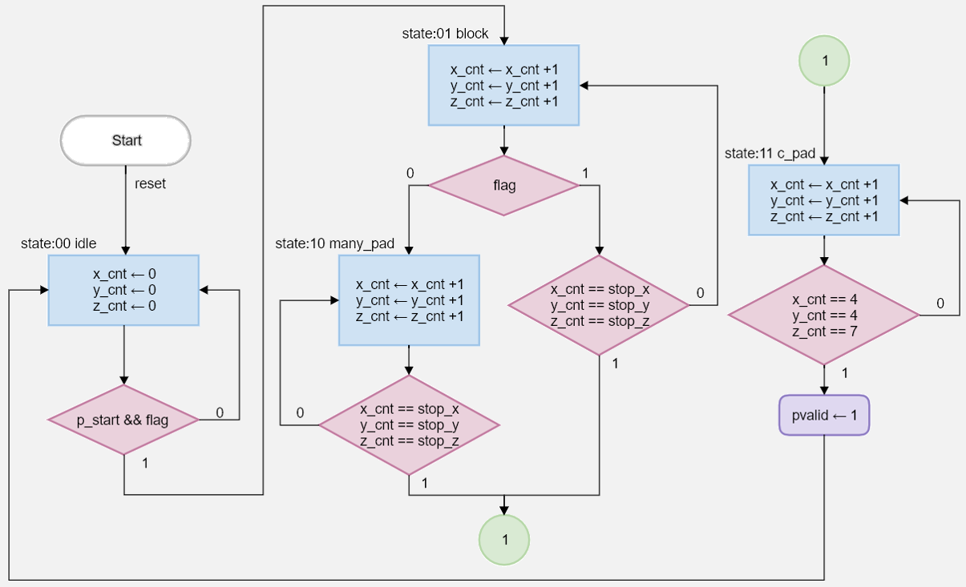
First、Second edition
04
Implementation
Block Module
SHA-3 structure
58

Slide 59
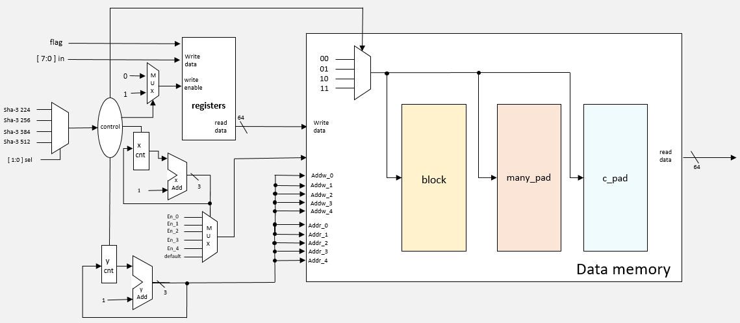
First、Second edition
04
Implementation
Block Module
SHA-3 structure
59

Slide 60
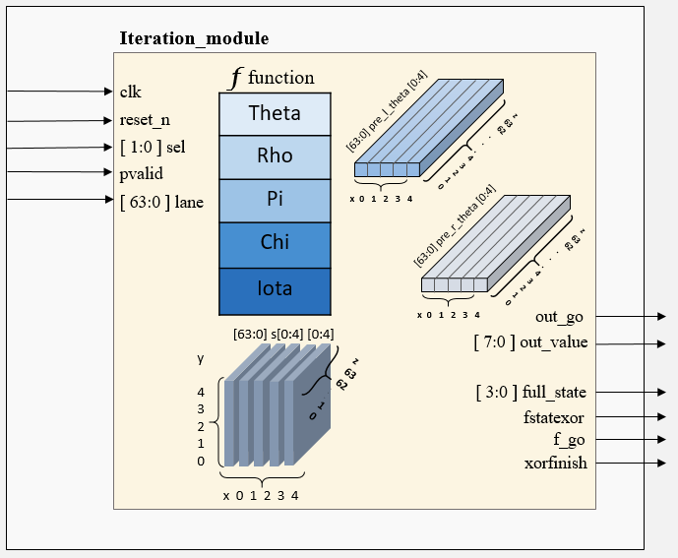
First edition
04
Implementation
Iteration Module
SHA-3 structure
60

Slide 61
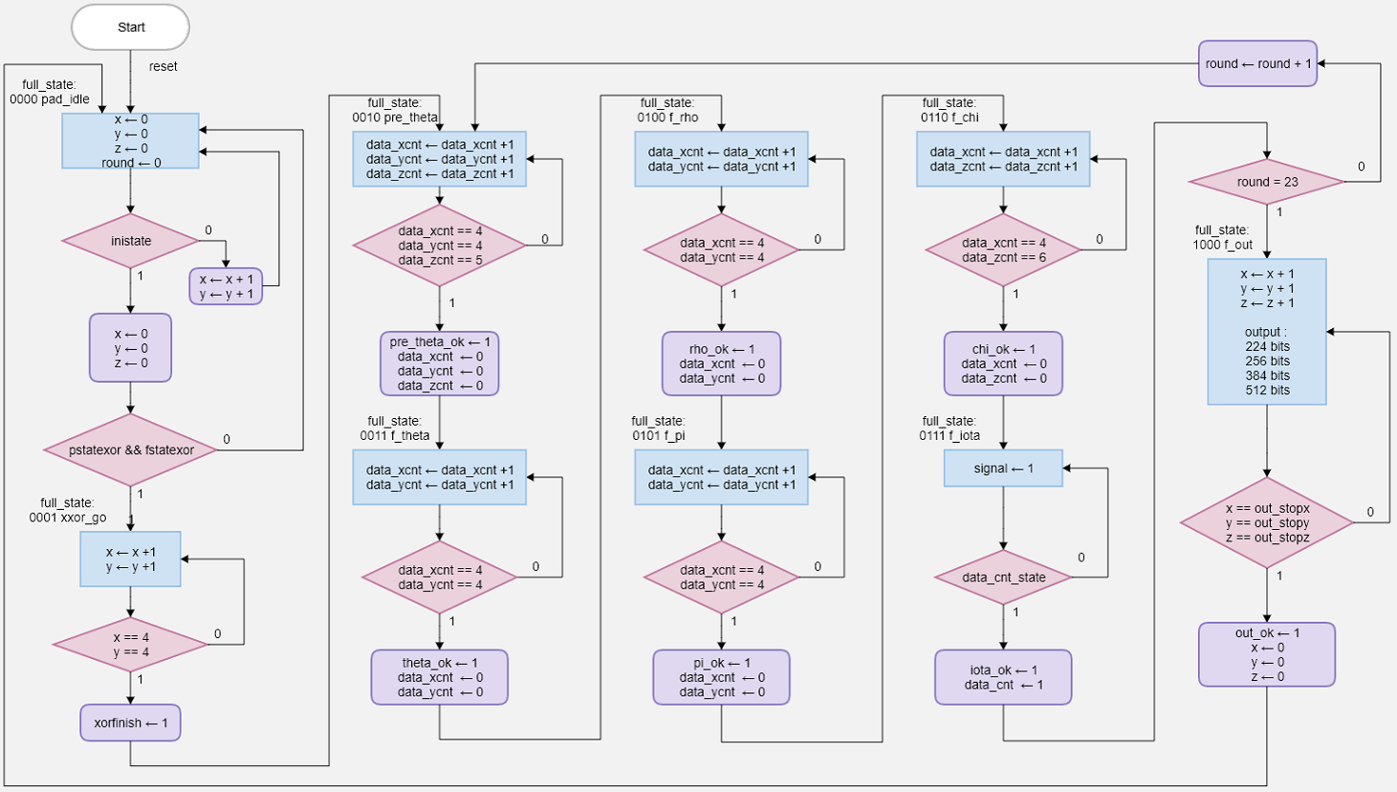
First edition
04
Implementation
Iteration Module
SHA-3 structure
61

Slide 62
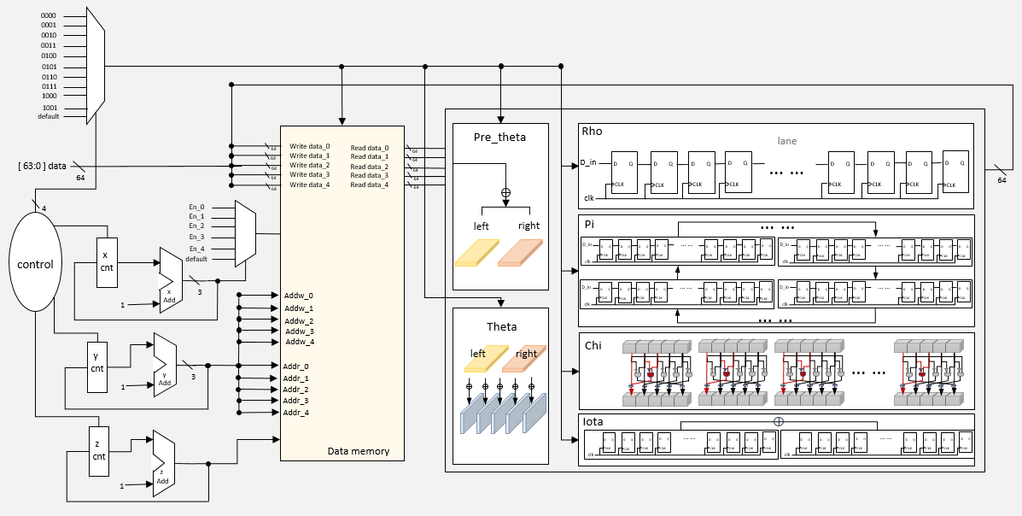
First edition
04
Implementation
Iteration Module
SHA-3 structure
62

Slide 63
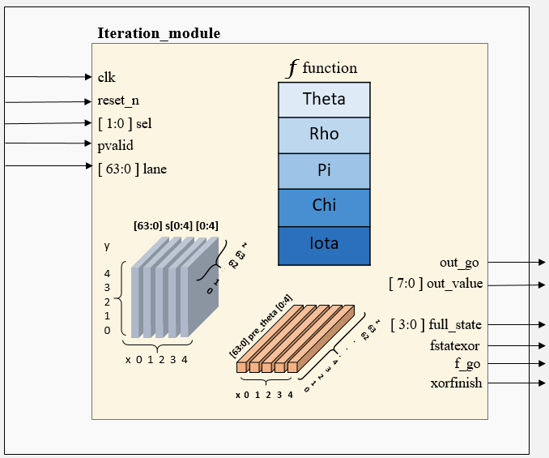
Second edition
04
Implementation
Iteration Module
SHA-3 structure
63

Slide 64
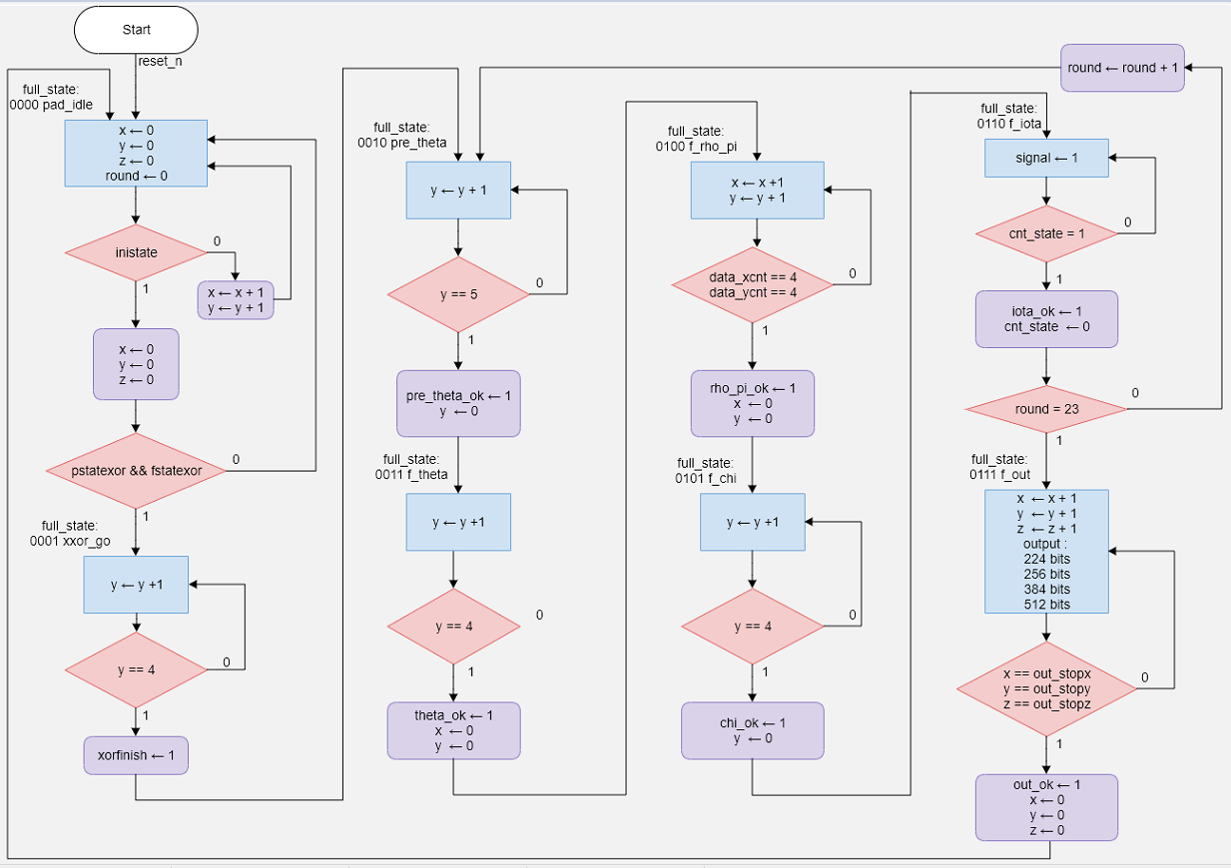
Second edition
04
Implementation
Iteration Module
SHA-3 structure
64

Slide 65
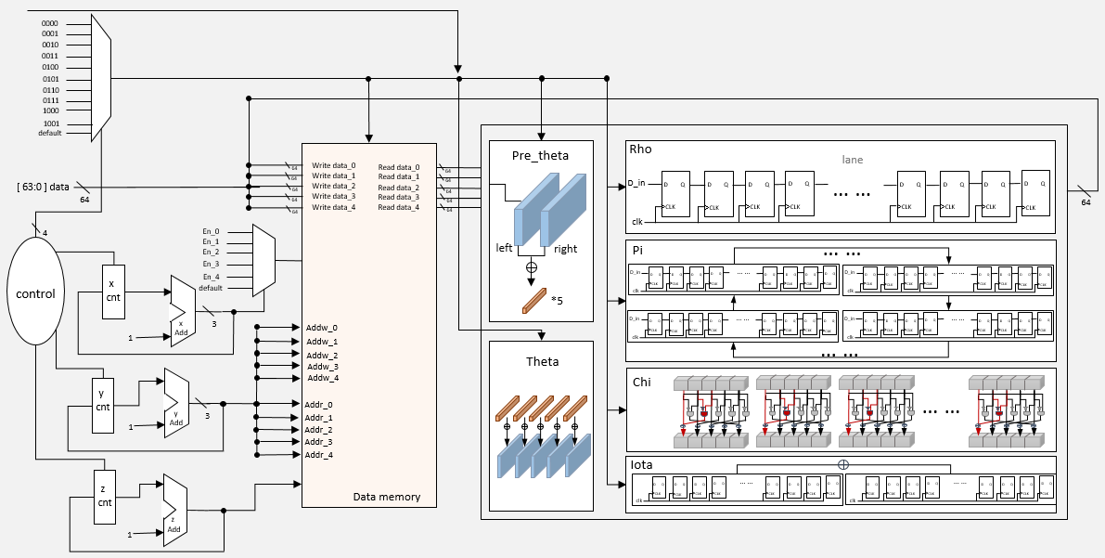
Second edition
04
Implementation
Iteration Module
SHA-3 structure
65

Slide 66
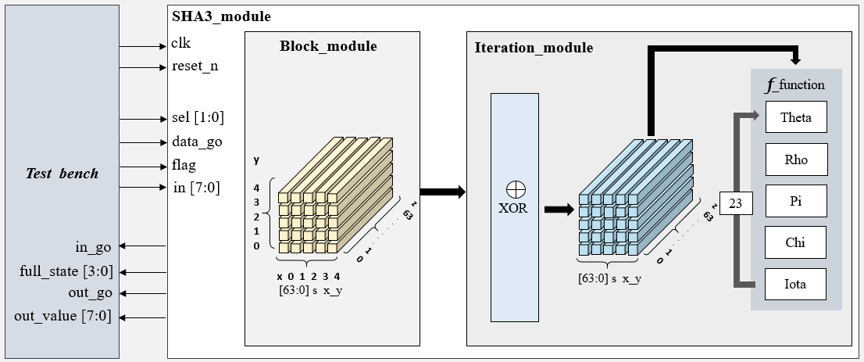
Third edition
04
Implementation
SHA-3 Module
SHA-3 structure
66

Slide 67
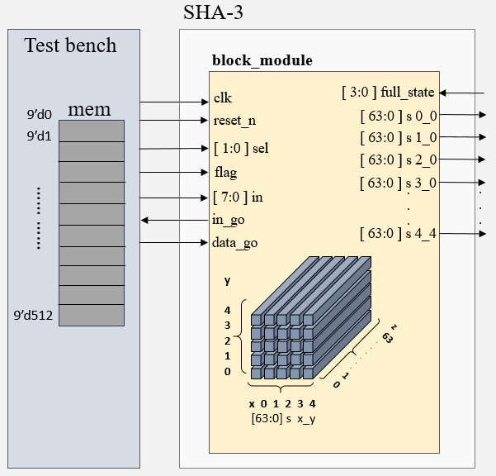
Third edition
04
Implementation
Block Module
SHA-3 structure
67

Slide 68
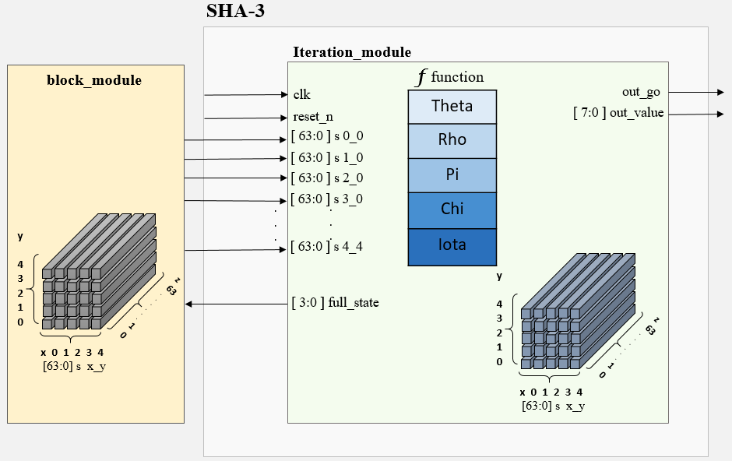
Third edition
04
Implementation
Iteration Module
SHA-3 structure
68

Slide 69
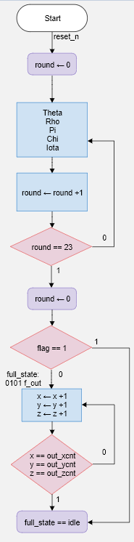
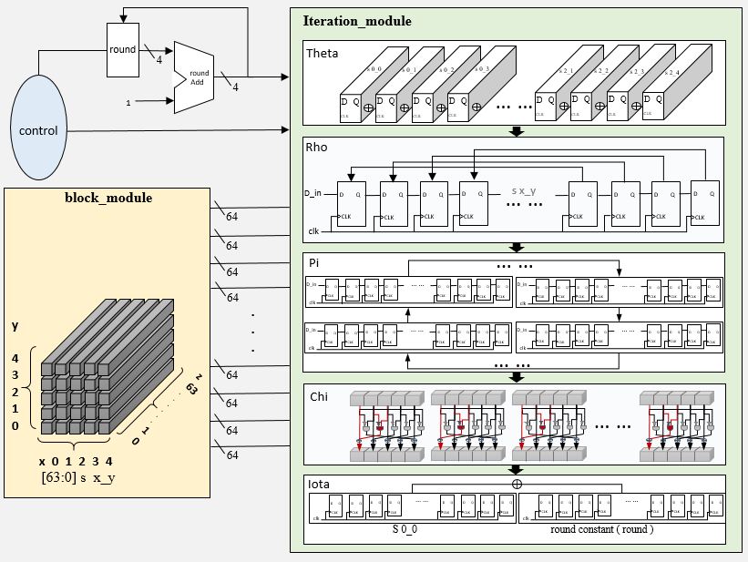
Third edition
04
Implementation
Iteration Module
SHA-3 structure
69

Slide 70
PART
Simulation and Results
05
FPGA design and implementation
ASIC design and implementation

Slide 71

05
Simulation and Results
FPGA Design Flow
FPGA
71

Slide 72


05
Simulation and Results
Usable Area & STA Reports
FPGA
72

Slide 73


05
Simulation and Results
Write & Read Channel Signal Waveforms
FPGA
Write signal
Read data
73

Slide 74


05
Simulation and Results
SHA-3 Signal Waveforms
FPGA
Input data
Output data
74

Slide 75




05
Simulation and Results
SHA-3 Simulation Results
FPGA
224 result
256 result
384 result
512 result
75

Slide 76


05
Simulation and Results
FPGA Simulation Results
FPGA
FPGA STA reports
First edition
 |  | First edition | Second edition | Third edition
Resources |  | 1,579 slices | 1,124 slices | 1,010 slices
Max frequency |  | 196 MHz | 182 MHz | 285 MHz
cycle |  | 3,624 | 1,200 | 24
Throughput | SHA3-224 | 62.3 Mbps | 174.5 Mbps | 13.71 Gbps
 | SHA3-256 | 58.9 Mbps | 164.8 Mbps | 12.95 Gbps
 | SHA3-384 | 45.0 Mbps | 126.1 Mbps | 9.90 Gbps
 | SHA3-512 | 31.7 Mbps | 87.3 Mbps | 6.86 Gbps
Second edition
Third edition
 | First edition | Second edition | Third edition
Throughput | 1 | 2.80 | 78.58
76

Slide 77
05
Simulation and Results
FPGA Simulation Results
FPGA
Design | Target Device | Max Frequency ( MHz ) | SHA Mode ( r ) | NO. of Slice | Throughput ( Gbps ) | Throughput /slices ( Mbps/s )
[10] | Virtex 5 | 205.5 | 256 | 1,433 | 8.747 | 6.10
[8] | Virtex 5 | 159 | 512 | 393 | 0.86 | 2.19
[9] | Virtex 5 | 144 | 512 | 914 | 3.13 | 2.04
[15] | Virtex 5 | 248 | 512 | 134 | 0.25 | 1.16
[5] | Virtex 5 | 137.01 | 512 | 1,647 | 2.39 | 1.45
[11] | Virtex 5 | 205 | 224 | 1,433 | 8.4 | 5.86
Ours project | Virtex 5 xc5vlx20t-2ff323 | 208.3 | 224 | 1,317 | 10.00 | 7.59
 |  |  | 256 |  | 9.44 | 7.17
 |  |  | 384 |  | 7.22 | 5.48
 |  |  | 512 |  | 5.00 | 3.80
77

Slide 78

05
Simulation and Results
ASIC Design Flow
ASIC
78

Slide 79


05
Simulation and Results
ASIC Layout
ASIC
Process | TSMC 0.18 μm
Package type | 208-PIN CQFP
Chip area | 1,700.01 μm $×$ 2,027.55 μm
Core area | 1,400.10 μm $×$1,657.22 μm
Gates | 148,218
Frequency | 83.33 MHz
Temperature | 0℃ ~ 125℃
Power | 34.0781 mW
Voltage | 1.8 V
79

Slide 80

05
Simulation and Results
ASIC Throughput
ASIC
$$Throughput = \frac{r×f}{cycle}$$
r: The size of the preprocessing bits for each block of the hash function
f : The maximum operating frequency of the chip
Cycle: The total number of clock cycles for processing a block at a time
Encryption Type | Throughput ( Gbps )
SHA3-224 | 4.00
SHA3-256 | 3.78
SHA3-384 | 2.89
SHA3-512 | 2.00
80

Slide 81
PART
Conclusions and Future Work
06
Conclusions
Future Work

Slide 82
06
Conclusions and Future Work
Conclusions
Conclusions
Designed an AXI SHA-3 IP that can provide four modes:
SHA3-224, SHA3-256, SHA3-384, SHA3-512.
Verified with FPGAs
Virtex-5: The maximum operating frequency is 208.3 MHz, the throughput is 10.00 Gpbs, and the area used is 1,317 slices.
Virtex-6: The maximum operating frequency is 222.22 MHz, the throughput is 10.67 Gpbs, and the area used is 1,125 slices.
Virtex-7: The maximum operating frequency is 285.71 MHz, the throughput is 13.71 Gpbs, and the area used is 1,010 slices.
Verified with ASIC
TSMC 0.18-μm cell library: The maximum operating frequency is 83.33 MHz and the throughput is 4.00 Gpbs. The overall chip area is 1,700.01 μm × 2,027.55 μm, and the core area of ​​the chip is 1,400.10 μm × 1,657.22 μm. The power consumption is 34.0781 mW.
82

Slide 83
06
Conclusions and Future Work
Future Work
Future Work
Using pipeline to make the calculation between the five functions more efficient.
Restructuring modules to shorten the propagation delay so as to increase the maximum operating frequency, and hence the throughput.
Using the manual floor-planning to re-arrange sponge construction.
Adding extendable output function.
83

Slide 84
PART
07
References

Slide 85
07
References
References
References
[1] F. Assad, F. Elotmani, M. Fettach, and A. Tragha, "An optimal hardware implementation of the KECCAK hash function on virtex-5 FPGA," in Proceedings of the IEEE 2019 International Conference on Systems of Collaboration Big Data, Internet of Things & Security (SysCoBIoTS), pp. 1-5, Casablanca, Morocco, December 2019.
[2] G. S. Athanasiou, G. Makkas, and G. Theodoridis, "High throughput pipelined FPGA implementation of the new SHA-3 cryptographic hash algorithm," in Proceedings of the IEEE 2014 6th International Symposium on Communications, Control and Signal Processing (ISCCSP), pp. 538-541, Athens, Greece, May 2014.
[3] M. A. Elmohr, M. A. Saleh, A. S. Eissa, K. E. Ahmed, and M. M. Farag, "Hardware implementation of a SHA-3 application-specific instruction set processor," in Proceedings of the IEEE 2016 28th International Conference on Microelectronics (ICM), pp. 109-112, Giza, Egypt, December 2016.
[4] FIPS PUB 202, FEDERAL INFORMATION PROCESSING STANDARDS PUBLICATION, SHA-3 Standard: Permutation-Based Hash and Extendable-Output Functions (SHA-3), Information Technology Laboratory National Institute of Standards and Technology Gaithersburg, August 2015.
[5] T. Honda, H. Guntur, and A. Satoh, "FPGA implementation of new standard hash function Keccak," in Proceedings of the IEEE 2014 3rd Global Conference on Consumer Electronics (GCCE), pp. 275-279, Tokyo, Japan, October 2014.
[6] L. Ioannou, H. E. Michail, and A. G. Voyiatzis, "High performance pipelined FPGA implementation of the SHA-3 hash algorithm," in Proceedings of the IEEE 2015 4th Mediterranean Conference on Embedded Computing (MECO), pp. 68-71, Budva, Montenegro, June 2015.
[7] B. Jungk, “Evaluation Of Compact FPGA Implementations For All SHA-3 Finalists.” in Proceedings of 2012 The Third SHA-3 Candidate Conference, Washington, pp.1-35, DC USA, March 2012.
85

Slide 86
07
References
References
References
[8] B. Jungk and J. Apfelbeck, "Area-Efficient FPGA Implementations of the SHA-3 Finalists," in Proceedings of the IEEE 2011 International Conference on Reconfigurable Computing and FPGAs, pp. 235-241, Cancun, Mexico, November 2011.
[9] B. Jungk and M. Stöttinger, "Among slow dwarfs and fast giants: A systematic design space exploration of KECCAK," in Proceedings of the IEEE 2013 8th International Workshop on Reconfigurable and Communication-Centric Systems-on-Chip (ReCoSoC), pp. 1-8, Darmstadt, July 2013.
[10] M. Knezevic et al., "Fair and Consistent Hardware Evaluation of Fourteen Round Two SHA-3 Candidates," in Proceedings of in IEEE Transactions on Very Large Scale Integration (VLSI) Systems, pp. 827-840, May 2012, Volume 20, no. 5.
[11] K. Kobayashi et al., "Prototyping platform for performance evaluation of SHA-3 candidates," in Proceedings of the IEEE 2010 International Symposium on Hardware-Oriented Security and Trust (HOST), pp. 60-63, Anaheim, CA, USA, June 2010.
[12] M. Rao, T. Newe, and I. Grout, "Efficient High Speed Implementation of Secure Hash Algorithm-3 on Virtex-5 FPGA," in Proceedings of the IEEE 2014 17th Euromicro Conference on Digital System Design, pp. 643-646, Verona, Italy, August 2014.
[13] W. Stallings, Cryptography and Network Security, Pearson, 2017.
[14] M. Sundal and R. Chaves, "Efficient FPGA Implementation of the SHA-3 Hash Function," in Proceedings of the IEEE 2017 Computer Society Annual Symposium on VLSI (ISVLSI), Bochum, Germany, pp. 86-91, Bochum, Germany, July 2017.
[15] J. Winderickx, J. Daemen, and N. Mentens, "Exploring the use of shift register lookup tables for Keccak implementations on Xilinx FPGAs," in Proceedings of the IEEE 2016 26th International Conference on Field Programmable Logic and Applications (FPL), Lausanne, pp. 1-4, Switzerland, August 2016.
86

Slide 87
07
References
References
References
[16] M. M. Wong, J. Haj-Yahya, S. Sau, and A. Chattopadhyay, "A New High Throughput and Area Efficient SHA-3 Implementation," in Proceedings of the IEEE 2018 International Symposium on Circuits and Systems (ISCAS), pp. 1-5, Florence, Italy, May 2018.
[17] 張祐崧，基於AXI-4界面的管線式AES矽智財設計與驗證，碩士論文-國立台灣科技大學電子工程學系，7月 2019年。
[18] David, Byte ordering and bit numbering in Keccak and SHA-3, 2017, https://cryptologie.net/article/387/byte-ordering-and-bit-numbering-in-keccak-and-sha-3/
87

Slide 88
Thanks for Your Attention
The Design and Verification of an IP for Secure Hash Algorithm SHA-3 with AXI-4 Interface
88

