Slide 1

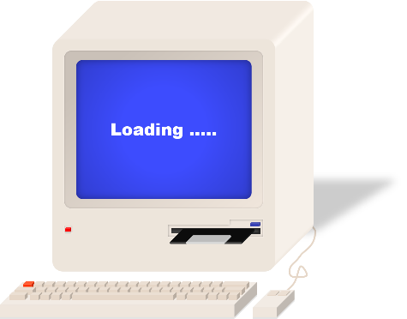
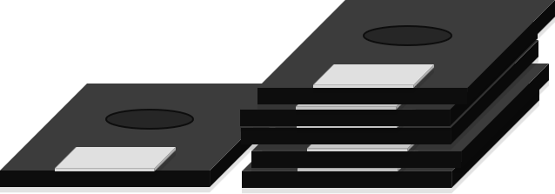
Final Project Presentation
組員：蘇柏丞、呂彥霖、 陳泓宇
中華民國 112 年 1 月 3日
Notes:
大家好，我是陳泓宇他是蘇她是呂。

Slide 2

Estimated performance
01
Function
02
Block Diagram
03
Register specification
OUTLINE
04
Compare
05
Discussion
06
Work Partition
Notes:
以下是我們的今天簡報的大綱，總共有5章，第一章我會先介紹我們期末專題要做的方向，接著會說明我們的架構，再來是我們定義的configuration register，以及我們的時程表，最後是分工。

Slide 3
01
Function

Slide 4
01
Function
An accelerator for matrix multiplication (4 x 4) and quicksort (11) has been designed and integrated into the SoC.
The baud rate for the UART has been changed from 9600 to 115200.
The type of memory is BRAM with prefetch controller.
The designs have be implemented on SoC.
The SoC have be programed into FPGA and verified on jupyter notebook
2
Notes:
我們期末專題會先從兩個workload的加速器開始做起，再改進先前lab的fir和uart，達到加速的效果，而uart的部分會先從之前上課有提到的baud rate下手。
完成這些後將這些東西整合到soc裡面，並燒入到FPGA版上，最後使用jupyter來做驗證。
我們使用的記憶體是bram

Slide 5
02
Block Diagram

Slide 6
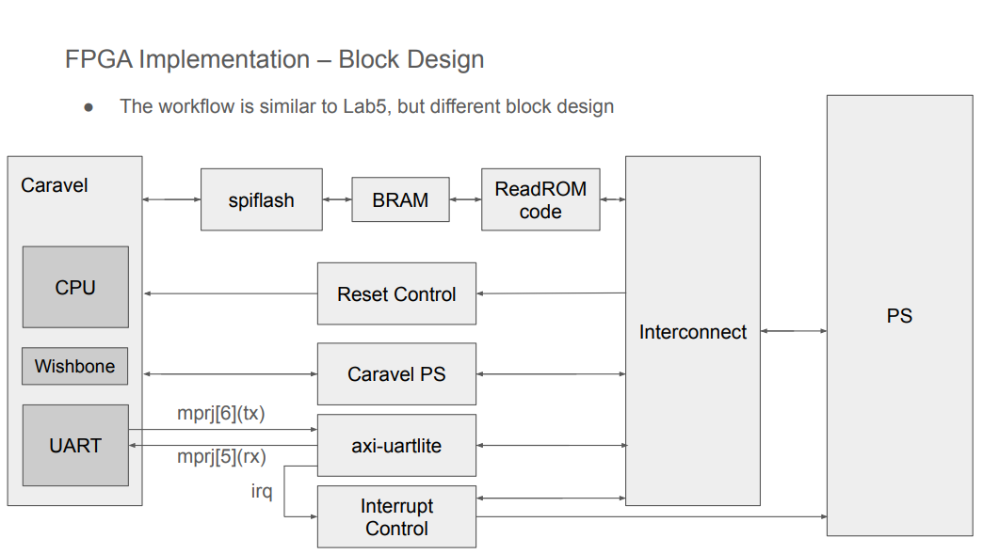
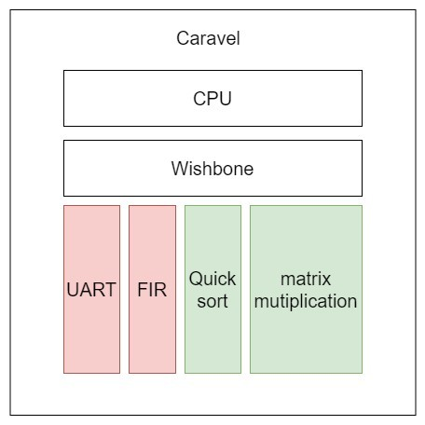
02
Block Diagram
4
Notes:
整體的架構目前預計還是和lab6相同。

Slide 7
03
Configuration Register Address Map

Slide 8
03
Configuration Register Address Map
User Project | Base Address Map
Memory Starting | 3800_0000
FIR Base Address | 3600_0000
Matrix Multiplication Base Address | 3400_0000
Quick Sort Base Address | 3200_0000
UART Base Address | 3000_0000
6
Notes:
這是我們的Configuration Register Address Map

Slide 9
03
Configuration Register Address Map - FIR
FIR
0x00 | [0] | ap_start (r/w)
 | [1] | ap_done (ro)
 | [2] | ap_idle (ro)
 | [3] | X[n]_ready to accept input (ro)
 | [4] | Y[n] is ready to read
0x10-13 | data-length
0x40-7F | Tap parameters
0x80-83 | X[n] input (r/w)
0x84-87 | Y[n] output (ro)
7

Slide 10
03
Configuration Register Address Map - Matrix Multiplication
Matrix Multiplication
0x00 | [0] | ap_start (r/w)
 | [1] | ap_done (ro)
 | [2] | ap_idle (ro)
 | [3] | X[n]_ready to accept input (ro)
 | [4] | Y[n] is ready to read
0x80-83 | X[n] input (r/w)
0x84-87 | Y[n] output (ro)
8

Slide 11
03
Configuration Register Address Map – Quick Sort
Quick Sort
0x00 | [0] | ap_start (r/w)
 | [1] | ap_done (ro)
 | [2] | ap_idle (ro)
 | [3] | X[n]_ready to accept input (ro)
 | [4] | Y[n] is ready to read
0x80-83 | X[n] input (r/w)
0x84-87 | Y[n] output (ro)
9

Slide 12
04
Compare

Slide 13
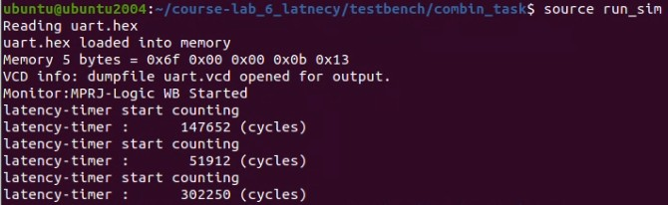

04
Compare - MM
Use CPU to perform MM
Per operation use
162388/11 = 14762.5 Cycles
Use user hardware to perform MM
Per operation use
4788/64 = 74.8 Cycles
11
Notes:
會想要直接從硬體下手是因為我們回顧先前4-2的lab的結果，並比對lab6中FIR部分，兩者的cycle數差距很大，

Slide 14

04
Compare - QS
Use CPU to perform QS
Per operation use
162388/11 = 14762.5 Cycles
Use user hardware to perform QS
Per operation use
4788/64 = 74.8 Cycles
12
Notes:
會想要直接從硬體下手是因為我們回顧先前4-2的lab的結果，並比對lab6中FIR部分，兩者的cycle數差距很大，

Slide 15

04
Compare - FIR
Use CPU to perform FIR
Per operation use
162388/11 = 14762.5 Cycles
Use user hardware to perform FIR
Per operation use
4788/64 = 74.8 Cycles
13
Notes:
會想要直接從硬體下手是因為我們回顧先前4-2的lab的結果，並比對lab6中FIR部分，兩者的cycle數差距很大，

Slide 16
04
Compare - UART
UART Baudrate set 9600
Per operation use
162388/11 = 14762.5 Cycles
UART Baudrate set 115200
Per operation use
4788/64 = 74.8 Cycles
14
Notes:
會想要直接從硬體下手是因為我們回顧先前4-2的lab的結果，並比對lab6中FIR部分，兩者的cycle數差距很大，

Slide 17

04
Compare – BRAM with Prefetch controller
no Prefetch
Matrix Multiplication Base Address | 2433
Quick Sort Base Address | 937
UART Base Address | 8511
Prefetch
Matrix Multiplication Base Address | 679
Quick Sort Base Address | 683
UART Base Address | 7377
15
Notes:
會想要直接從硬體下手是因為我們回顧先前4-2的lab的結果，並比對lab6中FIR部分，兩者的cycle數差距很大，

Slide 18
04
Discussion

Slide 19
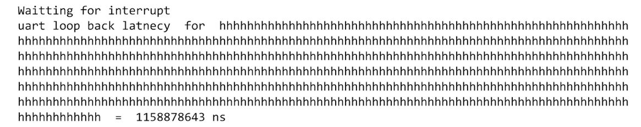
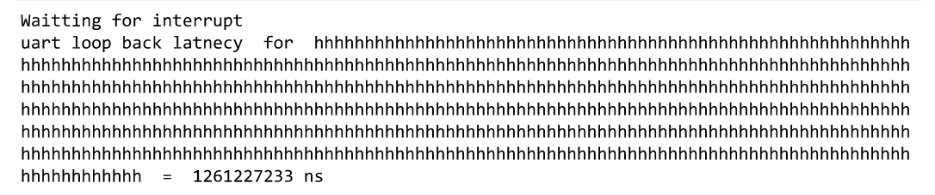
04
Discussion
17
Notes:
這邊是我們預計的結果以及lab6測出來的數據，左邊只使用cpu的部分約需要29萬個cycle，右邊是放入硬體加速的部分，約需要10103個cycle，但此部分是沒有加上UART的部分。
預估會有28倍的加速，但這數字太離譜，中間應該還有許多我們沒注意到的細節，這部分會在期末報告再加上去。

Slide 20
05
Work Partition

Slide 21

05
Work Partition
蘇柏丞
Quick Sort
PPT
Implementation
呂彥霖
Matrix Multiplication
Report
PS side verification
陳泓宇
UART
FIR
Integration
19

Slide 22
Thanks for Your Attention

