Slide 1
AES-128
學生：蘇柏丞

Slide 2
01
AES介紹
02
硬體架構
目錄
contents
03
合成結果
04
改善方向

Slide 3

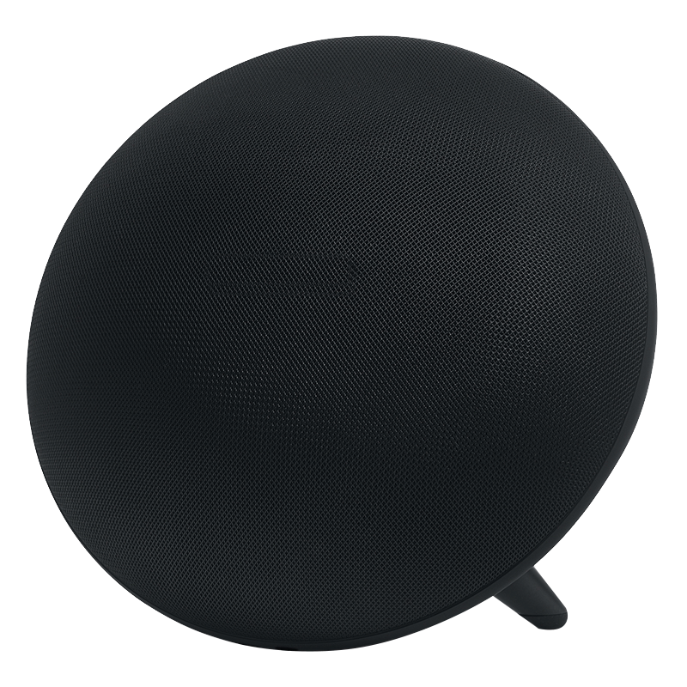
01
AES介紹

Slide 4







AES 介紹
對稱加密
數學運算相對複雜低，使得硬體成本較低，速度也較快
使用伽羅瓦有限場$GF(2^{8})$進行乘法與加法運算
key
transmission
sender
plaintext
Encrypt
ciphertext
ciphertext
Decrypt
plaintext
recipient
13

Slide 5

伽羅瓦有限場$GF(2^{8})$
基於二元，且每次處理資料的單位為8個位元
加法運算「+」：元素之間進行位元互斥或
乘法運算「 ‧ 」：使用分配律將被乘數的項次拆開各自相乘運算後，再將各自結果相加起來
13

Slide 6


AES Algorithm
Plaintext
Key
Key Expansion
AddRoundKey
W[0, 3]
Round 1
SubBytes
AES-128
Key size | 128 bits
Plaintext block size | 128 bits
Number of rounds | 10
Round key size | 128 bits
Number of expanded keys | 44
ShiftRows
MisColumns
AddRoundKey
W[4, 7]
…
Round ($Nr−1$)
SubBytes
ShiftRows
Two important parts：
Key expansion
Message encryption
MisColumns
AddRoundKey
W[4(Nr-1), 4(Nr-1)+3]
Round $N$r
SubBytes
ShiftRows
AddRoundKey
W[4Nr, 4Nr+3]
Ciphertext
14

Slide 7
































AES Algorithm – Substitute Bytes
S-box |  | Column
 |  | 0 | 1 | 2 | 3 | 4 | 5 | 6 | 7 | 8 | 9 | a | b | c | d | e | f
Row | 0 | 63 | 7c | 77 | 7b | f2 | 6b | 6f | c5 | 30 | 01 | 67 | 2b | fe | d7 | ab | 76
 | 1 | ca | 82 | c9 | 7d | fa | 59 | 47 | f0 | ad | d4 | a2 | af | 9c | a4 | 72 | c0
 | 2 | b7 | fd | 93 | 26 | 36 | 3f | f7 | cc | 34 | a5 | e5 | f1 | 71 | d8 | 31 | 15
 | 3 | 04 | c7 | 23 | c3 | 18 | 96 | 05 | 9a | 07 | 12 | 80 | e2 | eb | 27 | b2 | 75
 | 4 | 09 | 83 | 2c | 1a | 1b | 6e | 5a | a0 | 52 | 3b | d6 | b3 | 29 | e3 | 2f | 84
 | 5 | 53 | d1 | 00 | ed | 20 | fc | b1 | 5b | 6a | cb | be | 39 | 4a | 4c | 58 | cf
 | 6 | d0 | ef | aa | fb | 43 | 4d | 33 | 85 | 45 | f9 | 02 | 7f | 50 | 3c | 9f | a8
 | 7 | 51 | a3 | 40 | 8f | 92 | 9d | 38 | f5 | bc | b6 | da | 21 | 10 | ff | f3 | d2
 | 8 | cd | 0c | 13 | ec | 5f | 97 | 44 | 17 | c4 | a7 | 7e | 3d | 64 | 5d | 19 | 73
 | 9 | 60 | 81 | 4f | dc | 22 | 2a | 90 | 88 | 46 | ee | b8 | 14 | de | 5e | 0b | db
 | a | e0 | 32 | 3a | 0a | 49 | 06 | 24 | 5c | c2 | d3 | ac | 62 | 91 | 95 | e4 | 79
 | b | e7 | c8 | 37 | 6d | 8d | d5 | 4e | a9 | 6c | 56 | f4 | ea | 65 | 7a | ae | 08
 | c | ba | 78 | 25 | 2e | 1c | a6 | b4 | c6 | e8 | dd | 74 | 1f | 4b | bd | 8b | 8a
 | d | 70 | 3e | b5 | 66 | 48 | 03 | f6 | 0e | 61 | 35 | 57 | b9 | 86 | c1 | 1d | 9e
 | e | e1 | f8 | 98 | 11 | 69 | d9 | 8e | 94 | 9b | 1e | 87 | e7 | ce | 55 | 28 | df
 | f | 8c | a1 | 89 | 0d | bf | e6 | 42 | 68 | 41 | 99 | 2d | 0f | b0 | 54 | bb | 16
$$S_{0,0}$$
$$S_{0,1}$$
$$S_{0,2}$$
$$S_{0,3}$$
S-Box
$${S′}_{0,0}$$
$${S′}_{0,1}$$
$${S′}_{0,2}$$
$${S′}_{0,3}$$
$$S_{1,0}$$
$$S_{r,c}$$
$$S_{1,2}$$
$$S_{1,3}$$
$${S′}_{1,0}$$
$${S′}_{r,c}$$
$${S′}_{1,2}$$
$${S′}_{1,3}$$
$$S_{2,0}$$
$$S_{2,1}$$
$$S_{2,2}$$
$$S_{2,3}$$
$${S′}_{2,0}$$
$${S′}_{2,1}$$
$${S′}_{2,2}$$
$${S′}_{2,3}$$
$$S_{3,0}$$
$$S_{3,1}$$
$$S_{3,2}$$
$$S_{3,3}$$
$${S′}_{3,0}$$
$${S′}_{3,1}$$
$${S′}_{3,2}$$
$${S′}_{3,3}$$
Y
S_{(r , c)}
S-box
b7 | b6 | b5 | b4 | b3 | b2 | b1 | b0
X
X
Y
15

Slide 8



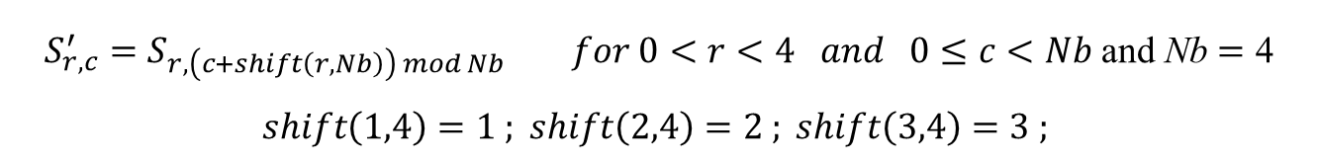






















AES Algorithm – Shift Rows
$$S_{r,c}^{′}=S_{r,\left(c+shift\left(r,Nb\right)\right) mod Nb} for 0<r<4 and 0≤c<Nb \text{and} \text{Nb}=\text{4}$$
$$shift\left(1,4\right)=1 ; shift\left(2,4\right)=2 ; shift\left(3,4\right)=3 ;$$
ShiftRows ()
$$S_{0,0}$$
$$S_{0,1}$$
$$S_{0,2}$$
$$S_{0,3}$$
$$S_{0,0}$$
$$S_{0,1}$$
$$S_{0,2}$$
$$S_{0,3}$$
$$S_{1,0}$$
$$S_{1,1}$$
$$S_{1,2}$$
$$S_{1,3}$$
$$S_{1,1}$$
$$S_{1,2}$$
$$S_{1,3}$$
$$S_{1,0}$$
$$S_{2,0}$$
$$S_{2,1}$$
$$S_{2,2}$$
$$S_{2,3}$$
$$S_{2,2}$$
$$S_{2,3}$$
$$S_{2,0}$$
$$S_{2,1}$$
$$S_{3,0}$$
$$S_{3,1}$$
$$S_{3,2}$$
$$S_{3,3}$$
$$S_{3,3}$$
$$S_{3,0}$$
$$S_{3,1}$$
$$S_{3,2}$$
16

Slide 9

































AES Algorithm – Mix Columns
$$a\left(x\right)=\left\{03\right\}x^{3}+\left\{01\right\}x^{2}+\left\{01\right\}x+\left\{02\right\}$$
$$S′\left(x\right)=a\left(x\right) ⨂ S\left(x\right)$$
$$\left[\begin{aligned}{S′}_{0,c} \\ {S′}_{1,c} \\ {S′}_{2,c} \\ {S′}_{3,c}\end{aligned}\right]=\left[\begin{aligned}02 \\ 01 \\ 01 \\ 03\end{aligned} \begin{aligned}03 \\ 02 \\ 01 \\ 01\end{aligned} \begin{aligned}01 \\ 03 \\ 02 \\ 01\end{aligned} \begin{aligned}01 \\ 01 \\ 03 \\ 02\end{aligned}\right]\left[\begin{aligned}S_{0,c} \\ S_{1,c} \\ S_{2,c} \\ S_{3,c}\end{aligned}\right] for 0≤c<Nb$$
MixColumns ()
$$S_{0,0}$$
$$S_{0,c}$$
$$S_{0,2}$$
$$S_{0,3}$$
$${S′}_{0,0}$$
$${S′}_{0,c}$$
$${S′}_{0,2}$$
$${S′}_{0,3}$$
$$S_{1,0}$$
$$S_{1,c}$$
$$S_{1,2}$$
$$S_{1,3}$$
$${S′}_{1,0}$$
$${S′}_{1,c}$$
$${S′}_{1,2}$$
$${S′}_{1,3}$$
$$S_{2,0}$$
$$S_{2,c}$$
$$S_{2,2}$$
$$S_{2,3}$$
$${S′}_{2,0}$$
$${S′}_{2,c}$$
$${S′}_{2,2}$$
$${S′}_{2,3}$$
$$S_{3,0}$$
$$S_{3,c}$$
$$S_{3,2}$$
$$S_{3,3}$$
$${S′}_{3,0}$$
$${S′}_{3,c}$$
$${S′}_{3,2}$$
$${S′}_{3,3}$$
17

Slide 10





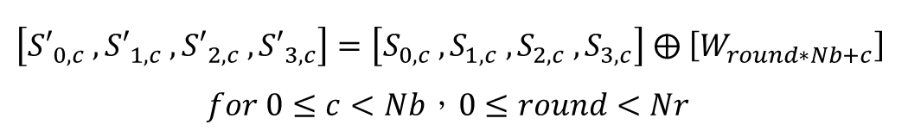
































AES Algorithm – Add Round Keys
$$\left[{S′}_{0,c} , {S′}_{1,c} , {S′}_{2,c} , {S′}_{3,c}\right]=\left[S_{0,c} , S_{1,c} , S_{2,c} , S_{3,c}\right] ⨁ \left[W_{round∗Nb+c}\right]$$
$$for 0≤c<Nb，0≤round<Nr$$
$$i=round∗Nb$$
$$S_{0,0}$$
$$S_{0,c}$$
$$S_{0,2}$$
$$S_{0,3}$$
$$W_{i}$$
$$W_{i+c}$$
$$W_{i+2}$$
$$W_{i+3}$$
$${S′}_{0,0}$$
$${S′}_{0,c}$$
$${S′}_{0,2}$$
$${S′}_{0,3}$$
$$S_{1,0}$$
$$S_{1,c}$$
$$S_{1,2}$$
$$S_{1,3}$$
$${S′}_{1,0}$$
$${S′}_{1,c}$$
$${S′}_{1,2}$$
$${S′}_{1,3}$$
$$S_{2,0}$$
$$S_{2,c}$$
$$S_{2,2}$$
$$S_{2,3}$$
$${S′}_{2,0}$$
$${S′}_{2,c}$$
$${S′}_{2,2}$$
$${S′}_{2,3}$$
$$S_{3,0}$$
$$S_{3,c}$$
$$S_{3,2}$$
$$S_{3,3}$$
$${S′}_{3,0}$$
$${S′}_{3,c}$$
$${S′}_{3,2}$$
$${S′}_{3,3}$$
18

Slide 11
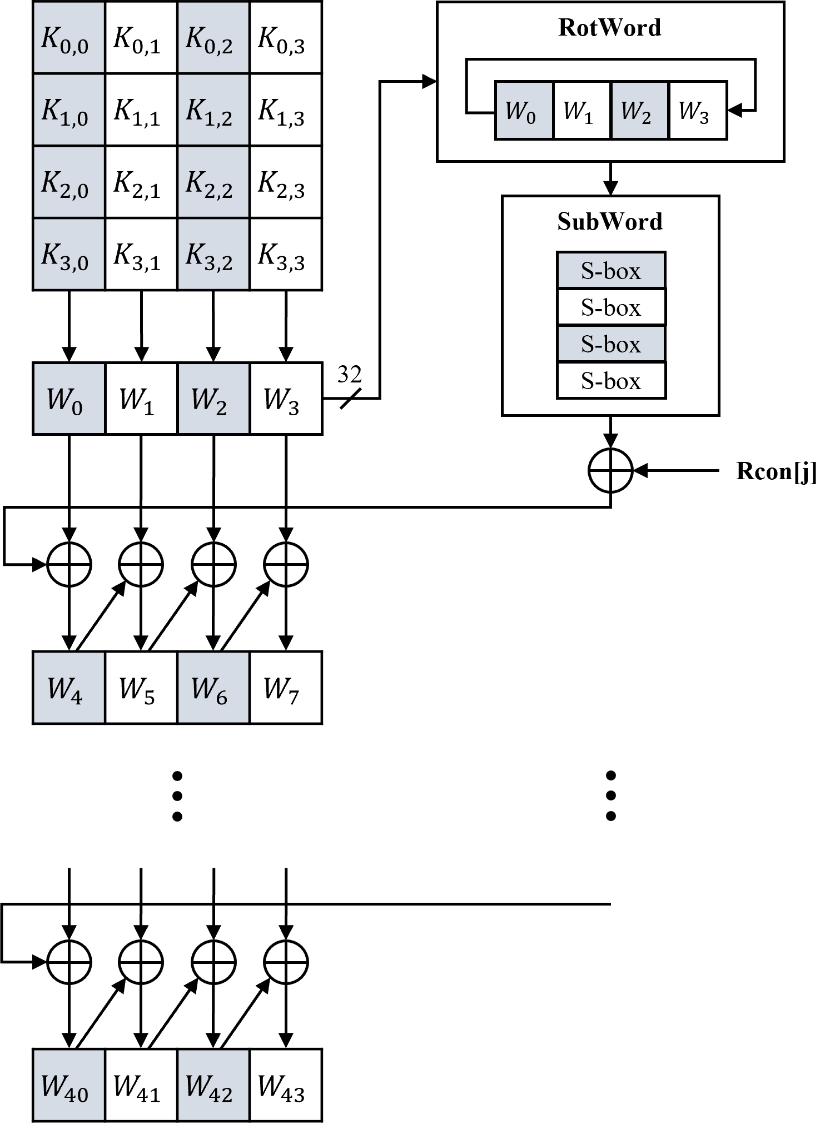
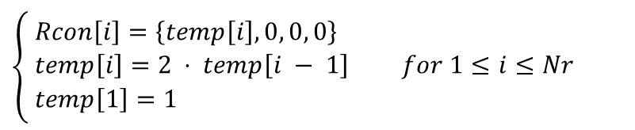
AES Algorithm – Key Expansion
$$\left\{ \begin{aligned}&Rcon\left[i\right]=\left\{temp\left[i\right], 0, 0, 0\right\} \\ &temp\left[i\right]=2 ⋅ temp\left[i − 1\right] for 1≤i≤Nr \\ &temp\left[1\right]=1\end{aligned}\right.$$
19

Slide 12
02
硬體架構

Slide 13
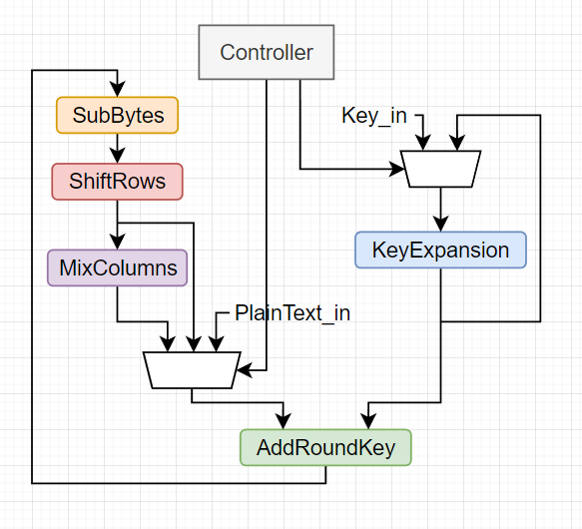
AES Module
20

Slide 14
03
合成結果

Slide 15
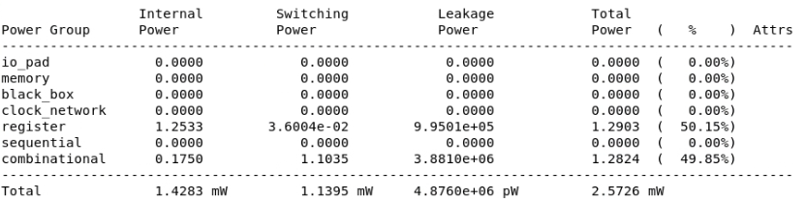
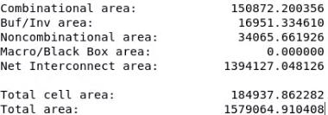
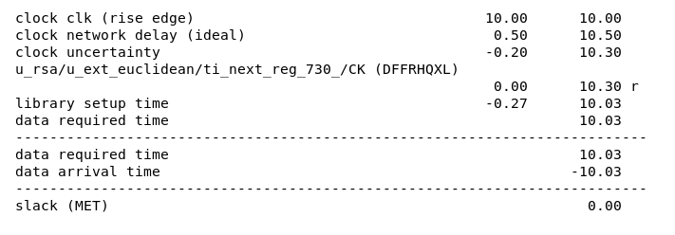
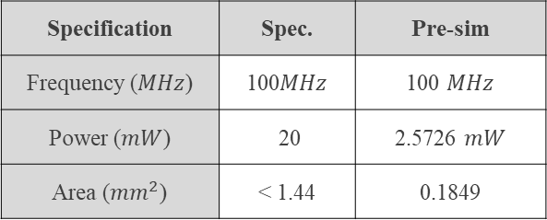
AES DC Result
Power
Specification | Spec. | Pre-sim
Frequency ($MHz$) | 100$MHz$ | 100 $MHz$
Power ($mW$) | 20 | 2.5726 $mW$
Area (${mm}^{2}$) | < 1.44 | 0.1849
Area
Timing
20

Slide 16
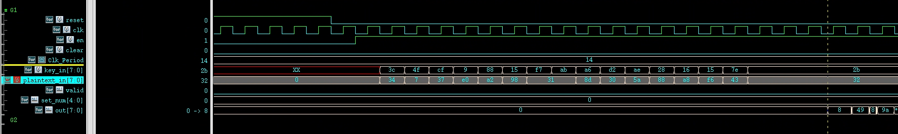
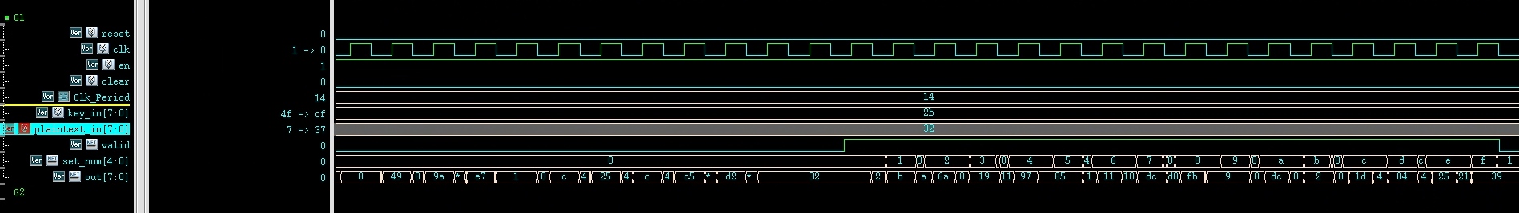

AES DC Result
20

Slide 17
04
改善方向

Slide 18











教育性晶片下線經驗-AES
Look-up Functionality
Composite Field Operation
Direct Logical Mapping
Multiplicative Inverse + Affine Transformation
4
$$x^{2}$$
$$×λ$$
$$×$$
4
8
$$δ$$
$$x^{−1}$$
8
$$δ^{−1}$$
&
affine
8
data_in
data_out
4
$$×$$
$$×$$
4
06

Slide 19

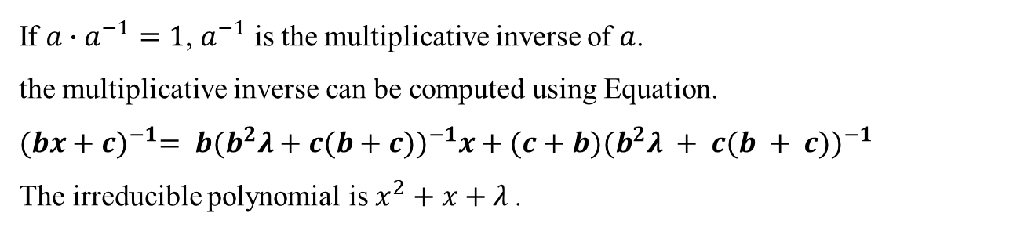



教育性晶片下線經驗-AES
Multiplicative inverse
If $a∙a^{−1}=1$, $a^{−1}$ is the multiplicative inverse of $a$.
the multiplicative inverse can be computed using Equation.
$${(bx+c)}^{−1}= b{(b^{2}λ+c(b+c))}^{−1}x+(c+b){(b^{2}λ + c(b + c))}^{−1}$$
The irreducible polynomial is $x^{2}+x+λ$.
4
$$x^{2}$$
$$×λ$$
$$×$$
4
data_in
8
$$δ$$
$$x^{−1}$$
8
$$δ^{−1}$$
8
data_out
4
$$×$$
$$×$$
4
06
Source : E. NC Mui, “Practical Implementation of Rijndael S-Box Using Combinational Logic,” unpublished draft.

Slide 20

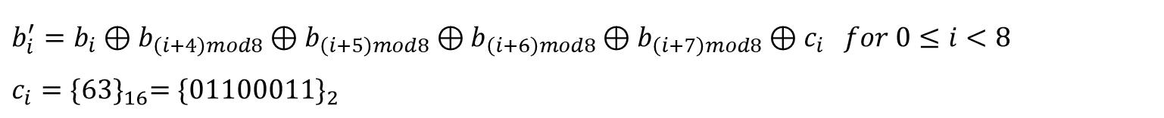
教育性晶片下線經驗-AES
Affine transformation
$b_{i}^{′}=b_{i}⊕b_{\left(i+4\right)mod8}⊕b_{\left(i+5\right)mod8}⊕b_{\left(i+6\right)mod8}⊕b_{\left(i+7\right)mod8}⊕c_{i}$ $for 0≤i<8$
$$c_{i}={\{63\}}_{16}={\{01100011\}}_{2}$$
$$\left[\begin{matrix}b_{0}^{′} \\ b_{1}^{′} \\ b_{2}^{′} \\ b_{3}^{′} \\ b_{4}^{′} \\ b_{5}^{′} \\ b_{6}^{′} \\ b_{7}^{′}\end{matrix}\right]=\left[\begin{matrix}1 & 0 & 0 & 0 & 1 & 1 & 1 & 1 \\ 1 & 1 & 0 & 0 & 0 & 1 & 1 & 1 \\ 1 & 1 & 1 & 0 & 0 & 0 & 1 & 1 \\ 1 & 1 & 1 & 1 & 0 & 0 & 0 & 1 \\ 1 & 1 & 1 & 1 & 1 & 0 & 0 & 0 \\ 0 & 1 & 1 & 1 & 1 & 1 & 0 & 0 \\ 0 & 0 & 1 & 1 & 1 & 1 & 1 & 0 \\ 0 & 0 & 0 & 1 & 1 & 1 & 1 & 1\end{matrix}\right]\left[\begin{matrix}b_{0} \\ b_{1} \\ b_{2} \\ b_{3} \\ b_{4} \\ b_{5} \\ b_{6} \\ b_{7}\end{matrix}\right]+\left[\begin{matrix}1 \\ 1 \\ 0 \\ 0 \\ 0 \\ 1 \\ 1 \\ 0\end{matrix}\right]$$
06

