Slide 1
02
Block Diagram

Slide 2
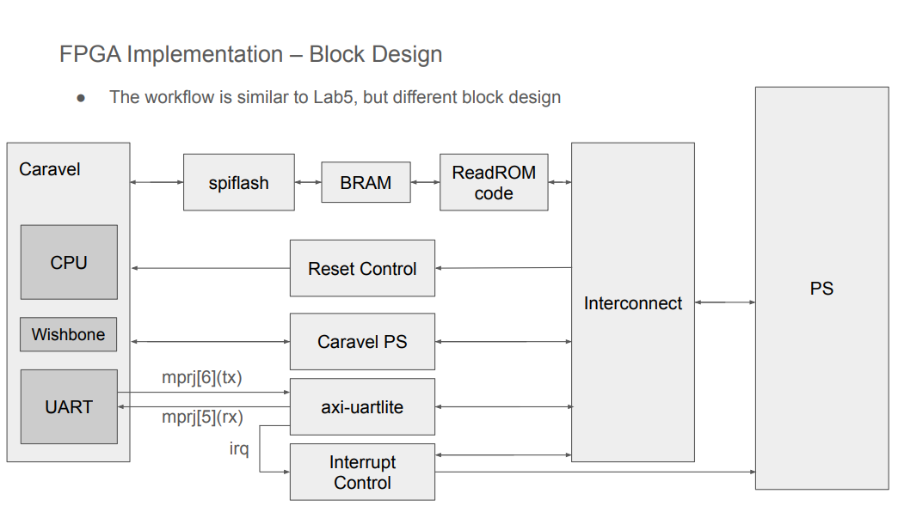
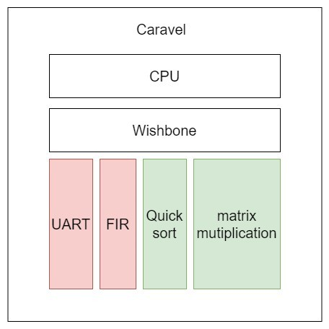
02
Block Diagram
4
Notes:
整體的架構目前預計還是和lab6相同。

Slide 3
03
Configuration Register Address Map

Slide 4
03
Configuration Register Address Map
User Project | Base Address Map
Memory Starting | 3800_0000
FIR Base Address | 3600_0000
Matrix Multiplication Base Address | 3400_0000
Quick Sort Base Address | 3200_0000
UART Base Address | 3000_0000
6
Notes:
這是我們的Configuration Register Address Map

Slide 5
03
Configuration Register Address Map - FIR
FIR
0x00 | [0] | ap_start (r/w)
 | [1] | ap_done (ro)
 | [2] | ap_idle (ro)
 | [3] | X[n]_ready to accept input (ro)
 | [4] | Y[n] is ready to read
0x10-13 | data-length
0x40-7F | Tap parameters
0x80-83 | X[n] input (r/w)
0x84-87 | Y[n] output (ro)
7

Slide 6
03
Configuration Register Address Map - Matrix Multiplication
Matrix Multiplication
0x00 | [0] | ap_start (r/w)
 | [1] | ap_done (ro)
 | [2] | ap_idle (ro)
 | [3] | X[n]_ready to accept input (ro)
 | [4] | Y[n] is ready to read
0x80-83 | X[n] input (r/w)
0x84-87 | Y[n] output (ro)
8

Slide 7
03
Configuration Register Address Map – Quick Sort
Quick Sort
0x00 | [0] | ap_start (r/w)
 | [1] | ap_done (ro)
 | [2] | ap_idle (ro)
 | [3] | X[n]_ready to accept input (ro)
 | [4] | Y[n] is ready to read
0x80-83 | X[n] input (r/w)
0x84-87 | Y[n] output (ro)
9

