Slide 1



Final Project Proposal
組員：蘇柏丞、呂彥霖、 陳泓宇
中華民國 112 年 12 月 14 日
Notes:
大家好，我是陳泓宇他是蘇她是呂。

Slide 2

Estimated performance
01
Function
02
Estimated performance
03
Block Diagram
OUTLINE
04
Register specification
05
Timeline
06
Work Partition
Notes:
以下是我們的今天簡報的大綱，總共有5章，第一章我會先介紹我們期末專題要做的方向，接著會說明我們的架構，再來是我們定義的configuration register，以及我們的時程表，最後是分工。

Slide 3
01
Function

Slide 4
01
Function
Matrix multiplication (4 x 4) and quick sort (11) accelerator will be designed.
Improve the previous fir and uart.
The Uart part will start with the baud rate.
The designs will be implemented on SoC.
The SoC will be program into FPGA and verified on jupyter notebook
The type of memory is BRAM.
2
Notes:
我們期末專題會先從兩個workload的加速器開始做起，再改進先前lab的fir和uart，達到加速的效果，而uart的部分會先從之前上課有提到的baud rate下手。
完成這些後將這些東西整合到soc裡面，並燒入到FPGA版上，最後使用jupyter來做驗證。
我們使用的記憶體是bram

Slide 5

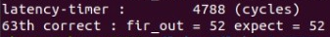
01
Function
Lab6
Use CPU to perform FIR
Per operation use
162388/11 = 14762.5 Cycles
Lab4-2
Use user hardware to perform FIR
Per operation use
4788/64 = 74.8 Cycles
3
Notes:
會想要直接從硬體下手是因為我們回顧先前4-2的lab的結果，並比對lab6中FIR部分，兩者的cycle數差距很大，

Slide 6
02
Estimated performance

Slide 7
02
Estimated performance
Sending 64 pieces of data from CPU to user hardware takes approximately 4976 cycles.
Sending one piece of data requires about 78 cycles.
Matrix multiplication takes 4976 cycles to transmit 32 pieces of data.
Quick sort requires 858 cycles to transmit 11 pieces of data.
Matrix multiplication is expected to be completed in 16 cycles.
Quick sort, in the worst-case scenario and using only one comparator, requires 55 cycles.
After computation, sending one piece of data to MPRJ takes about 70 cycles.
5
Notes:
那我們有大約做一下評估，使用先前lab的環境測出來傳送需要的時間，從cpu傳送64筆資料到我們的加速器約需要4976個cycle
因此每傳送一筆資料約78個cycle
所以算出來的矩陣乘法需要的資料約是4976個cycle
Quick sort約是需要858個cycle
運算完要傳送到mprj輸出大約是70個cycle
接下來是我們預計的硬體執行能力，矩陣乘法約需要16個cycle，quick sort最糟需要55個cycle，但此部分還沒有很確定，還要再邊執行邊修改。

Slide 8
02
Estimated performance
Cycle per data (sending) | 78
Cycle per data (writing) | 70
 | Cycle
Sending 32 +11 data from CPU to user hardware | 43 * 78 = 3354
Matrix multiplication | 16
Quick sort | 55
Sending 16 +11 data from user hardware to CPU | 27 * 70 = 1890
Overall | 5315
5
Notes:
這邊是我們要做的硬體加速部份的表格。

Slide 9
02
Estimated performance
CPU | Estimated performance for accelerator | After accelerated
289932 cycle | 5315 (MM & QS) + 4788 (FIR) = 10103 cycle | 289932 / 10103 = 28x
5
Notes:
這邊是我們預計的結果以及lab6測出來的數據，左邊只使用cpu的部分約需要29萬個cycle，右邊是放入硬體加速的部分，約需要10103個cycle，但此部分是沒有加上UART的部分。
預估會有28倍的加速，但這數字太離譜，中間應該還有許多我們沒注意到的細節，這部分會在期末報告再加上去。

Slide 10
03
Block Diagram

Slide 11
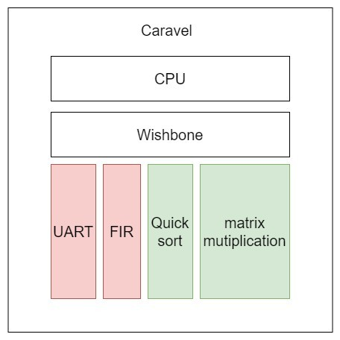
02
Block Diagram
5
Notes:
這是我們在期末專題所要修改的部分，其中紅色部分的uart fir 是之前的lab做的，會做小修改以符合我們的期末專題，而綠色部分是需要去實現的硬體部分。

Slide 12
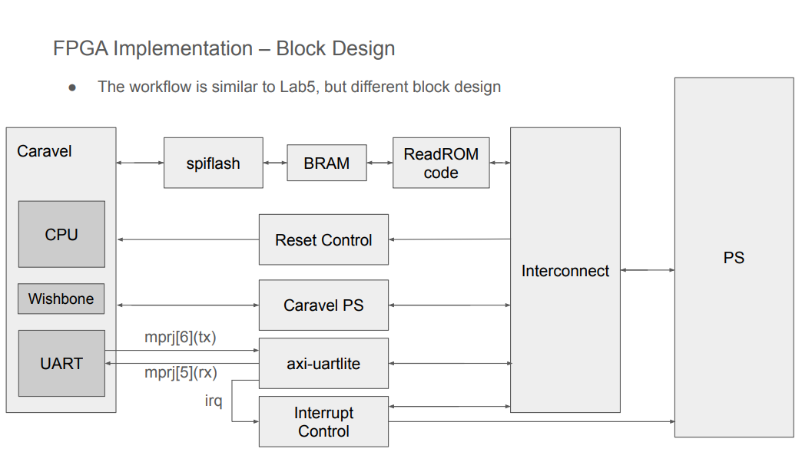
02
Block Diagram
5
Notes:
整體的架構目前預計還是和lab6相同。

Slide 13
03
Configuration Register Address Map

Slide 14
03
Configuration Register Address Map
User Project | Base Address Map
Memory Starting | 3800_0000
FIR Base Address | 3600_0000
Matrix Multiplication Base Address | 3400_0000
Quick Sort Base Address | 3200_0000
UART Base Address | 3000_0000
7
Notes:
這是我們的Configuration Register Address Map

Slide 15
03
Configuration Register Address Map - FIR
FIR
0x00 | [0] | ap_start (r/w)
 | [1] | ap_done (ro)
 | [2] | ap_idle (ro)
 | [3] | X[n]_ready to accept input (ro)
 | [4] | Y[n] is ready to read
0x10-13 | data-length
0x40-7F | Tap parameters
0x80-83 | X[n] input (r/w)
0x84-87 | Y[n] output (ro)
8

Slide 16
03
Configuration Register Address Map - Matrix Multiplication
Matrix Multiplication
0x00 | [0] | ap_start (r/w)
 | [1] | ap_done (ro)
 | [2] | ap_idle (ro)
 | [3] | X[n]_ready to accept input (ro)
 | [4] | Y[n] is ready to read
0x10-13 | data-length
0x80-83 | X[n] input (r/w)
0x84-87 | Y[n] output (ro)
9

Slide 17
03
Configuration Register Address Map – Quick Sort
Quick Sort
0x00 | [0] | ap_start (r/w)
 | [1] | ap_done (ro)
 | [2] | ap_idle (ro)
 | [3] | X[n]_ready to accept input (ro)
 | [4] | Y[n] is ready to read
0x10-13 | data-length
0x80-83 | X[n] input (r/w)
0x84-87 | Y[n] output (ro)
10

Slide 18
04
Timeline

Slide 19
05
Timeline
12/15 | 12/16 | 12/17 | 12/18 | 12/19 | 12/20 | 12/21 | 12/22 | 12/21 | 12/22 | 12/23 | 12/24 | 12/25 | 12/26 | 12/27 | 12/28
Topic Idea
HW/SW Impl
Integration
PYNQ
Conclusion
Presentation
12

Slide 20
05
Work Partition

Slide 21

05
Work Partition
蘇柏丞
Quick Sort
PPT
Implementation
呂彥霖
Matrix Multiplication
Report
PS side verification
陳泓宇
UART
FIR
Integration
14

Slide 22
Thanks for Your Attention

