Slide 1

About this Report
How to read this report
Table · 622 × 620
Definitions and data
Table · 622 × 620

Slide 2
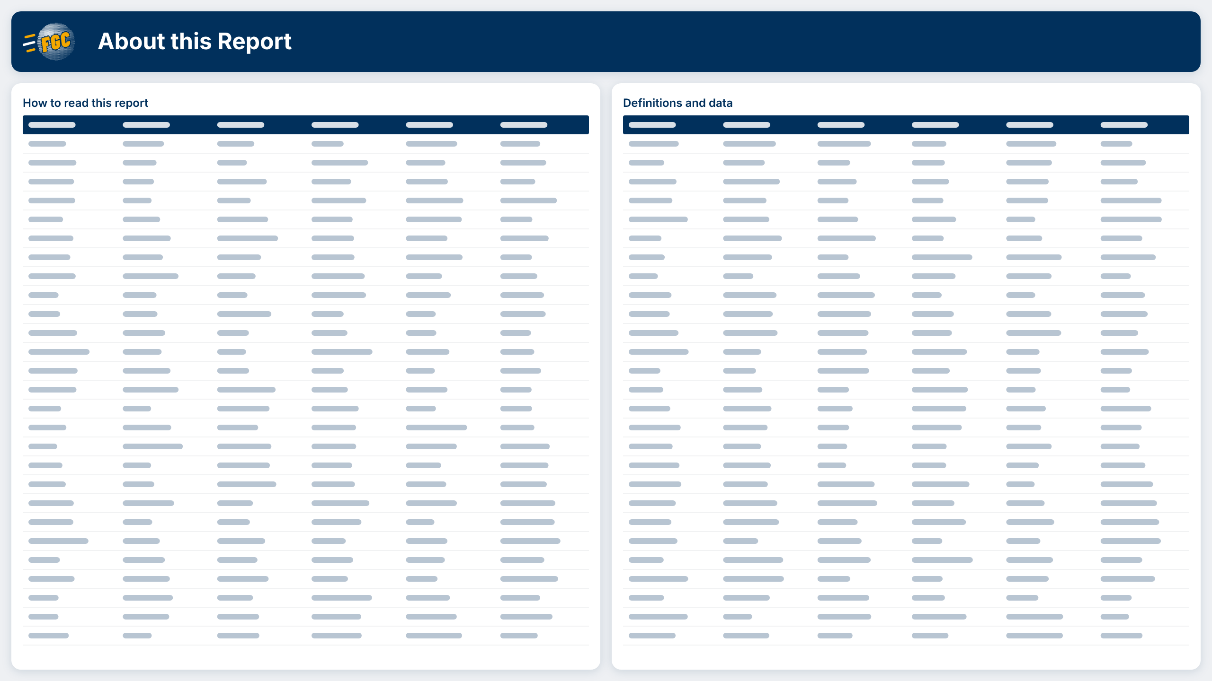

Slide 3


