Slide 1

The p-Dispersion Problem with Distance Constraints
UNIVERSITY OF WESTERN MACEDONIA
ELECTRICAL AND COMPUTER ENGINEERING
Name : Foteini Sarma
Email : ece01900@uowm.gr
Date : 2/2/2025
Course : Combinatorial optimization
Professor : Ploskas Nikolaos

Slide 2
Table of contents
01
Problem Description
Variant of p-dispersion with Minimum Distance Constraints for Facility Placement
02
Mathematical Model
Kuby based ILP model for the PDDP
03
Branch & Bound Implementations
Description and comparison of all the B&B implementations for the PDDP
04
Experimental Results
Performance Comparison of Custom B&B and Pyomo Model
05
Conclusions

Slide 3
01
Problem Description

Slide 4
Problem Description
The (max-min) p-dispersion problem aims to position a set of facilities within an area to maximize the minimum distance between any pair of facilities.
$\max{b}$, where the minimum distance between any pair of facilities
We examine a variant of this problem that includes additional constraints enforcing minimum allowable distances between facilities.
$x_{if_{1}}+x_{jf_{2}}≤1 ,$ where two facilities $f_{1}$ and $f_{2}$ can not be established at sites that are at a distance closer than the allowed distance between f1 and f2

Slide 5
Problem Description : Grid Creation
We assume that the candidate facility locations can are all placed in an $n×n$ grid. The grid is meant to simulate a map (e.g., $n=4$)
0
1
2
3
4
5
6
7
8
9
10
11
12
13
14
15

Slide 6
Problem Description : Candidate locations
Out of the $n^{2}$ possible locations we pick $P$ candidate facility locations. (e.g., $P=6$)
0
1
2
3
4
5
6
7
8
9
10
11
12
13
14
15

Slide 7
Problem Description : Distances between locations
All the $P^{2} −P$ possible distances between candidate facility locations must be calculated
0
1
2
3
4
5
6
7
8
9
10
11
12
13
14
15

Slide 8
Problem Description : Candidate facilities
We pick the $F$ number of facilities that we want to place. (e.g., $F=3$)
0
1
2
3
0
1
2
4
5
6
7
8
9
10
11
12
13
14
15

Slide 9



Problem Description : Distance constraints
All the $F^{2} −F$ distance constraints between the facilities must be set
0
1
2
3
$$d≥a$$
0
1
4
5
6
7
$$d≥b$$
0
2
8
9
10
11
$$d≥c$$
1
2
12
13
14
15

Slide 10



Problem Description
Whenever a potential solution is found, it must be verified that none of the distance constraints are violated.
0
1
2
1
$$d=3.162$$
0
5
6
7
$$d=3.605$$
$$d=3$$
8
9
10
11
12
13
14
2

Slide 11



Problem Description
For example, in the assignment below, even though the selected candidate facility sites have the maximum possible distance between them, the constraint between facilities 1 and 2 is violated.
0
1
2
1
$$d≥1$$
0
1
$$d=3.162$$
0
5
6
7
$$d≥1$$
0
2
$$d=3.605$$
$$d=3$$
8
9
10
11
$$d≥3.6$$
1
2
12
13
14
2

Slide 12
Problem Description
By adjusting the placement of the facilities within the same sites, we obtain the optimal solution.
0
1
2
0
$$d≥1$$
0
1
$$d=3.162$$
1
5
6
7
$$d≥1$$
0
2
$$d=3.605$$
$$d=3$$
8
9
10
11
$$d≥3.6$$
1
2
12
13
14
2

Slide 13

Problem Description
Unlike the classical p-dispersion problem, where a solution can always be found, the addition of distance constraints can render certain instances infeasible.
0
1
2
0
$$d≥0$$
0
1
$$d=3.162$$
1
5
6
7
$$d≥3.6$$
0
2
$$d=3.605$$
$$d=3$$
8
9
10
11
$$d≥3.6$$
1
2
12
13
14
2

Slide 14
02
Mathematical Model

Slide 15
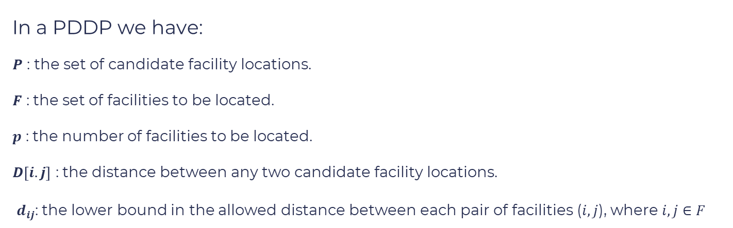
Mathematical Model
The ILP model used for the PDDP builds on Kuby’s classic p-dispersion formulation, extending it to accommodate heterogeneous facilities and enforce distance constraints.
In a PDDP we have:
$P$ : the set of candidate facility locations.
$F$ : the set of facilities to be located.
$p$ : the number of facilities to be located.
$D\left[i.j\right]$ : the distance between any two candidate facility locations.
$d_{ij}$: the lower bound in the allowed distance between each pair of facilities ($i,j$), where $i,j∈F$

Slide 16

Mathematical Model
In the extended model we have:
For each pair of facilities ($f_{1},f_{2}$) the set of quadruples ($i,j,f_{1},f_{2}$) is set of infeasible facility placements due to minimum distance constraints
$x_{ij}=1$: if facility $j∈F$ is placed at site $i∈P$ , 0 otherwise.
$y_{i}=1$: if facility $i∈P$ is placed at site, 0 otherwise.
$b$: The minimum facility distance to be maximized.
$C=\left\{\left(i,j,f_{1},f_{2}\right) | i,j∈P, f_{1},f_{2}∈F,D\left[i.j\right]≤d_{f_{1}f_{2}}\right\}, ∀ i∈P, ∀ j∈P,$

Slide 17
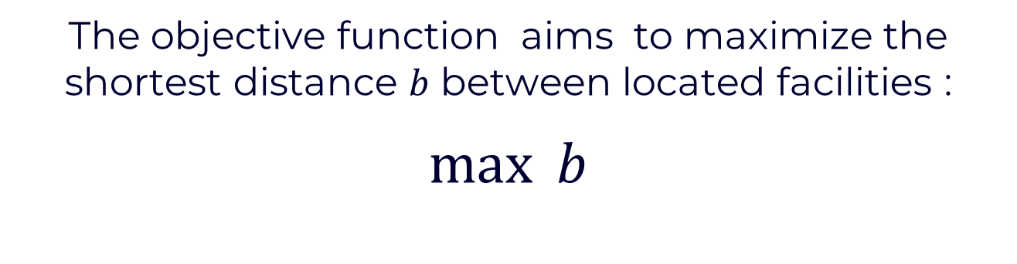
Mathematical Model : Objective Function
The objective function aims to maximize the shortest distance $b$ between located facilities :
$$\max{b}$$

Slide 18

Mathematical Model : Key Constraints
Constraint 2: Ensures exactly 𝑝 facilities are placed
$$\sum_{i∈P}{y_{i}}=p$$

Slide 19
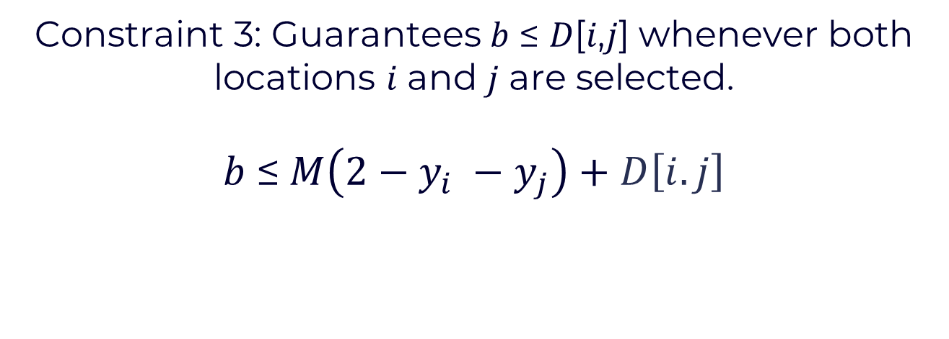
Mathematical Model : Key Constraints
Constraint 3: Guarantees 𝑏 ≤ 𝐷[𝑖,𝑗] whenever both locations 𝑖 and 𝑗 are selected.
$$b \text{≤} M\left({2−y}_{i} −y_{j}\right)+D\left[i.j\right]$$

Slide 20
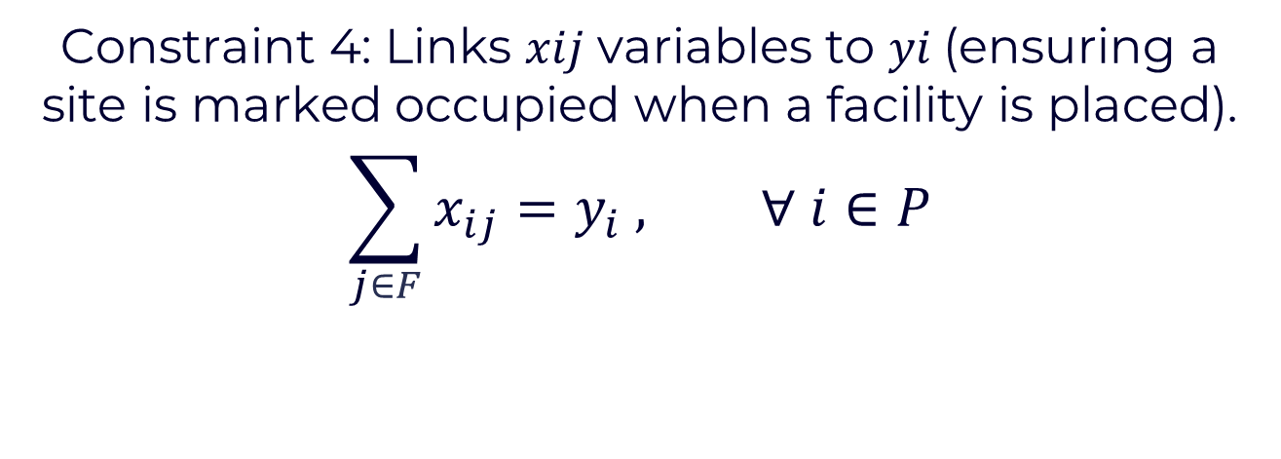
Mathematical Model : Key Constraints
Constraint 4: Links 𝑥𝑖𝑗 variables to 𝑦𝑖 (ensuring a site is marked occupied when a facility is placed).
$$\sum_{j∈F}{x_{ij}}=y_{i} , ∀ i∈P$$

Slide 21
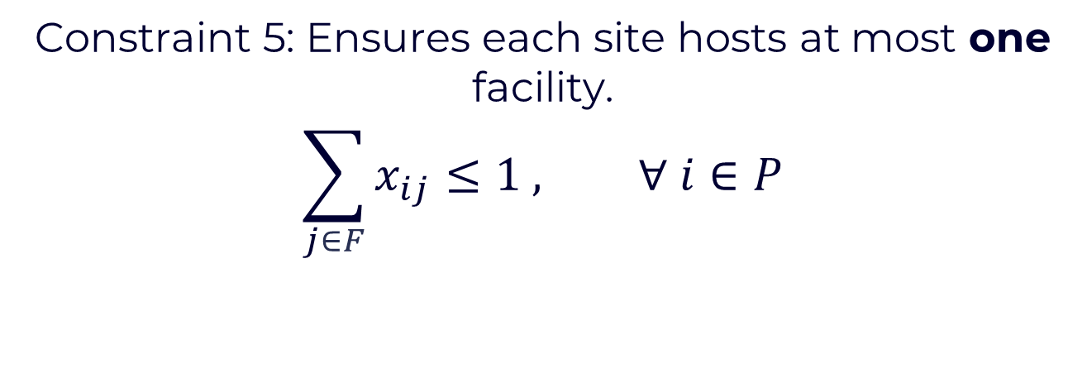
Mathematical Model : Key Constraints
Constraint 5: Ensures each site hosts at most one facility.
$$\sum_{j∈F}{x_{ij}}≤1 , ∀ i∈P$$

Slide 22
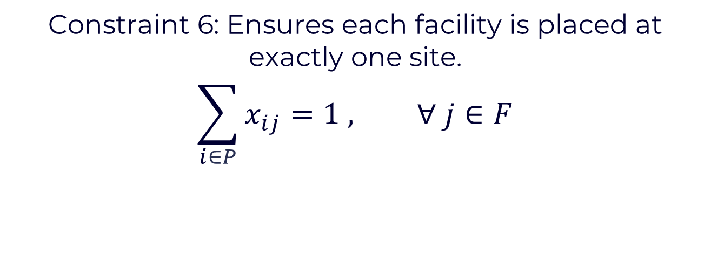
Mathematical Model : Key Constraints
Constraint 6: Ensures each facility is placed at exactly one site.
$$\sum_{i∈P}{x_{ij}}=1 , ∀ j∈F$$

Slide 23

Mathematical Model : Key Constraints
Constraint 7: Enforces minimum distance constraints between facilities.
$$x_{if_{1}}+x_{jf_{2}}≤1, ∀ \left(i,j,f_{1},f_{2}\right)∈C$$

Slide 24

Mathematical Model : Key Constraints
Constraint 8 & 9:.
$$x_{ij}∈\{0,1\}, ∀ i∈P, ∀ j∈P$$
$$y_{i}∈\{0,1\}, ∀ i∈P$$

Slide 25

Mathematical Model : Key Constraints
Constraint 10:.
$$b ≥ 0$$

Slide 26
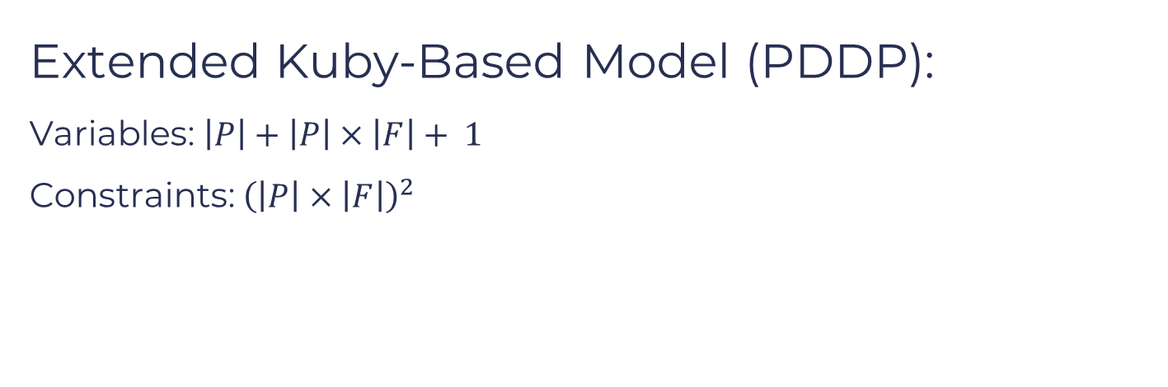
Mathematical Model : Model Complexity
Extended Kuby-Based Model (PDDP):
Variables: $\left|P\right|+\left|P\right|×\left|F\right|+ 1$
Constraints: ${\left(\left|P\right|×\left|F\right|\right)}^{2}$

Slide 27
03
Branch & Bound Implementations

Slide 28

Branch & Bound: Tree Search
Variables $y_{i}$: $\left|P\right|$
Variables $x_{ij}$: $\left|P\right|×\left|F\right|$
Objective Variable: $1$
Total Variables: $\left|P\right|+\left|P\right|×\left|F\right|+ 1$

Slide 29
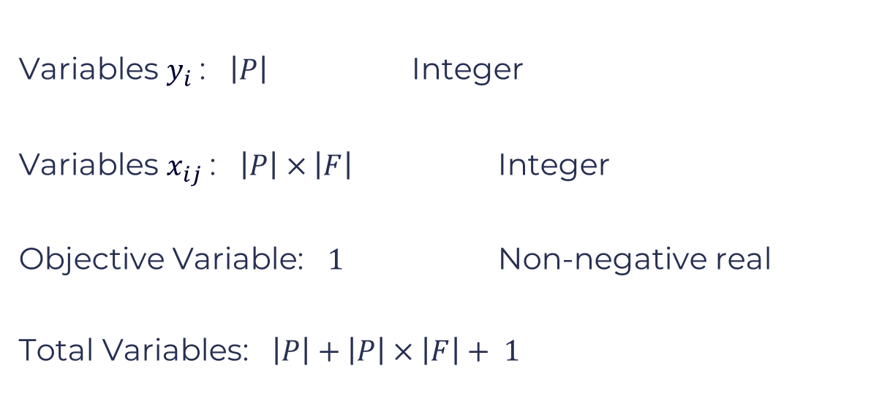
Branch & Bound: Tree Search
Variables $y_{i}$: $\left|P\right|$ Integer
Variables $x_{ij}$: $\left|P\right|×\left|F\right|$ Integer
Objective Variable: $1$ Non-negative real
Total Variables: $\left|P\right|+\left|P\right|×\left|F\right|+ 1$

Slide 30










Branch & Bound: Tree Search
$$y_{a}=0$$
$$y_{a}=1$$
$$y_{b}=0$$
$$y_{b}=1$$
$$y_{b}=0$$
$$y_{b}=1$$
$$y_{c}=1$$
$$y_{c}=1$$
$$y_{c}=0$$
$$y_{c}=0$$
$$y_{c}=1$$
$$y_{c}=0$$
$$y_{c}=0$$
$$y_{c}=1$$

Slide 31








Branch & Bound: Tree Search
$$y_{a}=0$$
$$y_{a}=1$$
$$y_{b}=0$$
$$y_{b}=1$$
$$y_{b}=0$$
$$y_{b}=1$$
$$\left|P\right|$$
$$y_{c}=1$$
$$y_{c}=1$$
$$y_{c}=0$$
$$y_{c}=0$$
$$y_{c}=1$$
$$y_{c}=0$$
$$y_{c}=0$$
$$y_{c}=1$$
$$…$$
$$…$$
$$…$$
$$…$$
$$…$$
$$…$$
$$…$$
$$…$$

Slide 32










































Branch & Bound: Tree Search
$$\left|P\right|$$
$$y_{p}=1$$
$$y_{p}=1$$
$$y_{p}=0$$
$$y_{p}=0$$
$$y_{p}=1$$
$$y_{p}=0$$
$$y_{p}=0$$
$$y_{p}=1$$
$$…$$
$$…$$
$$…$$
$$…$$
$$…$$
$$…$$
$$…$$
$$…$$
$$x_{aa}=1$$
$$x_{aa}=0$$
$$x_{aa}=1$$
$$x_{aa}=1$$
$$x_{aa}=1$$
$$x_{aa}=1$$
$$x_{aa}=1$$
$$x_{aa}=1$$
$$x_{aa}=0$$
$$x_{aa}=0$$
$$x_{aa}=0$$
$$x_{aa}=0$$
$$x_{aa}=0$$
$$x_{aa}=0$$
$$x_{aa}=0$$
$$x_{aa}=1$$
$$…$$
$$…$$
$$…$$
$$…$$
$$…$$
$$…$$
$$…$$
$$…$$
$$…$$
$$…$$
$$…$$
$$…$$
$$…$$
$$…$$
$$…$$
$$…$$
$$…$$
$$…$$
$$…$$
$$…$$
$$…$$
$$…$$
$$…$$
$$…$$
$$\left|P\right|×\left|F\right|$$
$$…$$
$$…$$
$$…$$
$$…$$
$$…$$
$$…$$
$$…$$
$$…$$
$$…$$
$$…$$
$$…$$
$$x_{PF}=1$$
$$x_{PF}=1$$
$$x_{PF}=1$$
$$x_{PF}=1$$
$$x_{PF}=1$$
$$x_{PF}=1$$
$$x_{PF}=1$$
$$x_{PF}=1$$
$$x_{PF}=1$$
$$x_{PF}=1$$
$$x_{PF}=1$$
$$x_{PF}=0$$
$$x_{PF}=0$$
$$x_{PF}=0$$
$$x_{PF}=0$$
$$x_{PF}=0$$
$$x_{PF}=0$$
$$x_{PF}=0$$
$$x_{PF}=0$$
$$x_{PF}=0$$
$$x_{PF}=0$$
$$x_{PF}=0$$

Slide 33
Branch & Bound: Tree Search
Depth First Search:
- Uses a Stack for node expansion
- Objective Function Value is computed after a node is
pushed onto the stack
- Two Variants: a) Expand 0
b) Expand 1

Slide 34
Branch & Bound: Tree Search – DFS 0
$$y_{a}=0$$
$$y_{a}=1$$
$$y_{b}=0$$
$$y_{b}=1$$
$$y_{b}=0$$
$$y_{b}=1$$
$$y_{c}=1$$
$$y_{c}=1$$
$$y_{c}=0$$
$$y_{c}=0$$
$$y_{c}=1$$
$$y_{c}=0$$
$$y_{c}=0$$
$$y_{c}=1$$

Slide 35



Branch & Bound: Tree Search – DFS 0
$$y_{a}=0$$
$$y_{a}=1$$
$$y_{b}=0$$
$$y_{b}=1$$
$$y_{b}=0$$
$$y_{b}=1$$
$$y_{c}=1$$
$$y_{c}=1$$
$$y_{c}=0$$
$$y_{c}=0$$
$$y_{c}=1$$
$$y_{c}=0$$
$$y_{c}=0$$
$$y_{c}=1$$

Slide 36
Branch & Bound: Tree Search – DFS 1
$$y_{a}=0$$
$$y_{a}=1$$
$$y_{b}=0$$
$$y_{b}=1$$
$$y_{b}=0$$
$$y_{b}=1$$
$$y_{c}=1$$
$$y_{c}=1$$
$$y_{c}=0$$
$$y_{c}=0$$
$$y_{c}=1$$
$$y_{c}=0$$
$$y_{c}=0$$
$$y_{c}=1$$

Slide 37



Branch & Bound: Tree Search – DFS 1
$$y_{a}=0$$
$$y_{a}=1$$
$$y_{b}=0$$
$$y_{b}=1$$
$$y_{b}=0$$
$$y_{b}=1$$
$$y_{c}=1$$
$$y_{c}=1$$
$$y_{c}=0$$
$$y_{c}=0$$
$$y_{c}=1$$
$$y_{c}=0$$
$$y_{c}=0$$
$$y_{c}=1$$

Slide 38
Branch & Bound: Tree Search
Best First Search:
- Uses a Priority Queue for node selection
- Objective Function Value is computed before pushing a
node onto the priority queue
- Prioritizes Nodes with the highest objective function value

Slide 39


Branch & Bound: Tree Search – BFS
$$y_{a}=0$$
$$y_{a}=1$$
$$ObjVal=20.1$$
$$ObjVal=25.3$$

Slide 40



Branch & Bound: Tree Search – BFS
$$y_{a}=0$$
$$y_{a}=1$$
$$ObjVal=25.3$$
$$ObjVal=20.1$$
$$y_{b}=0$$
$$y_{b}=1$$
$$ObjVal=13.9$$
$$ObjVal=19.8$$

Slide 41


Branch & Bound: Tree Search – BFS
$$y_{a}=0$$
$$y_{a}=1$$
$$ObjVal=20.1$$
$$ObjVal=25.3$$
$$y_{b}=0$$
$$y_{b}=1$$
$$y_{b}=0$$
$$y_{b}=1$$
$$ObjVal=18.2$$
$$ObjVal=20$$
$$ObjVal=13.9$$
$$ObjVal=19.8$$

Slide 42

Branch & Bound: Tree Search – BFS
$$y_{a}=0$$
$$y_{a}=1$$
$$ObjVal=20.1$$
$$ObjVal=25.3$$
$$y_{b}=0$$
$$y_{b}=1$$
$$y_{b}=0$$
$$y_{b}=1$$
$$ObjVal=18.2$$
$$ObjVal=20$$
$$ObjVal=13.9$$
$$ObjVal=19.8$$

Slide 43
Branch & Bound: Variable order
Variable Ordering Strategies:
Two approaches are used to select the next variable to be fixed: - Fractional First: Select the first variable with a fractional
value from all integer-constrained variables.
- Predefined Order: Use a predefined array of variables and
select the first fractional variable from the list.

Slide 44










Branch & Bound: Variable order - Fractional First
Select the first variable with a fractional value from all integer-constrained variables.
$$y_{0}$$
$$y_{1}$$
$$…$$
$$y_{P−1}$$
$$x_{00}$$
$$x_{01}$$
$$x_{02}$$
$$…$$
$$x_{(P−1)(F−1)}$$
$$b$$
Integers

Slide 45
Branch & Bound: Variable order - Fractional First
Select the first variable with a fractional value from all integer-constrained variables.
$$y_{0}$$
$$y_{1}$$
$$…$$
$$y_{P−1}$$
$$x_{00}$$
$$x_{01}$$
$$x_{02}$$
$$…$$
$$x_{(P−1)(F−1)}$$
$$b$$
Integers

Slide 46
Branch & Bound: Variable order - Fractional First
Select the first variable with a fractional value from all integer-constrained variables.
$$y_{0}$$
$$y_{1}$$
$$…$$
$$y_{P−1}$$
$$x_{00}$$
$$x_{01}$$
$$x_{02}$$
$$…$$
$$x_{(P−1)(F−1)}$$
$$b$$
Integers

Slide 47
Branch & Bound: Variable order - Fractional First
Select the first variable with a fractional value from all integer-constrained variables.
$$y_{0}$$
$$y_{1}$$
$$…$$
$$y_{P−1}$$
$$x_{00}$$
$$x_{01}$$
$$x_{02}$$
$$…$$
$$x_{(P−1)(F−1)}$$
$$b$$
Integers

Slide 48
Branch & Bound: Variable order - Fractional First
Select the first variable with a fractional value from all integer-constrained variables.
$$y_{0}$$
$$y_{1}$$
$$…$$
$$y_{P−1}$$
$$x_{00}$$
$$x_{01}$$
$$x_{02}$$
$$…$$
$$x_{(P−1)(F−1)}$$
$$b$$
Integers

Slide 49
Branch & Bound: Variable order - Fractional First
Select the first variable with a fractional value from all integer-constrained variables.
$$y_{0}$$
$$y_{1}$$
$$…$$
$$y_{P−1}$$
$$x_{00}$$
$$x_{01}$$
$$x_{02}$$
$$…$$
$$x_{(P−1)(F−1)}$$
$$b$$
Integers

Slide 50
Branch & Bound: Variable order - Fractional First
Select the first variable with a fractional value from all integer-constrained variables.
$$y_{0}$$
$$y_{1}$$
$$…$$
$$y_{P−1}$$
$$x_{00}$$
$$x_{01}$$
$$x_{02}$$
$$…$$
$$x_{(P−1)(F−1)}$$
$$b$$
Integers

Slide 51
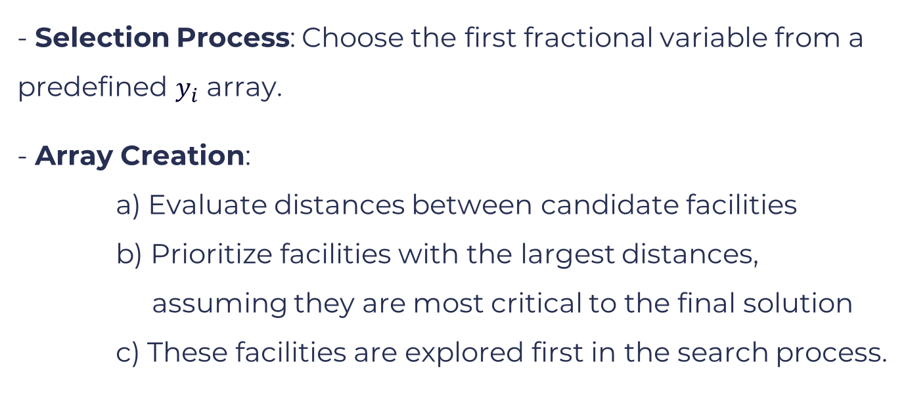
Branch & Bound: Variable order - Predefined Order
- Selection Process: Choose the first fractional variable from a predefined $y_{i}$ array.
- Array Creation:
a) Evaluate distances between candidate facilities
b) Prioritize facilities with the largest distances, assuming they are most critical to the final solution
c) These facilities are explored first in the search process.

Slide 52



















Branch & Bound: Variable order - Predefined Order
Predefined $y_{i}$Order array :
$$y_{2}$$
$$y_{0}$$
$$y_{1}$$
$$y_{P−1}$$
$$…$$
$$y_{3}$$
$$y_{0}$$
$$y_{1}$$
$$y_{2}$$
$$y_{3}$$
$$…$$
$$y_{P−1}$$
$$x_{00}$$
$$x_{01}$$
$$x_{02}$$
$$…$$
$$x_{(P−1)(F−1)}$$
$$b$$
Integers

Slide 53
Branch & Bound: Variable order - Predefined Order
Predefined $y_{i}$Order array :
$$y_{2}$$
$$y_{0}$$
$$y_{1}$$
$$y_{P−1}$$
$$…$$
$$y_{3}$$
$$y_{0}$$
$$y_{1}$$
$$y_{2}$$
$$y_{3}$$
$$…$$
$$y_{P−1}$$
$$x_{00}$$
$$x_{01}$$
$$x_{02}$$
$$…$$
$$x_{(P−1)(F−1)}$$
$$b$$
Integers

Slide 54
Branch & Bound: Variable order - Predefined Order
Predefined $y_{i}$Order array :
$$y_{2}$$
$$y_{0}$$
$$y_{1}$$
$$y_{P−1}$$
$$…$$
$$y_{3}$$
$$y_{0}$$
$$y_{1}$$
$$y_{2}$$
$$y_{3}$$
$$…$$
$$y_{P−1}$$
$$x_{00}$$
$$x_{01}$$
$$x_{02}$$
$$…$$
$$x_{(P−1)(F−1)}$$
$$b$$
Integers

Slide 55
Branch & Bound: Variable order - Predefined Order
Predefined $y_{i}$Order array :
$$y_{2}$$
$$y_{0}$$
$$y_{1}$$
$$y_{P−1}$$
$$…$$
$$y_{3}$$
$$y_{0}$$
$$y_{1}$$
$$y_{2}$$
$$y_{3}$$
$$…$$
$$y_{P−1}$$
$$x_{00}$$
$$x_{01}$$
$$x_{02}$$
$$…$$
$$x_{(P−1)(F−1)}$$
$$b$$
Integers

Slide 56
Branch & Bound: Variable order - Predefined Order
Predefined $y_{i}$Order array :
$$y_{2}$$
$$y_{0}$$
$$y_{1}$$
$$y_{P−1}$$
$$…$$
$$y_{3}$$
$$y_{0}$$
$$y_{1}$$
$$y_{2}$$
$$y_{3}$$
$$…$$
$$y_{P−1}$$
$$x_{00}$$
$$x_{01}$$
$$x_{02}$$
$$…$$
$$x_{(P−1)(F−1)}$$
$$b$$
Integers

Slide 57








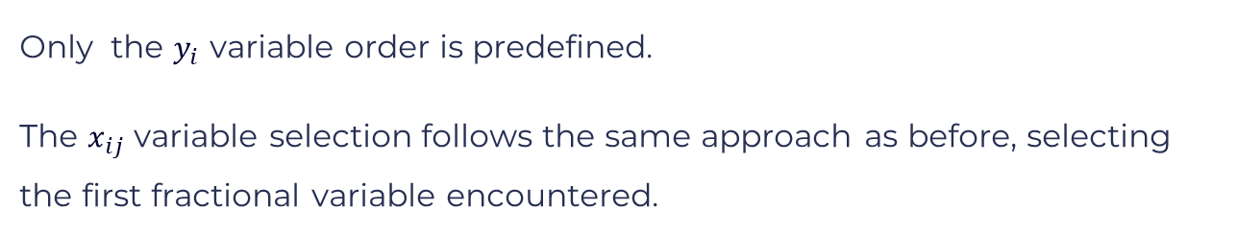




Branch & Bound: Variable order - Predefined Order
Only the $y_{i}$ variable order is predefined.
The $x_{ij}$ variable selection follows the same approach as before, selecting the first fractional variable encountered.
$$y_{0}$$
$$y_{1}$$
$$y_{2}$$
$$y_{3}$$
$$…$$
$$y_{P−1}$$
$$x_{00}$$
$$x_{01}$$
$$x_{02}$$
$$…$$
$$x_{(P−1)(F−1)}$$
$$b$$
Integers

Slide 58
Branch & Bound: Heuristic Solution Pruning
By applying a heuristic before starting the search, we can quickly identify a feasible solution.
This allows us to prune branches of the search tree that are less promising, reducing the search space

Slide 59


Branch & Bound: Heuristic Solution Pruning
If the random heuristic estimates the cost of a feasible solution as A, any branch with a value less than A will be immediately pruned.
$$y_{a}=0$$
$$y_{a}=1$$
$$ObjVal=c>A$$
$$ObjVal=b<A$$
$$y_{b}=0$$
$$y_{b}=1$$

Slide 60
Branch & Bound: Heuristic Solution Pruning
If the random heuristic estimates the cost of a feasible solution as A, any branch with a value less than A will be immediately pruned.
$$y_{a}=0$$
$$y_{a}=1$$
$$ObjVal=c>A$$
$$ObjVal=b<A$$
$$y_{b}=0$$
$$y_{b}=1$$

Slide 61
Branch & Bound: Upper Bound Update
To correctly update the upper bound, careful consideration is needed when selecting the best bound at each depth. Due to the presence of the Big M in our constraints, some objective function values can be excessively large. If we simply choose the largest value as the best bound at each depth because we have a maximization problem without accounting for feasibility, the upper bound may never reflect a valid solution.

Slide 62











Branch & Bound: Upper Bound Update
For example, if the maximum distance between any two facilities is 10 then the only potential feasible solutions are below 10
1657.2
$$y_{a}=0$$
$$y_{a}=1$$
1575.6
856.3
Best bound in depth 1: 1575.6
$$y_{b}=0$$
$$y_{b}=1$$
$$y_{b}=0$$
$$y_{b}=1$$
652.4
381.5
5.89
8.56
Best bound in depth 2 : 8.56
$$y_{c}=0$$
$$y_{c}=1$$
$$y_{c}=0$$
$$y_{c}=1$$
$$y_{c}=0$$
$$y_{c}=1$$
$$y_{c}=0$$
$$y_{c}=1$$

Slide 63
Branch & Bound: Experimental Results
Twelve variations of the branch and bound algorithm were tested:
- BFS_ordered_heuristic.py
- BFS_ordered_no_heuristic.py
- BFS_unordered_heuristic.py
- BFS_unordered_no_heuristic.py
- DFS_ordered_heuristic_0.py
- DFS_ordered_heuristic_1.py
- DFS_ordered_no_heuristic_0.py
- DFS_ordered_no_heuristic_1.py
- DFS_unordered_heuristic_0.py
- DFS_unordered_heuristic_1.py
- DFS_unordered_no_heuristic_0.py
- DFS_unordered_no_heuristic_1.py

Slide 64
Branch & Bound : Experimental Results
The best overall performance was achieved with BFS_unordered_heuristic.py, which applies a random heuristic at the start of the algorithm to identify a feasible solution and prune the search space accordingly. It then performs a Best-First Search (BFS) using a priority queue, selecting the first variable with a fractional value from all integer-constrained variables.

Slide 65
04
Experimental Results

Slide 66
Experimental Results
To evaluate the performance of our custom Branch and Bound algorithm, we conducted a computational study comparing it to a model implemented in Pyomo. We generated ten classes of problems, each containing 10 instances. Each problem was run five times for smaller instances and three times for larger ones, where any problem exceeding 5 minutes of runtime was classified as large.

Slide 67
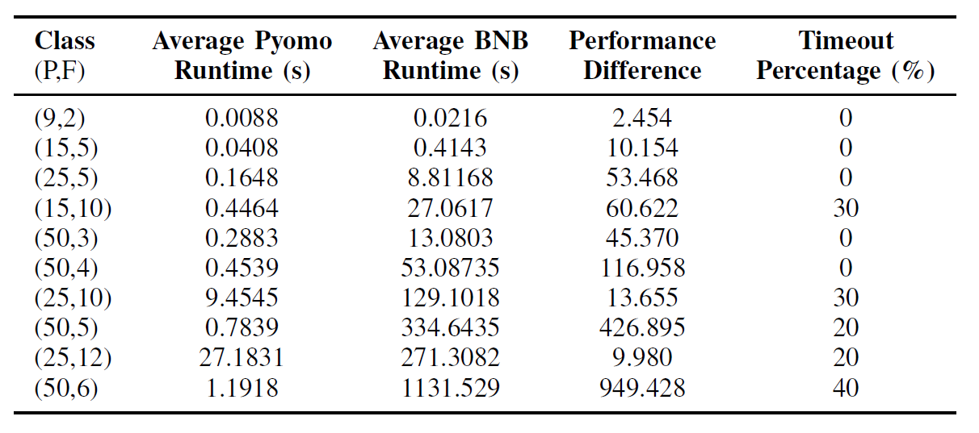
Experimental Results

Slide 68
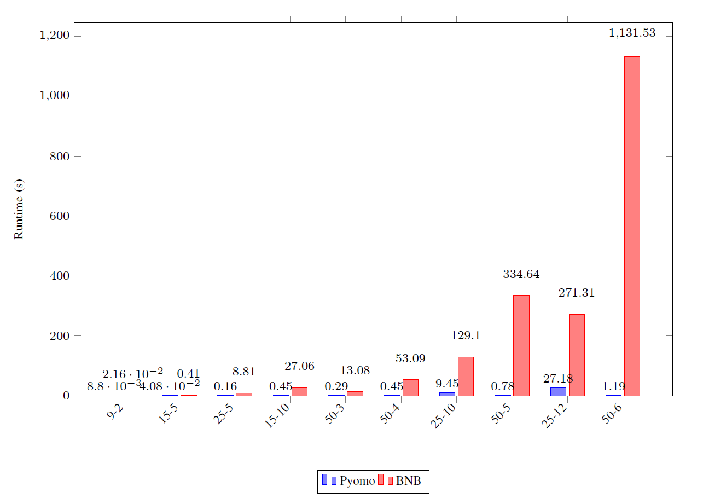
Experimental Results: Runtime difference

Slide 69
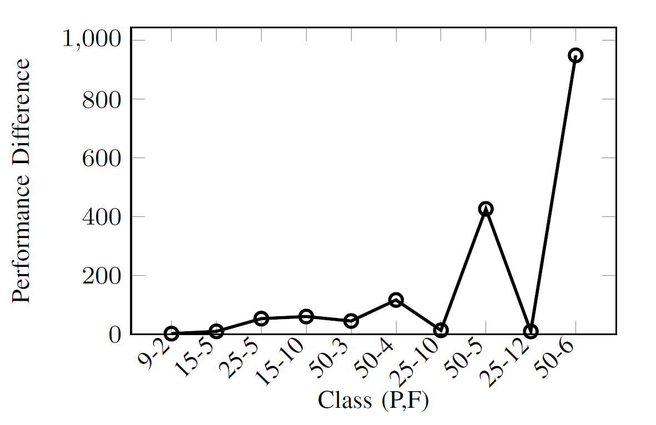
Experimental Results: Performance Difference

Slide 70
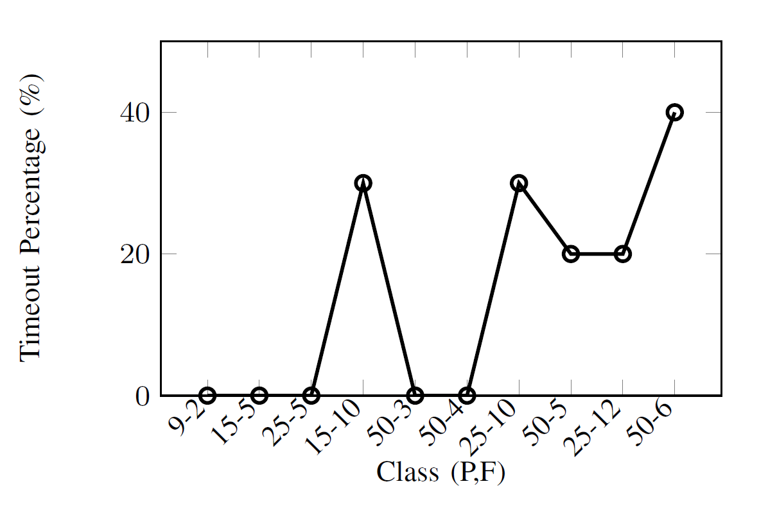
Experimental Results : Timeouts

Slide 71
05
Conclusion

Slide 72
Conclusion
We implemented a custom Branch-and-Bound algorithm for the p-dispersion problem with distance constraints. While our approach did not surpass the runtime performance of Pyomo, it was still capable of finding high-quality solutions for most of the instances it solved.

