Slide 1
Final Project Presentation by Nadir Aqbal
Analysis of Students Performance

Slide 2
Problem Statement and Relevance
Analyzed factors affecting students academic success.
Focused on final grades (G3) in secondary education.
Goal: Identify at-risk students and design better interventions.

Slide 3
Methodology
Dataset:
student-mat.csv with 33 attributes.
Tools: Python, Pandas, Matplotlib, Seaborn.
Steps: Data cleaning, EDA, visualization of grade trends.

Slide 4

Visualizations
Histogram of final grades (G3).
Bar plots: Average G3 by school, gender, address, family size, etc.
Compared performance across multiple categorical variables.

Slide 5
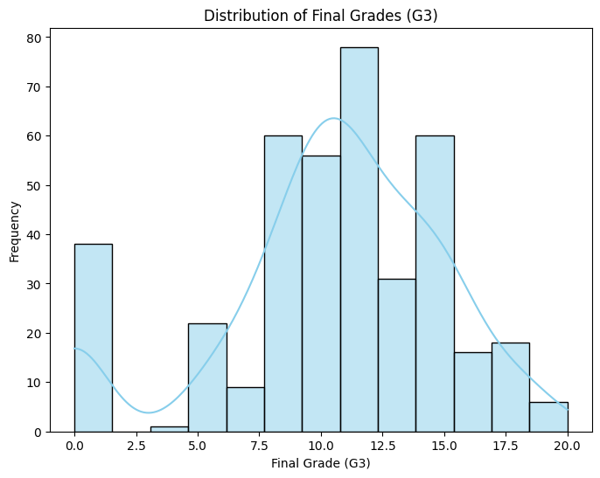
Visualizations

Slide 6
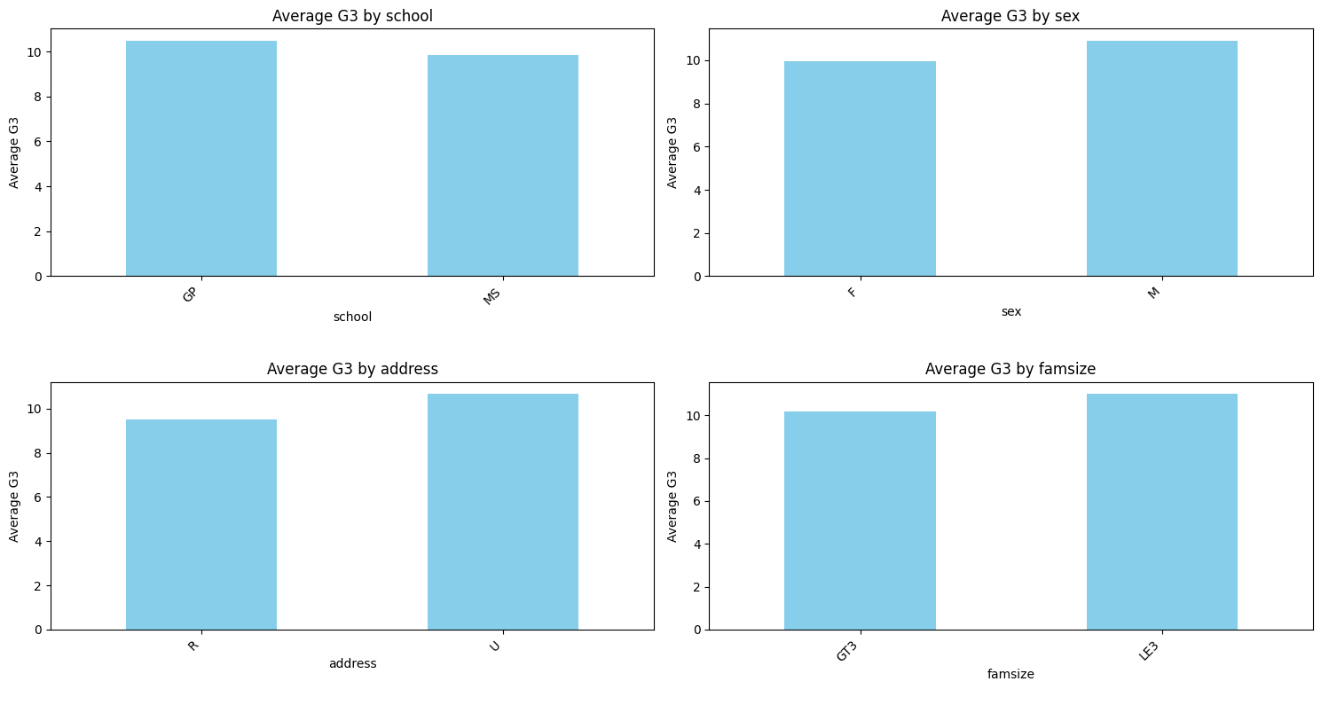
Visualizations

Slide 7
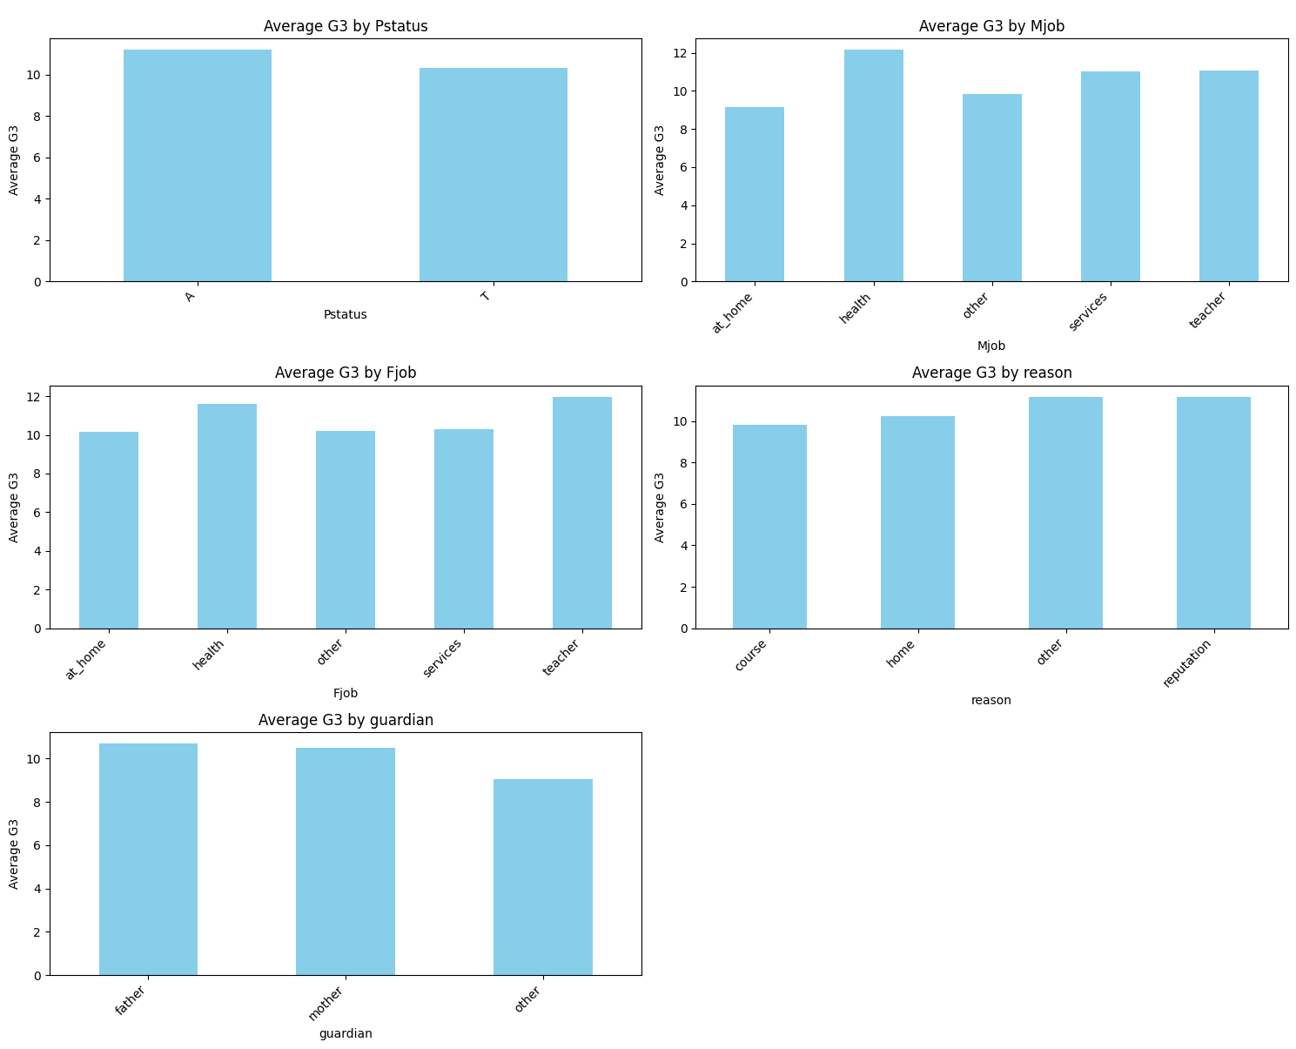
Visualizations

Slide 8
Key Findings
G3 distribution slightly left-skewed: higher scores common.
Gabriel Pereira school students performed better than MS.
Students with mothers in healthcare had lower average grades.
Urban students and smaller families had slight performance edge.

Slide 9
Reflections & Lessons Learned
Improved visualization and data interpretation skills.
Learned to handle categorical data in analysis.
Realized academic success is multifactorial.

Slide 10

Improvements & Next Steps
Use statistical tests (e.g., t-tests, ANOVA) for validation.
Include variables like study time, absences, parental education.
Explore ML models for grade prediction (e.g., regression).

Slide 11
Conclusion
Visual analysis provided actionable insights.
School environment and parental factors matter.
Next: Expand scope and use predictive modeling.

Slide 12

Thank you!

