Slide 1
Robotics
Team Member :
Qisai Liu
Fateme Fotouhi Ardakani
Jiaqiong Li

Slide 2
Question 1
First, reading the file depend on the ends in order to distinguish positive and negative files
Second, plotting the rectangular using “cv2.plylines” by grouping all the vertices from the locational files.
Looping it over for all the rectangles in locational files, and also all the provide files

Slide 3
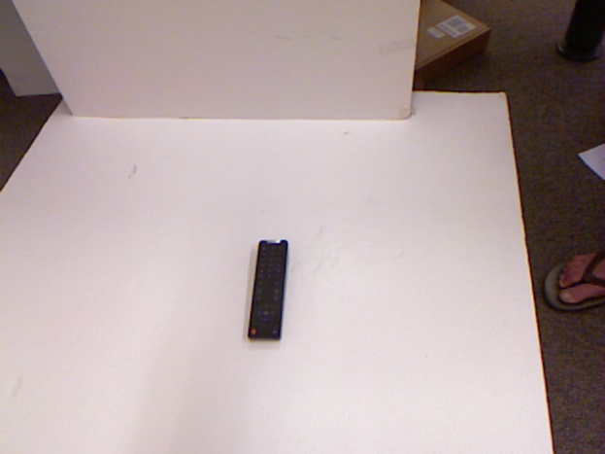
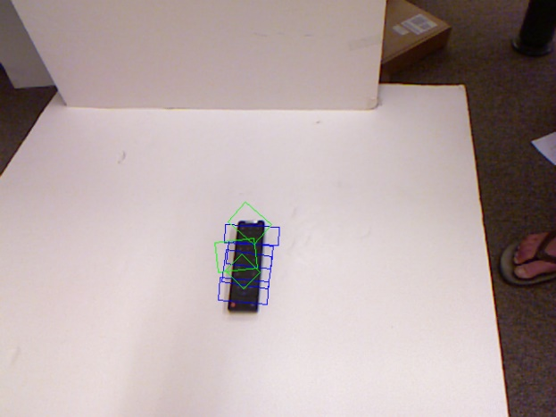
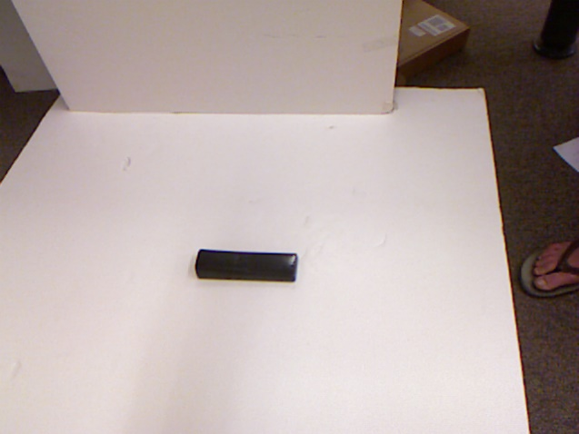
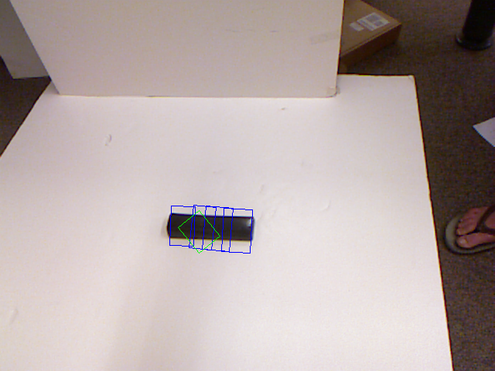
Example results

Slide 4
Question 2
First, reading the x, y, z location file to have the location
Second, using the distance equation to calculate the depth of the image. Distance equation :
d=√((x)²+(y)²+(z) ²)
Concatenation the depth value with the original RGB value to formalte the size of ( 480, 640, 4 )

Slide 5
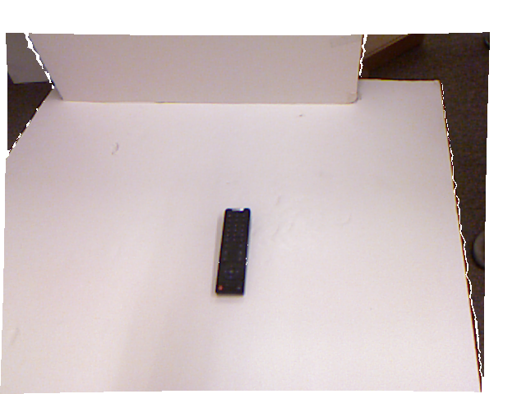
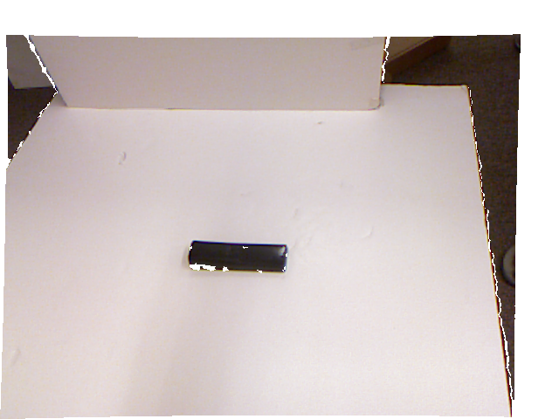
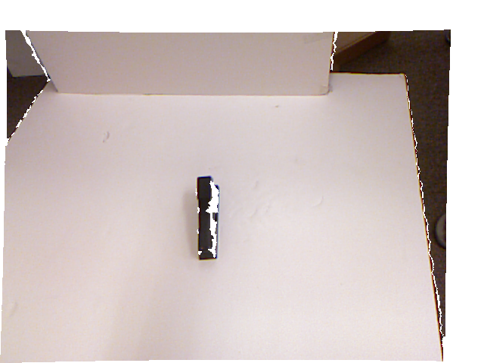
Example results

Slide 6
Question 3
First, using rectangles locational files extract sub-patches of images
Secondly, Convert the first 3 channels of the RGB-D image to YUV.
Here the Conversion applied two method, first is using the “cv2. cvtColor” , and second is manually computing. The result is different

Slide 7

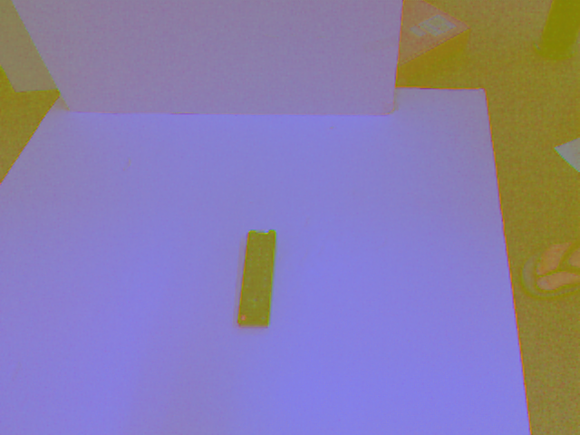
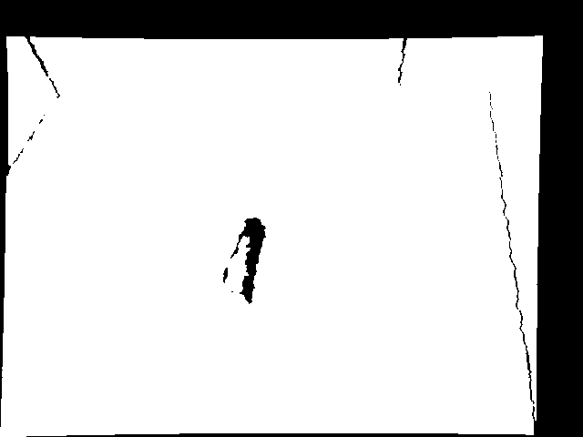
Example results for cv2.cvtColor

Slide 8
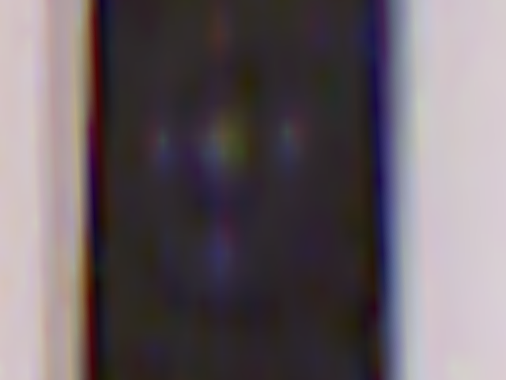
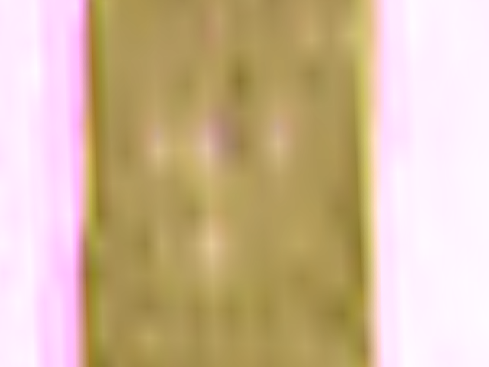
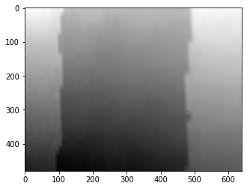
Example results for manually computing
Original image
YUV image
Depth image

Slide 9
Question 4
Using the sklearn PCA to compute the PCA with Whitening
Set up different values of SVD approximations
Apply pca.fit and pca.transform(X)
Plotting the result depth image arranged by SVD approximations

Slide 10
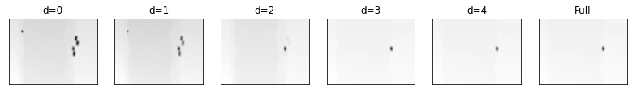
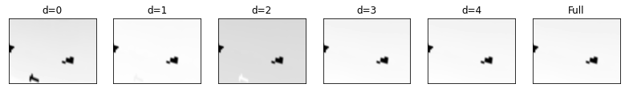
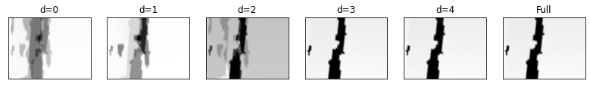
Example results

