Slide 1
DIET TRACKING SYSTEM
Database Practical Assignment
Fouad Bellili · Jakub Blaszczyk
Universidade de Aveiro — Bases de Dados — 2025/2026
Submission: June 3, 2026

Slide 2
01
02
03
04
05
06
07
08
Presentation Agenda
Project Overview
Requirements Analysis
Database Design
SQL Implementation
01
02
03
04
What the system does and why
Functional & non-functional requirements
ERD, Relational schema, normalization
DDL, indexes, constraints
Advanced SQL
C# Application
Demo Video
Delivery Checklist
05
06
07
08
Stored procedures, triggers, UDFs, views
Windows Forms GUI & connection
Live demonstration of the system
What is submitted

Slide 3
Project Overview
What is the Diet Tracking System?
11
7
A nutritional tracking platform built on SQL Server, backed by a C# Windows Forms application.
Tables
Stored Procedures
Log daily food intake
Follow personalized diet plans
Track weight progress over time
Subscribe to premium tiers
Make and track payments
4
3
UDFs
Triggers

Slide 4
Requirements Analysis
⚙ Functional Requirements
🛡 Non-Functional Requirements
RF01 — User registration & authentication
RF02 — Browse & subscribe to diet plans
RF03 — Log meals in a daily food diary
RF04 — Auto-calculate calories & macros
RF05 — Record weight & track progress
RF06 — Nutritionists manage diet plans
RF07 — Subscription tiers with features
RF08 — Payment recording & linking
RF09 — Automatic subscription updates
RF10 — BMI calculation from profile
Database: SQL Server (MSSQL)
Passwords stored in hashed form
One diary per user per day enforced
Nutritional values per 100g, extrapolated by meal quantity
C# Windows Forms GUI (Visual Studio)
Connection strings configurable for deployment

Slide 5
Database Design — Entities
Junction tables: plan_schedule_meals · user_diet_plans · log_meals
users
nutritionists
foods
Registered users with profile & goals
Professionals creating diet plans
Food items with nutritional data per 100g
diet_plans
meals
plan_schedules
Plans created by nutritionists
Food + quantity combinations
Weekly plan scheduling
daily_logs
progress
subscription_plans
User's food diary (one per day)
Weight records over time
Subscription tiers & features
user_subscriptions
payments
Active user subscriptions
Payments linked to subscriptions

Slide 6
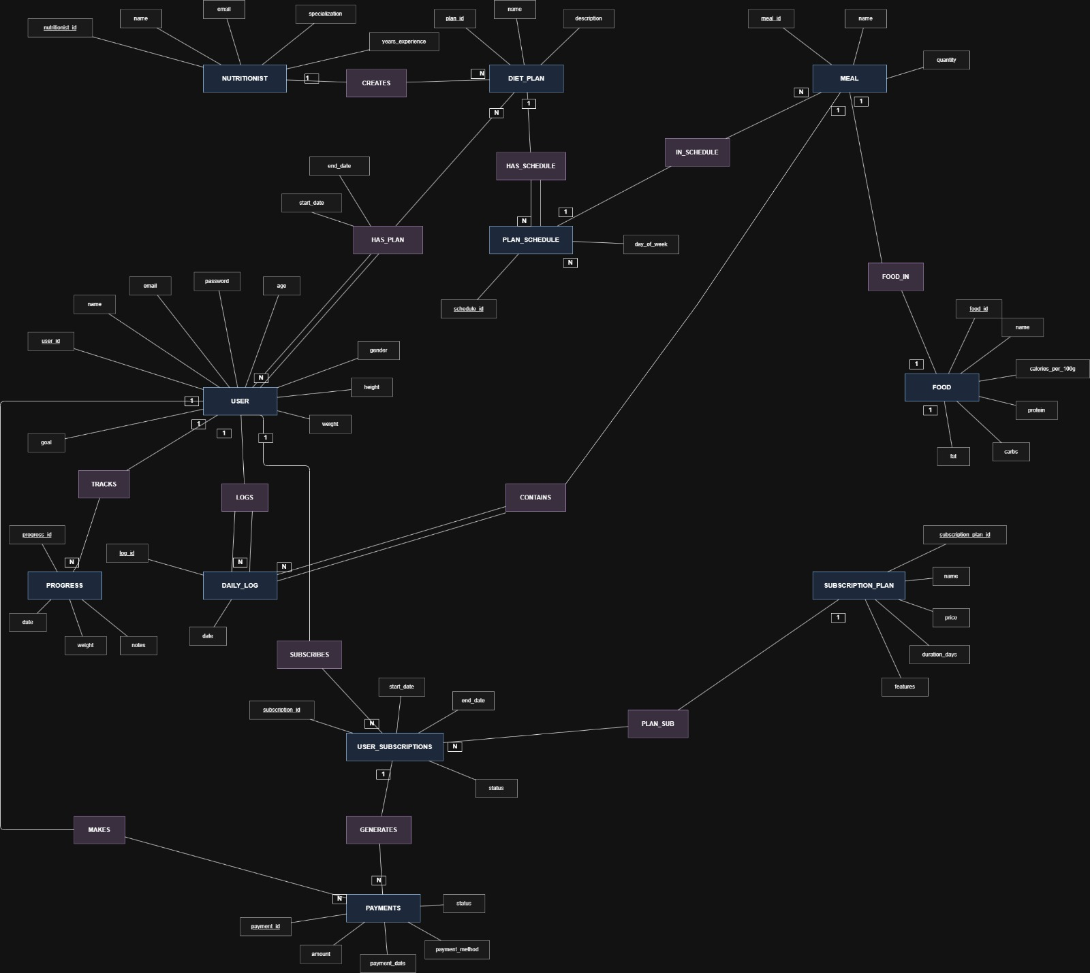
Entity-Relationship Diagram
11 entities · 3 junction tables · Full referential integrity with cascading foreign keys

Slide 7
Normalization
1NF — First Normal Form
All columns hold atomic values — no repeating groups or arrays
Every row uniquely identified by a primary key
features in subscription_plans is a descriptive string, not a list
2NF — Second Normal Form
All non-key attributes fully dependent on the entire primary key
user_diet_plans: start_date / end_date depend on full composite key
Junction tables (log_meals, plan_schedule_meals) have no non-key attrs
3NF — Third Normal Form
No transitive dependencies between non-key attributes
Nutritional data centralized in foods — not duplicated in meals
User weight auto-synced via trigger from progress — no redundancy

Slide 8
SQL DDL & Indexes
SQL Scripts Delivered
Key Indexes (10 total)
diet_tracking_system_tables.sql
Index
Type
Purpose
CREATE TABLE with PKs & FKs
ux_progress_user_id_date
Unique
One weight/day
food_tracking_constrainst.sql
ux_daily_logs_user_id_date
Unique
One log/day
ALTER TABLE — CHECK & UNIQUE
ix_user_subscriptions_...
Composite
Active sub check
diet_tracking_system_indexes.sql
ix_payments_subscription_id
Regular
Payment verify
CREATE INDEX for query optimization
ix_meals_food_id
Regular
JOIN optimization
diet_tracking_system_insertions.sql
Sample DML data insertions

Slide 9
Stored Procedures & Triggers
Stored Procedures (7)
Triggers (3)
sp_create_daily_log
Creates daily log with duplicate validation
trg_payments_set_subscription_status
payments — AFTER INSERT/UPDATE
sp_add_meal_to_log
Adds a meal to an existing log
Auto-activates subscription when payment is completed
sp_record_progress
Records user weight on a given date
trg_progress_update_user_weight
sp_assign_diet_plan
Assigns plan with date overlap check
progress — AFTER INSERT
Syncs user current weight with latest progress record
sp_register_payment
Registers payment for a subscription
trg_daily_logs_one_per_user_date
sp_get_user_daily_summary
Returns caloric / macro summary for a day
daily_logs — AFTER INSERT/UPDATE
Enforces one log per user/day with friendly error
sp_update_subscription_statuses
Bulk-updates expired / active subscriptions

Slide 10
User-Defined Functions & Views
User-Defined Functions (4)
fn_calculate_meal_calories(@meal_id)
Returns: DECIMAL(10,2)
Calories of a meal based on quantity and food nutritional data
fn_calculate_daily_log_calories(@log_id)
Returns: DECIMAL(10,2)
Total calories of all meals in a daily log
fn_calculate_user_bmi(@user_id)
Returns: DECIMAL(10,2)
User BMI: weight / (height/100)²
fn_user_has_active_subscription(@user_id, @date)
Returns: BIT
Returns 1 if user has an active subscription on that date
8 Views implemented in diet_tracking_system_views.sql for reporting and GUI data binding

Slide 11
C# Windows Forms Application
User Diary
Diet Plans
Progress Tracking
Log meals per day, view calorie totals via SP calls
Browse plans from nutritionists, assign to users
Record and visualize weight history
Subscriptions
Admin Panel
BMI Calculator
Subscribe to plans, register payments
Manage foods, nutritionists, subscription plans
Live BMI computed via fn_calculate_user_bmi UDF
Connection string location documented in project — easy to update user/password for testing

Slide 12
Live Demo
Diet Tracking System — Application Walkthrough
▶
INSERT DEMO VIDEO HERE
Replace this placeholder with the recorded demonstration video

Slide 13
Delivery Checklist
✓
PDF Report
Requirements, ERD, schema, normalization, DDL, DML, indexes, triggers, SPs, UDFs
✓
SQL DDL
diet_tracking_system_tables.sql + food_tracking_constrainst.sql
✓
SQL Insertions
diet_tracking_system_insertions.sql
✓
Stored Procedures
diet_tracking_system_procedures.sql + diet_tracking_system_read_procedures.sql
✓
UDFs
diet_tracking_system_udfs.sql
✓
Triggers
diet_tracking_system_triggers.sql
✓
Views & Indexes
diet_tracking_system_views.sql + diet_tracking_system_indexes.sql
✓
C# Application
DietTrackerApp — full source with configurable connection strings
○
Demo Video
To be recorded — demonstrates all app functionality

Slide 14
Thank You
Diet Tracking System — Bellili & Blaszczyk
Universidade de Aveiro · 2025/2026
Questions?

