Slide 1
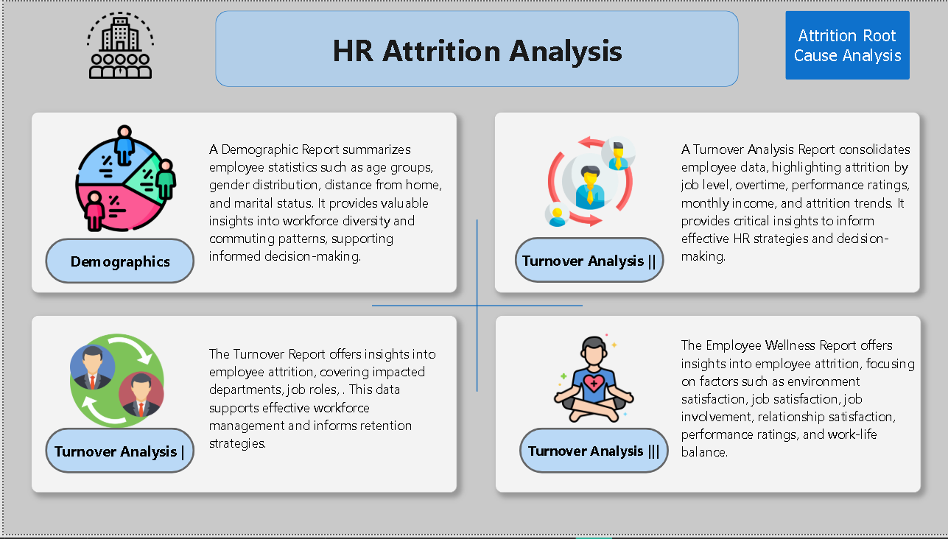
HR Attrition Analysis
Where we lose people, why, and what to do about it
Interactive Power BI report | 1,470 employees
Notes:
20s: I built an interactive Power BI report on 1,470 employees with four areas: overview, demographics, role drill-through, and root cause. I will show where attrition concentrates, why, and what to do.

Slide 2
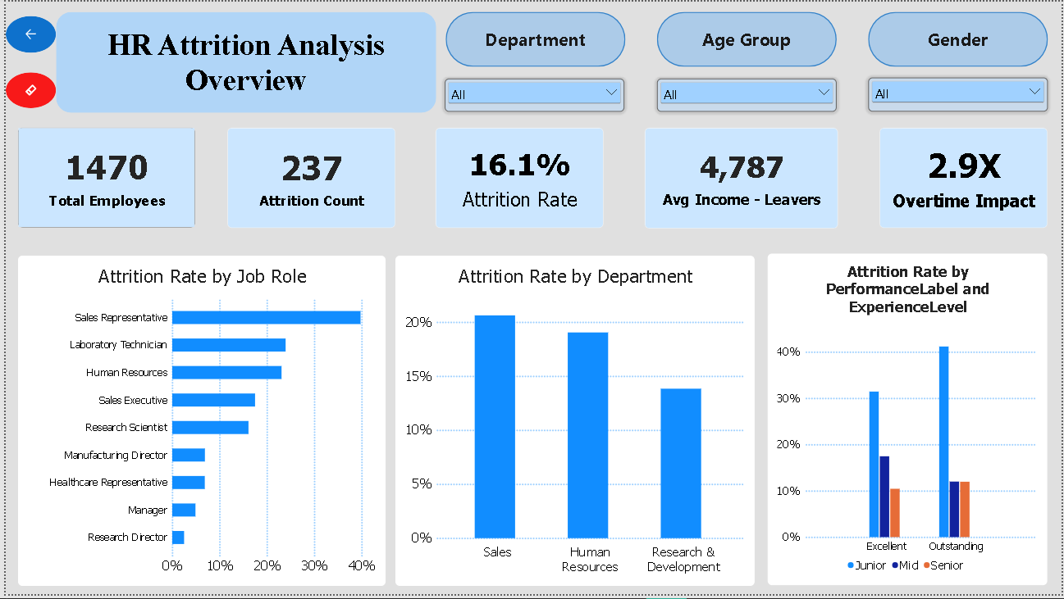
WHERE
1 in 6 employees has left, and the losses are concentrated
16.1%
237 of 1,470 employees have left
39.8%
Sales Representatives, the highest of any role
~41%
of junior employees rated Outstanding left (small group)
Source: HR attrition dataset (1,470 employees), Power BI report. Associations, not proof of causation.
Notes:
40s: 237 of 1,470 employees left, 16.1%. Sales Representatives leave at 39.8%, about 2.5 times the average. The right-hand chart is a warning: junior employees rated Outstanding leave at about 41%. It is a small group, but exactly the people we want to keep.

Slide 3
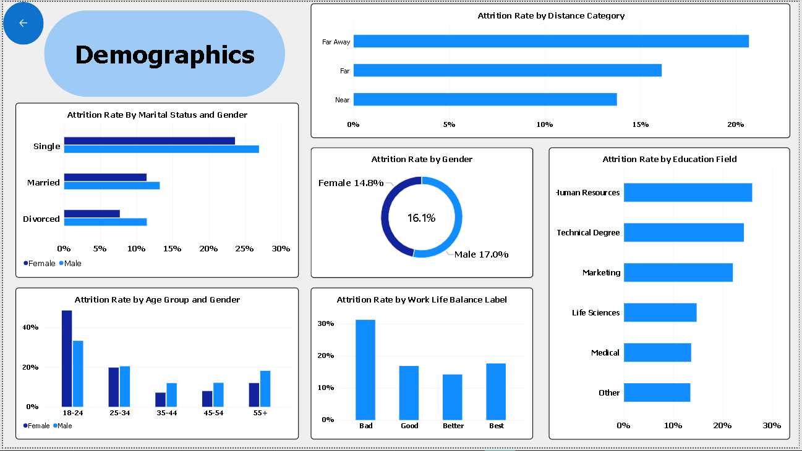
WHO
Risk rises with poor work-life balance, long commutes, and young age
31.2%
attrition when work-life balance is Bad (14.2% for Better)
~21%
for Far Away commuters vs ~14% for Near
48.6%
of women aged 18-24 left (men: 33.3%)
Overall gender gap is small: 14.8% female vs 17.0% male.
Source: HR attrition dataset (1,470 employees), Power BI report. Associations, not proof of causation.
Notes:
40s: Work-life balance rated Bad has 31.2% attrition versus 14.2% for Better. Far Away commuters are around 21% versus about 14% for Near. Employees aged 18 to 24 leave most: women 48.6% and men 33.3%, but these are small groups, so I treat them as signals. The gender gap overall is small, 14.8% female versus 17.0% male.

Slide 4
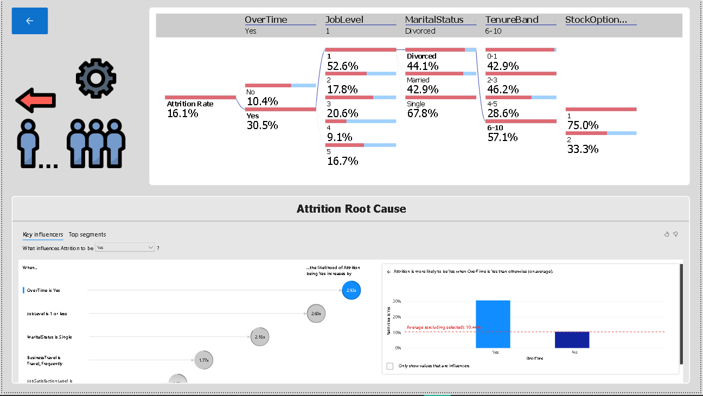
WHY
Root cause: overtime, entry level, and single status compound
30.5%
with overtime vs 10.4% without (2.93x more likely)
52.6%
Job Level 1 employees working overtime
67.8%
single employees at Level 1 with overtime
Source: HR attrition dataset (1,470 employees), Power BI report. Associations, not proof of causation.
Notes:
60s: The tree starts at 16.1%. With overtime it is 30.5%, without it 10.4%. Among overtime workers at Job Level 1 it is 52.6%, and single employees in that group reach 67.8%. Key influencers confirms this statistically: overtime makes leaving 2.93 times more likely, Job Level 1 or less 2.60 times, single 2.18 times, frequent travel 1.77 times. Deep branches such as stock options level 1 at 75% rest on very few employees, so I do not rely on them. These are associations; a pilot is needed to prove causation.

Slide 5
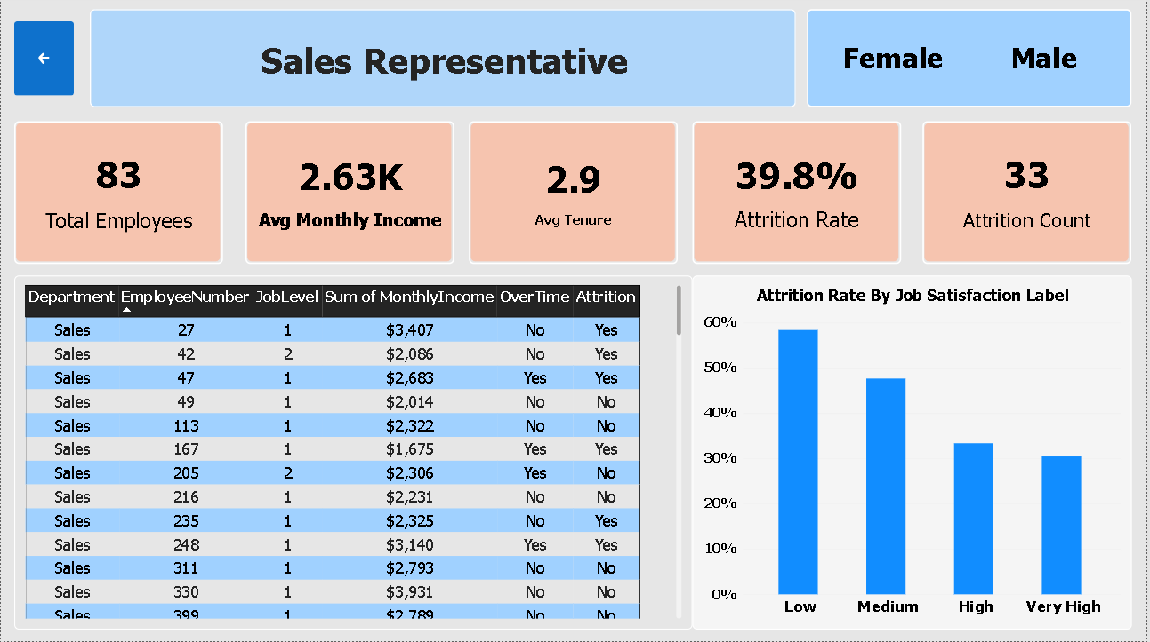
DRILL-THROUGH
Drill into any role: Sales Representatives leave at 39.8%
83 / 33
Sales Representatives / who left
2.63K
average monthly income, well below the company's other roles
58.3%
attrition when job satisfaction is Low (30.4% Very High)
Source: HR attrition dataset (1,470 employees), Power BI report. Associations, not proof of causation.
Notes:
35s: Any chart drills through to a role page. For Sales Representatives: 83 employees, 33 left, 39.8%, average monthly income 2.63K and average tenure 2.9 years. Attrition falls as job satisfaction rises: 58.3% when Low, 47.6% Medium, 33.3% High, 30.4% Very High. The page also lists the employees.

Slide 6
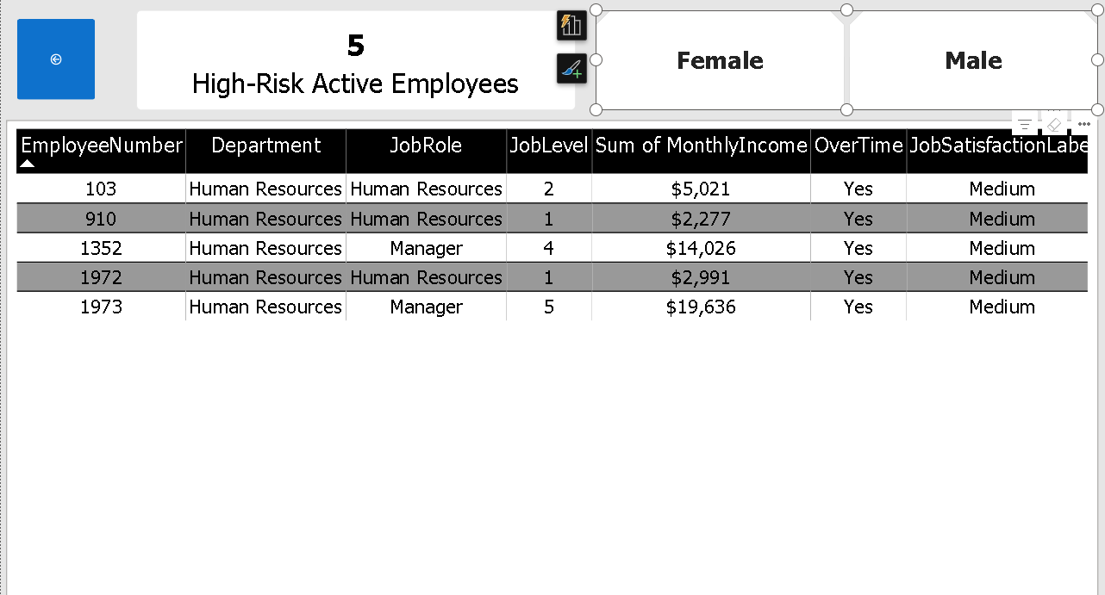
ACTION LIST
A named list of active employees at risk, ready for managers
5
High-Risk Active Employees shown for HR
97
active employees at risk company-wide: R&D 72, Sales 20, HR 5
Rule
high risk = overtime + low or medium job satisfaction
Source: HR attrition dataset (1,470 employees), Power BI report. Associations, not proof of causation.
Notes:
35s: A second drill-through page lists active employees who work overtime and report low or medium job satisfaction. Shown here: the 5 in Human Resources, all working overtime with Medium satisfaction. Company-wide the list has 97 people: 72 in R&D, 20 in Sales and 5 in HR. In production this page needs access controls.

Slide 7
RECOMMENDATIONS
Four actions, prioritised by evidence
# | Action | Evidence | Target KPI
1 | Cap and compensate overtime; follow up the 97 at-risk employees | 30.5% vs 10.4%; 2.93x more likely | Overtime attrition below 20%
2 | Sales Representative plan: pay structure, workload, career path | 39.8% attrition; 2.63K average income | Below 30%
3 | Level 1 retention programme: onboarding, workload, path to Level 2 | Level 1 + overtime 52.6% vs Level 2 17.8% | Level 1 + overtime below 40%
4 | Work-life balance and commute support (hybrid, transport) | Bad balance 31.2%; Far Away ~21% | Bad-balance attrition below 20%
Source: HR attrition dataset (1,470 employees), Power BI report. Associations, not proof of causation.
Notes:
80s: One, control overtime: 30.5% versus 10.4%, a 2.93 times higher likelihood. Two, a Sales Representative plan on pay structure and workload: 39.8% attrition and 2.63K average income. Three, a Level 1 retention programme: Level 1 with overtime is 52.6% versus 17.8% at Level 2. Four, improve work-life balance and commute support: Bad balance 31.2%, Far Away commuters around 21%. Savings are not estimated because the data has no replacement cost.

Slide 8
NEXT STEPS
Pilot, measure, and stay honest about the limits
Next steps
Limits of this analysis
Pilot overtime and Level 1 changes with the Sales team
Review the report monthly
Track the four KPIs against a control group
Single snapshot with no dates, so no trend over time
Associations only, not proof of causation
Small groups (e.g. junior high performers) are signals, not proof
No replacement-cost data, so no savings estimate
Source: HR attrition dataset (1,470 employees), Power BI report. Associations, not proof of causation.
Notes:
30s: Start with a pilot on the Sales team, review the report monthly, and track the four KPIs against a control group. Be transparent about the limits: one snapshot with no dates, associations only, small groups are signals not proof, and no cost data.

