Slide 1
PROBLEM-SOLVING TECHNIQUES • PART 1
Introduction to the Web
Understanding web fundamentals, developer toolkits, and the art of learning how to learn.

Slide 2

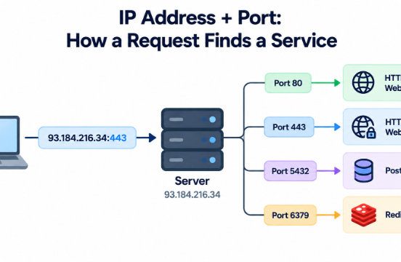


ARCHITECTURE
How Does the Web Work?
1. DNS Lookup
Translates domain names into server IP addresses.
2. HTTP Request
Browser sends request to target web server.
3. Server Response
Server returns HTML, CSS, and JS assets for rendering.

Slide 3



TOOLKIT & SKILLS
What You Need to Be a Web Developer
Core Web Languages
Essential Tooling
Problem-Solving Mindset
HTML for layout structure, CSS for styling, and JavaScript for client interactivity.
Modern code editor like VS Code, Git version control, and Browser DevTools.
Deconstructing complex issues into actionable, logic-driven steps.

Slide 4
MOTIVATION & META-SKILL
Why Web Development? Learning How to Learn
Why Choose Web Dev?
The Meta-Skill: "Learning to Learn"
Immediate Impact: Turn raw code into real visual interfaces quickly.
Precise Research: Master keyword searches and official documentation.
Global Reach: Deploy applications accessible to millions instantly.
Effective Inquiry: Ask targeted technical questions on forums.
Creative Logic: Bridge artistic interface design with technical algorithms.
Continuous Growth: Adapt smoothly as frameworks and tools evolve.

Slide 5
CORE TAKEAWAY
Web development is not about knowing every answer—it is about knowing how to find them.
Mastering research, precise questioning, and structured problem-solving opens the door to building anything on the web.
Checkpoint Completed

Slide 6

Image Sources
https://substackcdn.com/image/fetch/$s_!IzcV!,f_auto,q_auto:good,fl_progressive:steep/https%3A%2F%2Fsubstack-post-media.s3.amazonaws.com%2Fpublic%2Fimages%2F1ebc22e1-fe0b-4751-89a1-e0c6c62826be_1774x887.png
Source: designgurus.substack.com

