Slide 1
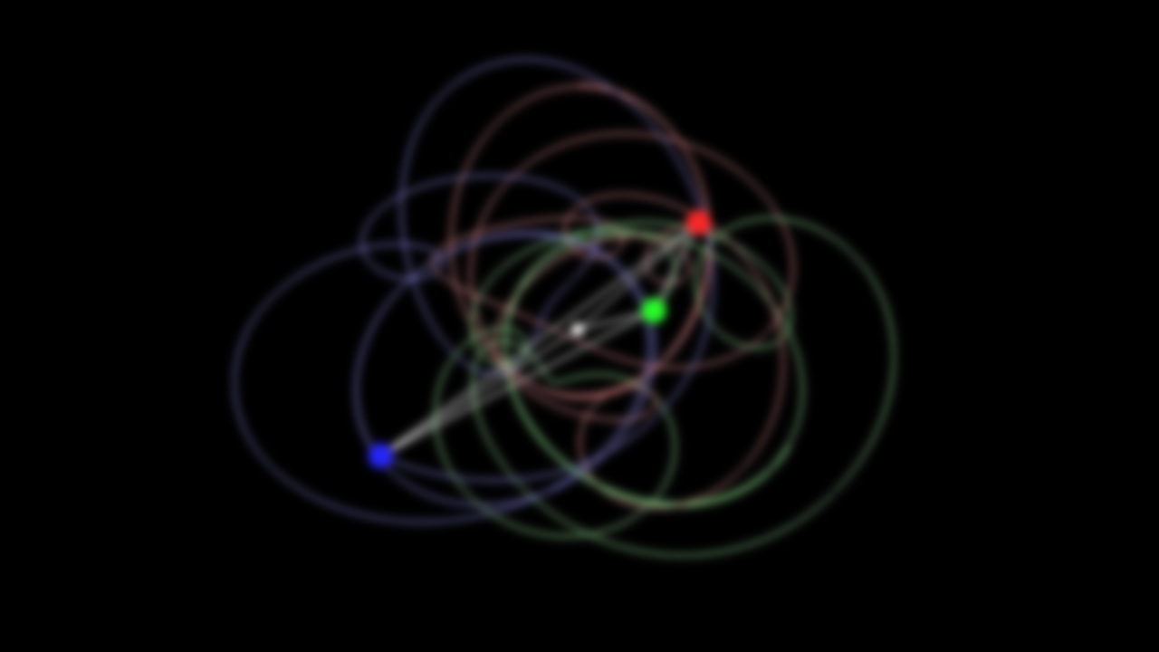
2D PHYSICS ENGINE
Made Using C++
Course name :- OOPs With C++
In Guidance of :- Prof. Dr Moses Dian
Made by :-
ANUBHAV KUMAR (25MIM10178)
NIKHIL TIWARI (25BAI11440)
MAHIT AGGARWAL (25MIM10073)
AARADHYA SINGHAI (25MEI10078)
AADARSH KUMAR (25BAI11087)
Libraries and concepts used :-
SFML (Simple Fast Media Library)
Cmath and Vector
Collision Physics and Rigid Body Physics

Slide 2
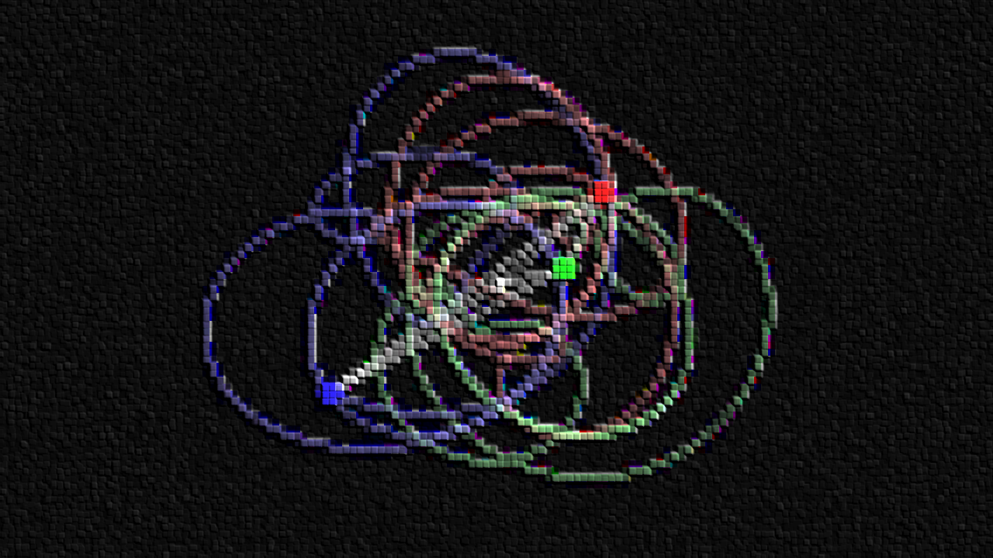
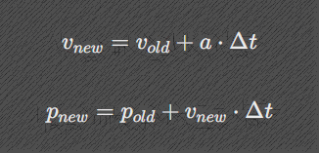
2D Physics Engine
Core Theory
This engine simulates rigid body dynamics in real-time by calculating forces, updating object states in discrete time steps, and mathematically resolving collisions.
Motion and Integration (Dynamics & Kinematics)
Every Rigid Body object possesses mass, position, velocity, and acceleration. When a force is applied, acceleration is calculated using Newton's Second Law
F = M/A
To move the objects frame-by-frame, the engine uses Semi-Implicit Euler Integration, which calculates the new velocity first, then uses it to find the new position:

Slide 3
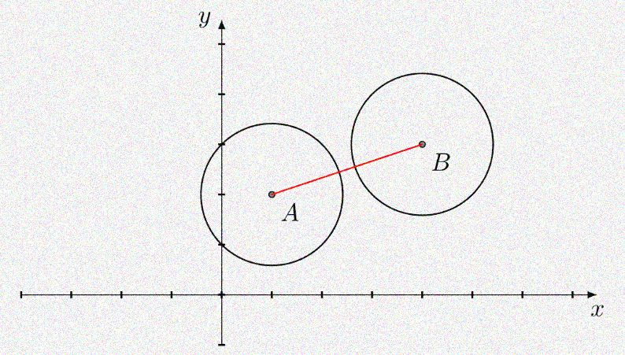

2. Collision
The system checks for intersections between circular bodies by calculating the distance between their centers using vector mathematics. If the distance is less than the sum of their radii ,a collision is registered:
3. Collision Resolution
When two bodies collide, the engine reacts in two required steps:
Positional Correction:
It physically translates the objects apart along the collision normal so they no longer overlap, preventing them from fusing together.
Impulse Application:
It calculates an instantaneous force (impulse) based on the Law of Conservation of Momentum and the materials' "bounciness" (Coefficient of Restitution). This impulse alters both objects' velocities, inversely scaled by their mass.

Slide 4
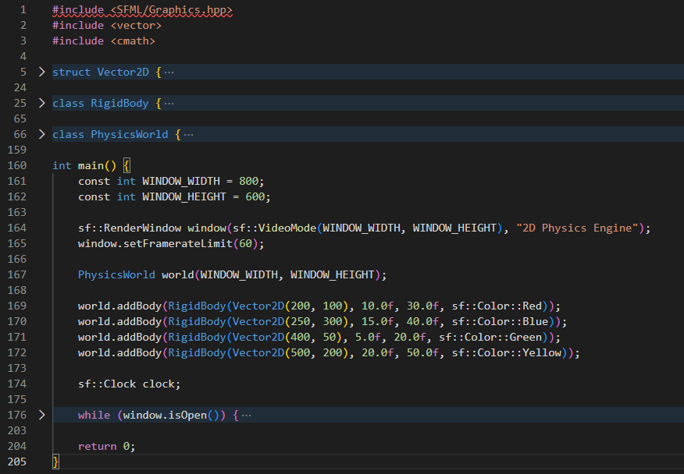
4. Object-Oriented Architecture
The simulation's math is strictly encapsulated into a C++ class hierarchy:
Vector2D:
A struct dedicated purely to geometric math (dot products, normalization).
Rigid Body:
Encapsulates physical state parameters and executes numerical integration.
Physics World:
The mediator class that applies global forces (like gravity) and iterates through the object arrays to detect and resolve collisions.

Slide 5
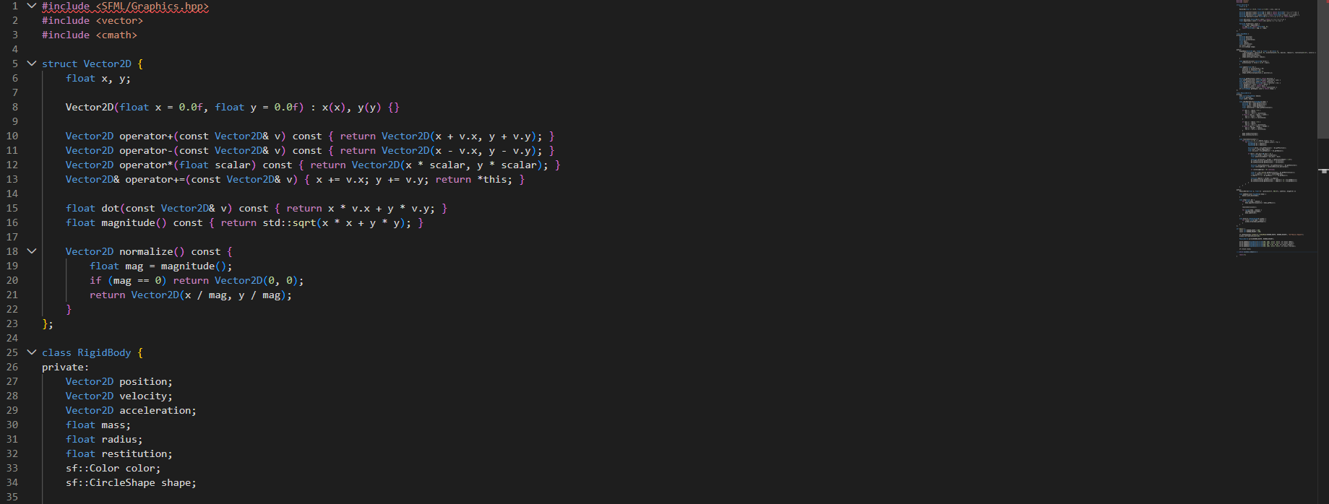
THE CODE

Slide 6
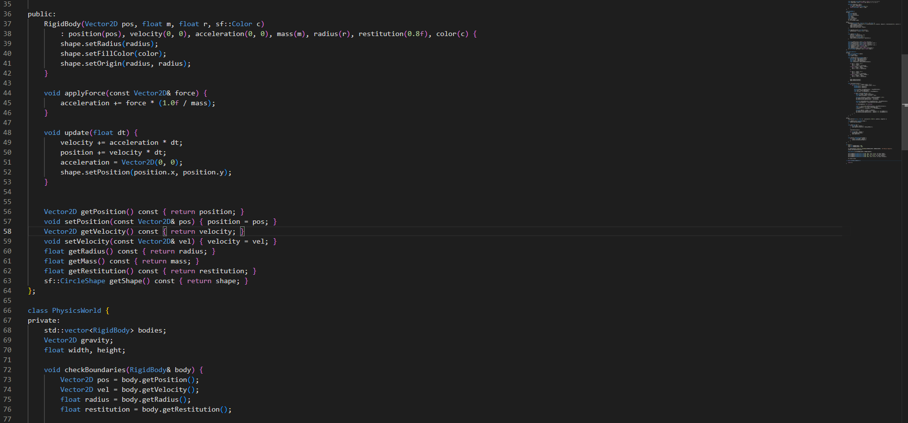

Slide 7
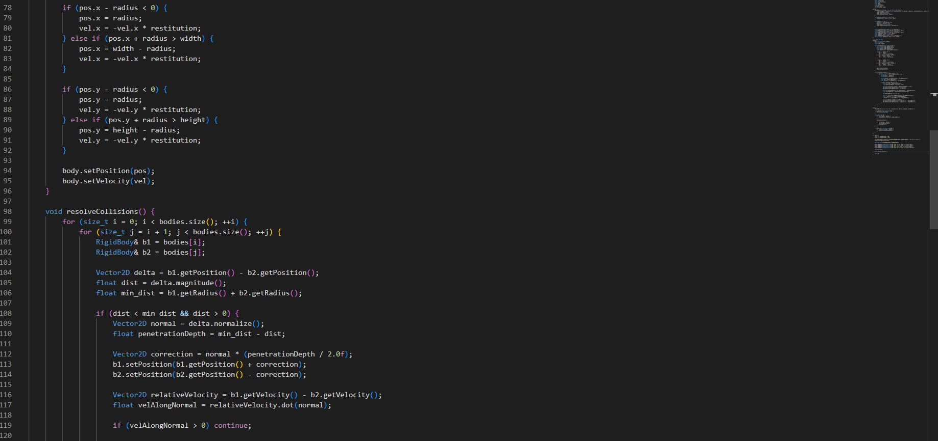

Slide 8
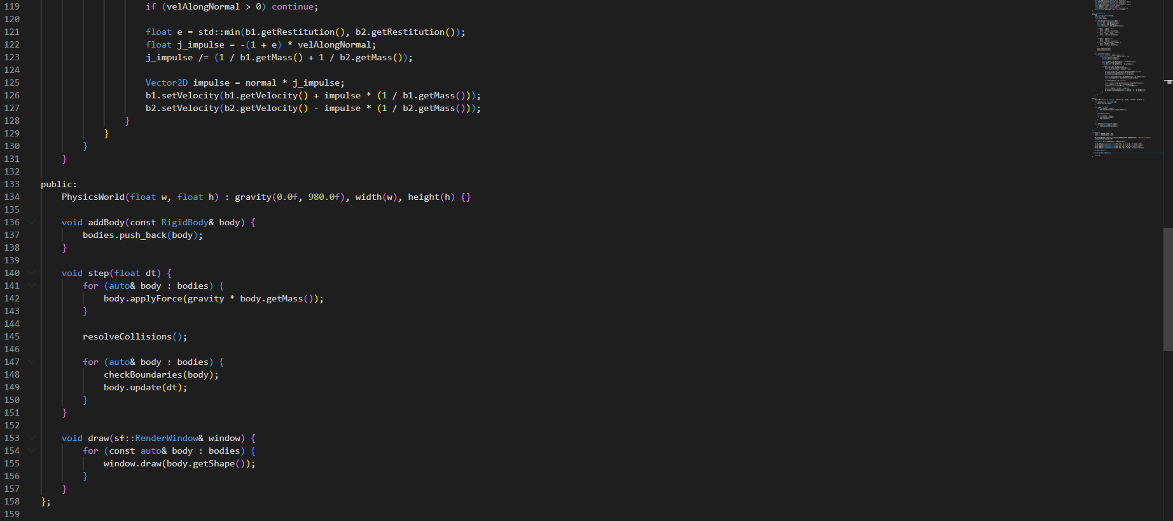

Slide 9
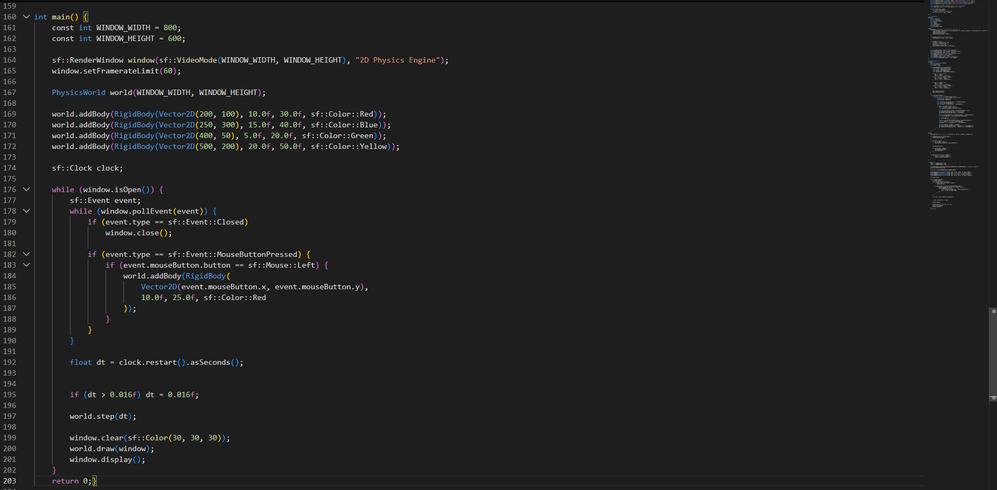

Slide 10
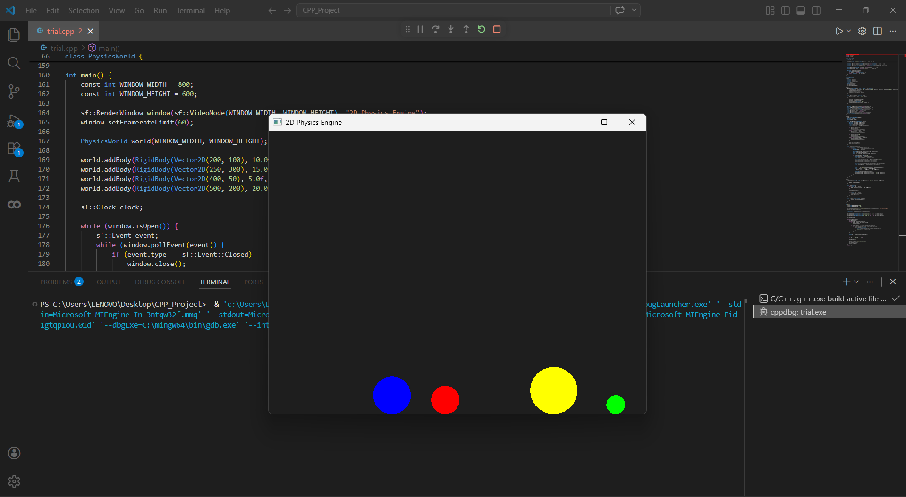
OUTPUT

Slide 11
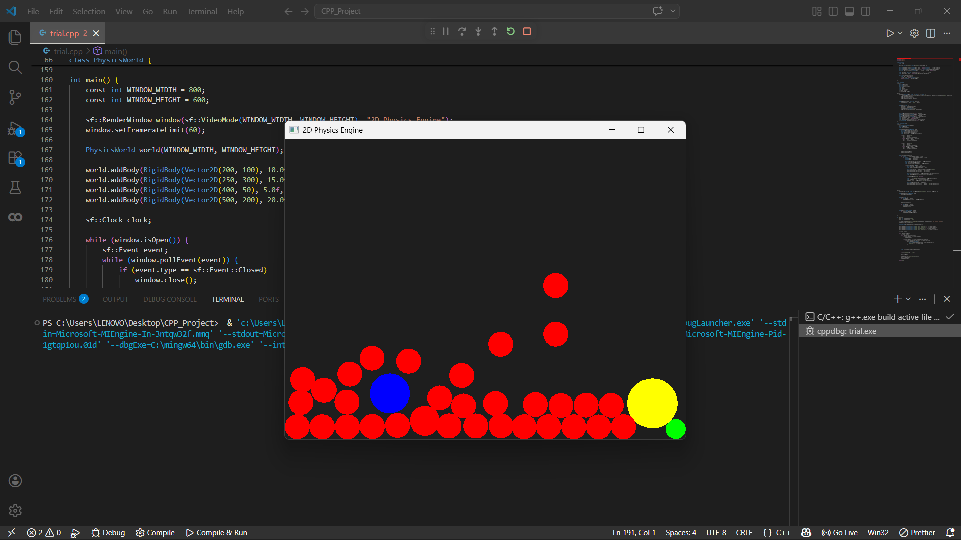
OUTPUT

Slide 12
THANK YOU

