Slide 1
Goals and Your Job
Starting Out
Notes:
Instructor:
Read through the whole lesson (including all the notes) before the day of class
Make note of and gather any supplies you need to bring
Prepare examples, stories
Think through how much time you want to spend on individual activities; make notes
Be sure to allow time to announce the assignment at the end
Overview:
Intro (slides 1-4): 2-3 minutes
Smart goals (5-22): 15-20 minutes
Motivation (23-46): 20-25 minutes
Wrap up (47-49): 2-3 minutes
Total: 45-51 minutes

Slide 2
Review
Get Noticed
Discuss potential difficulties with life after college
Walk through the process of moving to a new place and starting out fresh
Discuss the role of grit in starting something new
Notes:
Ask: What did we go over last class?

Slide 3

Reflect
Consider this:
Your future is in your hands.
What will you make of it?

Slide 4
Today
Objectives:
Explore the importance of SMART goal-setting
Discuss motivation and how to harness ours

Slide 5
SMART Goals
Notes:
Overview:
Intro (slides 1-4): 2-3 minutes
Smart goals (5-22): 15-20 minutes
Motivation (23-46): 20-25 minutes
Wrap up (47-49): 2-3 minutes
Total: 45-51 minutes

Slide 6
Review
Last time we talked about starting a new life – new place to live, doing things even when they’re hard, etc.
Let’s expand on those ideas

Slide 7

Activity
Imagine you’ve moved in to your new place and you’re about to start the first day of work.
Where will you be working?
How much will you be earning?
What will you be doing?
Notes:
Instructor: Write a few responses to the questions above on the board (or ask students to write their answers).
Image from unsplash.com

Slide 8

…now what?
How can you take advantage of that new opportunity?
Further, how can you take advantage of your current opportunities?
Notes:
Image from pixabay.com

Slide 9

Answer = Goals
Setting goals is a way to provide purpose and direction to your actions.
They have the power to propel you toward meaningful life accomplishments
Notes:
Image from pixabay.com

Slide 10
SMART
You may have heard this before, but let’s explore SMART Goal-Setting
Specific
Measurable
Accountable
Relevant
Timely
Specific
Timely
Measurable
Accountable
Relevant

Slide 11
Application
As we move through this presentation, think of a goal you have, and apply the principles we discuss to your goal
E.g., “I want to be the smartest person in the room.”
Specific
Timely
Measurable
Accountable
Relevant
Notes:
Feel free to think up your own example. Start with something vague.

Slide 12
Specific
Take general ambitions to targeted objectives
Think: how can you make your situation more specific?
E.g., “I want to be the smartest person in the room = “I want to get really good grades.”
Specific
Timely
Measurable
Accountable
Relevant

Slide 13
Measurable
Specific
Timely
Measurable
Accountable
Relevant
Think of specific ways to show that you’ve completed your goal
Think: how can you make your situation measurable?
E.g., “I want to get really good grades.” = “I want to get on the dean’s list.”

Slide 14
Accountable
Involve someone that you can report your progress to
Think: who do you want to have know about your goal?
E.g., “I want to get on the dean’s list.” = “I want to get on the dean’s list (my dad).”
Specific
Timely
Measurable
Accountable
Relevant

Slide 15
Relevant
Think of goals that apply to other goals or principles in your life
Think: how can you make your situation relevant?
E.g., “I want to get on the dean’s list (my dad).” = “I want to get on the dean’s list & be valedictorian (my dad).”
Specific
Timely
Measurable
Accountable
Relevant

Slide 16
Timely
Give yourself a timeframe
Think: how long will this goal take to complete?
E.g., “I want to get on the dean’s list and be valedictorian (my dad).” = “I want to get on the dean’s list this semester and be valedictorian at graduation (my dad).”
Specific
Timely
Measurable
Accountable
Relevant

Slide 17
Compare
Before: “I want to be the smartest person in the room.”
After: “I want to get on the dean’s list this semester and be valedictorian at graduation (my dad).”
Why is the second goal more effective than the original?

Slide 18



Categories
Another thing to consider is using SMART goals in categories. For example,
Academic
Financial
Athletic
Social
Spiritual
Notes:
Images from creativevix.com
Pexels.com
startupstockphotos.com

Slide 19
Activity
Write down SMART goals for the following categories in your life:
Academic
Financial
Social
Remember:
Specific
Measurable
Accountable
Relevant
Timely
Notes:
3-5 minutes to write goals; 1-2 minutes to share at least one goal with a partner

Slide 20
Take-away
Use SMART goals to direct your efforts—
particularly in novel situations

Slide 21

A thought
We can always do better
Part of goal-setting is knowing which goals are worthy of pursuit, and how hard we should pursue them
Be thoughtful about which goals you should pursue

Slide 22
HW
Act: Set three goals that you want to accomplish in the next year (maybe in the next week).
Think: Which SMART goals could you set for your life, that will prepare you for what you want to accomplish in the future?

Slide 23
Motivation

Slide 24
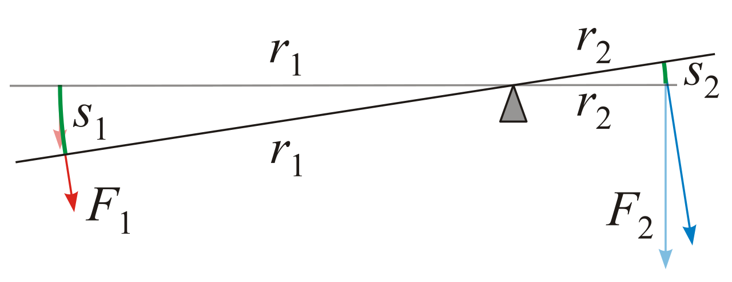
Motivation
Goals are important, yes, but they’re not the driving force behind our actions
That role belongs to motivation
Notes:
Image from commons.wikimedia.org

Slide 25
Question
What is motivation?
Write down a one-sentence definition.

Slide 26
Definitions
There are many definitions for motivation, similar to those you provided:
“Motivation is an urge to behave or act in a way that will satisfy certain conditions, such as wishes, desires, or goals.”
Notes:
Source:
Boundless. “Defining Motivation.” Boundless Psychology. Boundless, 26 May. 2016. Retrieved 17 Aug. 2016
https://www.boundless.com/psychology/textbooks/boundless-psychology-textbook/motivation-12/introduction-to-motivation-64/defining-motivation-247-12782/

Slide 27
Definitions
“Motivation is a theoretical construct used to explain behavior.
It represents the reasons for people's actions, desires, and needs.”
“Motivation can also be defined as ‘one's direction to behavior, or what causes a person to want to repeat a behavior and vice versa.’”
Notes:
Source:
https://en.wikipedia.org/wiki/Motivation
Ellliot, Andrew J; Covington, Martin. "Approach and Avoidance Motivation". Educational Psychology Review. 13 (2001): 2.

Slide 28
The “why” in behavior
Psychologists, economists, anthropologists, sociologists, and others have sought an answer to this question:
“Why do we do what we do?”

Slide 29



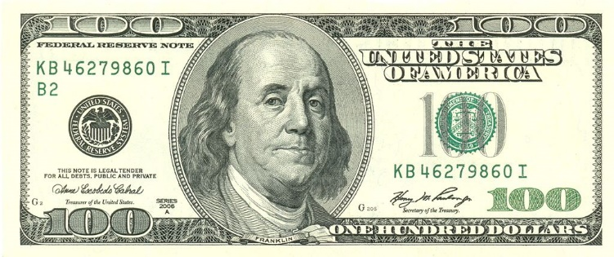
Motivators
There are many things that could motivate us
What motivates you?
Notes:
Image from commons.wikimedia.org
pixabay.com
stock.tookapic.com
pexels.com

Slide 30
Inside & Outside
Another long-standing discussion in psychology is the distinct importance and differences between extrinsic (external; outside) and intrinsic (internal; self-managed) motivators

Slide 31
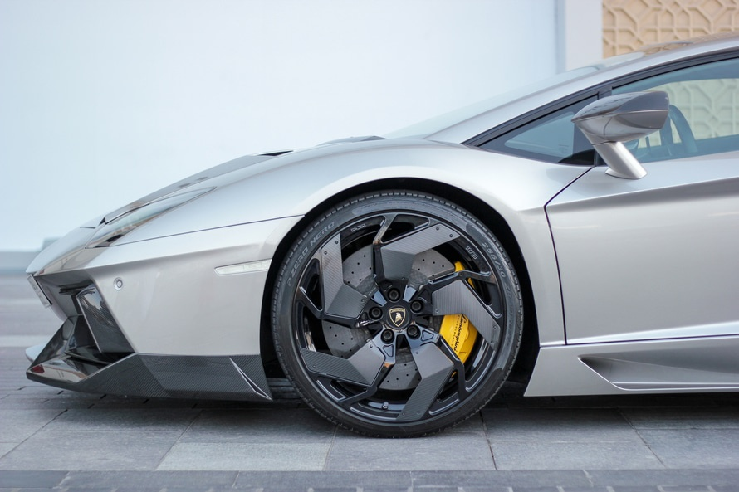
Extrinsic
Extrinsic motivators describe the external things which drive our behavior
E.g., Money, grades, a place on the dean’s list, a new car, etc.
Notes:
Image from pexels.com

Slide 32

Intrinsic
Intrinsic motivators describe the internal things which drive our behavior
These are deeper, and more complex to understand
E.g., The need to belong to something, the desire to succeed, pushing against hardship, etc.
Notes:
Image from pexels.com

Slide 33
Activity
Take a moment and answer these two questions:
What are three external motivators in my life?
What are three internal motivators in my life?
Notes:
Have students write their answers or share with a partner

Slide 34
Class Activity: Intrinsic or Extrinsic?
“My mom is paying me to get good grades.”
“I love working on cars.”
“I want to be successful.”
“Growing up in Singapore, I learned to give value to things. Now, I want to teach that to my children.”
“I want to make the world a better place, maybe try to win the Nobel prize in Chemistry.”
“I am sick of seeing so much poverty, I need to do something!”
“I want to get a raise at work to better provide for my family.”
“I’m hungry.”
Notes:
Instructions for teacher (explain to class):
1. Identify one side of the classroom as the extrinsic side, and the opposite as intrinsic.
2. Read a situation, ask students to determine whether the motivator at play is extrinsic and intrinsic, then move to the appropriate side of the room and prepare to potentially defend their answer.
3. Call on someone and ask them to explain their answer. The class will determine which is “correct” together.
Ready?

Slide 35
Reflect
Why might it be important to be able to differentiate extrinsic from intrinsic motivators?
Shoot for intrinsic motivators—they are deeper and more powerful than extrinsic ones.
Notes:
Many people believe that teachers and parents need to start with extrinsic motivators (rewards and punishments) to get kids to do certain things (e.g., behave, practice piano, do chores or homework), but that eventually the intrinsic motivation will kick in. Other experts say that if you provide too much extrinsic motivation, then you extinguish intrinsic motivation.

Slide 36

Different perspectives
Let’s examine a few perspectives on motivation and see which you agree with most.
Notes:
Image from conversation.salamzaban.com

Slide 37

Hierarchy of Needs
Self-
Actualization
Abraham Maslow thought that our needs were essentially hierarchical—baser needs (e.g., food, shelter, etc.) need to be met before other things can.
Esteem
Social
Safety
Physiological

Slide 38

This is Chester Elton, who coined “the Carrot Principle”—essentially, “reward your employees and you will increase profits and productivity”.
Notes:
https://www.youtube.com/watch?v=V-BcXI1rV4I
The video may take a minute to load—sometimes it helps to advance one slide, then come back.

Slide 39
Contrasting View
Autonomy
Mastery
Purpose
In Drive, Daniel Pink argues that in complex tasks, carrots and sticks don’t motivate people nearly as well as these three elements:
Notes:
http://www.danpink.com/books/drive/

Slide 40

What about fight, flight, or freeze as motivators?

Slide 41
Herzberg
1. Achievement
2. Recognition
3. The work itself
4. Responsibility
5. Advancement
6. Growth
Frederick Herzberg (1959) showed six factors as the top motivational factors:

Slide 42
Herzberg
Company policies
Supervision
Relationship with manager
Work conditions
Salary
Relationship with peers
He also showed the following as the top “hygiene factors”:

Slide 43

OK, all of this is super great, mega important, blah blah blah.
Why should we care?
Notes:
Image from www.flickr.com

Slide 44

Take-away
In understanding the roots of motivation, you can exert greater control on your life and make goals that will push you in the direction you want to move.
That means success, improvement, happiness!

Slide 45
Invitation
Motivations
Goals
Think about your motivations, and how goals can help you achieve more with them.

Slide 46
HW
Identify your major motivators
Set (SMART) goals that will push you toward success with those motivators

Slide 47
Review
Objectives:
Explore the importance of SMART goal-setting
Discuss motivation and how to harness ours

Slide 48
Additional Resources
SMART goals: topachievement.com/smart.html
Maslow’s Hierarchy: www.simplypsychology.org/maslow.html
Herzberg: http://www.netmba.com/mgmt/ob/motivation/herzberg/
Motivation: https://www.boundless.com/psychology/textbooks/boundless-psychology-textbook/motivation-12/introduction-to-motivation-64/defining-motivation-247-12782/
Drive, Daniel Pink
http://www.danpink.com/books/drive/
https://www.youtube.com/watch?v=u6XAPnuFjJc

Slide 49
Content (not images or videos) copyright information:

