Slide 1
Talking Good
Grow your worth
Notes:
Instructor:
Read through the whole lesson (including all the notes) before the day of class
Make note of and gather any supplies you need to bring
Prepare examples, stories
Think through how much time you want to spend on individual activities; make notes
Be sure to allow time to announce the assignment at the end
Overview:
Intro (slides 1-3): minutes
Smart Guy Problem (4-13): 20-25 minutes
Dealing with BS (14-28): about 10 minutes
Active Listening (29-40): about 10 minutes
Wrap-up (41-43): 1-2 minutes

Slide 2

Review
What did we go over last class?
Synergy
Notes:
Image from en.wikipedia.org

Slide 3
Today
Objectives:
Consider the “Smart Guy” Problem
Discuss the BS problem and how to deal with it
Learn and apply principles of active listening

Slide 4
The "Smart Guy" Problem

Slide 5
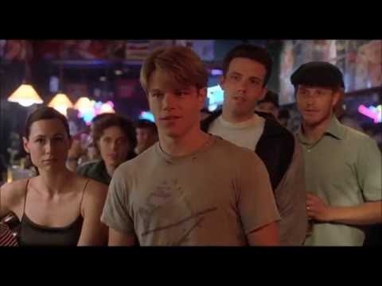
Notes:
3:30
Video may take a few seconds to load
Source: https://youtu.be/LMD2vUErcYU

Slide 6
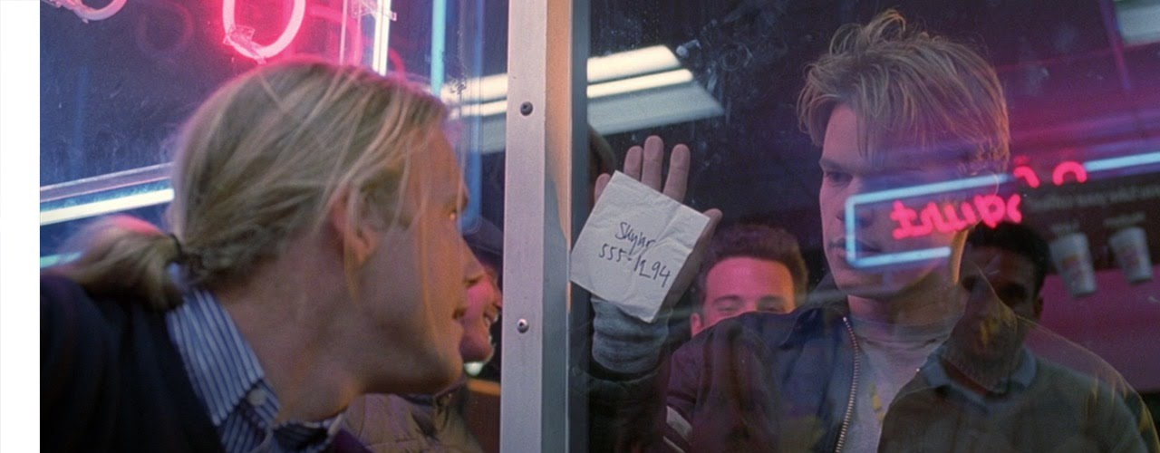
Class Discussion
Do you know someone who is like the ponytail guy? (Or maybe Will Hunting?)

Slide 7
This can seem funny or even desirable–to be the smartest person in the room, and to make that known.
But, it can come with a steep price:
Can’t get a job
Talking back to a higher-up
Getting fired
Losing respect

Slide 8
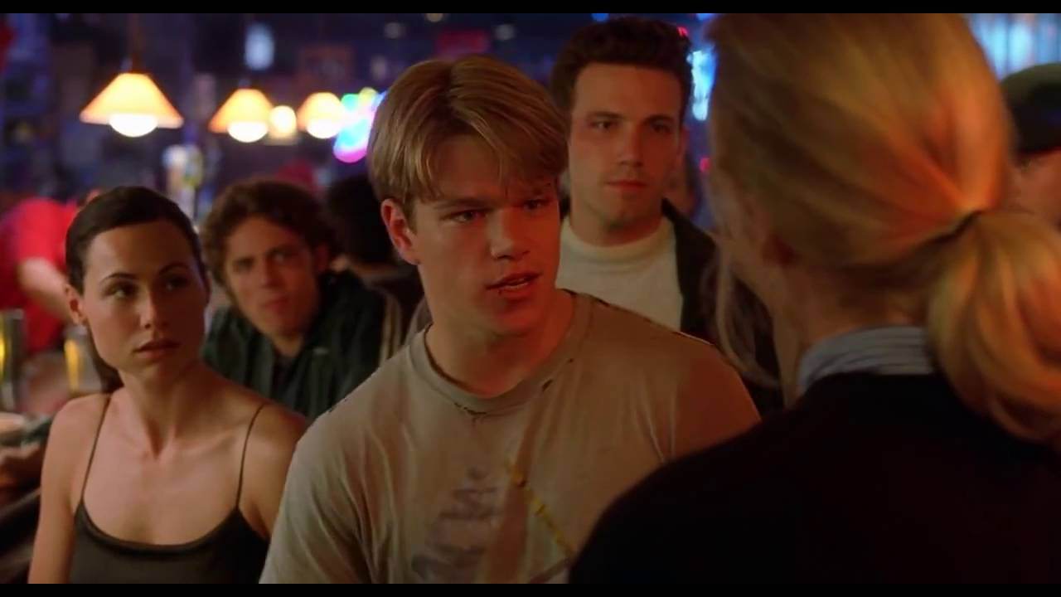
Will was so worried about being smart that he (almost) lost the girl, a few times

Slide 9
Question
Is it possible to be the smartest person in the room, but to also:
Not offend anyone?
Work well with others?
Be respectful?

Slide 10
Two Bosses
A man once told a story about two of his bosses:
One boss, Jack, was clearly very intelligent and wanted everyone to acknowledge it. The man said it was clear that whenever Jack entered the room, Jack was the smartest man in that room.
Another boss, Steve, was brilliant but humble. He listened to his employees and built them up instead of building himself up. The man said, when Steve entered the room, he made you feel like you were the smartest person in the room.
Who would you rather work for? Why?

Slide 11
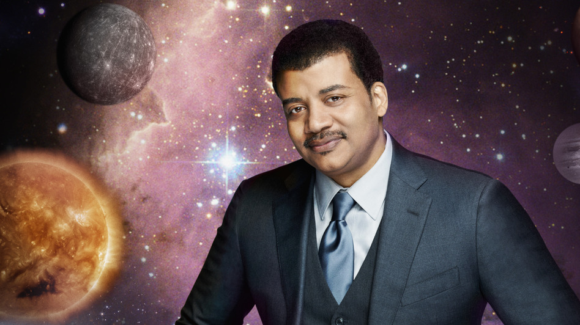
Example: Neil Degrasse Tyson
Notes:
Notes: Neil Degrasse Tyson is a public figure because of his astrophysical and general scientific knowledge. But, instead of trying to keep all the knowledge for himself or being the smartest person in the world, he talks about science and tries to get others interested in it. He’s not perfect, but he’s trying to use his knowledge to make the world a better place.

Slide 12
Bottom Line
Being smart is great;
Being smart and allowing others to be smart, is excellent.

Slide 13
Dealing with BS

Slide 14
“One of the most salient features in our society is that there is so much [BS]. Everyone knows this. Each of us contributes his share.”
Poll
Agree or disagree?
Why?
Notes:
Quote from On Bullshit, Harry G. Frankfurt (2005)
Ask students whether they agree or disagree with Frankfurt’s statement.
Source: http://www.limbicnutrition.com/blog/wp-content/uploads/2015/11/on-bullshit2.jpg

Slide 15
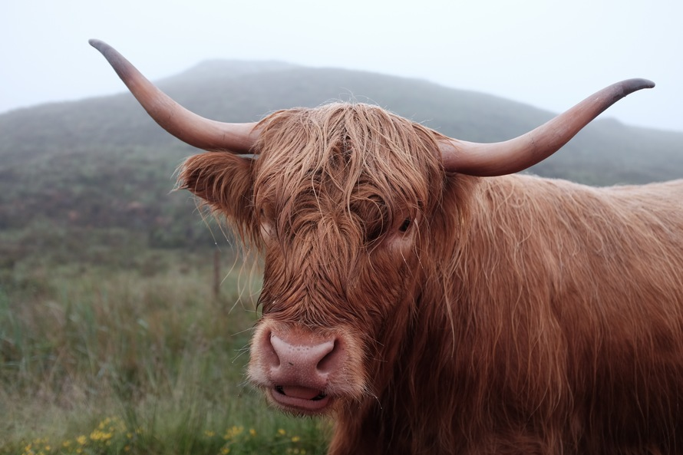
Reflect
Who is the worst purveyor of BS that you know?
On a scale of 1-10, how bad is the BS that they spew?
What is it like being around this person?
Notes:
Image from unsplash.com

Slide 16
A synonym
Frankfurt says that BS has a synonym: humbug
Humbug: “deceptive misrepresentation, short of lying, especially by pretentious word or deed, of somebody’s own thoughts, feelings, or attitudes.”

Slide 17

“…deceptive misrepresentation…”
So, lying.
Who do you know that lies to make themselves look better?
…do we sometimes do that?
Notes:
Image from pixabay.com

Slide 18
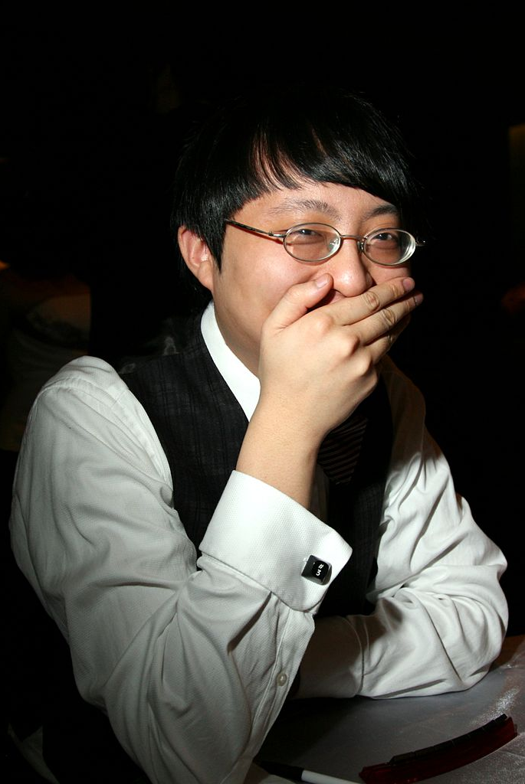
Question
On a scale of 1-10, how bad is the BS that you spew?
Notes:
Instructor (optional): “Write down your name, and your “BS Score” next to it”
Image from commons.wikimedia.org

Slide 19
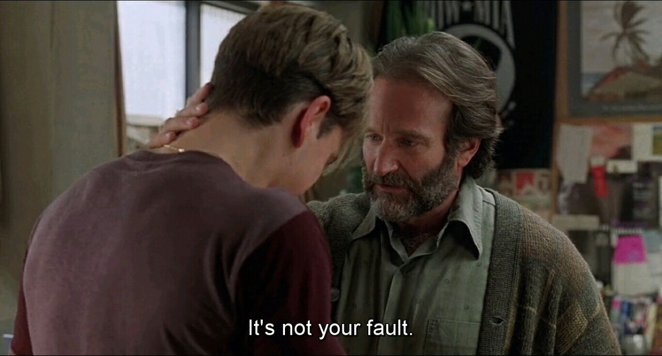

Slide 20

Don’t worry
Remember, “each of us contributes his share.” Frankfurt’s statement is, in a way, liberating.
If all of us participate in BS dispersion, then each of us has some blame, and some control over the situation.

Slide 21
In sum
The book’s ultimate message can be summed thusly:
We use BS to subtly, deliberately deceive others, to augment the way we are perceived.
Using BS implies a lack of sincerity about what is “right” and “wrong”—an “indifference to how things really are.”
BS is worthless (“a corpse of nourishment”) and should be avoided where truth ought to reside.

Slide 22

Application
Here’s the beef:
If we can recognize our own BS, then we can begin to wipe up our mess.
We can judiciously forgive others for their lackadaisical use of BS.
We can begin to understand (or, learn to avoid) people who use BS with us.
Notes:
Image from stock.tookapic.com

Slide 23
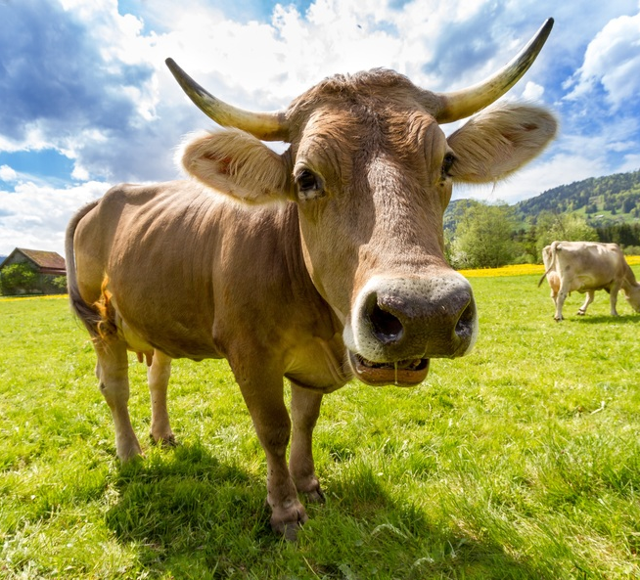
This might seem like a scolding, but it’s not; it’s a call to awareness.
It’s possible to recover from our use of BS, and to forgive others for their use of it.
Notes:
Image from pixabay.com

Slide 24
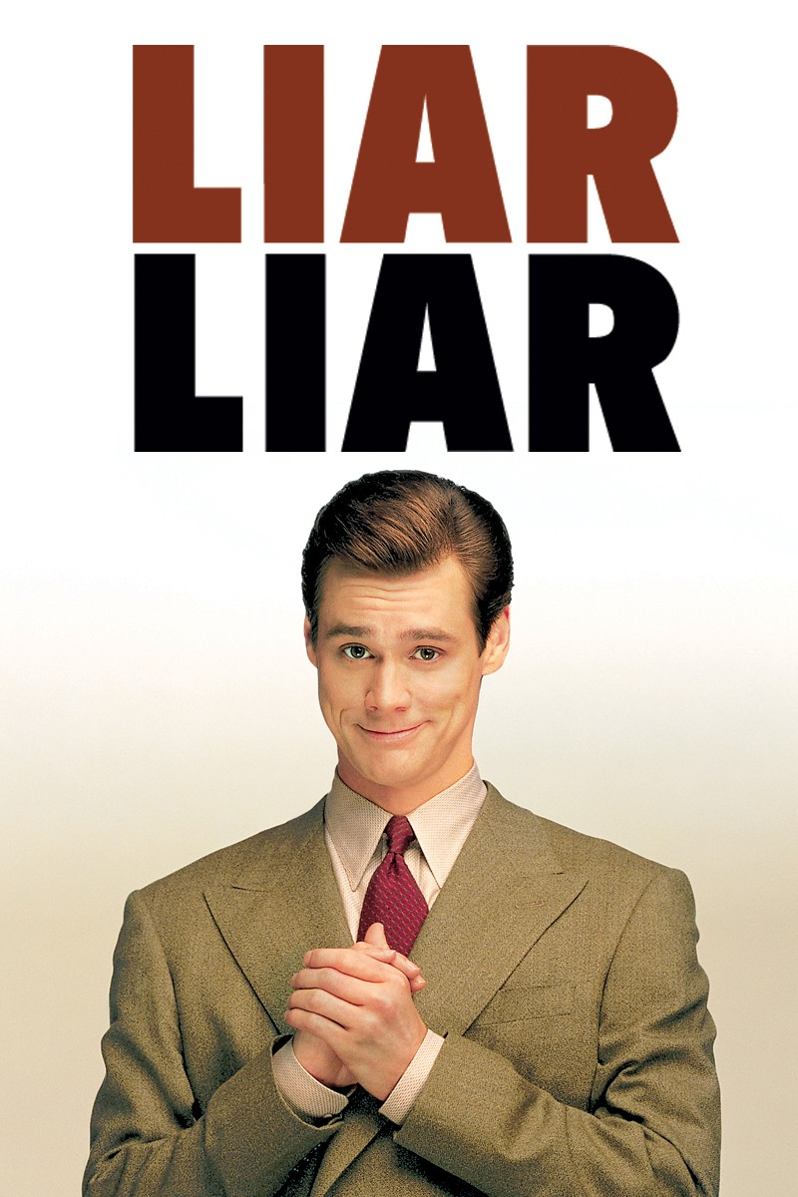
Alternatives?
Do you know people who are brutally honest—who say what they think, even when it’s offensive or mean?
What is it like being around someone who is brutally honest?
Where on the honesty spectrum should we aim?
Notes:
Ex. Jim Carrey in Liar, Liar
Started as a serial liar and BSer (albeit a very funny one)
Ended up more honest, committed to his family, and a better lawyer
Source: http://resizing.flixster.com/XcazdOtf4URDdVSh-aDzeUbAiXQ=/800x1200/v1.bTsxMTE3MTk0ODtqOzE3MTYyOzIwNDg7ODAwOzEyMDA

Slide 25
HW
Think:
How much BS do you hear every day?
Who is the main distributor?
How can you cut down on your own participation in the BS market?

Slide 26
Active Listening

Slide 27

We’ve talked a lot about how to (or how not to) present ourselves so far.
Let’s change gears and think about another key element of conversation: how we listen.

Slide 28
Poll
How well do you listen to others?
(1 = not at all; 10 = perfectly)
Anyone over here?
1
5
10
Notes:
Optional: Draw a line on the board with the numbers 1-10 along the line. Then, have students stand in front of the part of the line which represents their self-reported score for their listening.

Slide 29
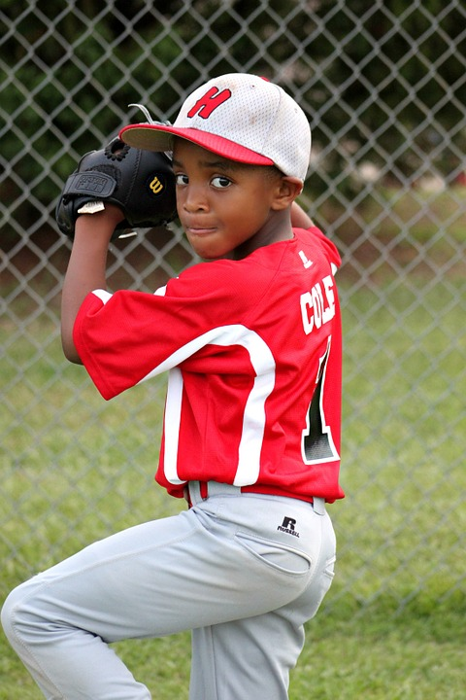
Activity
Think of the proudest moment of your life—where you were at your best.
Share that experience with someone in the room.
Listen intently to that person’s experience.
Notes:
Instructor: Encourage students to stand up, move around the room, talk to someone new. Each person should get a chance to share and to listen.
(3-5 minutes)
Image from pixabay.com

Slide 30
Reflect
How did that go? What do you remember from what you heard?
How well did you listen?
1
5
10
Notes:
Optional: Have students take their place at the board again

Slide 31
Active Listening
Active listening is a step beyond just hearing and understanding what others say
It’s about genuinely caring about what is being said
Tools:
Body language
Participation in the conversation
Genuine interest

Slide 32
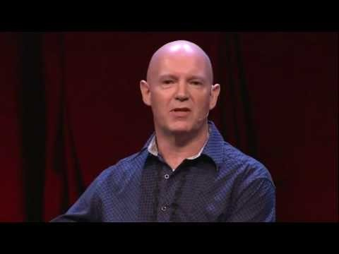
Notes:
Instructor: “Julian Treasure has published books on listening and is a great speaker
See what you can learn from what he says in this video on listening”
7:51
https://www.ted.com/talks/julian_treasure_5_ways_to_listen_better?language=en

Slide 33
Reflect & Discuss
What are your thoughts on the video?
What are your main
take-aways?

Slide 34
Activity: Active Listening
Get into groups of 3-4
Take turns discussing the following question in your groups: “Who was one of your heroes growing up? What made this person your hero?”
While listening, practice the following:
Eye contact
Clarifying questions
Be interested
Notes:
Instructor: “The best way to get better at active listening is to practice.”
(5-10 minutes)

Slide 35
Reflect
Did you listen more effectively in this activity than usual?
How did it feel to be listened to?
What could you do to listen more effectively?

Slide 36
Take-away
Listening leads to understanding

Slide 37
HW
In at least one conversation this week, make a special effort to listen actively.
Think about the difference it makes in that one conversation.

Slide 38
Additional Resources
Crucial Conversations PDF
https://wizchan.org/hob/src/1449204259443-1.pdf
Or, purchase the book online
The Power of Listening (William Ury, TED)
https://www.youtube.com/watch?v=saXfavo1OQo
10 Ways to have a Better Conversation (Celeste Headlee, TED)
https://www.youtube.com/watch?v=R1vskiVDwl4
Notes:
These resources have information and examples for effective cover letters and resumes

Slide 39
Content (not images or videos) copyright information:

