Slide 1
Personality Theory & Mindfulness
Soft Skills
Notes:
Instructor:
Read through the whole lesson (including all the notes) before the day of class
Make note of and gather any supplies you need to bring
Prepare examples, stories
Think through how much time you want to spend on individual activities; make notes
Be sure to allow time to announce the assignment at the end
Overview:
Intro (slides 1-5): 3 minutes
Personality crash course (slides 4-13): 20 minutes
Parables (slides 14-22): 8-10 minutes
WW_D? (slides 23-39): 15-20 minutes
Learning More (slides 40-44): 3 minutes
Total: 49-56 minutes

Slide 2
Prepare
This class is jam-packed—be sure to review several times. If all activities cannot be completed in time, that’s all right; just reduce the quantity. For example:
Video section: Decide whether you want to watch the whole thing; if not, decide ahead of time where to start and stop. You could also allow less time for discussion than is suggested.
Parable activity: allow less discussion time
WW_D activity: ask for 3 volunteers instead of 5
Note: The video in the first section might take a while to load; be sure it’s ready to go beforehand.

Slide 3
Review
Discuss working definitions of leadership
Explore the styles of great leaders throughout history
Identify personal leadership formula and write your leadership manifesto
Discuss leadership's potential in productivity, creativity, and relationships
Notes:
What did we discuss last time?
Outcomes from lesson 13

Slide 4
Outcomes
Learn several terms to help us discuss personality
Interpret three parables of personality
Experience others’ viewpoints
Understand methods to improve empathy and understanding

Slide 5
Personality— Crash Course
ACME Seminar
Notes:
Overview:
Intro (slides 1-5): 3 minutes
Personality crash course (slides 4-13): 20 minutes
Parables (slides 14-22): 8-10 minutes
WW_D? (slides 23-39): 15-20 minutes
Learning More (slides 40-44): 3 minutes
Total: 49-56 minutes

Slide 6
A note
As you will see, there is way more on personality than can possibly be covered in 50 minutes
We hope that this class will prime and inspire you to learn more. Regardless, you’ll leave with an intro to the concept that may be valuable for you.

Slide 7
Personality
Definition: “The combination of characteristics or qualities that form an individual's distinctive character.”

Slide 8
Personality
Psychologists and philosophers seek to answer questions about why people do what they do
“Personality theory” is a tool they have developed to measure the differences and similarities between people—in their thinking, behavior, desires, etc.

Slide 9
Activity
In 1-2 sentences, describe the schools of thought concerning personality, elucidating their divergences and convergences and highlighting key theories.
Share with a neighbor.
Notes:
Take no more than 1 minute. Students aren’t really expected to be able to do this.

Slide 10
Oof.
…yeah, that’s a bit much for even most psychology majors.
But, a brief introduction to the concept will help us to become familiar with the concept of “personality”—and enable us to consider its importance for ACME students
We’re going to watch a brief video on personality and you’ll get a crash course of what psych majors get in a few semesters—in 10 minutes.
Take note: you’ll answer the same question you attempted just now after the video. You’re smarter than psych majors, right?

Slide 11
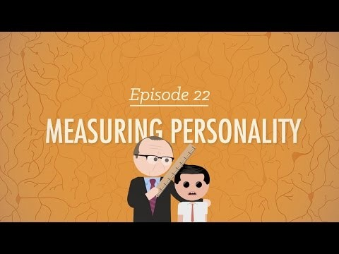
Notes:
Source: https://www.youtube.com/watch?v=sUrV6oZ3zsk
Might take a while to load; just be sure it’s ready to go beforehand.

Slide 12
Reflect
What about personality did this video help you to understand?
How might understanding personality theory be beneficial for you?

Slide 13
Follow-up
In 1-2 sentences, describe the schools of thought concerning personality, elucidating their divergences and convergences and highlighting key theories.
Share with a neighbor.

Slide 14
Take-away
“Before you can be heard, you must speak;
Before you speak, you must know how to say it;
Before you know how to say it, you must know what to say.”
—Anonymous
Learning the fundamentals of personality will help you in your efforts to understand and empathize with others—and, hopefully, inspire you to learn more.

Slide 15
Parables of Personality
ACME Seminar
Notes:
Overview:
Intro (slides 1-5): 3 minutes
Personality crash course (slides 4-13): 20 minutes
Parables (slides 14-22): 8-10 minutes
WW_D? (slides 23-39): 15-20 minutes
Learning More (slides 40-44): 3 minutes
Total: 49-56 minutes

Slide 16
Parables
Here are a few parables that we’ll go through to illustrate some of the primary questions which personality attempts to answer:
The Elephant
The Goat
The Chicken
Think about the meanings of these parables as we read them:

Slide 17

The Elephant
It’s Bernice Bear’s birthday and she gets her favorite dessert at her party: ice cream cake. All her friends are there and are singing “Happy Birthday” as her neighbor, Elmer Elephant, stumbles into the party with peanut whiskey on his breath. Everyone watches, mortified, as Elmer careens toward the cake…and squashes it.
Fast forward one year, and we’re back at Bernice’s house for her birthday party—minus one large guest. Bernice blows out the candles and then who shows up but Elmer. Everyone averts their eyes from the elephant in the room except Bernice, whose glare bores into his face like a laser beam.
Notes:
Image: http://easyway1234.blogspot.com/2013/04/too-much-greed-destroys-us.html

Slide 18

The Goat
Several years later, we’re at Bernice’s wedding to the well-respected Karl Kodiak of Kodiak Lumber. But during the reception, in struts Gary Goat, the town’s failed stand-up comic and legendary party ruiner. After Karl’s best man toasts the happy couple, Gary stands and begins to speak, bleating under his breath.
“What a pair!” he says, awkwardly describing the impending wedding night and eluding to their long hibernation. He ends his terrible speech with the taboo statement for all bears: “How ‘bout them Cubs?” The silence is tangible, and all eyes are on Bernice—whose face has turned Christmas red.
Notes:
Image: http://www.clipshrine.com/goat-in-a-sweater-7112-medium.html

Slide 19

The Chicken
Even with Gary’s terrible speech, Bernice’s maid of honor, Cathy Clucks, took care of everything. The bride’s dress, the presentation, the lights on the trees, the beautiful duck dinner—all were prepared by Mrs. Clucks and her party-planning company, “Little Red When?”.
Once the happy couple was on its way, Cathy took charge of the clean-up with the acumen of an army drill sergeant, organizing her team with precision and speed. Within 30 minutes the venue was perfectly clean, all the excess food packed, and the couple’s presents on their way to their brand-new cave. Then Mrs. Clucks celebrated a job well-done for her best friend with a tall glass of corn.
Notes:
Image: http://www.shapingyouth.org/childrens-app-reviews-money-talks/

Slide 20
Poll
What are the interpretations of these parables?
Elephant, Goat, & Chicken

Slide 21
(Suggested) Interpretations
The Elephant: unresolved interpersonal conflict
The Goat: difficult or annoying situations
The Chicken: task preparation and completion

Slide 22
Reflect
How do you deal with unresolved conflict?
E.g., Head-on, go through a friend, ask for help, etc.
How do you handle awkward situations?
E.g., Laugh out loud, sit quietly and wish for death, etc.
How do you approach tasks to do?
E.g., Plan and prepare, jump straight in, delegate, etc.

Slide 23
Take-aways
There are many aspects of personality apart from these
All of us approach these things idiosyncratically (i.e., differently than any other person would)
Learning about how people operate and why they do what they do will help you in working with others

Slide 24
WW_D?
ACME Seminar
Notes:
Overview:
Intro (slides 1-5): 3 minutes
Personality crash course (slides 4-13): 20 minutes
Parables (slides 14-22): 8-10 minutes
WW_D? (slides 23-39): 15-20 minutes
Learning More (slides 40-44): 3 minutes
Total: 49-56 minutes

Slide 25
We need 3-5 volunteers for an activity
Notes:
Adjust number of volunteers according to amount of time left for class

Slide 26
Activity: WW_D?
One person at a time leaves the room; a paragraph describing a normal life situation is displayed on-screen
The class tries to determine how this individual would act/react/behave in this situation, given their personality
When the class has made its decision, the individual returns and describes how they would act/react/behave
If the class disagrees with the individual’s description, they can challenge until a consensus is reached ☺
Sometimes the situation is broken down into parts; in this case, determine the action/reaction/behavior for each part.

Slide 27
WW_D: Timing
Class Discussion – 1 minute
Read the paragraph and decide how volunteer would act
Read & Report –1 minute
Volunteer returns to class, reads the paragraph, and spokesman from the class explains the class’ decision
Volunteer Description – 1-2 minutes
Volunteer reports their actual predicted behaviors; possible rebuttal

Slide 28
Activity: WW_D?
Some personality traits to consider:
Extraverted or introverted?
Intuitive or sensing?
People-pleasing or distant?
Arrogant or meek?
Quantitative or qualitative?
Problem-solving or problem-causing?
Ready to go?
Notes:
Time limit: 1 minute (a. class, b. student)
Who will keep time?

Slide 29

First volunteer!
Notes:
One person at a time leaves the room; a paragraph describing a normal life situation is displayed on-screen
The class tries to determine how this individual would act/react/behave in this situation, given their personality
When the class has made its decision, the individual returns and describes how they would act/react/behave
If the class disagrees with the individual’s description, they can challenge until a consensus is reached ☺
Sometimes the situation is broken down into parts; in this case, determine the action/reaction/behavior for each part.
Image from https://pixabay.com/en/volunteer-help-service-volunteering-1550327/ (CC0 license)

Slide 30

Situation #1
WW_D?
Your professor gives you a special math problem to solve which no student has ever figured out. He promises that solving this problem will grant you immediate acceptance into whichever internship you’d like. You work for weeks on end, to no avail.
Later, you have a meeting with the professor and, during the meeting, you see the solution to the problem on his desk.
Notes:
One person at a time leaves the room; a paragraph describing a normal life situation is displayed on-screen
The class tries to determine how this individual would act/react/behave in this situation, given their personality
When the class has made its decision, the individual returns and describes how they would act/react/behave
If the class disagrees with the individual’s description, they can challenge until a consensus is reached ☺
Sometimes the situation is broken down into parts; in this case, determine the action/reaction/behavior for each part.
Image: https://www.flickr.com/photos/peterrosbjerg/4257452000

Slide 31
Next volunteer!
Notes:
One person at a time leaves the room; a paragraph describing a normal life situation is displayed on-screen
The class tries to determine how this individual would act/react/behave in this situation, given their personality
When the class has made its decision, the individual returns and describes how they would act/react/behave
If the class disagrees with the individual’s description, they can challenge until a consensus is reached ☺
Sometimes the situation is broken down into parts; in this case, determine the action/reaction/behavior for each part.
Image from https://pixabay.com/en/volunteer-help-service-volunteering-1550327/ (CC0 license)

Slide 32
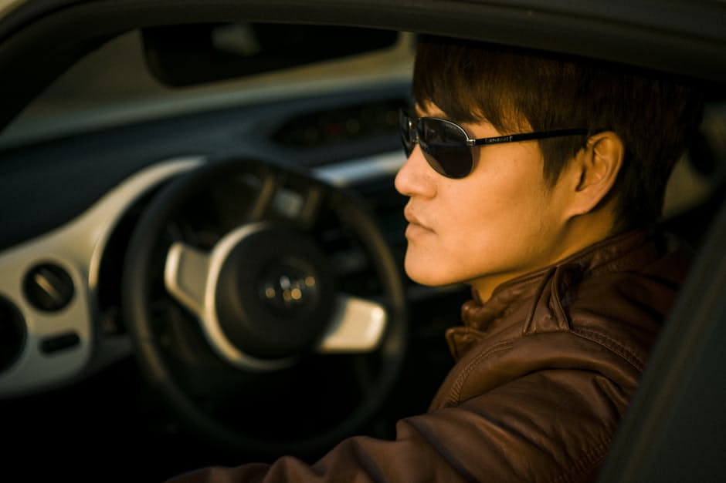
Situation #2
WW_D?
An attractive 20-something of the opposite gender, quite obviously texting, rear-ends your car
The person apologizes profusely, exchanges insurance information, and, smiling, offers to take you to dinner in return for the trouble
Notes:
One person at a time leaves the room; a paragraph describing a normal life situation is displayed on-screen
The class tries to determine how this individual would act/react/behave in this situation, given their personality
When the class has made its decision, the individual returns and describes how they would act/react/behave
If the class disagrees with the individual’s description, they can challenge until a consensus is reached ☺
Sometimes the situation is broken down into parts; in this case, determine the action/reaction/behavior for each part.
Image: https://www.pexels.com/photo/man-people-model-glasses-46232/

Slide 33
Next volunteer!
Notes:
One person at a time leaves the room; a paragraph describing a normal life situation is displayed on-screen
The class tries to determine how this individual would act/react/behave in this situation, given their personality
When the class has made its decision, the individual returns and describes how they would act/react/behave
If the class disagrees with the individual’s description, they can challenge until a consensus is reached ☺
Sometimes the situation is broken down into parts; in this case, determine the action/reaction/behavior for each part.
Image from https://pixabay.com/en/volunteer-help-service-volunteering-1550327/ (CC0 license)

Slide 34
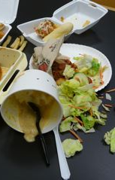
Situation #3
WW_D?
You’ve been waiting in line for your favorite food from your favorite fast-food chain for the past 20 minutes.
They finally call your name, and, in your haste to find a table and eat, you trip and drop your food on the floor.
Notes:
One person at a time leaves the room; a paragraph describing a normal life situation is displayed on-screen
The class tries to determine how this individual would act/react/behave in this situation, given their personality
When the class has made its decision, the individual returns and describes how they would act/react/behave
If the class disagrees with the individual’s description, they can challenge until a consensus is reached ☺
Sometimes the situation is broken down into parts; in this case, determine the action/reaction/behavior for each part.
Image: http://library.case.edu/ksl/aboutus/policies/food/

Slide 35
Next volunteer!
Notes:
One person at a time leaves the room; a paragraph describing a normal life situation is displayed on-screen
The class tries to determine how this individual would act/react/behave in this situation, given their personality
When the class has made its decision, the individual returns and describes how they would act/react/behave
If the class disagrees with the individual’s description, they can challenge until a consensus is reached ☺
Sometimes the situation is broken down into parts; in this case, determine the action/reaction/behavior for each part.
Image from https://pixabay.com/en/volunteer-help-service-volunteering-1550327/ (CC0 license)

Slide 36

Situation #4
WW_D?
You are working on a group project in your least-favorite class, and your team leaves you with the most work.
You get an ‘A’ on your project, and your professor asks about your group’s performance. They approach you and ask for mercy, and promise to help more on the final project.
Notes:
One person at a time leaves the room; a paragraph describing a normal life situation is displayed on-screen
The class tries to determine how this individual would act/react/behave in this situation, given their personality
When the class has made its decision, the individual returns and describes how they would act/react/behave
If the class disagrees with the individual’s description, they can challenge until a consensus is reached ☺
Sometimes the situation is broken down into parts; in this case, determine the action/reaction/behavior for each part.
Image: https://www.pexels.com/photo/man-sitting-next-to-couple-of-person-walking-on-the-street-during-daytime-211050/

Slide 37
Last volunteer!
Notes:
One person at a time leaves the room; a paragraph describing a normal life situation is displayed on-screen
The class tries to determine how this individual would act/react/behave in this situation, given their personality
When the class has made its decision, the individual returns and describes how they would act/react/behave
If the class disagrees with the individual’s description, they can challenge until a consensus is reached ☺
Sometimes the situation is broken down into parts; in this case, determine the action/reaction/behavior for each part.
Image from https://pixabay.com/en/volunteer-help-service-volunteering-1550327/ (CC0 license)

Slide 38
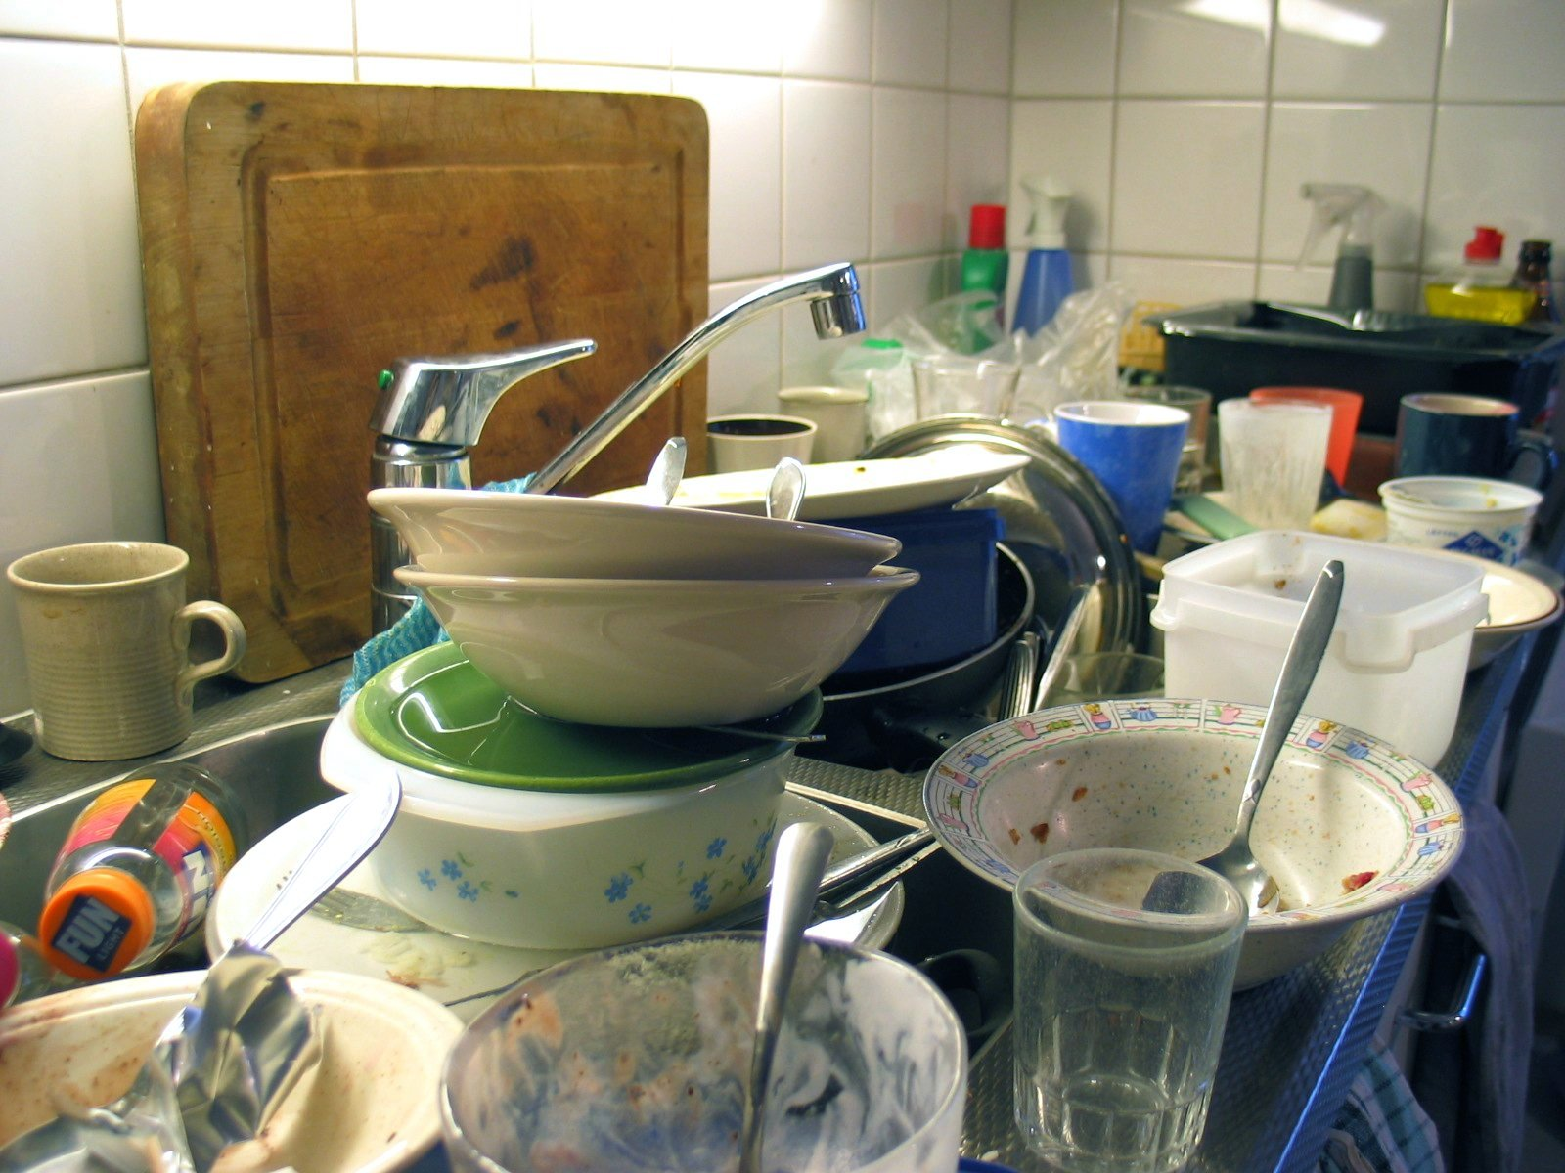
Situation #5
WW_D?
The dishes are piled up to the ceiling in your tiny apartment, and each of your 6 roommates knows who the culprit is.
Notes:
One person at a time leaves the room; a paragraph describing a normal life situation is displayed on-screen
The class tries to determine how this individual would act/react/behave in this situation, given their personality
When the class has made its decision, the individual returns and describes how they would act/react/behave
If the class disagrees with the individual’s description, they can challenge until a consensus is reached ☺
Sometimes the situation is broken down into parts; in this case, determine the action/reaction/behavior for each part.
Image: https://commons.wikimedia.org/wiki/File:Dirty_dishes.jpg

Slide 39

Reflect
What did you think of this activity?
Did it help you in your ability to understand what others do—and possibly how others perceive you?
Notes:
Image from https://www.pexels.com/photo/woman-with-denim-jacket-walking-in-the-crowd-of-people-128983/

Slide 40
Take-away
Learning to think about why others do what they do is essential to being a well-educated, successful person
It’s not always easy—and that’s ok! Keep practicing and your ability to understand others will increase.

Slide 41
Learning More
ACME Seminar
Notes:
Overview:
Intro (slides 1-5): 3 minutes
Personality crash course (slides 4-13): 20 minutes
Parables (slides 14-22): 8-10 minutes
WW_D? (slides 23-39): 15-20 minutes
Learning More (slides 40-44): 3 minutes
Total: 49-56 minutes

Slide 42
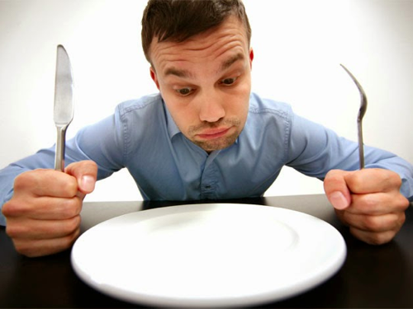

Personality
Ultimately, this class comes down to having an increased desire to learn about others’ perspectives, and why people do what they do
There are entire books on personality, empathy, behavior, understanding, “walking in another’s shoes”, etc. It would be foolish to attempt to do it all now.
Notes:
Images: https://openclipart.org/detail/18925/small-whale
http://www.usabilidoido.com.br/atividade_social_como_base_de_projetos_de_interacao.html

Slide 43
Tips
That said, here are a few tips to help you learn more:
Take a reputable personality test
Learn personality terminology
Become interested in the differences in people

Slide 44
Recommended Tests
MMPI
MBTI
Gallup Strengths
VIA Survey (Martin Seligman)
Notes:
For BYU students: BYU’s Career Center offers career assessments and personality profiles, including MBTI: https://casc.byu.edu/career-assessments

Slide 45
Take-aways
Look for the similarities and differences in people. Your interest in others will increase your knowledge of, and ability to understand and relate to, them.

Slide 46
Homework
Take a personality test and become more familiar with your own tendencies, strengths, and desires
Learn to use the right terminology to describe personality-based phenomena

Slide 47
Outcomes
Learn several terms to help us discuss personality
Interpret three parables of personality
Experience others’ viewpoints
Understand methods to improve empathy and understanding

Slide 48
Additional resources
Publications by Brent Slife (BYU) on personality
Personality inventories (MMPI, MBTI, Gallup StrengthsFinder test, etc.)
Your college career center
Notes:
BYU students can take assessments at https://casc.byu.edu/career-assessments

Slide 49
Content (not images or videos) copyright information:

