Slide 1
Group Problem-Solving
Soft Skills
Notes:
Instructor:
Read through the whole lesson (including all the notes) before the day of class
Make note of and gather any supplies you need to bring
Prepare examples, stories
Think through how much time you want to spend on individual activities; make notes
Be sure to allow time to announce the assignment at the end
Overview:
Intro (slides 1-5): 2 minutes
Formal & informal (slides 6-12): 10 minutes
Scavenger hunt (slides 13-21): 35 minutes
Strategies (slides 22-31): 5-15 minutes
Total: 52-62 minutes

Slide 2
Prepare
Remember, the main activity here is the scavenger hunt; give the students plenty of time beforehand to understand the rules, and time afterward to talk about their exploits and learnings. They will likely be excited to share what they did!
Consider reducing the time for class discussion on other topics to give more time for the activity.
Bring your favorite snack/treat for the team which wins the scavenger hunt. Ask ACME professor contact for reimbursement if needed.
The scavenger hunt sheet is embedded on the next page; print out 5-7 copies for the class before class begins.

Slide 3
Scavenger Document (double click to activate)

Slide 4
Review
Understand conflicts that affect work teams
Learn strategies for conflict management
Practice proactive listening
Notes:
What did we discuss last time?
Objectives from lesson 18

Slide 5
Outcomes
Compare informal to formal problem-solving
Participate in Group Scavenger Hunt to practice problem-solving by doing
Review strategies for group problem-solving (GOAL)

Slide 6
Formal vs. Informal Problem-Solving
ACME Seminar
Notes:
Overview:
Intro (slides 1-5): 2 minutes
Formal & informal (slides 6-12): 10 minutes
Scavenger hunt (slides 13-21): 35 minutes
Strategies (slides 22-31): 5-15 minutes
Total: 52-62 minutes

Slide 7
The purpose of this class is to explore general group problem-solving
You have already encountered problems to solve—both formally, and informally
Let’s differentiate these!

Slide 8
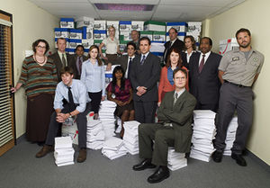
Formal vs. Informal
Formal problem-solving: approaching a problem’s solution built inside the structure of a formal organization
E.g., How best to allocate resources to branches of a mid-size paper company
Notes:
Image: https://en.wikipedia.org/w/index.php?curid=24144354

Slide 9
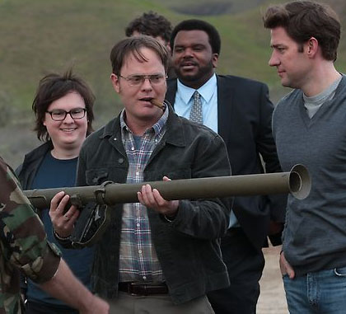
Informal problem-solving:
solving a problem outside the structure of a formal organization
E.g., How to plan, organize, and carry out the best bachelor party ever
Notes:
Image: http://nerdreactor.com/2013/05/20/the-office-finale-one-of-the-best-ever/

Slide 10
Poll
What formal problems have you had to solve in the past week? (name 2-3)
What informal problems have you had to solve in the past week? (name 2-3)
Which of these problems were solved in groups?

Slide 11
Group Problem-Solving
Most significant problems are too big for one person to solve
Formal Examples: building the Titanic, forming the United Nations, electing a president
Informal Examples: plane passengers on 9/11 taking over the ship and preventing disaster, figuring out which restaurant your friends want to eat at, etc.

Slide 12
Take-away
Opportunities for learning are all over the place—formally, and informally. Take advantage of each.
Your ability to successfully problem-solve in groups will enable you to do great things!

Slide 13
Group Scavenger Hunt
ACME Seminar
Notes:
Overview:
Intro (slides 1-5): 2 minutes
Formal & informal (slides 6-12): 10 minutes
Scavenger hunt (slides 13-21): 35 minutes
Strategies (slides 22-31): 5-15 minutes
Total: 52-62 minutes

Slide 14
Scavenger Hunt
We’re going to apply problem-solving in a different way: in a scavenger hunt!
This will give you the opportunity to practice your skills, and give you experience with group problem-solving.
We are purposely jumping into this to give you little/no time to prepare—just have fun with it ☺

Slide 15
Scavenger Hunt
Goal: get the most points in 25 minutes! Complete challenges to get points. Challenges are divided into three groups; the harder and crazier they are, the more points they’re worth.
Each group must be comprised of 3-5 people
Work together; use every team member
All groups start and end at the same time
All groups must agree to the honor system (no lying, destroying property, causing a riot, etc.)
Have fun!

Slide 16
1. Count off into groups
(3-5 people/group)
Notes:
Facilitator: count off with the students until they are all in the groups of the appropriate size

Slide 17
2. Grab a Scavenger Hunt Sheet
(No reading before time starts)

Slide 18
3. GO!!!
(Be back in 25 minutes, or forfeit!)
Notes:
Keep on this screen until the students are back.

Slide 19
Debrief
Who won?
Who has the best/craziest/funniest story?
Spoils to the winners

Slide 20
Consider the Following
How did you approach the Scavenger Hunt?
What did your team do well?
What could you have improved?
Create a pros and cons list on the board

Slide 21
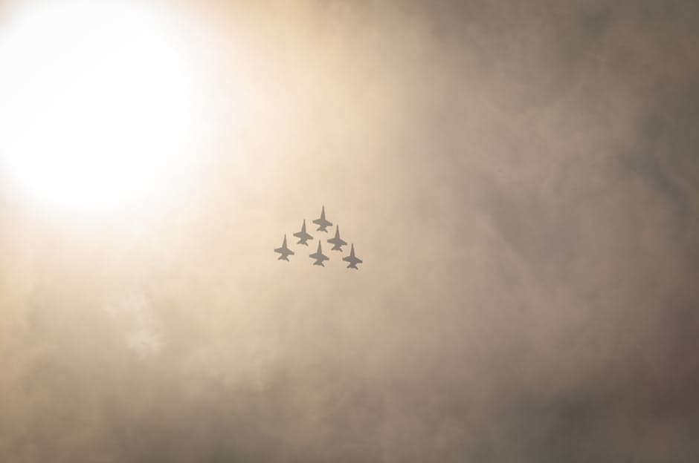
Take-away
Learning to problem-solve effectively in groups can be the difference between success and failure.
Notes:
Image: https://www.pexels.com/photo/flight-sky-clouds-cloudy-2002/

Slide 22
Strategies for Group Problem-Solving
ACME Seminar
Notes:
Overview:
Intro (slides 1-5): 2 minutes
Formal & informal (slides 6-12): 10 minutes
Scavenger hunt (slides 13-21): 35 minutes
Strategies (slides 22-31): 5-15 minutes
Total: 52-62 minutes

Slide 23
Strategies
Consider using the following strategies as you problem-solve in groups or teams:
Think GOAL:
Develop and state the common goal
Break down problem into smaller parts (orchestration)
Assign each member equal and cooperating responsibilities in solving the problem
Be “leadable” (objective, thick-skinned, and optimistic)

Slide 24
Develop and State the Common Goal
What is your goal? What do you hope to accomplish?
E.g., Win the basketball game, complete the algorithm, find the answer, etc.
Apply: think of an assignment you’re working on (preferably as a group). What is your goal?
Write it down

Slide 25

Orchestrate the Problem
How can the problem be broken down?
E.g., Basketball game: run successful plays + play tenacious defense + call time-outs at key points + increase ball movement + etc.
Apply: think back to the assignment. How can you break it down?
Write it down
Notes:
Image: https://www.pexels.com/photo/man-holding-orange-basketball-hoop-29011/

Slide 26
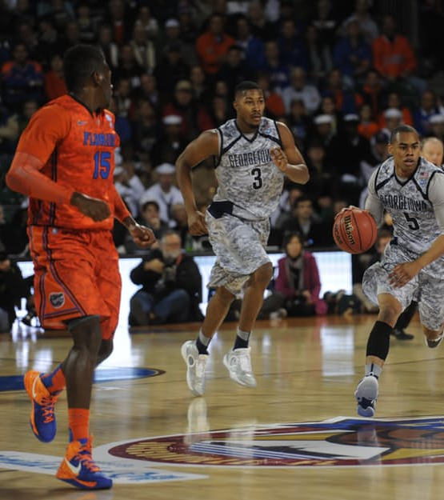
Assign Responsibilities
Now that you’ve broken down the problem, who is going to do what?
E.g., Basketball: Point guard, Shooting guard, Small forward, Power forward, Center, Head Coach, etc.
Apply: think back to the assignment. Who is doing what?
Write it down
Notes:
Image: https://www.pexels.com/photo/men-playing-basketball-on-lighted-court-39593/

Slide 27
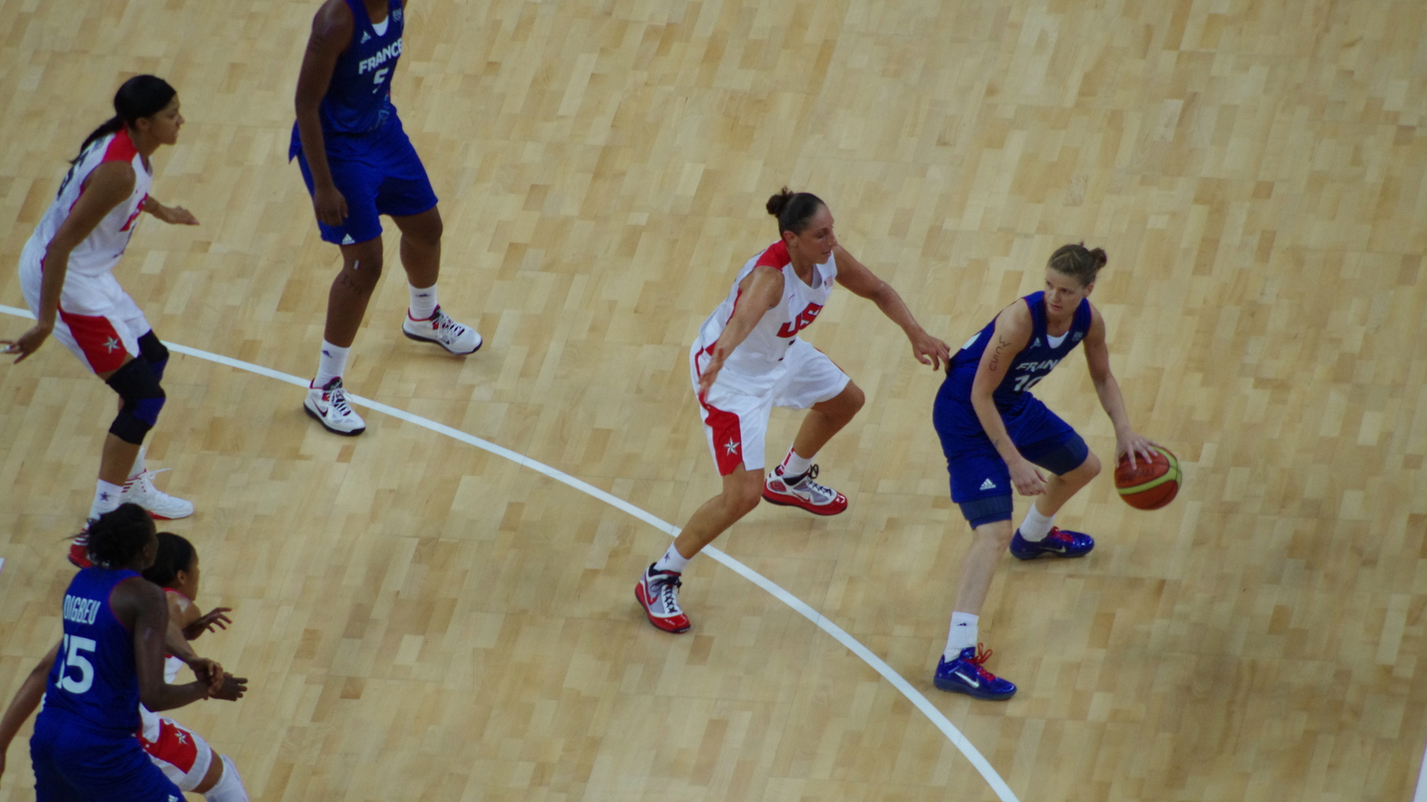
Be “leadable”
Think objectively and optimistically.
Be thick-skinned—not every idea you have will be the right one. Allow others to improve on your methods.
E.g., Basketball: sometimes you will score the points, and sometimes you will set screens and grab rebounds.
Apply: think back to the assignment. How might being “leadable” help you accomplish your goals?
Write it down
Notes:
Image: https://commons.wikimedia.org/wiki/File:Womens_basketball_final_at_London_Olympics_2012.jpg

Slide 28
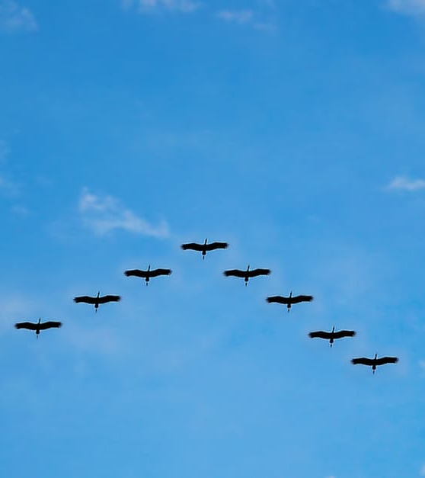
Remember
Before any of this happens, someone has to take charge—and others have to lead
Sometimes you will be the leader, and sometimes you will follow
Learn to be a leader, and learn to be led. Both are incredibly important.
Notes:
Image: https://www.pexels.com/photo/v-formation-of-bird-during-daytime-62667/

Slide 29
Take-away
Opportunities for learning are all over the place—formally, and informally. Take advantage of each.
When approaching a group problem, make a GOAL.

Slide 30
Outcomes
Compare informal to formal problem-solving
Participate in Group Scavenger Hunt to practice problem-solving by doing
Review strategies for group problem-solving (GOAL)

Slide 31
Additional resources

