Slide 1
Time and Project Management
Notes:
Instructor:
Read through the whole lesson (including all the notes) before the day of class
Make note of and gather any supplies you need to bring
Prepare examples, stories
Think through how much time you want to spend on individual activities; make notes
Be sure to allow time to announce the assignment at the end
Overview:
Intro (slides 1-3): 2 minutes
Time management (slides 4-16): 12-18 minutes
Project management (slides 17-45): 30-35 minutes
Wrap-up: 1 minute
Total: 45-56 minutes

Slide 2
Review
Objectives:
Understand optimism and how to increase it
Discuss the benefits of gratitude
Notes:
What did we discuss last time?
Objectives from lesson 16

Slide 3
Today
Objectives:
Develop a working knowledge of basic project planning and scheduling skills
Learn how to use basic tools
Work breakdown structures
Resource allocation
Gantt charts
Understand the need for tracking managing commitments
Practice time management

Slide 4
Time Management
Notes:
Overview:
Intro (slides 1-3): 3-4 minutes
Time management (slides 4-16): 12-18 minutes
Project management (slides 17-45): 30-35 minutes
Wrap-up: 1-2 minutes
Total: 46-59 minutes

Slide 5

Activity
How are you at time management?
Write down your strengths and weaknesses
What do you hope to gain from this discussion of time management?
Notes:
1-2 minutes to write
1-2 minutes to share
Image source: https://www.pexels.com/photo/numbers-time-watch-white-1778/

Slide 6
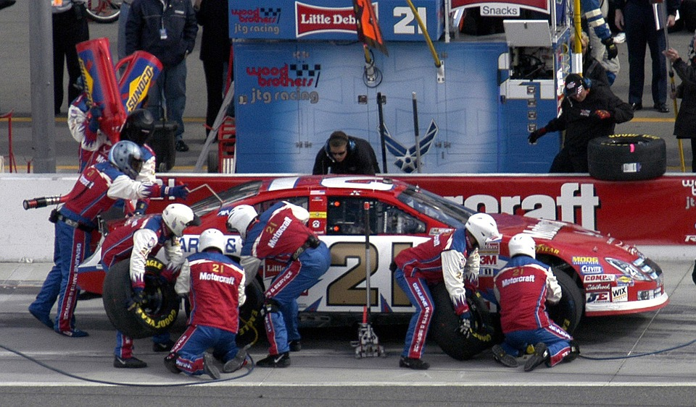
The power of speed
Notes:
In your career, you may be expected to work as fast as a Nascar pit crew.
Photo source: https://pixabay.com/en/pit-crew-nascar-tires-gasoline-916445/
Ideas from Harding, Misty. (10/27/2016). “2016/10/27 - IP&T Seminar - Misty Harding” https://www.youtube.com/watch?v=U18Ec-8qDLk

Slide 7
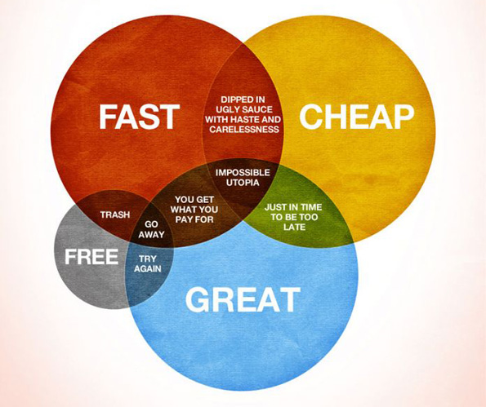
What people want
Fast
Cheap
Great
(Impossible)
Therefore, learn to
Work within constraints
Focus on what matters most
Accept that you can’t produce your best work on every project
Notes:
Harding, Misty. (10/27/2016). “2016/10/27 - IP&T Seminar - Misty Harding” https://www.youtube.com/watch?v=U18Ec-8qDLk
Image from http://www.paulingraham.com/how-would-you-like-your-_____-pick-two.html. Original source unknown

Slide 8
There’s never enough time
Many companies tout their “fast-paced work environments”
Work deadlines are often much faster than we’re used to in school
Instead of having a month or a semester to do a project, you might have week, a day, or a few hours

Slide 9
What Do You Manage?
You do not manage time
You manage your commitments

Slide 10
Structures for Time Management
Where is the last place you should put your commitments?
In your memory
Why?
How many things can you keep in your memory?
What do you remember when you are upset?
How long does it take to get upset in your normal day?
We need some structure outside of your memory in which commitments can exist

Slide 11

Methods to Track Time
Time management books or schedulers
Scheduling app
A piece of paper to write things down
Memory
Notes:
Image from https://www.pexels.com/photo/person-using-silver-iphone-6-beside-red-plastic-vase-on-white-surface-199093/ CC0 license

Slide 12
Open Item List
Date | What | Who | Resources | Date Due

Slide 13
Weekly Schedule
 | Sun | Mon | Tue | Wed | Th | Fr | Sat
7AM
9AM
11AM
1PM
3PM
5PM
7PM

Slide 14

The problem of procrastination
Notes:
About 3 minutes (you don’t need to watch the whole thing to get the idea)
Video URL: https://youtu.be/sAJVfEaaw3w
Video may take several seconds to load

Slide 15
Overcoming the problem of procrastination
Break down big tasks into smaller tasks
Set a timer, stick to it
Make your deadlines well before actual deadlines
Start when you get the assignment instead of waiting until it’s due
Notes:
Discuss: What works for you? How do you avoid putting off things you don’t want to do?

Slide 16
Prepare for a fast-paced job
Start timing yourself
Look for ways to be efficient
Build good habits
Schedule your commitments
Reflect—after finishing a project, ask what you could have done better or faster
Notes:
Harding, Misty. (10/27/2016). “2016/10/27 - IP&T Seminar - Misty Harding” https://www.youtube.com/watch?v=U18Ec-8qDLk

Slide 17
Managing Your Project: Planning & Time
Notes:
Overview:
Intro: 7-10 minutes
Project management (slides 8-35): 25-30 minutes
Time management (slides 36-49): 10-15 minutes
Wrap-up: 1-2 minutes
Total: 43-57 minutes

Slide 18
Notes:
Introduction to project management: https://www.youtube.com/watch?v=Jk-JwtScIlw
Video may take several seconds to load.

Slide 19

Project Planning Activity
Identify a class project to use as we move through this lesson
What is your project name?
What is the main goal of your team’s project?
Notes:
Form teams; spend about 2 minutes identifying a project (real or imaginary). You’ll be working on this project for the next 20-30 minutes.
Image from https://www.pexels.com/photo/notebook-pencil-notes-sketch-8763/ CC0 License

Slide 20
Phases of Project Management
Define the project’s scope
Develop the project’s plan
Implement the plan & control the process
Close out the project
Notes:
Our focus today is on developing a plan.

Slide 21
Develop the Project’s Plan
Break Down Project
Tasks (WBS)
Time Estimation &
Dependencies
Review & adjust
Determine Resource
Needs
Develop Gantt Chart
Notes:
Planning is an iterative process. Some projects won’t require a proposal

Slide 22
1. Break down project tasks: Work Breakdown Structure (WBS)
A hierarchical representation of activities
It starts with the major project areas to be accomplished
It breaks the project areas into actionable pieces of work, segmenting elements into appropriate sublevels

Slide 23
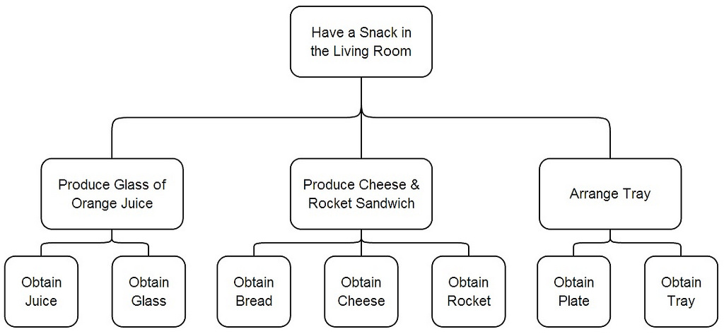
Example of WBS
Level 1
Level 2
Level 3
Notes:
Image (WBS) from https://www.flickr.com/photos/pshegubj/8325576453

Slide 24
WBS – Activity Levels
Level 1 – Identify major objective areas or categories
Level 2 – Begin to divide the areas into sub-tasks
Level 3 – Continue to break down the sub-tasks into actionable items
The lowest level associated with a branch in the hierarchy is referred to as a “work package”
# of levels depends on project complexity

Slide 25
WBS: Crane Example
Design support columns (Level 1)
1.1 Select final material (Level 2)
1.1.1 Design for compression (Level 3)
1.1.2 Design for buckling (Level 3)
1.1.3 Calculate deformation (Level 3)
Notes:
This is another way to write a WBS—this is just the first part of the plan.

Slide 26
Project Planning Activity
As a group, create a work breakdown structure (WBS) for your project
Notes:
Spend 3-5 minutes (you may not complete the WBS--that’s ok)
Level 1 – Identify major objective areas or categories
Level 2 – Begin to divide the areas into sub-tasks
Level 3 – Continue to break down the sub-tasks into actionable items
(See example on previous slides)

Slide 27
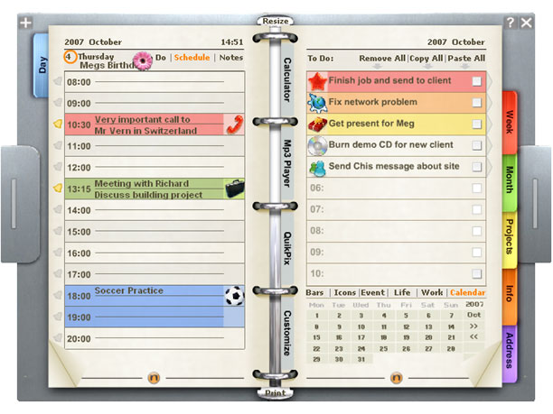
2. Time Duration
Managing a project requires awareness of two time frames:
The amount of effort a task will take (in time), e.g., 3 hours to write a report
The calendar span over which the activity will occur, e.g., the report will be done within a week

Slide 28

Time Estimation
If feasible, have the person responsible make the estimate
Clock yourself
Make a schedule
Include time for problems, revisions
Don’t spin your wheels
Ask for help when you need it
Plan to finish early
Leave time for others
Notes:
Your boss will ask, “When can you have that done by?” Here are suggestions to help you answer that question.
Harding, Misty. (10/27/2016). “2016/10/27 - IP&T Seminar - Misty Harding” https://www.youtube.com/watch?v=U18Ec-8qDLk

Slide 29
Project Planning Activity
For each work package, estimate the time duration in days
Then determine the time duration of each higher level activity
Notes:
Take a couple of minutes

Slide 30

3. Identifying Resources
To accomplish each activity identified in the WBS requires the use of resources:
Personnel (who, how many, their skills)
Space (meeting location, lab facilities)
Equipment (rent, own, purchase, how long needed)
Money (budget limitations)
Notes:
Image from https://www.pexels.com/photo/people-laptop-industry-internet-132700/ CC0 license

Slide 31

Assigning Resources
Assign resources to the appropriate tasks (personnel, space, equipment, money)
Be realistic– no one can be in two places at one time
Notes:
Image from https://www.pexels.com/photo/late-running-work-job-24068/ CC0 license

Slide 32
Project Planning Activity
As a group, identify the resources needed for each task in the WBS
Notes:
Take a couple of minutes

Slide 33
The Gantt Chart: A Visual Scheduling Tool
Graphically represents WBS information
Shows dependencies between tasks, time duration, personnel, and other resource allocations
Tracks progress towards project completion

Slide 34
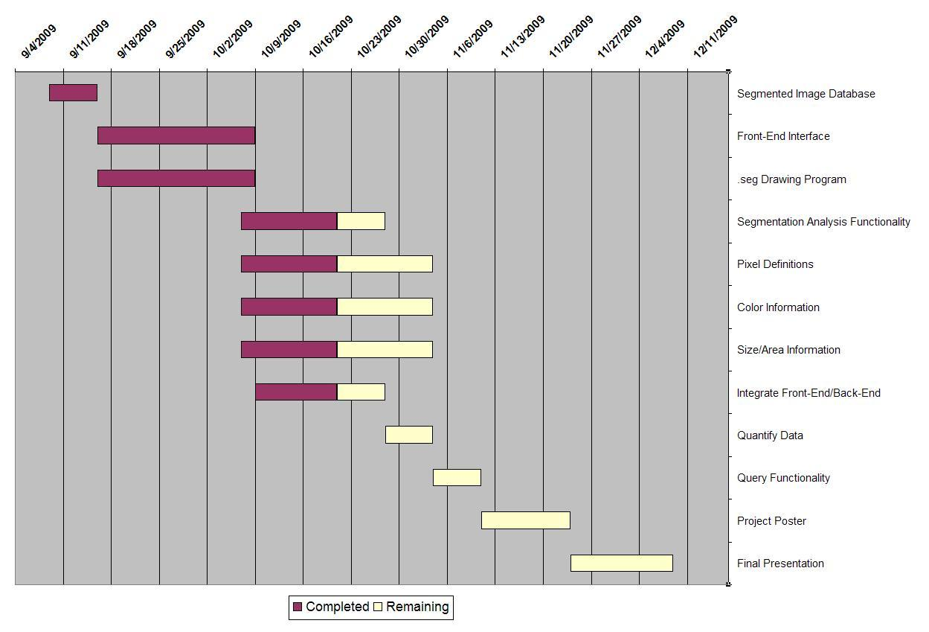
Gantt Chart Example

Slide 35
Building a Gantt Chart - Axes
List all tasks and milestones from the WBS along the vertical axis
List time frame along the horizontal axis
Tasks:
Design support columns
Select final material
Design…
Time Frame: day 1 day 2 day 3

Slide 36
Project Planning Activity
Based on the WBS (tasks, durations) create a Gantt Chart

Slide 37
Next Step: Implement the Plan
After the plan is complete, everyone should know who is responsible for each activity and when each task must be complete to ensure project success

Slide 38

Project Planning Summary
Create WBS to identify activities
Estimate time durations
Identify resource needs
Schedule activities using a Gantt chart
Review plan until you reach agreement
Put plan into action!

Slide 39
Assignment
If you aren’t using a scheduling tool (e.g., calendar or app), start now
On your next project, practice using work breakdown structures, resource allocation, and Gantt charts

Slide 40
Acknowledgment of Support
The material is based on work supported by the National Science Foundation under grant No. DUE-0089079: “Implementing the BESTEAMS model of team development across the curriculum.”
Any opinions, findings, and conclusions or recommendations expressed in this material are those of the author(s) and do not necessarily reflect the views of the National Science Foundation.
Additional support was provided by the A. James Clark School of Engineering, the Mechanical Engineering department at the University of Maryland, College Park, and Morgan State University, the United States Naval Academy, and Howard University.

Slide 41
References
Van Aken, S. (2001) University Leadership Development, Virginia Tech, Blacksburg, VA
Gido, J., & Clements, J.P. (1999). Successful project management. South-Western College Publishing.
Weiss, J.W., and Wysocki, R.K. (1992) 5-Phase Project Management: A Practical Planning and Implementation Guide. Reading, MA: Addison Wesley.

Slide 42
Resources
Videos:
How to Manage Your Time Better: https://youtu.be/VUk6LXRZMMk?list=PLcJkeEnqH05DiZVkLO5ezibzrDuajLV0z
The Secret Powers of Time, Philip Zimbardo
https://youtu.be/A3oIiH7BLmg

Slide 43
Content (not images or videos) copyright information:

