Slide 1
benchmarking STREAM
Stefano Cozzini
AreaSciencePark

Slide 2

Resource to benchmark
CPU/GPU
Computational speed
Memory Hierarchy
(bandwith/latency)
Node Interconnect

Slide 3
Stream benchmark
Created in 1991
Intended to be an oversimplified representation of low-computing intensity and long vector operations
Realistic baseline for memory bandwidth on HPC system
Widely used, more 1100 results in the database
Hosted at www.cs.virginia.edu/stream
Compilation and execution trivial
Warning: reported and actual BW numbers may differ..

Slide 4
Stream
Four kernels, separately timed:
N chosen to make each array >> cache size
Repeated several times, first iteration ignored
Min/Max/Avg reported and the best time used to compute Bandwidth
TYPE | OPERATION | BYTE/cycle | FLOPS/cycle
COPY | A(:) = C(:) | 16 | 0
SCALE | A(:) = s * C(:) | 16 | 1
ADD | A(:) = B(:) + C(:) | 24 | 1
TRIAD | A(:) = B(:) + s * C(:) | 24 | 2

Slide 5
Stream: which kind of performance can we expect ?
Let us take a look how memory is organized on modern Intel CPU on ORFEO

Slide 6
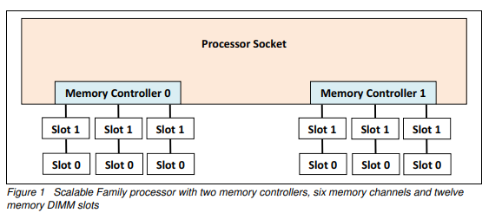
Memory layout on skylakeX processors
Picture from : Intel Xeon Scalable Family Balanced Memory Configurations (lenovopress.com)

Slide 7
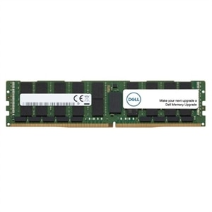
Memory should be balanced !
Three rules:
All populated memory channels should have the same total memory capacity
All memory controllers on a processor socket should have the same configuration of DIMMs
All processor sockets on the same physical server should have the same configuration of DIMMs

Slide 8
ORFEO Intel : RAM
NODE TYPE | processor | # Channels | Max speed | Memory types
THIN | Xeon(R) Gold 6126 | 6 | 2666MT/sec | DDR4-2666
FAT | Xeon(R) Gold 6154 | 6 | 2666MT/sec | DDR4-2666
GPU | Xeon(R) Gold 6226 | 4 | 2933MT/sec | DDR4-2933
𝑏_{𝑝𝑒𝑎𝑘}= # 𝐶ℎ𝑎𝑛𝑛𝑒𝑙𝑠 × 𝑓_{𝑀𝐸𝑀} × 8𝐵/𝑐𝑦𝑐𝑙𝑒
see https://www.intel.com/content/www/us/en/products/processors/xeon/scalable/gold-processors.html

Slide 9
Memory layout on ORFEO thin node
RAM=768 GB 12 LRDIMM of 64 GB each
12 on each single processor

Slide 10
Memory layout on ORFEO fat node
RAM=1536GB 24 LRDIMM of 64 GB each
12 on each single processor

Slide 11
Memory layout on ORFEO gpu node
RAM=256 GB 8 LRDIMM of 32GB each
4 on each single processor

Slide 12
ORFEO Intel nodes: peak performance
NODE TYPE | processor | # Channels | # socket | Memory types
THIN | Xeon(R) Gold 6126 | 6 | 2 | 6x2666x8x2 =~ 256GB/sec
FAT | Xeon(R) Gold 6154 | 6 | 2 | 6x2666x8x2 =~ 256GB/sec
GPU | Xeon(R) Gold 6226 | 4 | 2 | 4x2933x8x2 =~ 188GB/sec

Slide 13
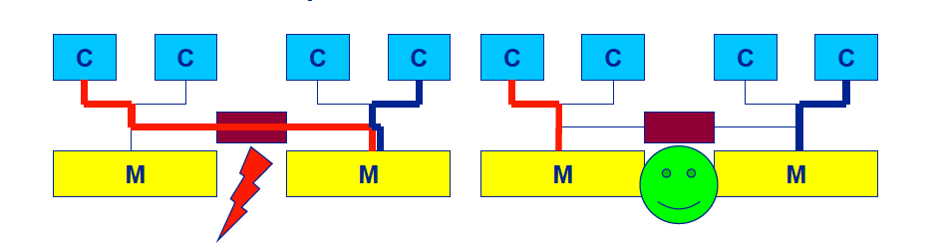
NUMA performance problem
NUma:
Whole memory is transparently accessible
But physically distributed with different latency and bandwidth
=> potential contention
How to we make sure that memory access is always as “local” and “distribute” as possible ?

Slide 14
Thread Affinity and Data Locality
Affinity
Process Affinity: bind processes (MPI tasks, etc.) to CPUs
Thread Affinity: further binding threads to CPUs that are allocated to their parent process
Data Locality
Memory Locality: allocate memory as close as possible to the core on which the task that requested the memory is running
Cache Locality: use data in cache as much as possible
Correct process, thread and memory affinity is the basis for getting optimal performance.

Slide 15
Thread placement - numactl
numactl is a command of the operating system providing much focused on the NUMA features of a system.
numactl understands which processors form a NUMA node and how threads need to be grouped together
Important options:
--membind <n>: place pages on NUMA node <n>
--cpunodebind <n>: pin threads to node <n>
--interleave <nodes>: put the pages round-robin on <nodes>
Example:
numactl --cpunodebind=0 --membind=0,1 ./a.out
This puts memory on nodes 0 and 1, but threads only on node 0.

Slide 16
STREAM performance on 1 socket (thin node)

Slide 17
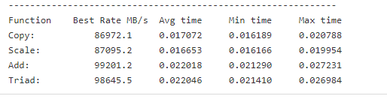
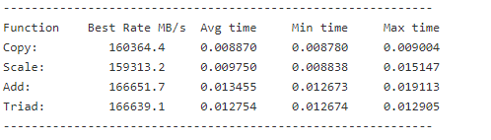
Stream in action:
Naïve way:
Pinning processor: likwid-pin –c N:0-23 ./stream.x

Slide 18
Stream on ORFEO Epyc nodes
See the the excellent tutorial prepared by Niccolo on the github repo

