Slide 1


High Performance Computing
Lecture 7: network basics
for parallel computing
2023-2024 Stefano Cozzini

Slide 2
Agenda
Network basic for parallel architecture
Network basic performance characteristics

Slide 3
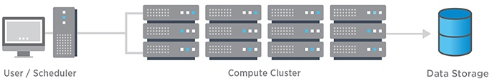
Recap on HPC architecture
Several computers (nodes) often in special cases for easy mounting in a rack
One or more networks (interconnects) to hook the nodes together
MP application’ performance rely on the characteristics of the networks.

Slide 4
Network cluster classification
HIGH SPEED NETWORK
parallel computation
low latency /high bandwidth
Usual choices: Infiniband...
I/O NETWORK
I/O requests (NFS and/or parallel FS)
latency not fundamental/ good bandwidth
GIGABIT could be ok /10Gb and/or Infiniband better
In band Management network
management traffic of all services (LRMS/NFS/software etc..)
Out of band Management network:
Remote control of nodes and any other device

Slide 5
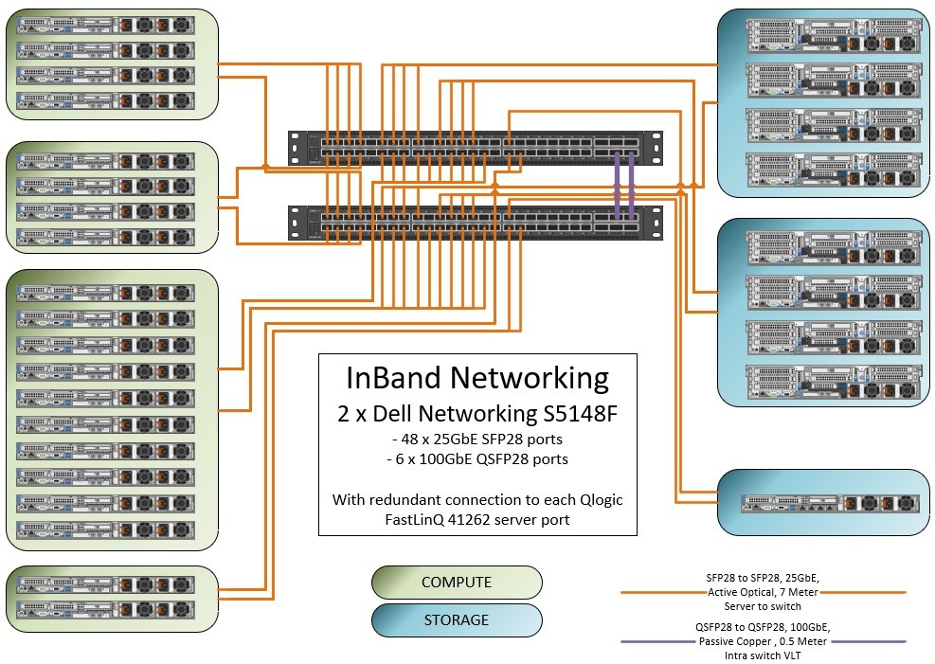
Orfeo in band management network: 25 Gbit ethernet

Slide 6
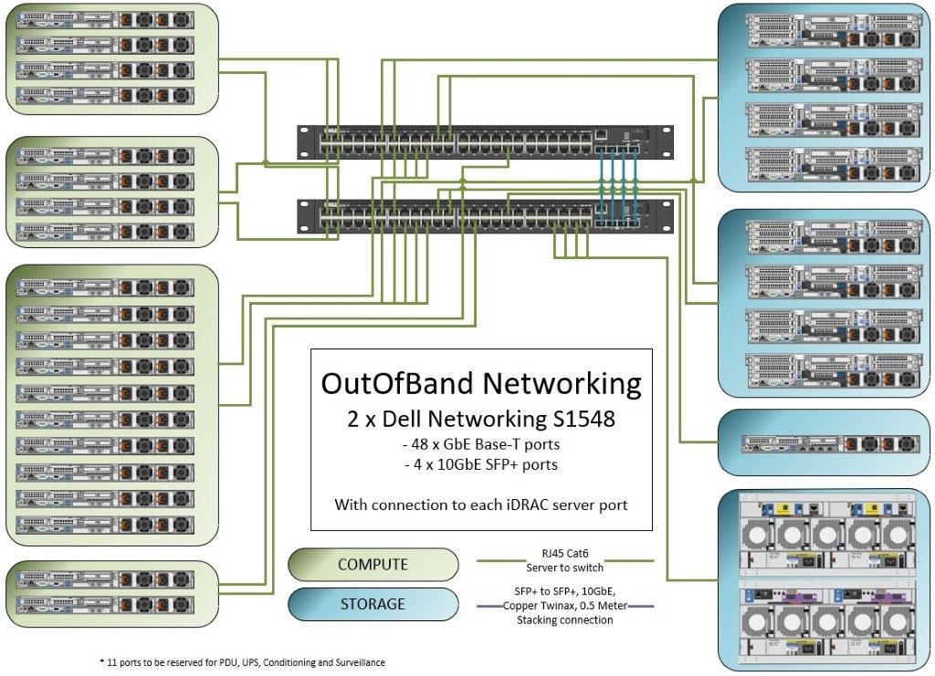
Orfeo out of band management network: 1 Gbit ethernet

Slide 7
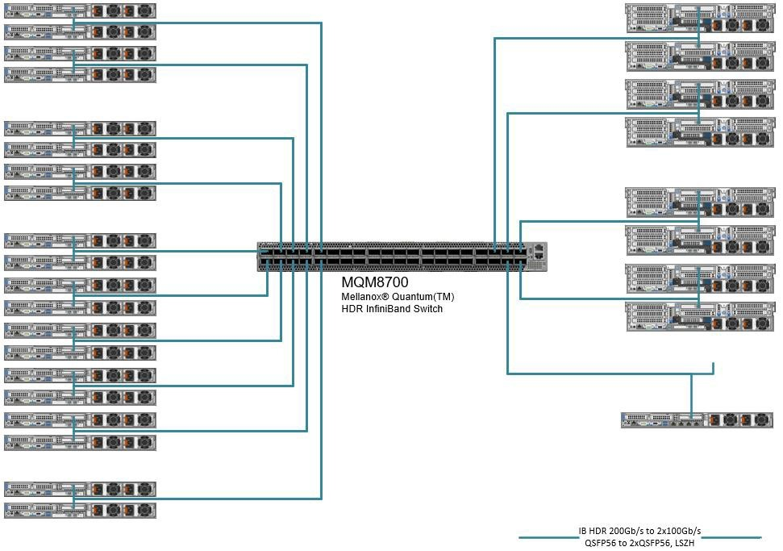
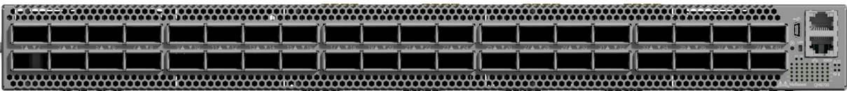
Orfeo High Speed network: 100 Gbit Infiniband

Slide 8
Orfeo network classification
100 Gbit HDR Infiniband
HIGH SPEED NETWORK
I/O NETWORK
In band Management network
Out of band Management network:
25Gbit Ethernet
1Gbit Ethernet

Slide 9
How to model network performance ?
Network capacity to transfer data
Very simple model :
Total transfer time of a message
λ is the latency of the network : i.e. the time to setup the communication channel
b_{network} is the asymptotic network bandwidth measured in Mb/sec.
T_{comm} = λ + (Size of message) / b_{network}

Slide 10
How can we estimate/measure latency and bandwidth ?
Using a simple “Ping-Pong” program :
Two processes on the network exchange point-to-point message.
A single message of N Bytes is sent forward and backward: data transfer is 2N

Slide 11
Ping-Pong algorithm
1 myID= get_process_ID()
2 if(myID.eq.0) then
3 targetID= 1
4 S = get_walltime()
5 call Send_message(buffer,N,targetID)
6 call Receive_message(buffer,N,targetID)
7 E = get_walltime()
8 MBYTES = 2*N/(E-S)/1.d6 ! MBytes/sec rate
9 TIME = (E-S)/(2*1.d6) ! transfer time in microsecs
10 ! for single message
11 else
12 targetID= 0
13 call Receive_message(buffer,N,targetID)
14 call Send_message(buffer,N,targetID)
15 endif

Slide 12
Ping Pong implementations
Available on the most common benchmark suite:
IMB: Intel MPI benchmark
intel/mpi-benchmarks (github.com)
OSU microbenchmarks
MVAPICH :: Benchmarks (ohio-state.edu)

Slide 13
Measuring MPI point-to-point performance on Orfeo
Download Intel MPI benchmark
Compile it
Run it
Get results and interpret it
See README file in MPI directory..

Slide 14
Measuring MPI point-to-point performance on Orfeo

Slide 15
Measuring MPI performance on Orfeo

Slide 16
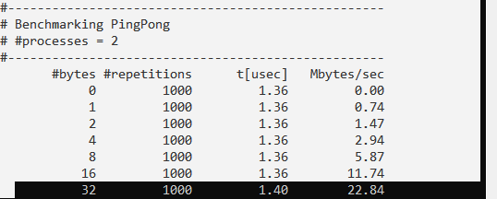
Extrapolating values for internode communication
𝜆
𝑏_{𝑛𝑒𝑡𝑤𝑜𝑟𝑘}

Slide 17
Network topology
How the components are connected.
Important properties
Diameter: maximum distance between any two nodes in the network (hop count, or # of links).
Nodal degree: how many links connect to each node.
Bisection bandwidth: The smallest bandwidth between half of the nodes to another half of the nodes.
A good topology: small diameter, small nodal degree, large bisection bandwidth

Slide 18
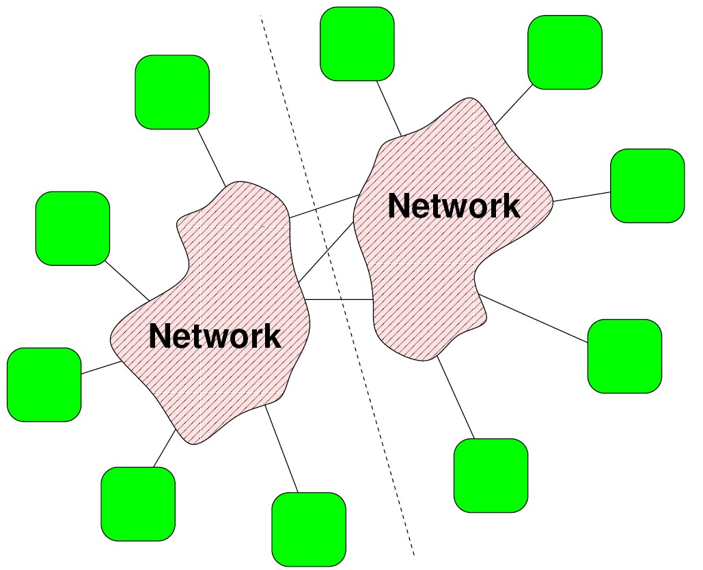
Bisection bandwidth: B_{b}
Split N nodes into two groups of N/2 nodes such that the bandwidth between these two groups is minimum
general metric for the data transfer “capability” of a system
More meaningful metric in terms of system scalability: B_{b} /Nodes

Slide 19
Common Topologies in HPC
Bus
Crossbar switches
Fat tree
CBB (Constant Bi-sectional Bandwidth)
Mesh
3D torus

Slide 20
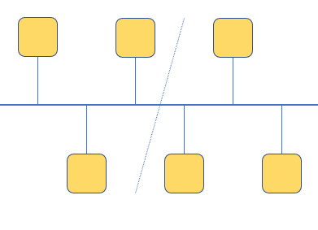
Bus topology
Bus can be used by one connection at a time
Bandwidth is shared among all devices
Bisection BW is constant: Bb/Nnodes ~ 1/Nnodes
Examples: PCI bus
Advantages
Low latency
Easy to implement
Disadvantages
Shared bandwidth, not scalable
Problems with failure resiliency (one defective agent may block bus)

Slide 21
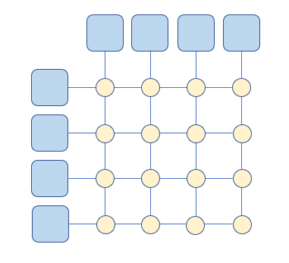
Non blocking crossbar switch
A non-blocking crossbar can mediate a number of connections between a group of input and a group of output elements
This can be used as a 4-port non-blocking switch
Switches can be cascaded to form hierarchies (common case)
Allows scalable communication at high hardware/energy costs
Not feasible for large HPC installations

Slide 22
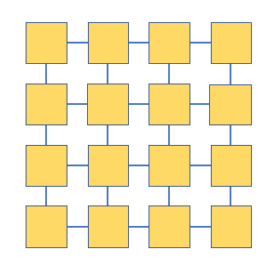
Meshes
Fat trees can become prohibitively expensive in large systems
Compromise: Meshes
n-dimensional Hypercubes
Toruses (2D / 3D)
Many others (including hybrids)
Each node is a “router”
Direct connections only between direct neighbors
Different from a crossbar!
Intelligent resource management and routing algorithms are essential

Slide 23
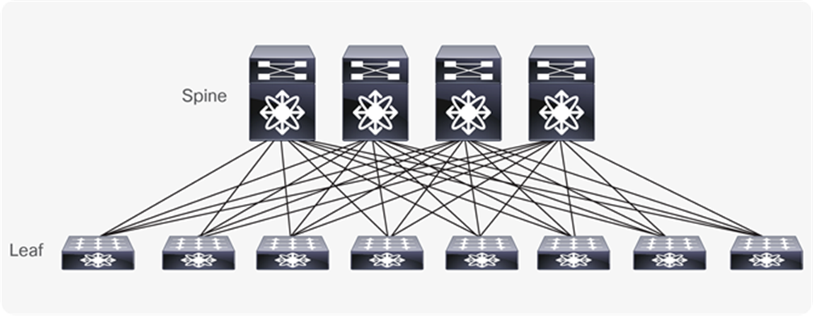
Switches and Fat-Trees
HPC clusters are built with switched networks
Compute nodes (“devices”) are split up in groups – each group is connected to single (non-blocking crossbar-) switch (“leaf/edge switches”)
Leaf switches are connected with each other using an additional switch hierarchy (“spine switches”) or directly (for small configs.)
“Perfect” world: fat- trees

Slide 24
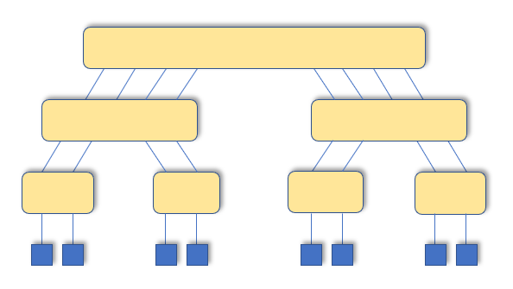
Fat-trees switch hierarchy..
Fully non-blocking:
Each level double the number of link of the switches
Not practical. Root is NXN switch

Slide 25
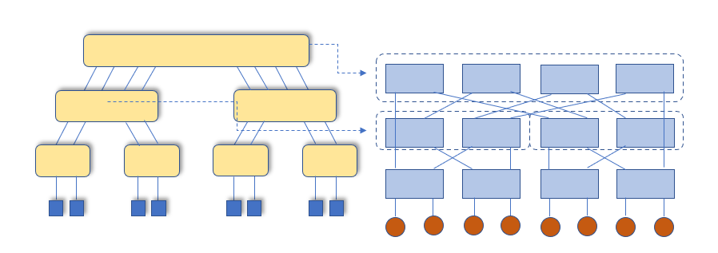
Practical fat-tree implementation
Use smaller switches to approximate large switches.
Most commodity large clusters use this topology.
Also call constant bisection bandwidth network (CBB)
N_{nodes}/2 end-to-end connections with full bandwidth
B_{b} = B * N_{nodes} /2
B_{b} / N_{nodes} = const. = B/2

Slide 26
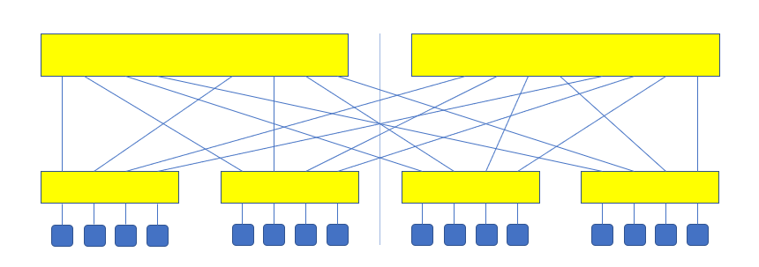
Two level CBB example
N_{nodes}/2 end-to-end connections with full bandwidth: 8
B_{b} = B * N_{nodes} /2= 8B
B_{b} / N_{nodes} = const. = B/2

Slide 27
Fat tree and static routing
Generally, CBB are using static routing algorithm.
path taken between any two node pairs is statically computed
Full bandwidth is not always seen in practice.
The number of potential routes R for a total node count of N: R=N(N-1)=N²-N.
Number of routes o(N²)
Number of Intermediate Spine link is o(N)
➔ There are scenarios where certain host communications will use the same Intermediate Spine link

Slide 28
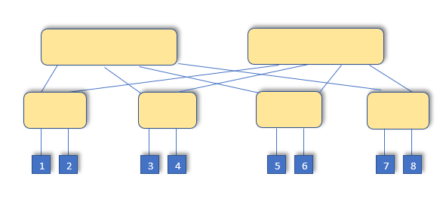
Example
For 1->5,2->6,3->7,4->8 is ok
For 1->5,2->7,3->6,4->8 is no longer fine if there is static routing

Slide 29
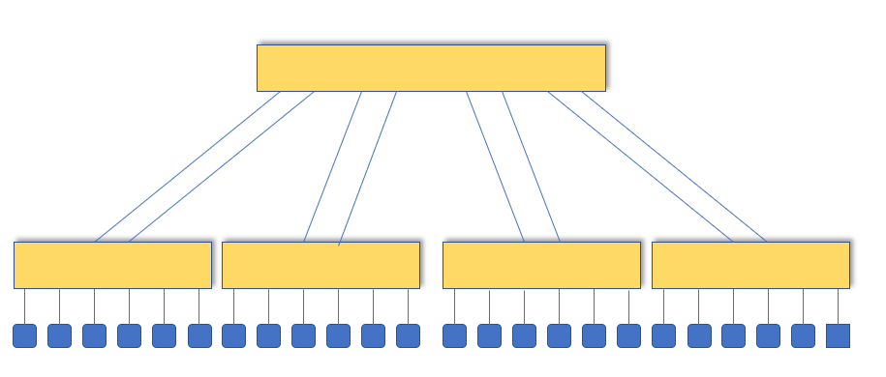
Oversubscription
Spine does not support N_{nodes}/2 full BW end-to-end connections
B_{b}/ N_{nodes} = const. = B/(2k), with k oversubscription factor (k=3 for the example)
Resource management (job placement) is crucial

Slide 30
High speed networks
Infiniband
The de-facto standard
27% of ToP500 are based on infiniband
Omni Path
started by Intel in 2015
one of the youngest HPC interconnects
8.6% of Top500 are Omni-Path systems
Both are used behind a MPI implementation..

Slide 31
Infiniband speed: physical layer..
InfiniBand uses serial stream of bits for data transfer
Linkwidth
1x – One differential pair per Tx/Rx
4x – Four differential pairs per Tx/Rx
12x - Twelve differential pairs per Tx and per Rx
LinkSpeed
Single Data Rate (SDR) - 2.5Gb/s per lane (10Gb/s for 4x)
Double Data Rate (DDR) - 5Gb/s per lane (20Gb/s for 4x)
Quad Data Rate (QDR) - 10Gb/s per lane (40Gb/s for 4x)
Fourteen Data Rate (FDR) - 14Gb/s per lane (56Gb/s for 4x)
Enhanced Data rate (EDR) - 25Gb/s per lane (100Gb/s for 4x)
Linkrate
Multiplication of the link width and link speed
Most common shipping today is 4x ports DFR/EDR

Slide 32
Infiniband speed: data encoding
For SDR, DDR and QDR, links use 8b/10b encoding:
every 10 bits sent carry 8bits of data
Thus single, double, and quad data rates carry 2, 4, or 8 Gbit/s useful data, respectively.
For FDR and EDR, links use 64b/66b encoding
every 66 bits sent carry 64 bits of data.

Slide 33
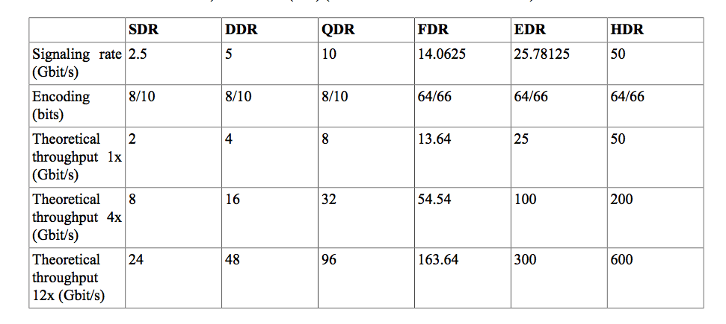
InfiniBand performance

Slide 34
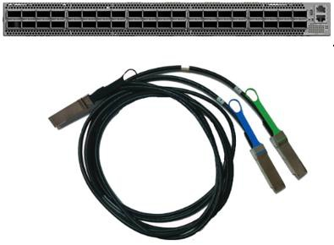
ORFEO IB network
Performance
• 40 x HDR 200Gb/s ports in a 1U switch
• 80 x HDR100 100Gb/s ports (using splitter
cables)
• 16Tb/s aggregate switch throughput
• Sub-130ns switch latency

Slide 35
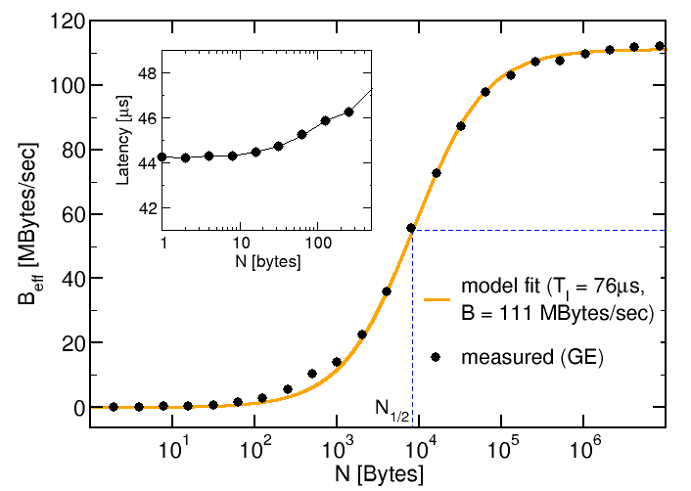
Gbit ethernet performance
Latency: ~44 microsecond
BW: ~ 111 Mb/second (theoretical one: 1000/8=125)

Slide 36
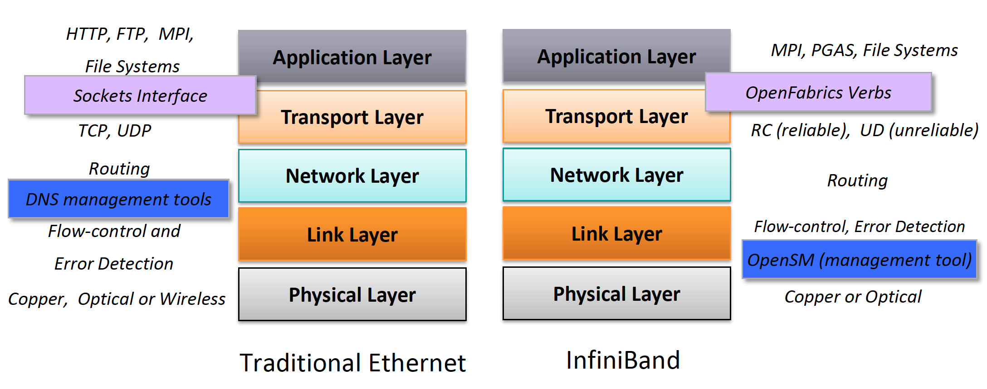
Infiniband vs Ethernet..
Notes:
36

Slide 37
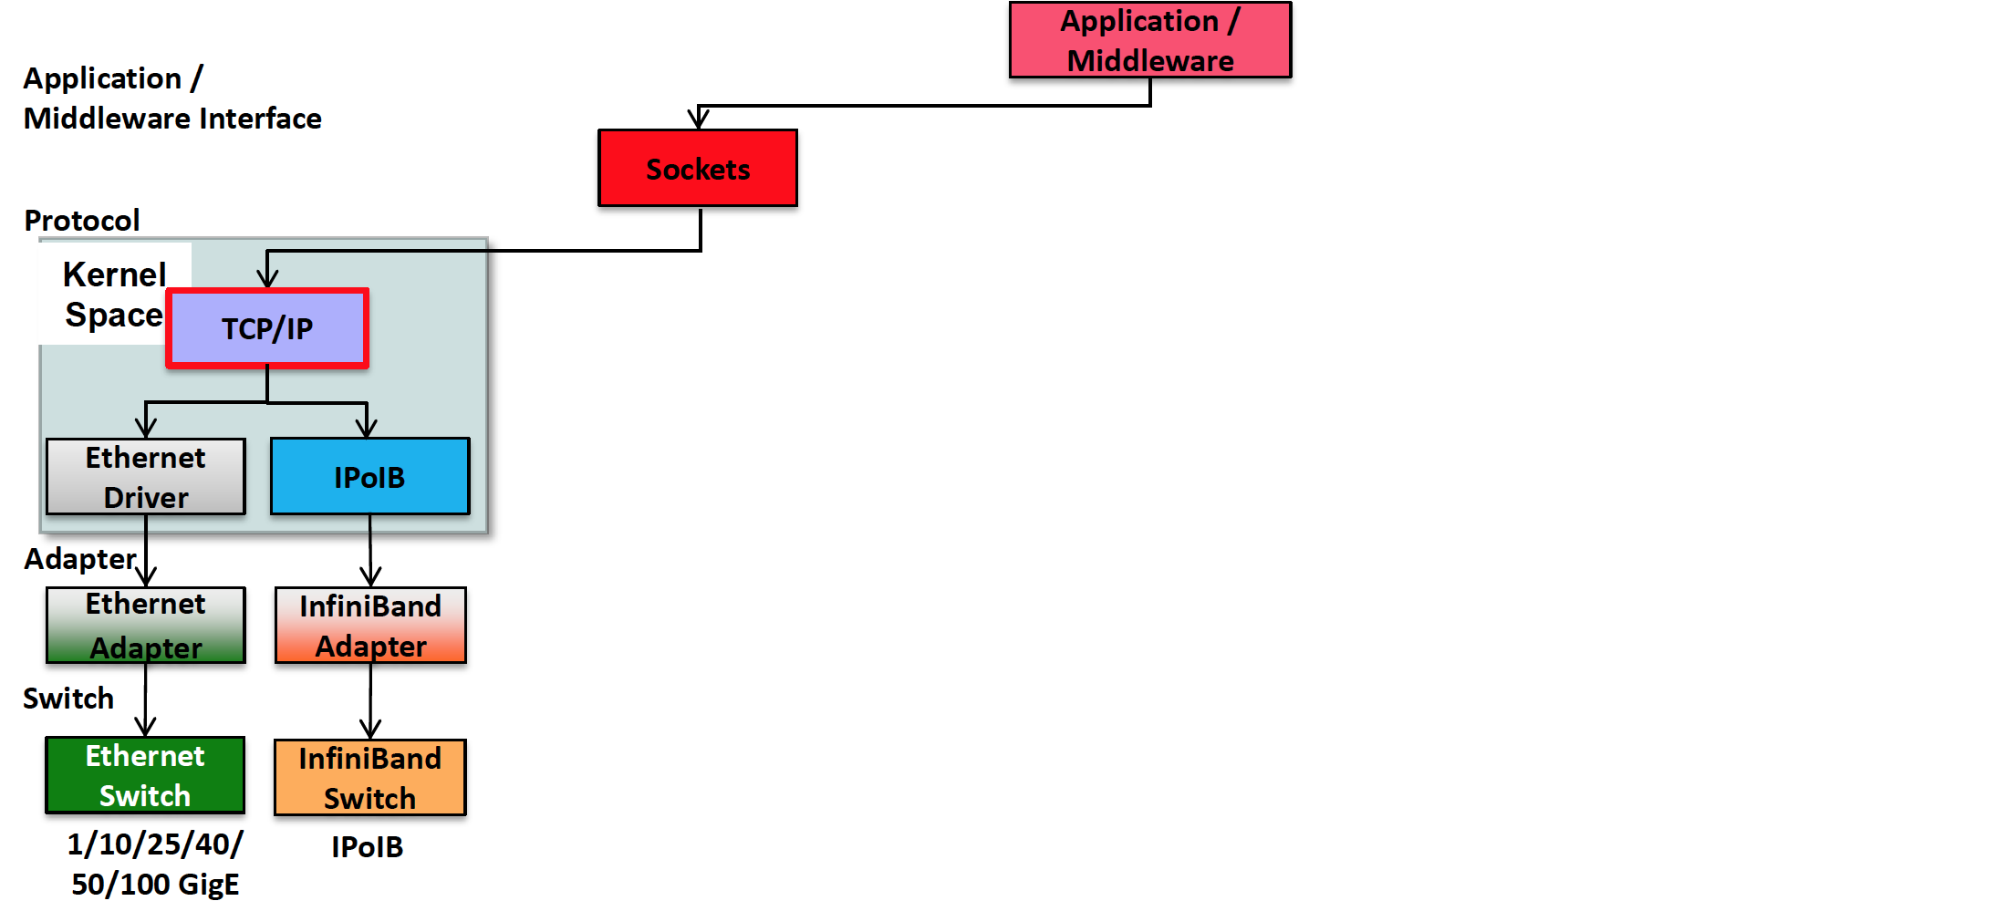
TCP/IP and IPoIB protocol
37
Notes:
37

Slide 38
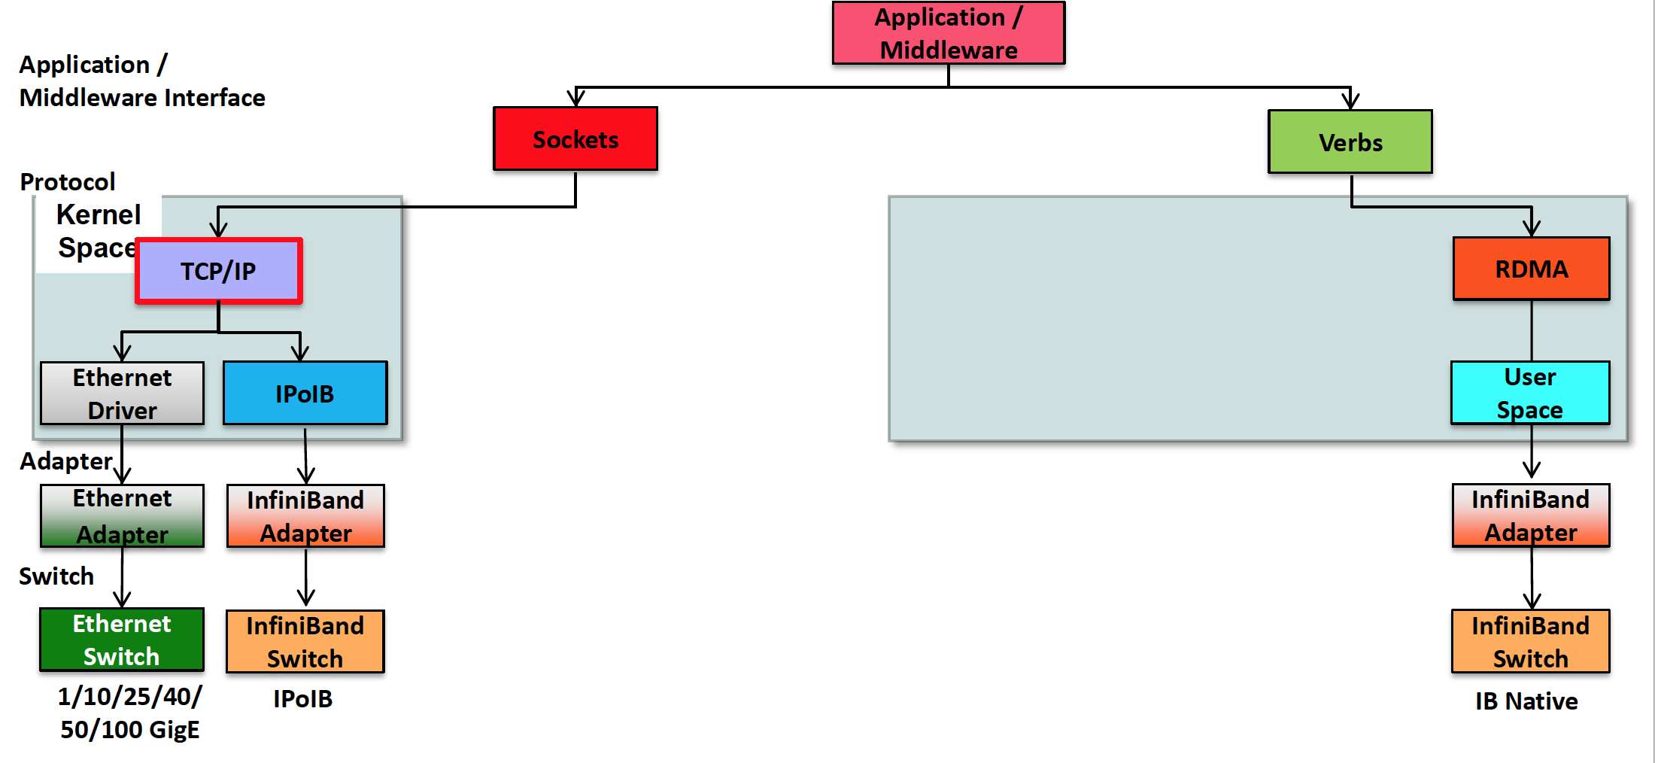
TCP/IP and IPoIB protocol vs native infiniband ones
Notes:
38

Slide 39
Our network: ORFEO ones..
We can assume full non-blocking network:
P/2 pair of nodes communicate in parallel at full speed
𝑇_{𝑐𝑜𝑚𝑚} =𝜆+ message-size/𝑏_{𝑛𝑒𝑡𝑤𝑜𝑟𝑘}
Where
𝜆= 1.35 microsecond
𝑏_{𝑛𝑒𝑡𝑤𝑜𝑟𝑘} =12Gb/second

Slide 40
Exercise/Tutorial:
Confirm the data of the previous slide for all the kind of nodes and all the kind of MPI libraries.

