Slide 1
Ripple
PR REVIEW ORCHESTRATOR · HACKATHON 2026
Know what a pull request can break before it merges, not after it pages someone.
Tanmay · built on the OpenTelemetry Demo
Notes:
Opening line: "Most outages start as a PR someone approved. The reviewer just couldn't see what it touched." Ripple is a PR review orchestrator: it tells you what a change can break before it merges.

Slide 2




Code review only sees the diff.
THE PROBLEM
“
Most outages start as a PR someone approved. The reviewer just couldn’t see what it touched.
Blast radius is invisible
Every PR gets the same scrutiny
A one-line change to a response field can break five consumers the author has never heard of.
A README typo and a tier-1 contract change wait in the same queue for the same reviewers.
No view of who calls the service, how critical it is, or whether a similar change caused an outage last quarter.
Lessons don’t flow back
AI reviewers make it worse
RCAs get written, filed and forgotten. The next risky PR never sees them.
They comment on style and nulls inside the diff, and stay blind to the system around it.
The cost: change-induced incidents, slow reviews on PRs that don’t need them, and rushed reviews on the ones that do.
Notes:
Four failure modes. The key one: blast radius is invisible. The author of a payment change usually has never heard of every consumer. And AI reviewers, which everyone is adding, only look inside the diff.

Slide 3




Ripple reads the system the diff lands in.
THE IDEA
Dependency graph
LOW
runtime, from OpenTelemetry traces
Quiet approve-to-proceed. No agents, no delay.
Risk
gate
Incident history
MEDIUM
The diff
past outages + RCA learnings
Targeted warning: soft-edge callers, related incidents.
Planning intent
HIGH
the linked Jira ticket
Full review: blast radius, incidents, ticket check, reviewers, checks.
One PR comment a human can act on in 30 seconds. Ripple advises and routes reviewers; a human always makes the merge call.
Notes:
Three signal families go into one risk gate. Effort scales with risk: low-risk PRs stay fast, high-risk PRs get the full treatment. Ripple never blocks; it advises.

Slide 4
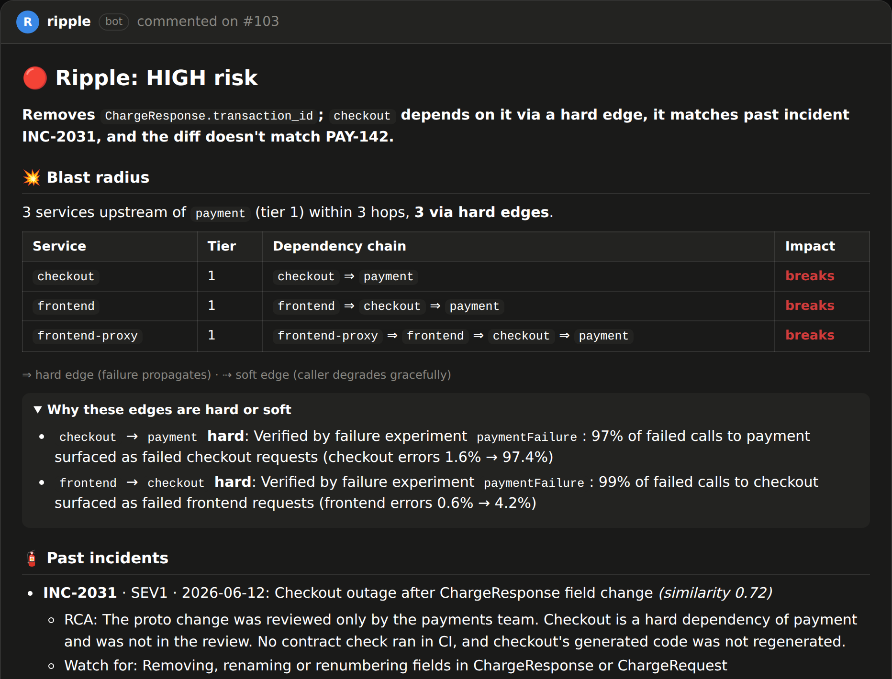
One comment, top to bottom in 30 seconds.
WHAT THE DEVELOPER SEES
1
A risk verdict with a one-line reason
Removes ChargeResponse.transaction_id; checkout depends on it via a hard edge…
2
Blast radius, hard edges called out
Every upstream service within 3 hops: breaks or degrades.
3
Past incidents and their RCA
INC-2031 broke checkout the same way, and what to watch for.
4
Suggested reviewers
Owners of the hard-dependent services, not just the author’s team.
5
Checks to run before merging
Proto breaking check, consumer-first deploy, end-to-end probes.
Notes:
This is a real comment Ripple posted for the payment contract PR. Five parts. Low-risk PRs get a one-line approve-to-proceed instead.

Slide 5

One risk gate. Only the agents a PR needs.
HOW IT WORKS
fetched in parallel
LOW
short comment, agents skipped
Planning
Jira ticket
Risk
gate
PR comment
+ advisory check
Code
MEDIUM / HIGH
agents in parallel:
GitHub
webhook
tier · N-hop graph
· Blast radius
Build
· Incident historian
· Intent verifier
change risk · incidents
· Reviewer router
· Checks planner
· Narrator (LLM)
Fast: the analysis itself takes single-digit milliseconds once signals are fetched. Explainable: every point of the score is itemised in the comment. Safe: never blocks a merge.
Notes:
GitHub webhook in. The three signal families are fetched in parallel. The risk gate is deterministic and cheap. Low-risk PRs stop there. Medium and high fan out to only the agents their signals call for, in parallel.

Slide 6
Three questions every risky PR should answer.
SIGNALS
Planning
Code
Build
Does the diff match the stated intent and scope?
Who depends on this, how critically, and how far does a failure travel?
Has a change like this hurt us before?
Linked Jira ticket (key from title, branch or body)
Touches services outside the ticket’s components?
Breaking changes the ticket never mentions
“Additive only” tickets that aren’t
Service tier and owners (catalog)
Direct dependents and the N-hop chain
Hard vs soft edges, verified by experiment
Runtime graph from OpenTelemetry traces
Proto contract diff: removed, renamed, renumbered fields
Migrations, diff size, CI status
Incident + RCA recall by similarity
Owning service of shared contract files
Notes:
Planning, Code, Build. Each family answers one question. All three are fetched in parallel per PR.

Slide 7

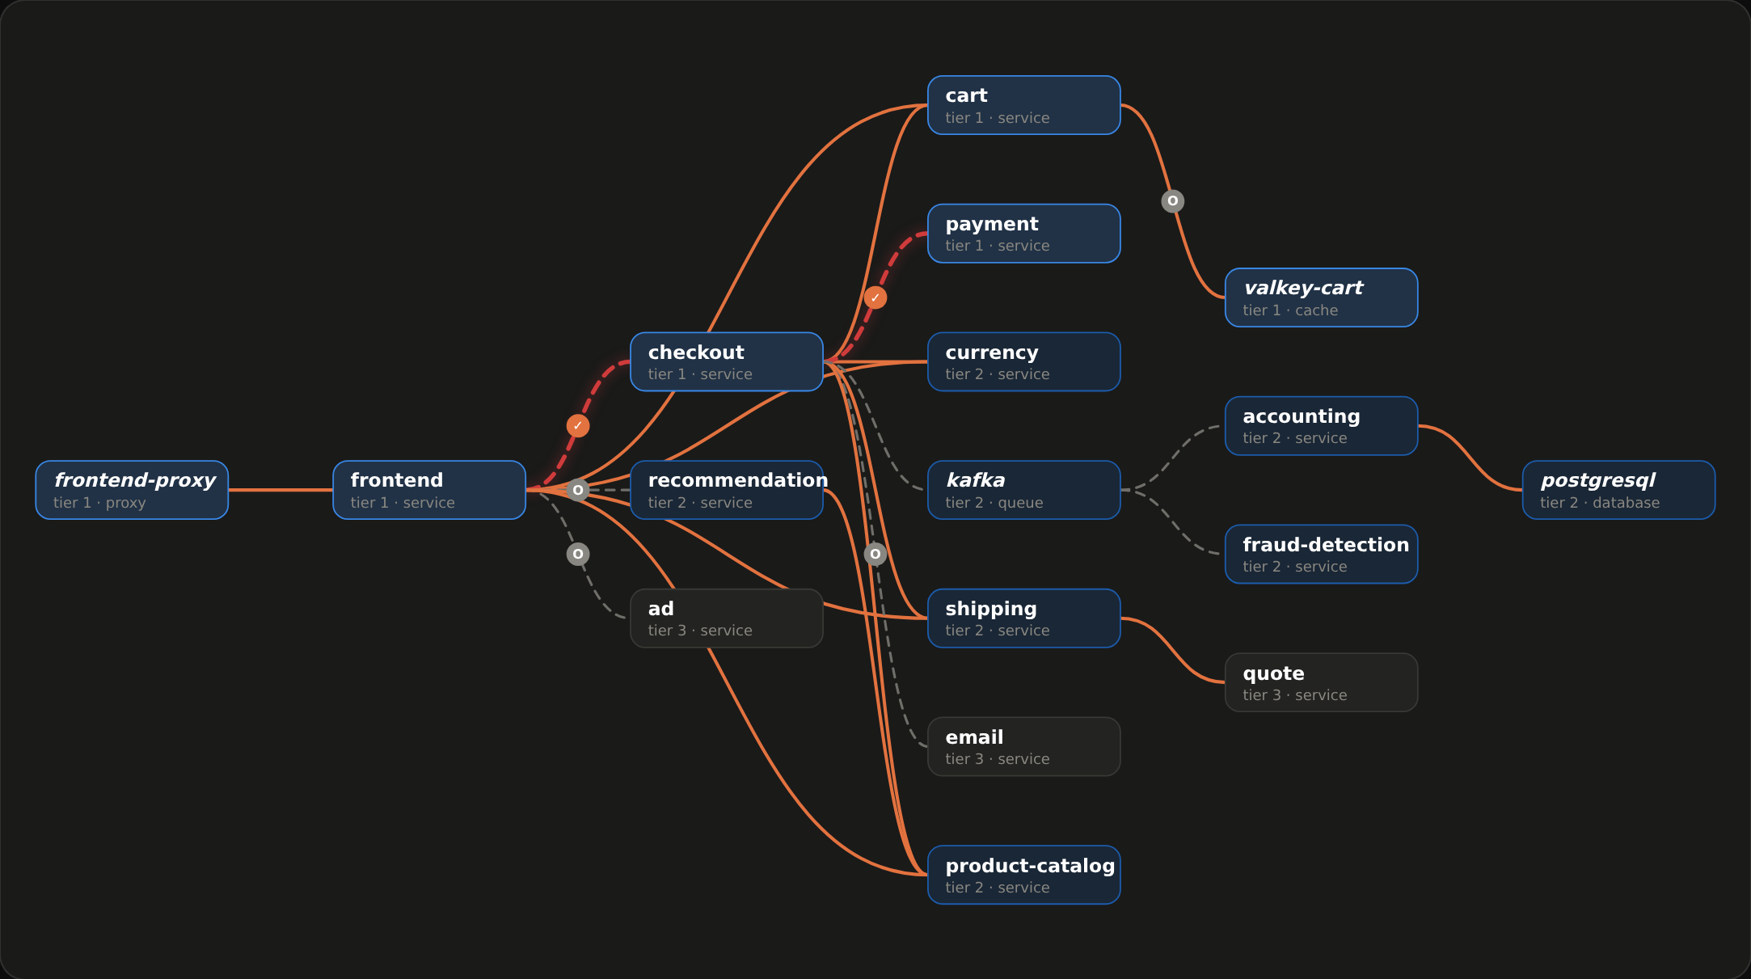



This map isn’t drawn by hand.
CODE SIGNAL · BUILT FROM OPENTELEMETRY TRACES
Collector servicegraph
turns traces into caller → callee edge metrics in Prometheus; Jaeger is the fallback
Rebuilt on a schedule
every edge carries calls/min, error rate and when it was last seen
Bounded blast radius
3 hops by default; recursive CTE when the graph lives in Postgres
Live here
paymentFailure flipped on stage: checkout → payment and frontend → checkout turn red within 5s
Notes:
"This map isn't drawn by hand. It's rebuilt from traffic." Solid orange = hard edge, dashed = soft. Red pulsing = failing right now: we flipped paymentFailure. Click payment to show its blast radius.

Slide 8
We broke it on purpose.
HOW EDGES BECOME HARD · FLAGD FAILURE INJECTION
checkout → payment
HARD
frontend → checkout
HARD
frontend → ad
SOFT
97%
99%
0%
of failed payment calls became failed checkout requests
of failed checkout calls became failed frontend requests
of failed ad calls reached users: frontend drops the ad slot
1
Protocol default
2
Failure experiment
3
Owner override
Synchronous HTTP/gRPC on the request path starts hard; Kafka and cache calls start soft.
Flip a flagd flag, sample Prometheus before, during and after, restore the flag. Measure how many failed calls became failed caller requests.
The service catalog wins both ways, e.g. cart → valkey-cart is a cache call but the system of record, so it’s hard.
Why propagation, not error rate: frontend’s overall error rate only moved 0.6% → 4.2%, because it serves far more than checkout traffic. Yet 99% of checkout failures reached users.
Notes:
"That's how we know checkout-to-payment is a hard edge. We broke it on purpose." Numbers come from the recorded experiment. Insight: measure propagation, not raw error rate.

Slide 9
Deterministic, itemised, and it doesn’t cry wolf.
THE RISK GATE
Factor | Points
Tier of the changed service | tier 1 +3 · tier 2 +1
Breaking / additive contract change | +3 / +1
API handler changed | +2
Interface change with hard-edge callers | +3 (+1 if tier 1)
…with soft-edge callers only | +1
Migrations · big diff · CI failing | +2 · +1/+2 · +2
Past incident match / related | +2 / +1
Ticket mismatch / partial / missing | +2 / +1 / +1
Don’t cry wolf. HIGH also needs a real way to break something: an interface change with hard tier-1 callers, a breaking change, or a migration. Otherwise it’s capped at MEDIUM. Soft edges warn; they never escalate.
LOW < 3 · MEDIUM ≥ 3 · HIGH ≥ 7
Notes:
"Won't it flag everything?" No. Every point is itemised in the comment. Low-risk PRs skip the agents. HIGH requires a way to actually break something.

Slide 10




Low-risk PRs skip them. Risky ones get what they need.
SPECIALIST AGENTS
Blast radius mapper
Incident historian
Intent verifier
Affected services, chains, and why each edge is hard or soft.
Matching incidents, the RCA, and what to watch for.
Diff vs ticket: scope, unmentioned breaking changes.
Reviewer router
Checks planner
Narrator (optional)
Owners of hard-dependent callers within 2 hops; never the author.
Concrete pre-merge steps: proto check, deploy order, e2e probes.
Gemini rewrites the verdict line; falls back silently.
Deterministic by default, so the demo and the comment never depend on a model. With a Gemini key, the intent verifier and narrator add model-written judgement; every call has a timeout and a fallback.
Notes:
Agents run in parallel. Skipped ones show struck through in the dashboard pipeline. The LLM is optional and additive.

Slide 11
The contrast between verdicts does the selling.
THREE REAL PRS ON THE OPENTELEMETRY DEMO
LOW
0
MEDIUM
6
HIGH
14
score
score
score
#101 Spring sale ad copy
#102 Up to 10 recommendations
#103 PAY-142 currency code
Copy tweak in the ad service (tier 3, leaf).
ListRecommendations returns 10 sorted results instead of 5 random.
Removes transaction_id from the tier-1 payment contract.
String-literal-only change
frontend → ad is a soft edge
No agents, no extra reviewers
Frontend calls it, but has a fallback
All chains degrade, none break
Related: INC-1877 silent degradation
checkout ⇒ payment is a verified hard edge
INC-2031 broke checkout the same way
PAY-142 asked for an additive change
Comment lands in seconds; nothing to see is the point.
Ripple warns instead of crying wolf.
Full review: right reviewers, right checks.
Notes:
1:40 PR 1: "Low risk. No extra reviewers, no delay. Most PRs should feel like this." 2:10 PR 2: "Frontend depends on this, but degrades gracefully. Ripple says so instead of crying wolf." 2:50 PR 3: walk the comment. All three are real patches against the OpenTelemetry Demo.

Slide 12

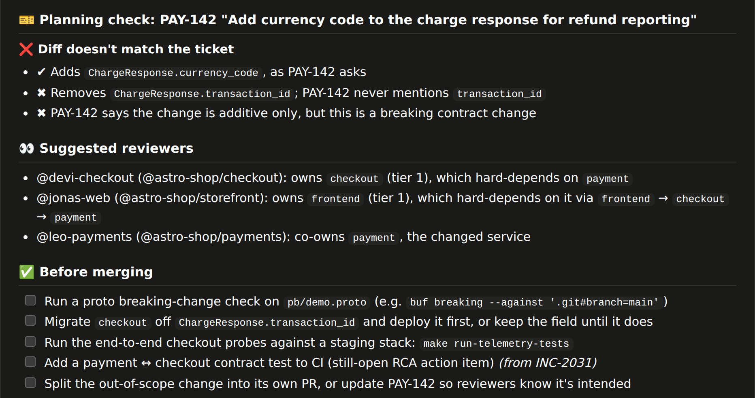
It catches what the reviewer couldn’t see.
PR 3 · THE HIGH-RISK COMMENT
The ticket said additive only
PAY-142 asked to add currency_code. The diff also removes transaction_id, which the ticket never mentions.
The right people review it
Checkout and storefront owners, who hard-depend on payment, not just the payments team. That gap was the INC-2031 RCA.
Concrete next steps
Proto breaking check, migrate and deploy checkout first, run the end-to-end checkout probes.
Notes:
Walk the bottom half: planning mismatch, reviewers chosen from the dependency graph, concrete checks. The score breakdown (14) is in the collapsible section.

Slide 13
From an offline laptop to the real stack, one step at a time.
RUNS ANYWHERE
4
45 min
3
15 min
2
5 min
Real OTel Demo
1
2 min
Real GitHub PRs
make start + overlay
OTel mock
npm run webhook:replay
Offline
15 services in Docker; servicegraph connector; experiments flip the real flagd.
npm run demo:full
Ripple comments and posts a status on real PRs in your fork. No tunnel needed with replay.
npm run demo
Simulated Astronomy Shop behind the real Prometheus and Jaeger APIs. Real flag flips, real experiments, labelled Mock.
Seeded graph, tickets, incidents and sample recordings. Backup for the stage.
Step-by-step guide: docs/JUMPSTART.md
Notes:
The OTel mock is what makes this a full demo on a laptop: the same Prometheus and Jaeger APIs, simulated traffic, real flagd flag flips. Ripple has no special code path for it, and labels everything from it as Mock.

Slide 14
Say it plainly.
WHAT’S REAL
Signal | Status | Source
Dependency edges and chains | ● Live | OTel traces: Collector servicegraph → Prometheus, or Jaeger
Hard vs. soft classification | ● Live | flagd failure injection + trace correlation
Change risk and CI | ● Live | Real PRs via GitHub webhook
…on a laptop (demo:full) | ● Mock | Same APIs, simulated Astronomy Shop; labelled Mock everywhere
Service tier and owners | ● Seeded | Hand-written catalog YAML
Jira tickets | ● Seeded | 7 tickets linked to the demo PRs (real Jira adapter included)
Incidents and RCAs | ● Seeded | 10 writeups, several from failures we triggered on purpose
Every seeded source sits behind an adapter with the same interface a real integration uses, so swapping in real Jira or a real incident tool is a config change, not a rewrite.
Notes:
"Graph and failures are real. Jira and incidents are seeded behind swappable adapters." The dashboard shows this table live, reflecting what is connected right now.

Slide 15

Existing AI reviewers read the diff. Ripple reads the system.
WHY IT WINS
 | Typical AI code reviewer | Ripple
Context | The diff and nearby files | Diff + runtime dependency graph + incident history
Blast radius | None | N-hop chain from real traces, hard edges flagged
Effort per PR | Same for every PR | Scaled to risk: low-risk PRs stay fast
Learns from outages | No | Past RCAs recalled on similar changes
Reviewers | Whoever the author picks | Owners of the services that could break
Future of Work
Senior engineers stop being the only people who know what’s safe to change. That knowledge becomes something every PR gets for free.
Notes:
The gap judges should remember: they see the diff; we see who depends on the code, how critically, and what broke last time.

Slide 16
No Datadog, no paid APM.
BUILT ON A FULLY OPEN-SOURCE STACK
Demo system
OpenTelemetry Demo (Astronomy Shop) · Ripple OTel mock
~15 real microservices with Kafka, Valkey, Postgres and flagd failure flags
Telemetry
OTel SDKs + Collector servicegraph connector
Turns traces into caller → callee edge metrics (overlay validated with otelcol-contrib)
Metrics and traces
Prometheus + Jaeger
Edge call counts and error rates; dependency fallback
Graph and memory
Postgres recursive CTEs (or in-memory)
Dependency chain, service catalog; incident recall by similarity
Agents
Deterministic specialists + Gemini (optional)
Risk gate and agents run without a model; LLM adds judgement
Integration
GitHub webhook + Checks API / commit statuses
Triggers on PR, posts the comment, never blocks
Notes:
Node.js service, no build step for the dashboard. 20 automated tests including webhook-to-comment, the OTel mock and Postgres CTE parity.

Slide 17




Grows by adding signal providers, not rewrites.
ROADMAP
Built
Next
Then
Later
GitHub webhook, comment + status
Graph from OTel traces, N-hop
Failure experiments → hard/soft
Proto contract diffing
Risk gate + 6 agents
OTel mock + presenter dashboard
Real Jira and incident-tool adapters
pgvector embeddings for RCA recall
Static analysis for edges with no traffic yet
Learning loop: post-merge incidents tune the risk weights
Per-team thresholds
Deploy-time gating: high-risk changes require a canary or a deploy lock
Notes:
Next: real adapters, embeddings, static analysis. Then: a learning loop. Later: deploy-time gating.

Slide 18

The questions we expect.
JUDGE Q&A
How is this different from AI code review?
What if a service isn’t instrumented?
They see the diff. We see who depends on the code, how critically, and what broke last time.
Owners assert edges in the catalog. Static analysis is next on the roadmap.
Won’t it flag everything as risky?
How fresh is the graph?
Low-risk PRs skip the agents. Soft edges warn; only hard edges on critical tiers escalate.
Rebuilt from recent traffic on a schedule; each edge carries when it was last seen.
Does it block merges?
How does it scale?
No. It advises and routes reviewers; a human always decides.
Graph queries are bounded to a few hops, and signals are fetched in parallel per PR.
Notes:
Keep answers to one sentence each.

Slide 19
Ripple gives every PR the judgment of your most senior engineer.
EXISTING AI REVIEWERS READ THE DIFF. RIPPLE READS THE SYSTEM.
github.com/tanmaycodes13/ripple · npm run demo:full
Notes:
Closing line. Then take questions.

