Slide 1

CLIMATE ANALYSIS · MALI
Changes and
Variability in Mali’s Annual Temperature Cycle
Historical analysis: 1960–2014
Future projections: 2015–2050 under CMIP6 scenarios
Presented by : Founè BERTHÉ
Notes:
Good morning, everyone.
My name is Founè Berthé.
Today, I am going to present my research about temperature changes in Mali.
My study focuses on historical temperature from 1960 to 2014 and future projections from 2015 to 2050.
I will also compare two climate models and three climate scenarios.
Let's start with the background of the study.
It examines how Mali’s annual temperature cycle has changed historically and how it may evolve under future CMIP6 scenarios. The analysis covers 1960–2014 and projects conditions from 2015–2050.

Slide 2

01 · PURPOSE
Why this study matters and what it tests
Climate change is affecting temperatures worldwide, and Mali is exposed to increasing temperatures and climate variability.
Temperature changes can affect agriculture, water resources, and human activities.
Main objective: analyse historical temperature trends and assess future changes over a selected domain covering Mali.
Compare annual mean temperature, TGx, TGn, two models, their ensemble mean, and three CMIP6 scenarios.
Notes:
This slide explains why the analysis matters. It connects rising temperatures and variability with agriculture, water resources, and human activities, then states the study objective and the comparisons used.

Slide 3
02 · DATA AND DOMAIN
CMIP6 data and the study domain
Variable: tas, daily mean air temperature; converted from Kelvin to degrees Celsius.
Models: ACCESS-CM2 (ACCESS) and MPI-ESM1-2-HR (MPI).
Periods: historical 1960–2014; future 2015–2050.
Scenarios: SSP126, SSP245, and SSP585.
Domain: 12.5°W–4.5°E and 10°N–25°N; an approximate rectangle, not an exact national boundary mask.
Notes:
My study focuses on a geographical area covering Mali.
The selected longitude is from 12.5 degrees West to 4.5 degrees East.
The latitude is from 10 degrees North to 25 degrees North.
This is an approximate rectangular area.
It is important to explain that it is not an exact map of Mali's national borders.
The study uses daily mean air temperature, tas, from two CMIP6 models. The historical and future periods, three scenarios, and the approximate rectangular domain are defined here. The map must be inserted manually.

Slide 4
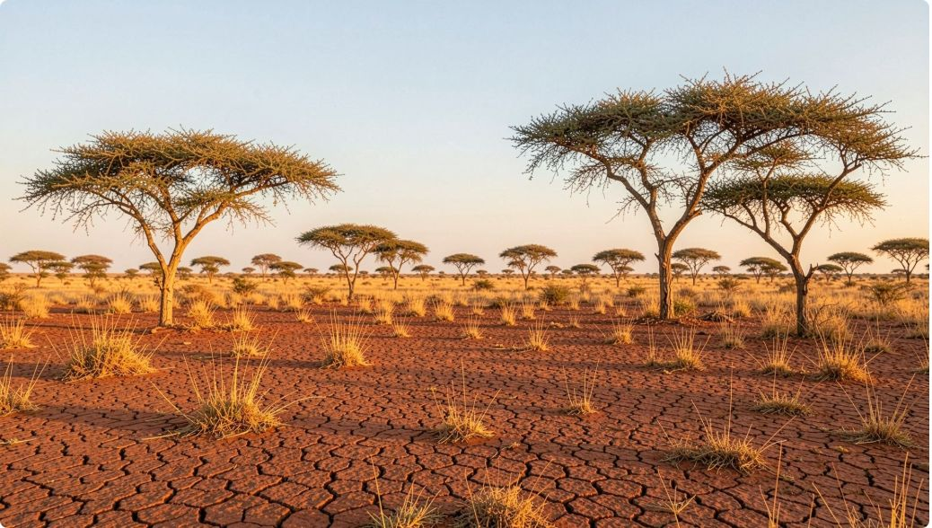
03 · METHOD
From daily tas to annual indicators and trends
Collect daily CMIP6 temperature data.
Extract the selected geographical domain.
Convert Kelvin to Celsius.
Calculate annual mean temperature.
Calculate TGx and TGn at each grid cell.
Calculate spatial means.
Calculate ensemble mean: (ACCESS + MPI) / 2.
Analyse trends using linear regression.
TGx: annual maximum of daily mean tas · TGn: annual minimum of daily mean tas · TGx and TGn use tas, not tasmax or tasmin.
Notes:
The workflow begins with daily tas data and ends with annual indicators and linear trends. The ensemble mean is calculated as the average of ACCESS and MPI. TGx and TGn are based on daily mean tas, not tasmax or tasmin.

Slide 5
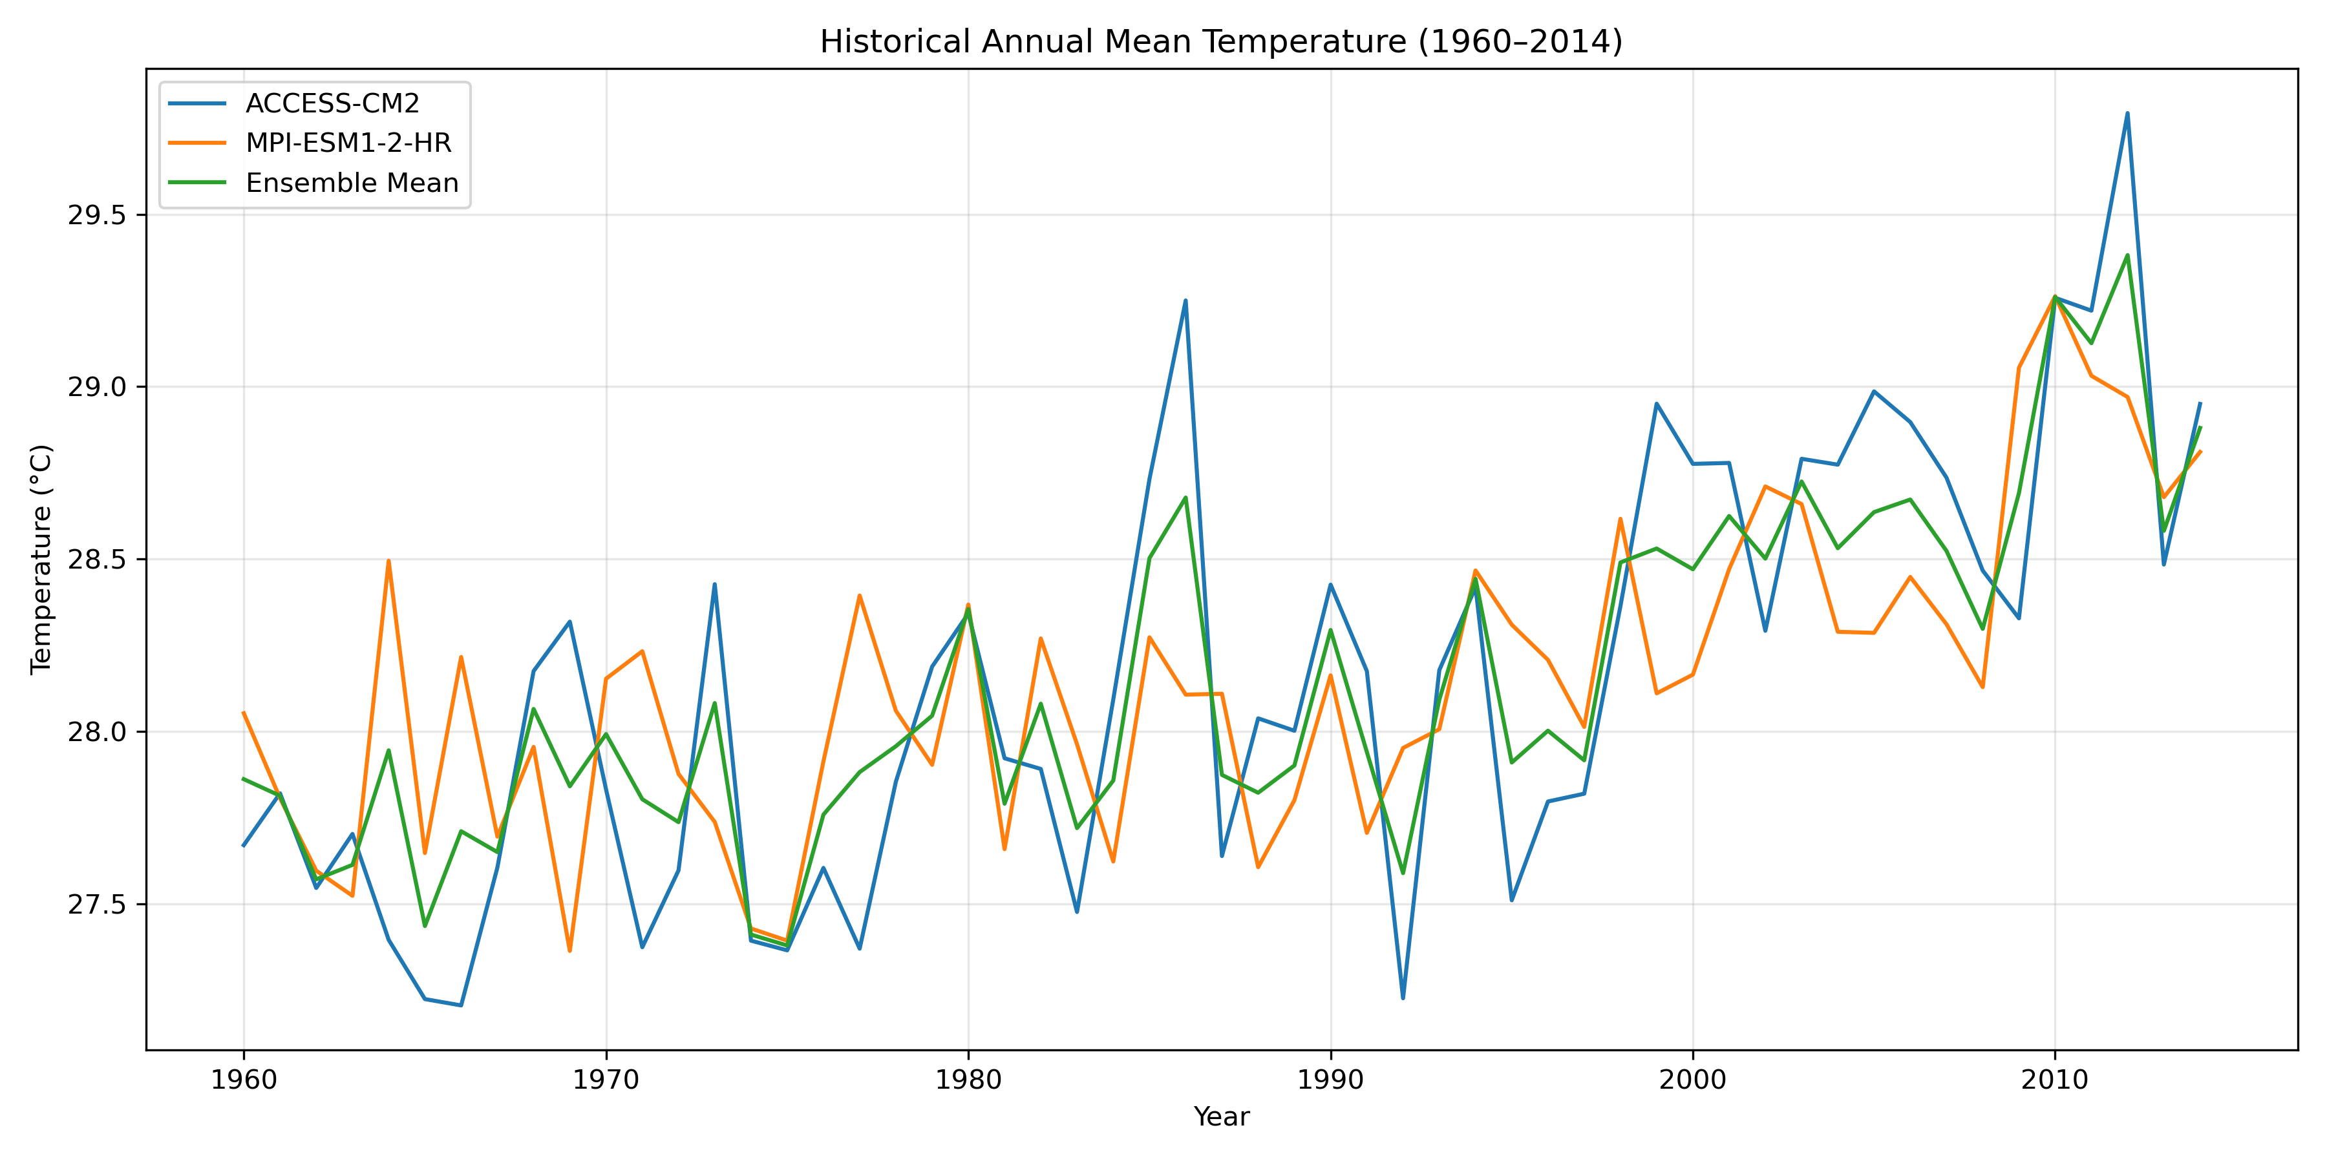
04 · HISTORICAL RESULTS
Historical annual mean temperature is increasing
ACCESS
°C/decade
MPI
°C/decade
Ensemble
°C/decade
Historical annual mean temperature shows an increasing trend.
Historical_Temperature_Comparison.png]
Notes:
This graph shows the historical annual mean temperature from 1960 to 2014.
We can see that temperature changes from year to year.
However, the general trend is increasing.
The ensemble mean shows an increase of about 0.23 degrees Celsius per decade.
This result indicates that the study area experienced warming during the historical period.
The reported trends are positive for ACCESS, MPI, and the ensemble, supporting the key message that historical annual mean temperature is increasing.

Slide 6
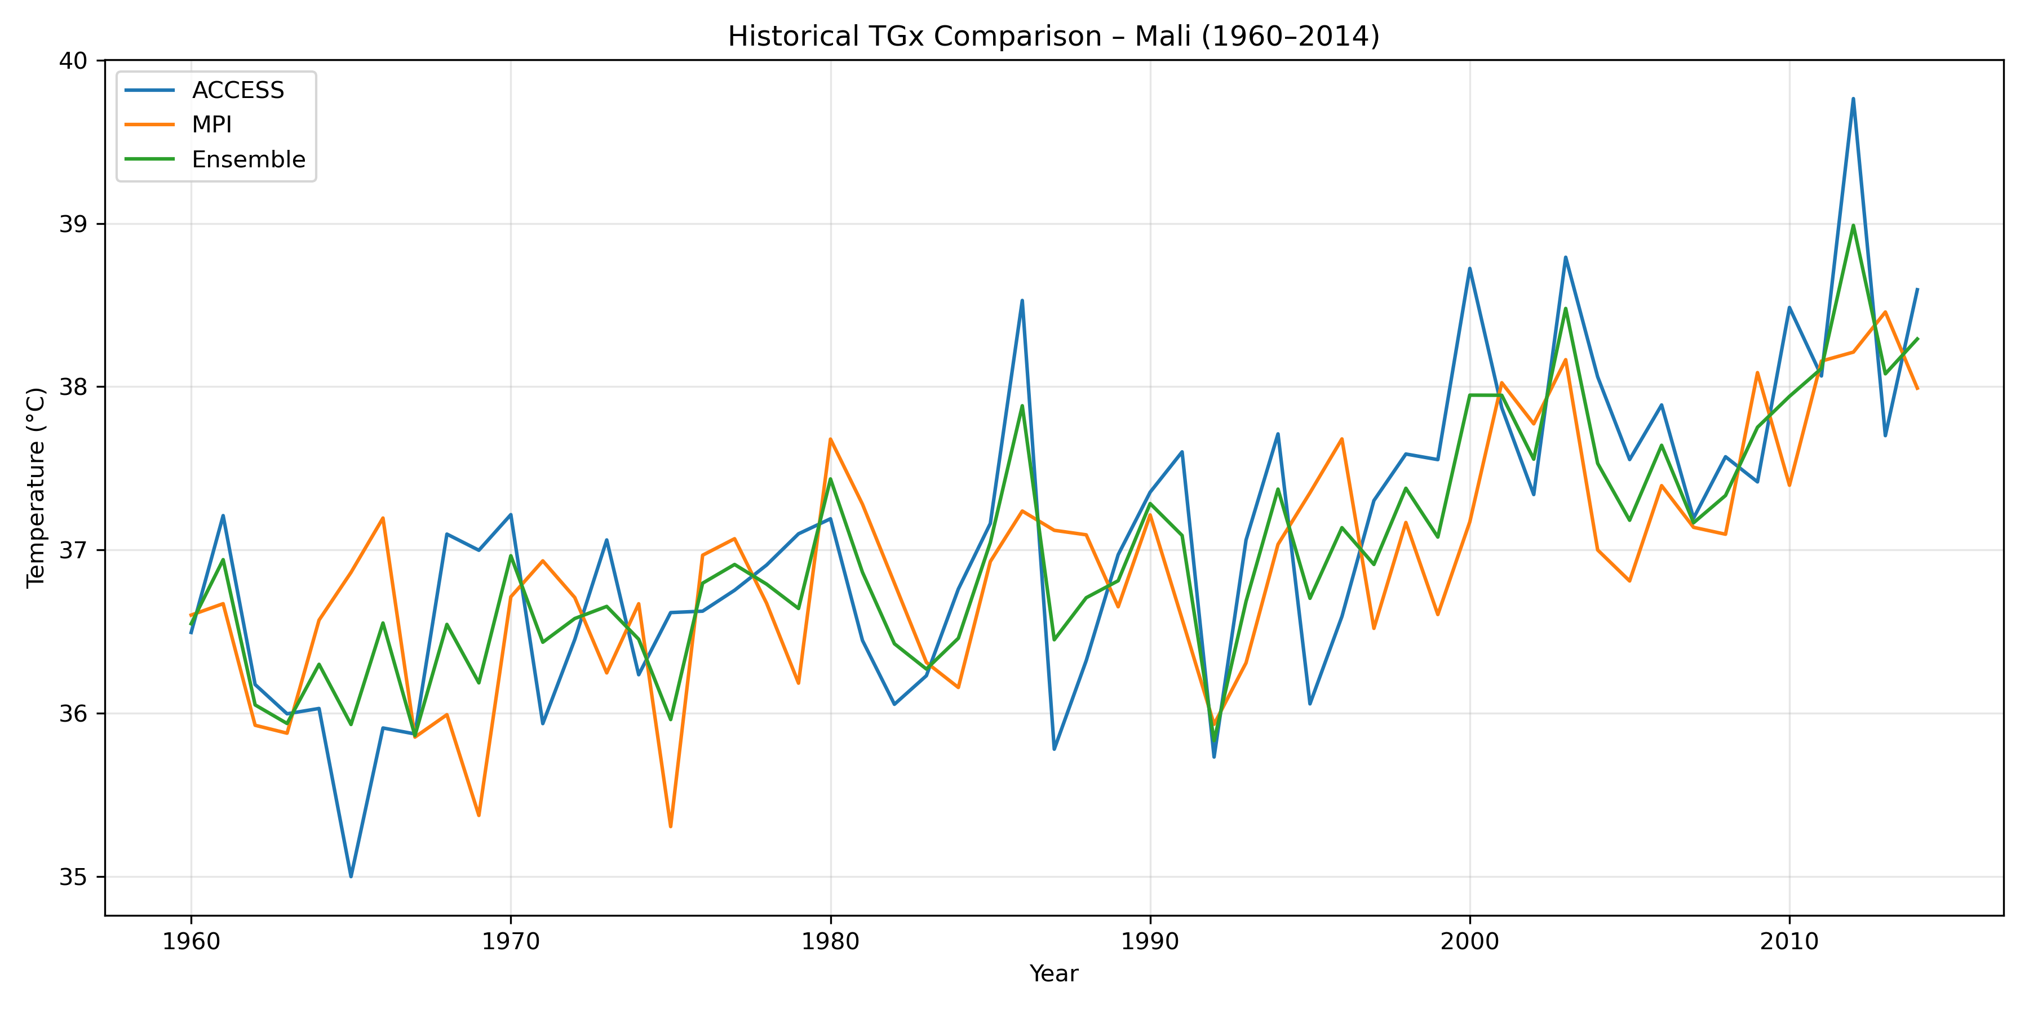
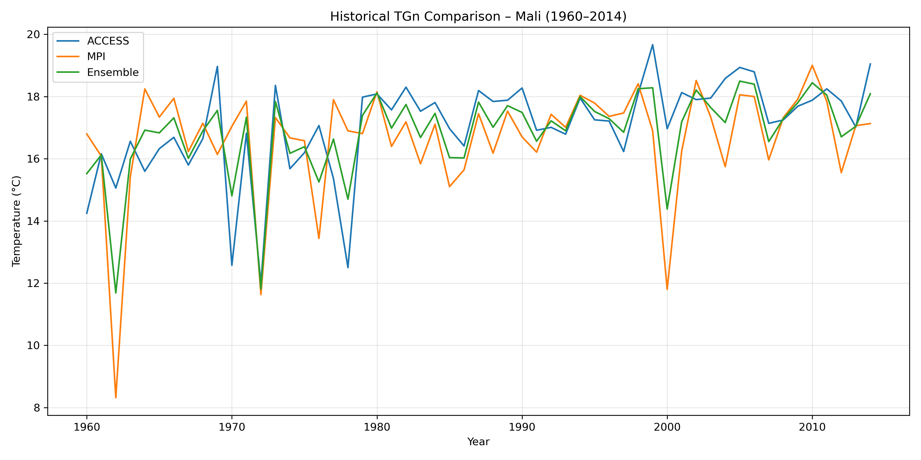
05 · HISTORICAL EXTREMES
Historical TGx and TGn also show warming
TGx
ACCESS: +0.3958 · MPI: +0.2954 · Ensemble: +0.3456 °C/decade.
ACCESS: +0.5299 · MPI: +0.2935 · Ensemble: +0.4117 °C/decade.
MPI TGn is not statistically significant at 5%: p = 0.0549.
Notes:
This slide compares the historical warm and cool annual extremes. Both TGx and TGn have positive ensemble trends. The significance statement is important: MPI TGn is not statistically significant at the 5% level because p = 0.0549.

Slide 7
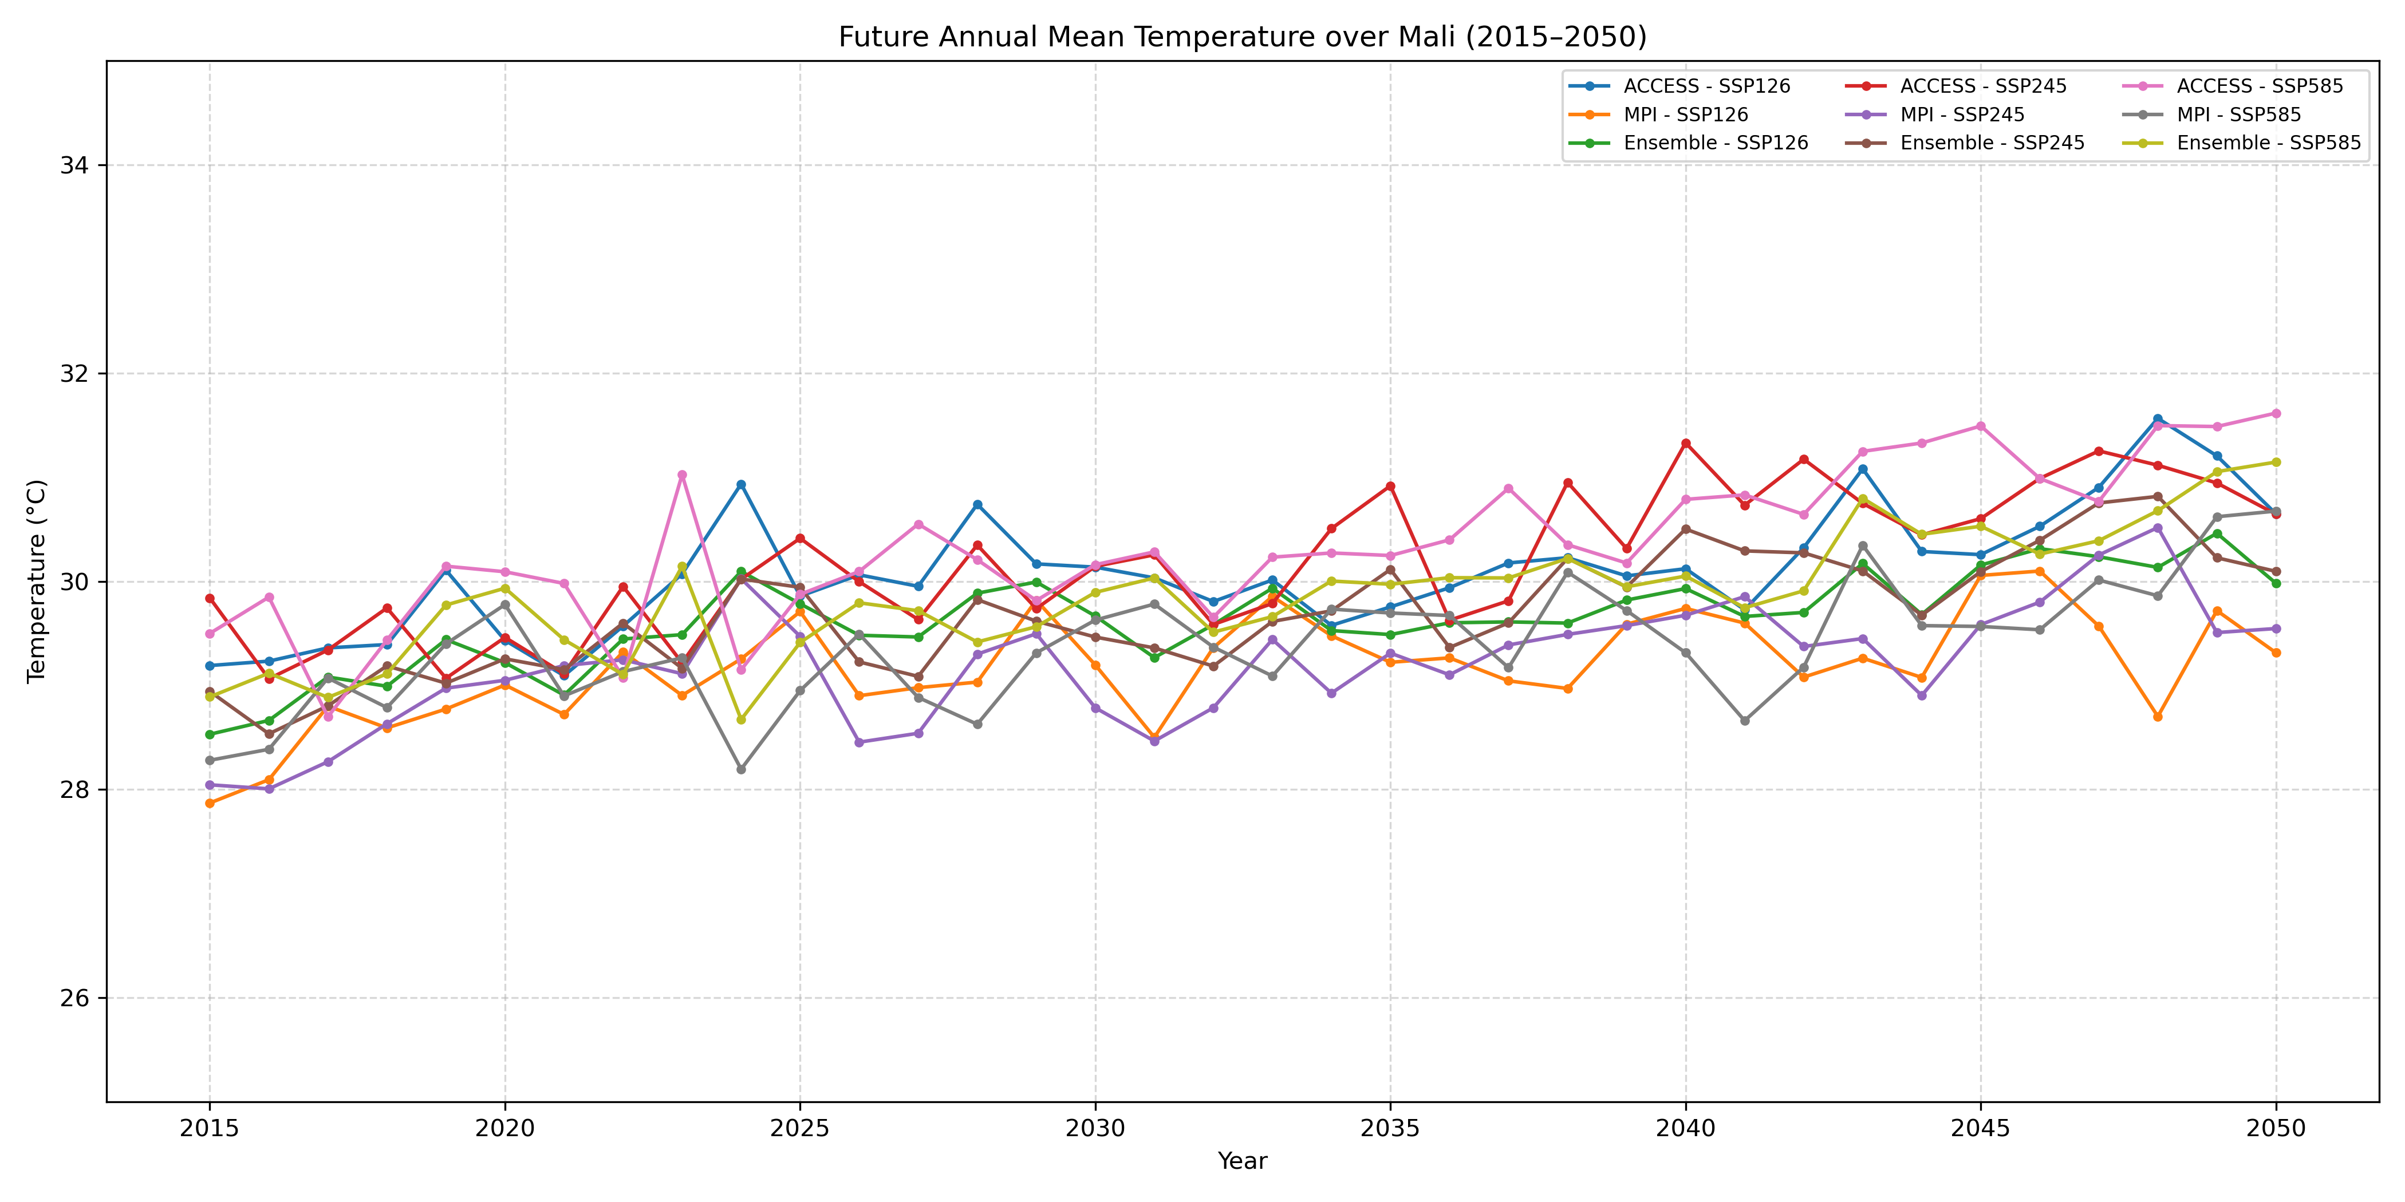
06 · FUTURE MEAN TEMPERATURE
SSP585 gives the strongest future mean-warming trend
Future projections compare ACCESS, MPI, and the ensemble under SSP126, SSP245, and SSP585.
Ensemble trend
SSP126 +0.3328
SSP245 +0.4392
SSP585 +0.4665 °C/decade.
SSP585 shows the strongest ensemble warming trend.
Future_Temperature_Comparison_2015_2050.png]
Notes:
The future comparison covers ACCESS, MPI, and the ensemble across SSP126, SSP245, and SSP585. The ensemble trend is strongest under SSP585 at +0.4665 °C/decade.

Slide 8
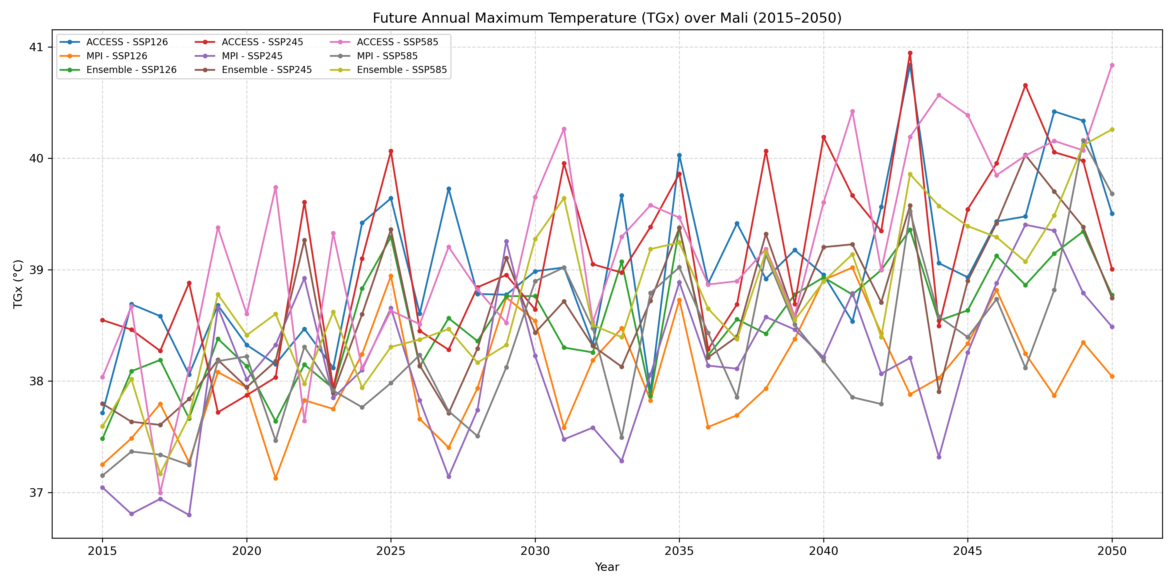
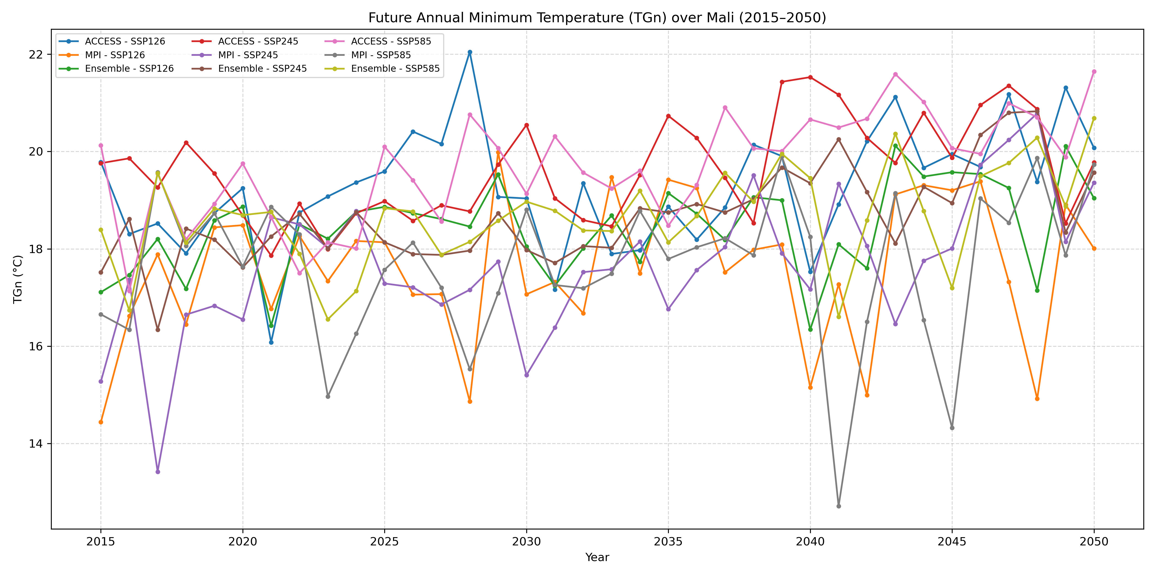
07 · FUTURE EXTREMES
Future TGx and TGn respond differently by scenario
Ensemble trend: SSP126 +0.3231 · SSP245 +0.4160 · SSP585 +0.5305 °C/decade.
Ensemble trend: SSP126 +0.3568 · SSP245 +0.6302 · SSP585 +0.4252 °C/decade.
TGx is strongest under SSP585; TGn is strongest under SSP245
Notes:
These results show changes in both high and low daily mean temperatures.
TGx and TGn do not respond in the same way across scenarios. The strongest ensemble TGx trend occurs under SSP585, while the strongest ensemble TGn trend occurs under SSP245.

Slide 9
08 · PERIOD AVERAGES
Future averages are warmer than historical averages
Ensemble mean difference between 1960–2014 and 2015–2050 period averages.
These are differences between two period averages, not projected temperatures specifically in 2050.
Indicator | SSP126 | SSP245 | SSP585
Mean temperature | +1.49 °C | +1.55 °C | +1.72 °C
TGx | +1.55 °C | +1.63 °C | +1.75 °C
TGn | +1.59 °C | +1.81 °C | +1.82 °C
Notes:
This table compares ensemble mean differences between the historical and future period averages. The values describe differences between two periods, not temperatures specifically projected for the year 2050.

Slide 10
09 · CONCLUSION
Warming is consistent, but the analysis has clear limits
Historical annual mean temperature, TGx, and TGn show increasing trends.
Future projections indicate warming under all three scenarios.
ACCESS generally projects stronger historical trends than MPI.
Limitations: rectangular domain, two climate models, and no precise national mask.
More models and a precise national mask could improve the analysis.
Thank you for your attention. Questions and Discussion.
Notes:
The conclusion is clear: warming appears in the historical indicators and under all three future scenarios. The interpretation remains limited by the rectangular domain, two models, and the absence of a precise national mask. More models and a precise mask could improve the analysis.

Slide 11
THANK YOU FOR YOUR ATTENTION
QUESTIONS?

