Slide 1
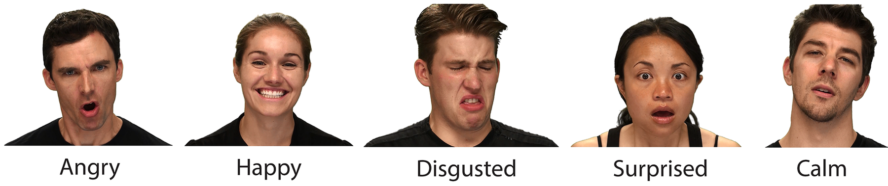


Emotion and Gender Bias by Phone Call
Angry
Happy
Disgusted
Happy
Calm
Haotian Fang & Isaiah Glymour
CS1699 Final Project at University of Pittsburgh

Slide 2

Problem Statement
Angry
Happy
Disgusted
Happy
Calm

Slide 3

Dataset
The Ryerson Audio-Visual Database of Emotional Speech and Song (RAVDESS)
Filename identifiers
Modality (01 = full-AV, 02 = video-only, 03 = audio-only).
Vocal channel (01 = speech, 02 = song).
Emotion (01 = neutral, 02 = calm, 03 = happy, 04 = sad, 05 = angry, 06 = fearful, 07 = disgust, 08 = surprised).
Emotional intensity (01 = normal, 02 = strong).
Statement (01 = "Kids are talking by the door", 02 = "Dogs are sitting by the door").
Repetition (01 = 1st repetition, 02 = 2nd repetition).
Actor (01 to 24. Odd numbered actors are male, even numbered actors are female).
Filename example
03-01-05-01-02-01-02.mp4
audio-only (03)
Speech (01)
Angry (05)
Normal intensity (01)
Statement "dogs" (02)
1st Repetition (01)
2nd Actor (02) [Female]
Livingstone, S. R., & Russo, F. A. (2018, April 5). The Ryerson Audio-Visual Database of Emotional Speech and Song (RAVDESS). Zenodo; Zenodo. https://zenodo.org/record/1188976#.Ylwa9NPMIUE
‌

Slide 4
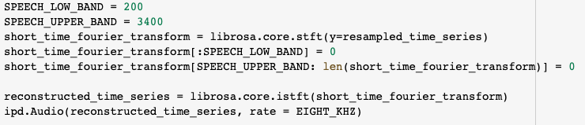
Our Approach - Modifying Sound
The original sound file:
The core feature of Adaptive Multi Rate audio codec:
Sampling frequency 8 kHz/13-bit (160 samples for 20 ms frames), filtered to 200–3400 Hz.
The original sound is high fidelity audio, resample to 8khz.
Using a Short Time Fourier Transform to set the resampled audio into its respective frequencies. Then we zero out the frequencies mentioned in AMR - 0-200 and > 3400.
DeCaro, J. (2018, October 28). Making high-fidelity audio sound like it came through the phone. JonLuca’s Blog. https://blog.jonlu.ca/posts/phone-calls
‌
‌

Slide 5
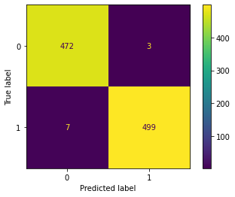
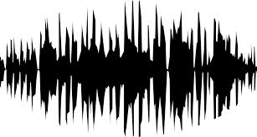
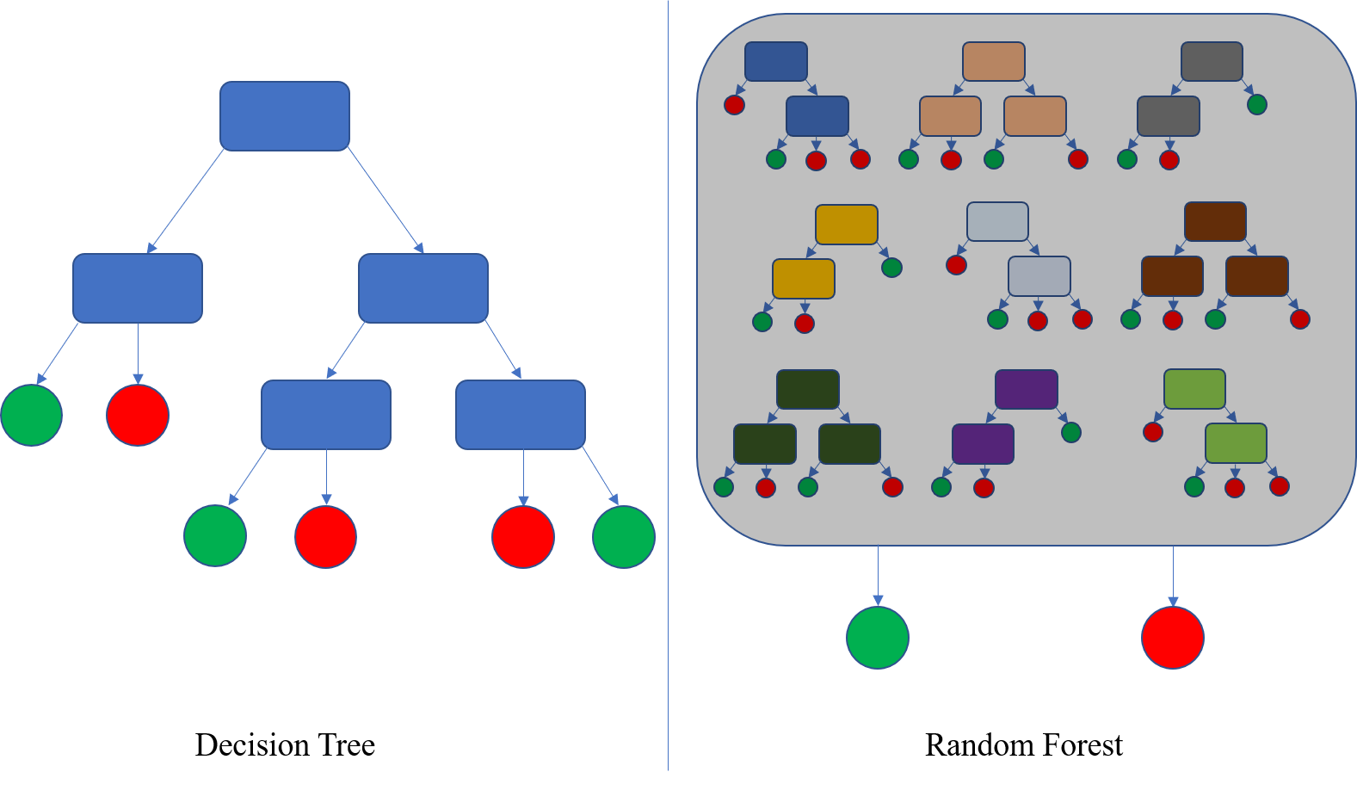
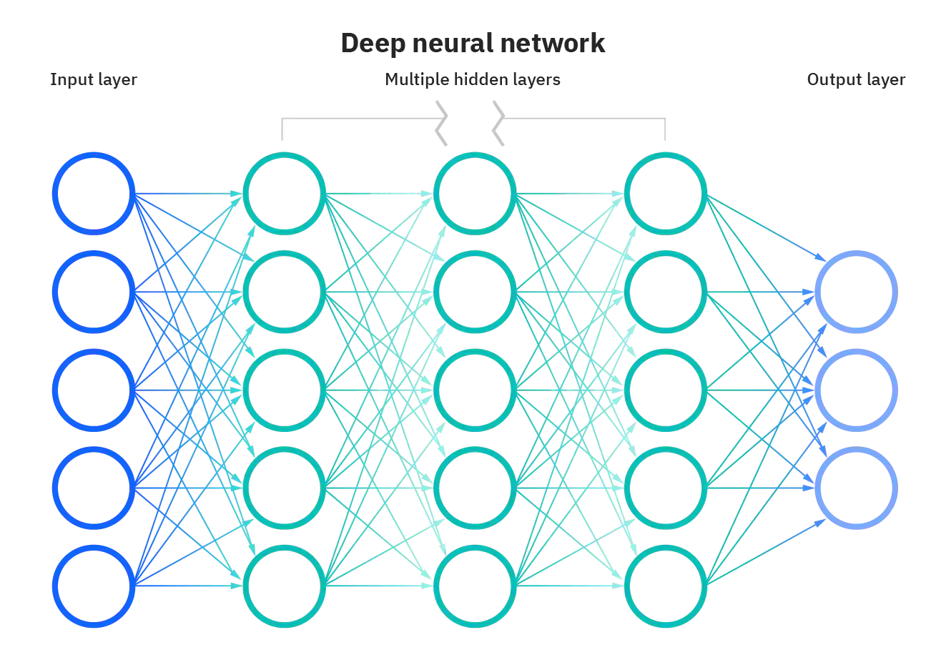
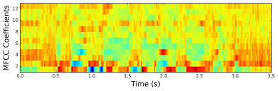

Our Approach - Structure
Original Sound
Modified Sound
(Analog phone calls)
MFCC
Model
Output
Confusion Matrix
Decision Tree
Random Forest
Neural Network
Emotion
Gender
Decision Tree
Random Forest
Neural Network
Emotion
Gender

Slide 6
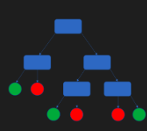
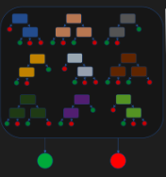
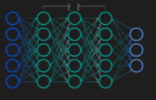

Evaluation
Confusion Matrix
Decision Tree
Random Forest
Neural Network

Slide 7
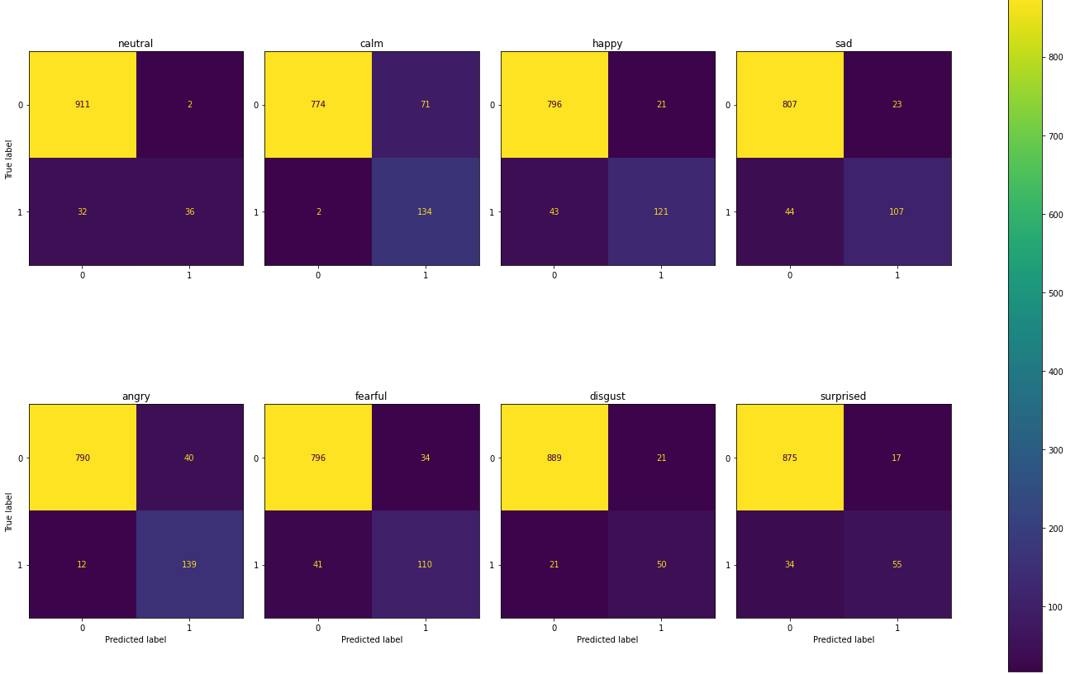
Evaluation
rf_full_emo_matrix
Confusion Matrix - Full View
Random Forest
Neural Network

Slide 8
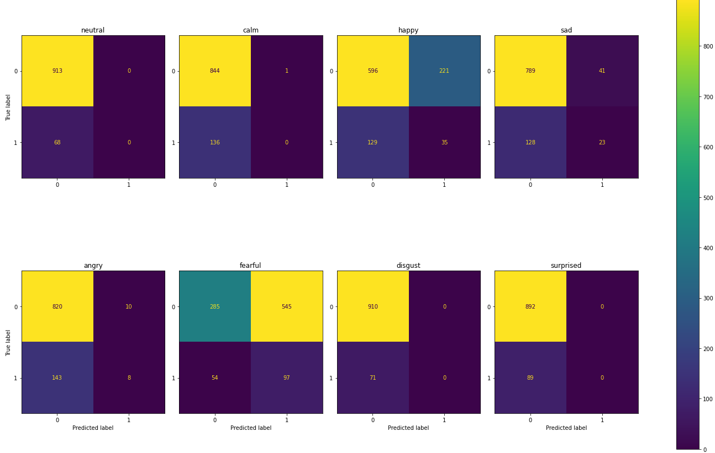
Evaluation
rf_mod_full_emo_matrix
Confusion Matrix - Full View
Random Forest
Neural Network

Slide 9
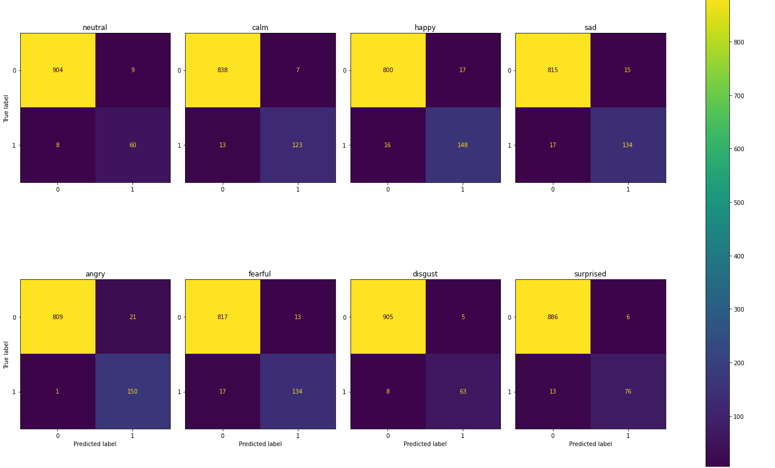
Evaluation
nn_full_emo_matrix
Confusion Matrix - Full View
Neural Network

Slide 10
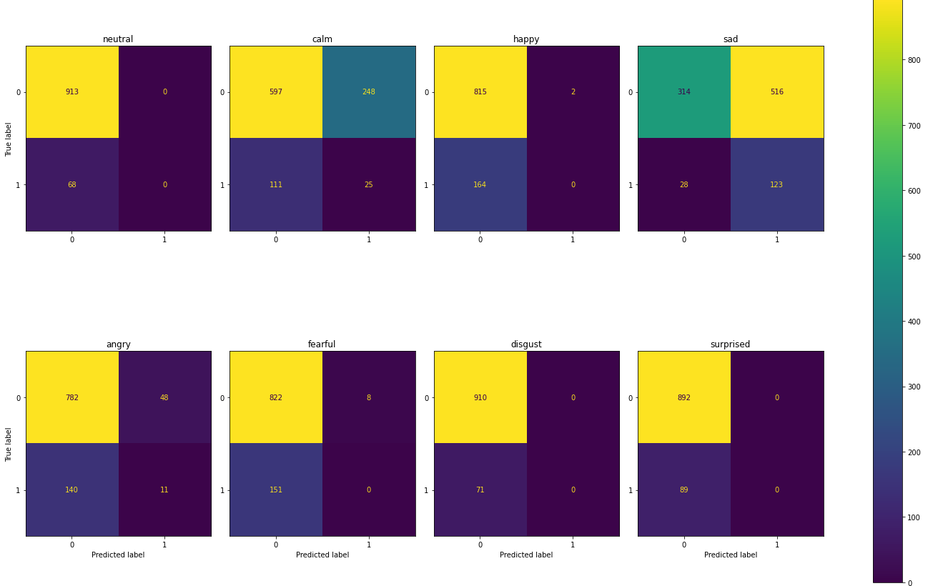
Evaluation
nn_mod_full_emo_matrix
Confusion Matrix - Full View
Neural Network

Slide 11
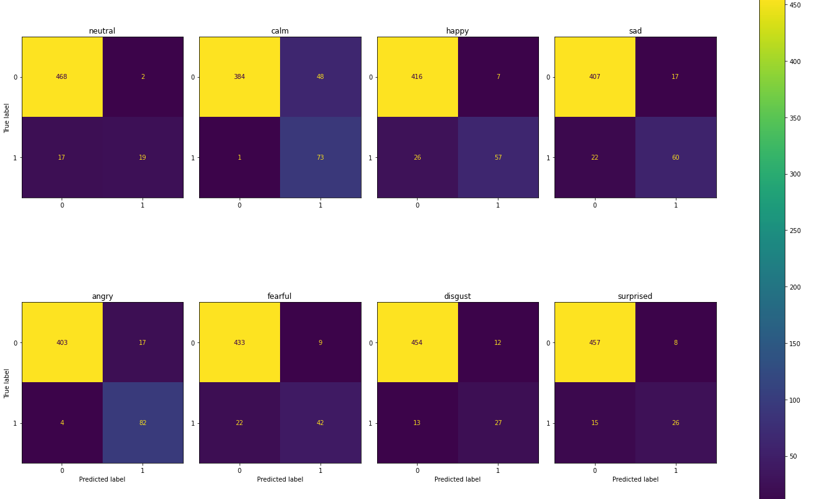
Evaluation
rf_male_emo_matrix
Confusion Matrix - Male
Random Forest
Neural Network

Slide 12
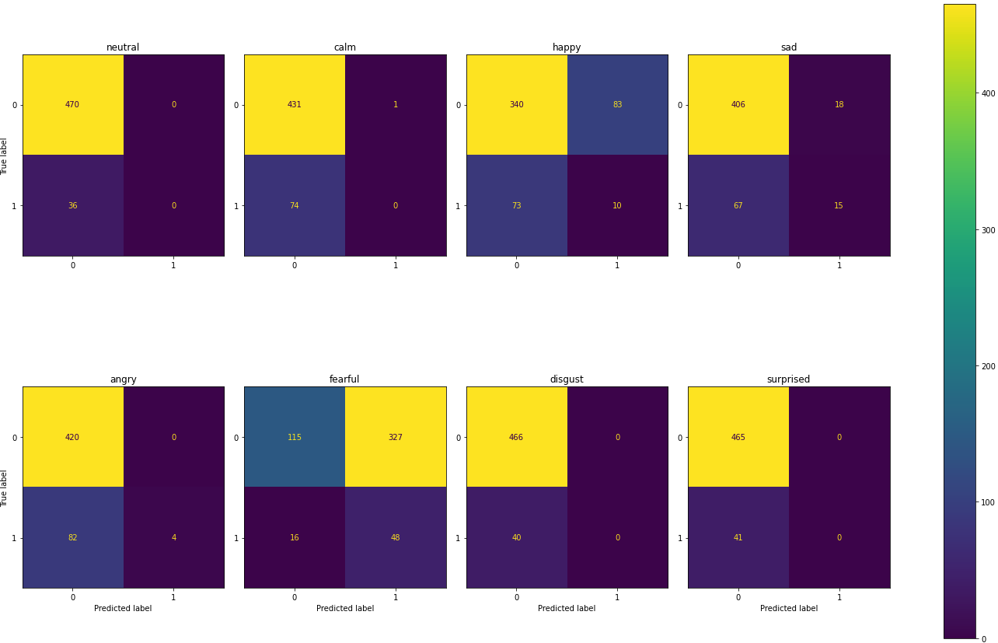
Evaluation
rf_mod_male_emo_matrix
Confusion Matrix - Male
Random Forest
Neural Network

Slide 13
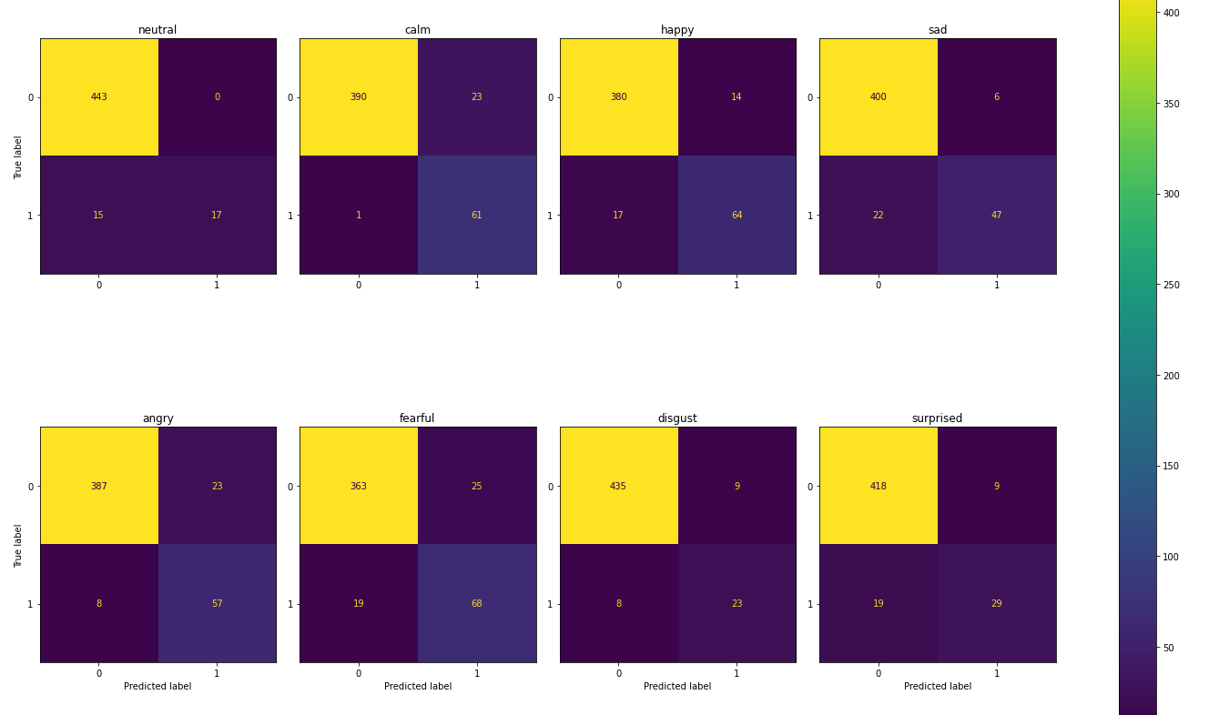
Evaluation
rf_female_emo_matrix
Confusion Matrix - Female
Random Forest
Neural Network

Slide 14
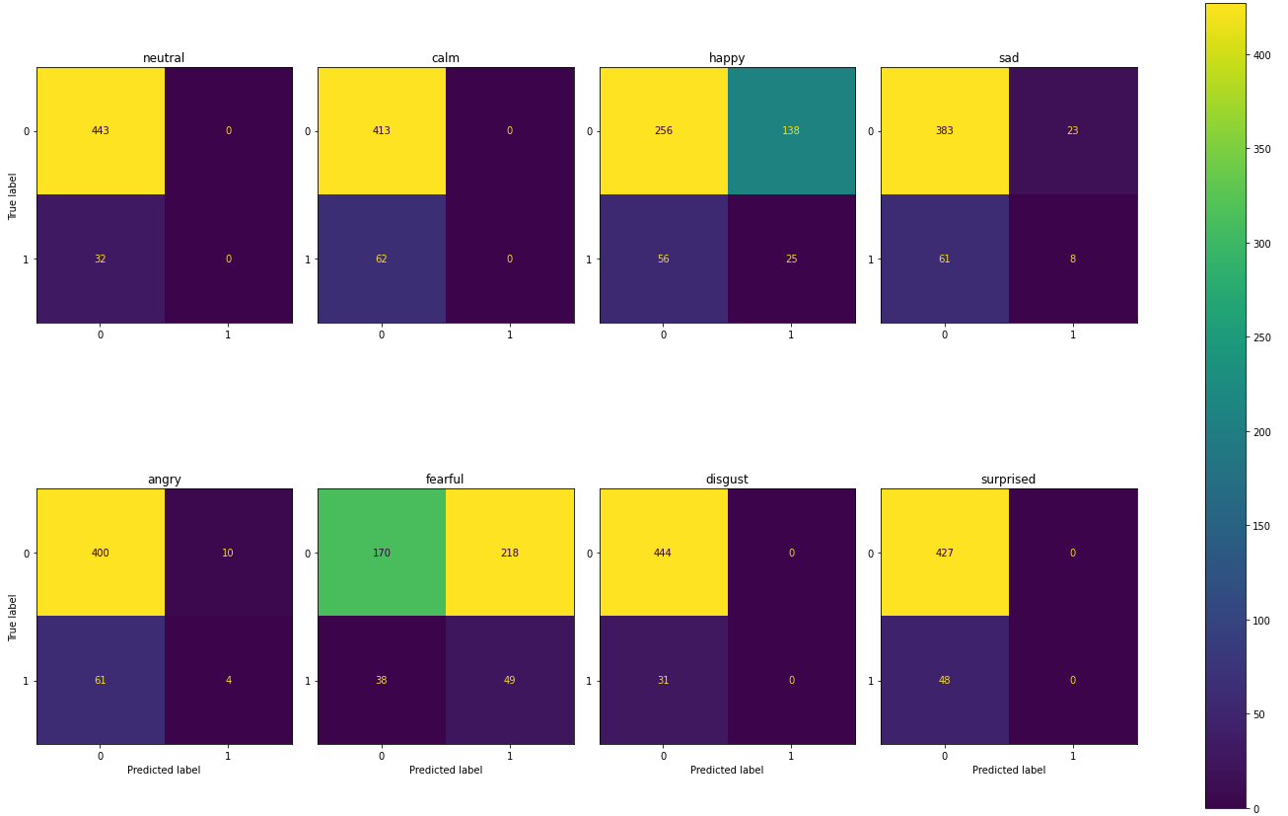
Evaluation
rf_mod_female_emo_matrix
Confusion Matrix - Female
Random Forest
Neural Network

Slide 15
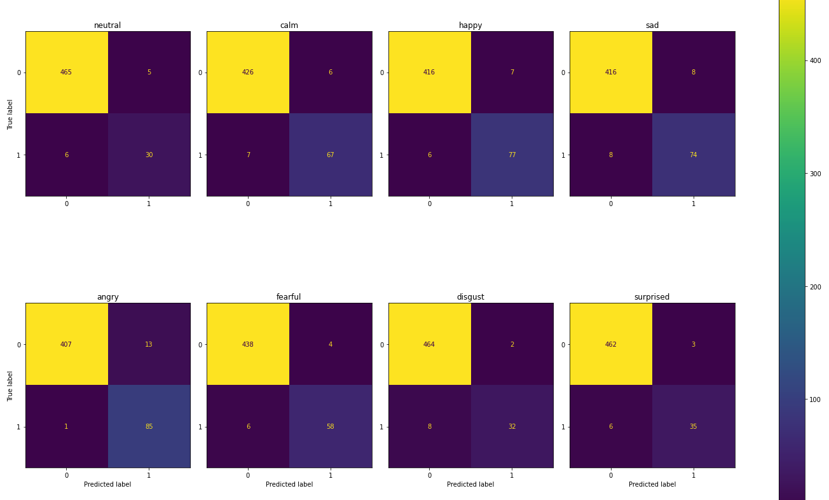
Evaluation
nn_male_emo_matrix
Confusion Matrix - Male
Neural Network

Slide 16
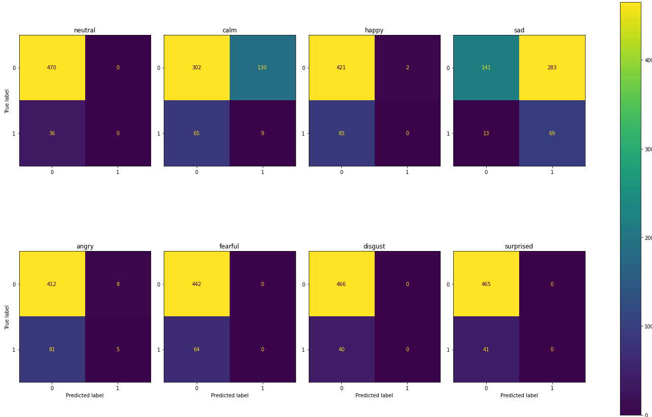
Evaluation
nn_mod_male_emo_matrix
Confusion Matrix - Male
Neural Network

Slide 17
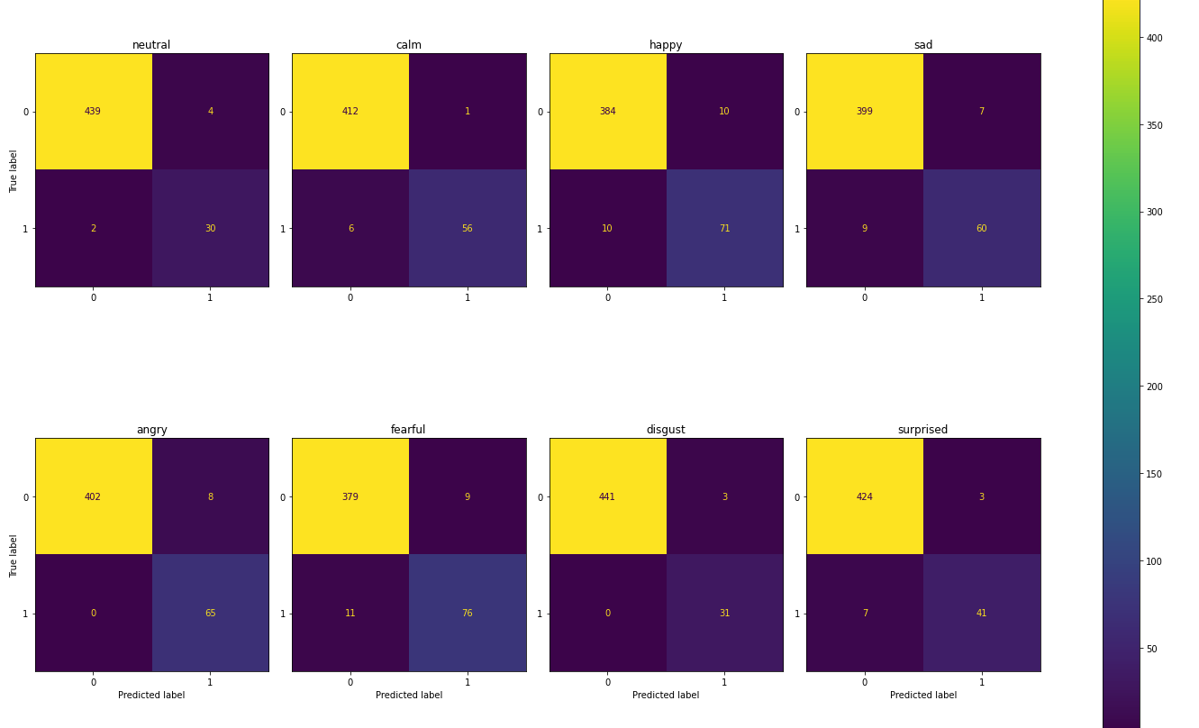
Evaluation
nn_female_emo_matrix
Confusion Matrix - Female
Neural Network

Slide 18
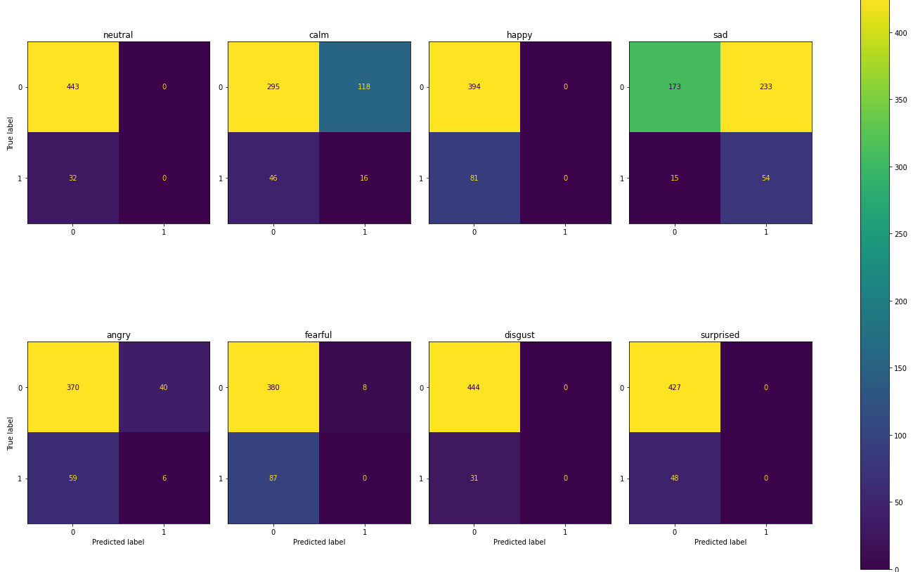
Evaluation
nn_mod_female_emo_matrix
Confusion Matrix - Female
Neural Network

Slide 19






Evaluation
Neutral: Male
Female
Happy:
Male
Female
Emotion & Gender Bias
Decision Tree
Random Forest
Neural Network
High FPR
More likely to be predicted as positive
Happy
Fearful
Sad
Calm

