Slide 1
Prolific slime
A Task manager and productivity tool

Slide 2
The Problem
In this day and age, a lot of people get sucked up in their phones. They aren’t productive or efficient enough in whatever work they do.
Introducing Prolific Slime – an innovative web tool that allows you to keep track of your tasks as well as time.
We keep track so you don’t lose track.

Slide 3
What’ve we got?
Calm and Soothing UI
Neat Animations
Cursor Follower
Custom Pomodoro Timer
And a Slime xD

Slide 4
Made using…
HTML
CSS
JavaScript
React js
Node js
Photoshop
Clip Studio Paint

Slide 5
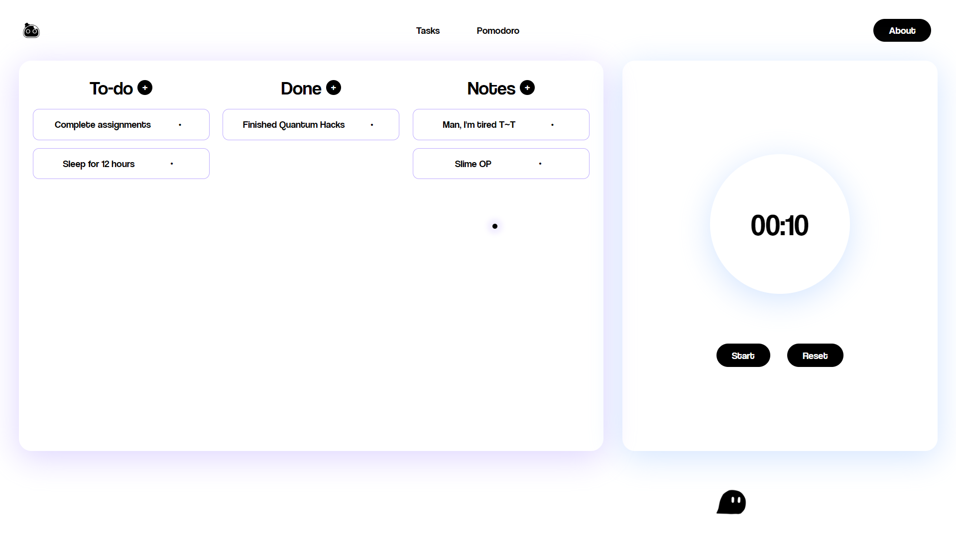

Slide 6
Created for Quantum Hack in under 24 hours
Made by Four Bits:
Nithesh Kumar (1NH21IS104)
P Aditya (1NH21IS105)
Harsh Valaki (1NH21IS060)
Nikhil Bhatt (1NH21IS100)

