Slide 1

Project
Introduction
FOUR DIRECTION

Slide 2
Problem Statement
Most travel apps only handle one piece of this with either bookings, or budgeting, or itineraries. So travellers end up manually piecing it all together themselves. Group trips make it worse, since getting everyone's schedules, budgets, and preferences to line up is genuinely difficult. And when something changes mid-trip, there's rarely any real help from existing platforms in adjusting.

Slide 3

Target users
Traveler
Our main principle on this project is to get all traveler to use our app to plan:
  rich traveler
  budget traveler

Slide 4
Pricing: Freemium model
FREE
To download......
Pay for premium usage

Slide 5
Feature | Free | Pro (RM200/year)
Offline Access | Wi-Fi / Data required | Full offline maps & itinerary
Route Optimization | Manual sorting | 1-click auto-optimizes best route
Booking Sync | Manual email forward | Auto-syncs from Gmail
Map Export | None | Export to Google Maps
Experience | Has upgrade prompts | Ad-free & priority support
AI Assistant | Basic AI suggestions | Unlimited AI trip generation

Slide 6
Problem encountered
Making an all in one service will be quite impossible, because there will be a few problem that we must address:
  Cost will be high
  Not enough time
  Server lagging problem

Slide 7
Final Solutions
A – Integrated Travel Planner
Combines multiple travel-related functions into one platform and directly addresses the problem of switching between different apps.
B – AI Travel Assistant
Provides personalized travel recommendations and assistance, making trip planning more convenient and efficient.
We’ll exclude services such as :
  booking hotel
  booking flights
  booking foods services

Slide 8
Group Chat
Budget tracker
Community
App Features
AI Planner
AI Travel Co-Pilot

Slide 9
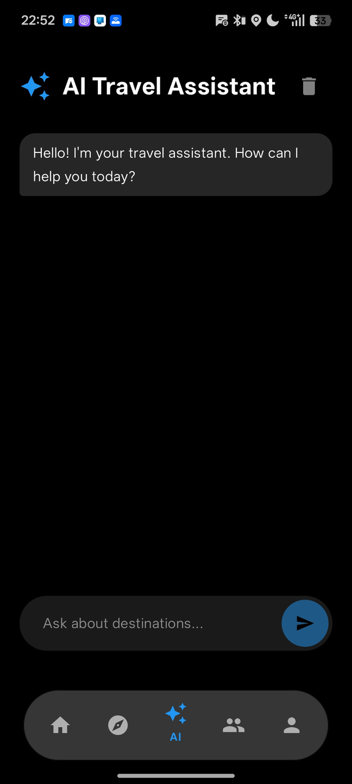
AI Planner
Can plan whole journey:
  Plan Budget (Affordable/Midrange/Premium)
  Suggest a suitable location
    Restaurant
    Entertaiment
    Culture/History
    Knowledge
  Plan the time and date
  Plan the transport
  Create document to refer to
HIGHTLIGHT：
  Can manually modify the plan, it will also help to rewrite the document
  It will automatically view the details of travel destinations.
    Give suggestion to join the local event
    Observe any accident and give a backup plan

Slide 10
Budget tracker
  Implemented a Dynamic Allowance system. If a user saves money on Monday (e.g., they ate street food instead of a restaurant), that surplus automatically moves to Tuesday. Their "Safe to Spend" ring actually grows! Conversely, if they overspend, it intelligently recalculates to keep the trip on track. It’s a "Living Budget."
  Added Back-Tracking support with a Date Picker. Users can go back in time to log missed items, and the "Safe to Spend" pulse ring for today will re-adjust instantly.

Slide 11
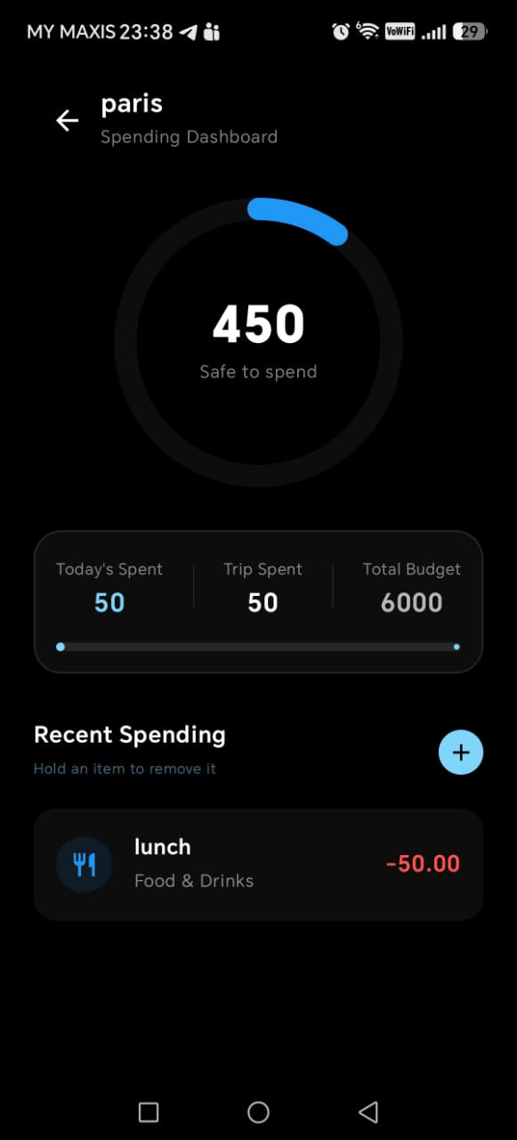
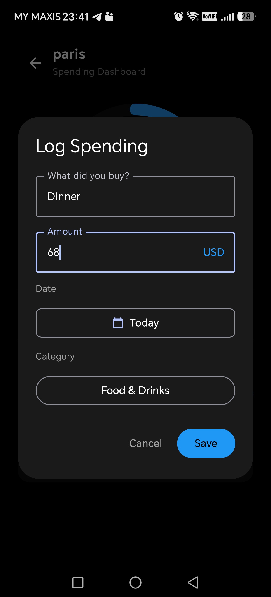
Budget Planner

Slide 12
Budget Planner
  Integrated a Safety Buffer Slider (0–20%). This allows users to bake an "Emergency Fund" directly into their plan with one swipe. The app treats this as a separate, protected category.
  Added Quick Start Templates (Backpacker, Mid-Range, Luxury). These aren't just labels; they are intelligent presets that suggest realistic daily allowances and category ratios based on the user's selected travel style.

Slide 13
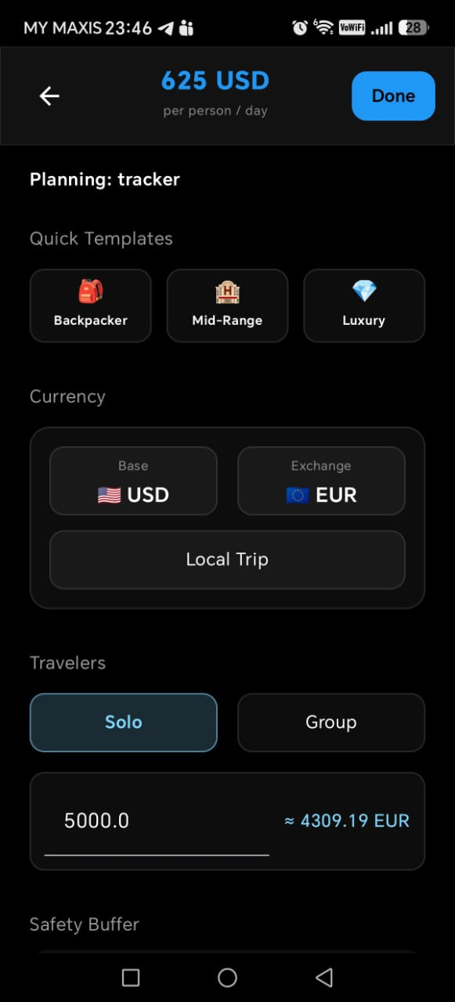
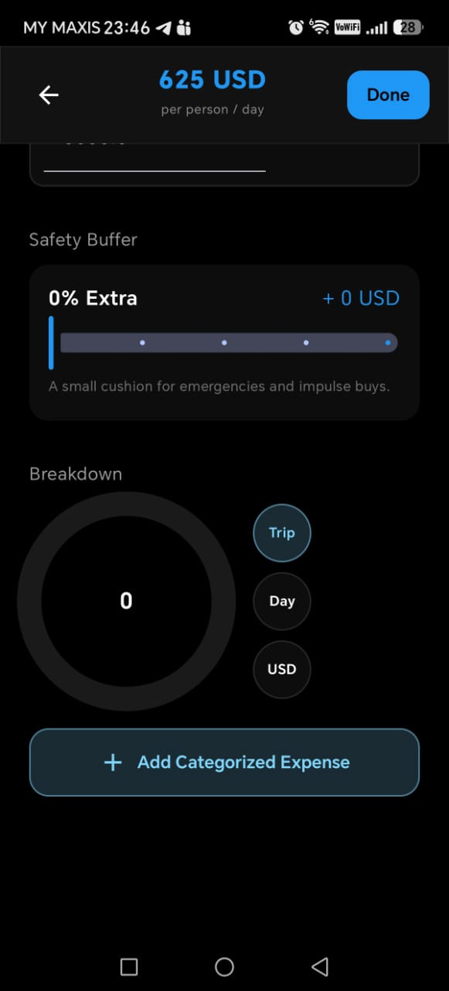
Budget Planner

Slide 14
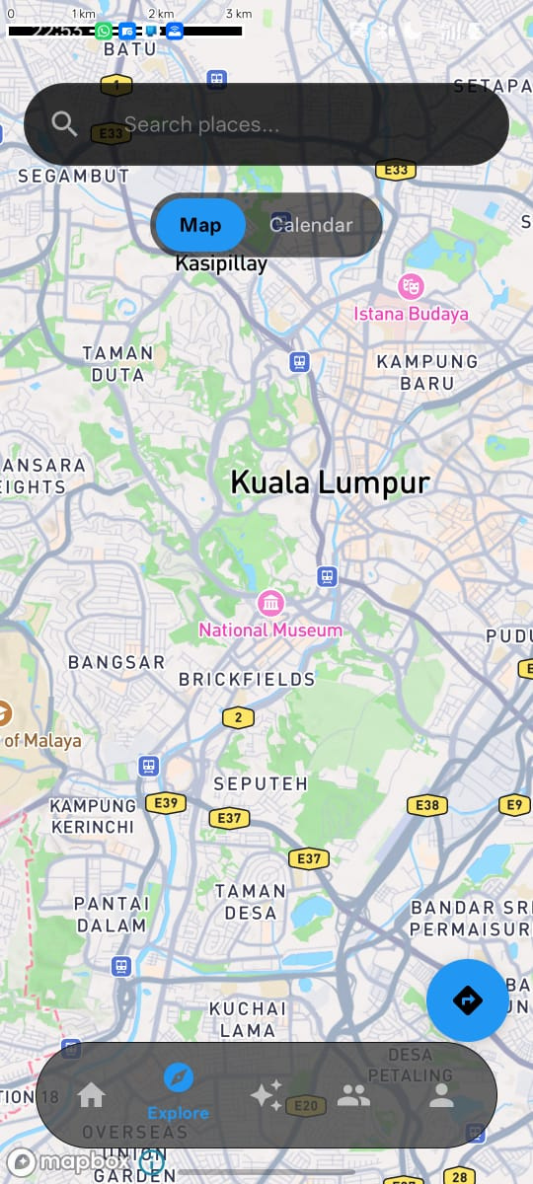
Navigation / Map
  An integrated map service that provides turn-by-turn navigation directly to destinations found in the user's AI-planned itinerary.
  Built directly into the ecosystem to ensure a seamless transition from planning to traveling without the friction of external apps.
  Integration with the In-app Calendar helps make it easy for users to plan routes

Slide 15
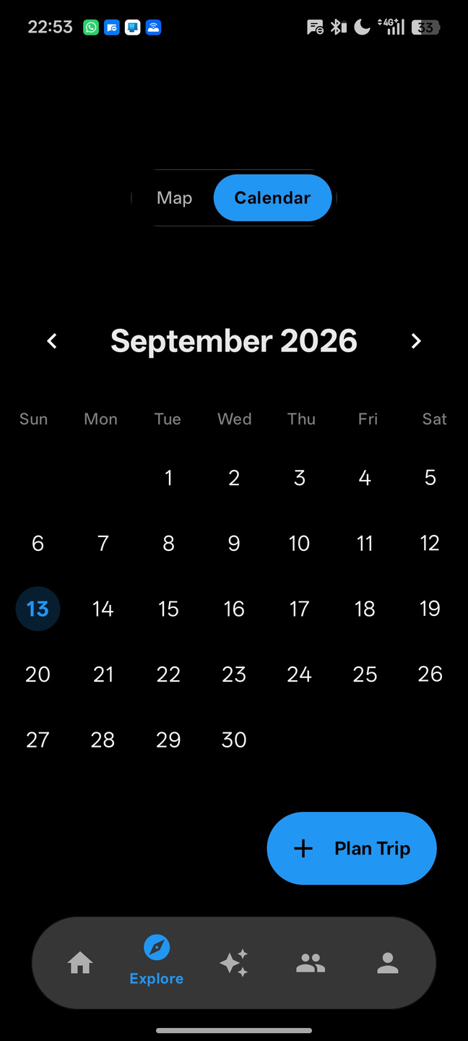
In-app Calendar
  An in-app calendar that is able to record plans such as planned locations to visit, hotels to stay at, and notes to keep track off.
  Has integration with AI Trip Planner and Navigation, allows the AI to update your plans, and view routes and photos in-app. Allows collaboration with other people in Group Chat, helping people in a group plan hassle free.

Slide 16
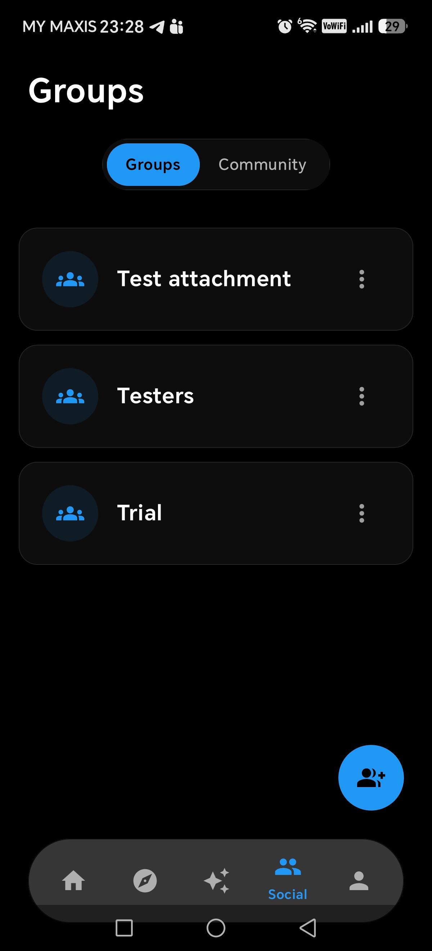
Community & Group Chat
In our app, we are open for users to form communities where people can post travel guides, travel tips and travel trends.
Users can also form group chat with family mambers or friends where they can discuss and plan about their travel. Groups that are created can easily add or remove places of interest or plans from their schedules. They can plan together in one seamless environment, with each connected system.

Slide 17


Resources
We are using android studio developed by IntelliJ and Kotlin language to develop this app for android mobile devices to ensure high performance, modern syntax, and seamless integration with Android's UI components and mapping SDKs.

Slide 18



Resources
Mapbox Maps SDK
Google Places API
Google Gemini API
Pros:
  High customization for map styles
  High-performance vector rendering
  Features offline support
Cons
  Commercial platform with a usage-based billing tier
  More initial configuration required
Pros:
  Allows us to gather data such as photos and reviews about physical locations, businesses, landmarks, and points of interest (POIs) globally.
Cons
  Using Googles Pay-as-you-go policy, we are only allowed limited request per month.
Pros:
  Allows us to use Google Gemini AI as a source of AI interactions.
Cons
  We are limited to Flash and Flash-Lite models only as a free tier user, so we can only make typically 5–15 Requests per minute

Slide 19
Closing Statement
Thank you

