Slide 1
Akmal Hossain
ID: 2019-3-60-123
Department: Computer Science & Engineering
East West University

Slide 2
Linear Probing Hash Table

Slide 3
Problem Description
A hash table is a data structure used to implement an associative array, a structure that can map keys to values. A hash table uses a hash function to compute an index into an array of buckets or slots.
The idea of Linear Probing is used to probe the through the subsequent elements of array to avoid collisions of keys starting from the hash code index of the key.

Slide 4
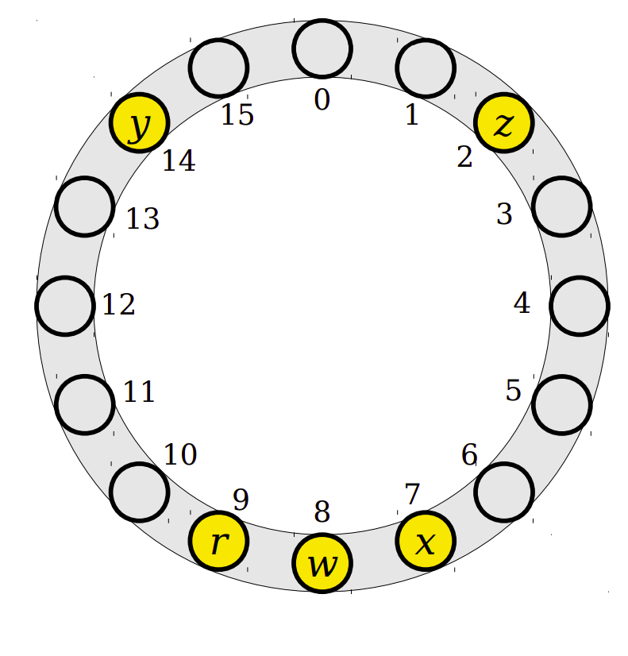
Insertion
To insert an element x at a certain key -
Compute hash(key) and try to place x there.
If that position is full, keep moving through the array, wrapping around at the end, until a free spot is found and place x there.

Slide 5
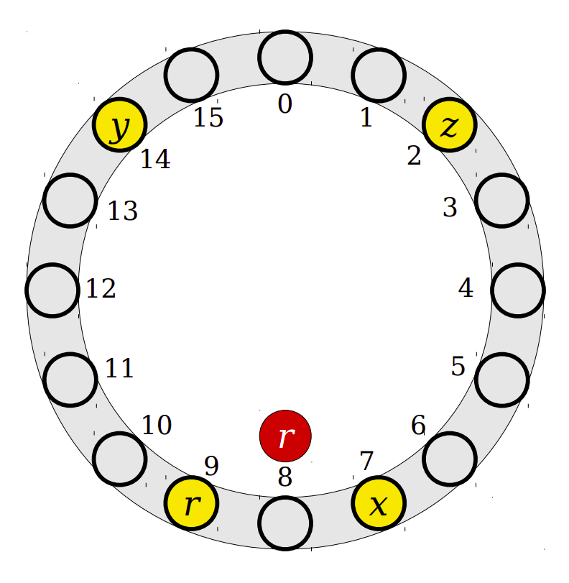
Deletion
Deletions are a bit tricky because, we cannot just do search and remove,
as that will result in blank spots in the middle of the array disjointing the hashtable elements.

Slide 6
Deletion
When removing an element, we have to mark the index as previously occupied. This is known as a tombstone.
So that when we lookup/search a key, we dont stop at a tombstone. Instead we keep the search going until an actual blank spot is found.
While inserting data, we can replace any tombstone we find as it is a free space.

Slide 7
Linear Probing in Practice
Advantages
Low memory usage: Since we use an array and a hash function, this method has low memory usage.
Locality: When collisions occurs, we only lookup in the adjacent locations. Therefore locality of the key/value pairs are better.

Slide 8
Linear Probing in Practice
Disdvantages
Performance: Linear probing has severe performance degradations when load factor gets high.
Primary clustering: The number of collisions grow as a function of the number of existing collisions.

Slide 9
THANK YOU

