Slide 1

Enhancing LLM responses with
RAG / Vector Search
Sebastien FLAESCH
Apr 2026

Slide 2
What is RAG ?
Retrieval Augmented Generation (RAG) empowers LLMs by enabling them to access external knowledge sources.
With RAG, LLMs can use relevant information to generate more accurate and contextually responses.
A crucial aspect of RAG is efficient information retrieval.
This is where vector embeddings and specialized database technologies come into play.

Slide 3
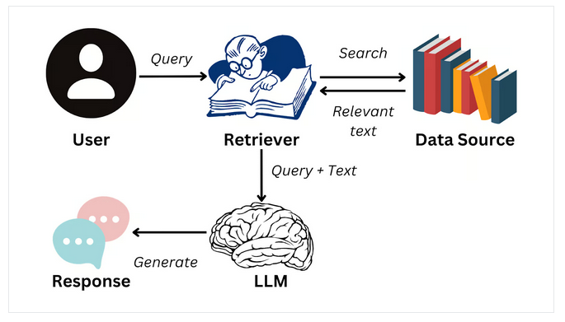
Source: https://www.datacamp.com/blog/what-is-retrieval-augmented-generation-rag

Slide 4
Benefits of RAG
Minimize hallucinations: LLMs can generate inaccurate responses if they lack substantial data
=> RAG provides context to LLMs.
Up-to-date information: LLMs are trained on public data up to a specific date
=> RAG provides fresh data.
Confidentiality: Company-specific data must not be made public.
=> Keep enterprise data within your realm using local LLMs or in a cloud tenancy.

Slide 5
Efficient Retrieval Matters
Retrieval must be fast and semantically accurate
Vector Embeddings & Vector Databases enter in action!
Applies to structured and unstructured data:
Text, image, video, audio …

Slide 6
What are Vector Embeddings?
Numerical representation of the semantic meaning and relationships of real-world concepts or objects that are easily utilized by AI models and algorithms.
For example, a text:
“I have a dream …” => [ 0.234, 0.341, 1.580, … ]
Dimension = Total number of features that are encoded in the vector representation.
A vector can be converted to/from a JSON array!

Slide 7
How to produce a vector?
Use Embedding Models from AI providers (can be public or private embedding model installed in-house):
AI provider
Data Object
(text, image, sound, video)
Vector
[ 0.234, -0,1345, 0.234 … ]
Embedding Model

Slide 8
Vector generation example
Using OpenAI API “text-embedding-ada-002” model:
curl https://api.openai.com/v1/embeddings \
-H "Authorization: Bearer $OPENAI_API_KEY" \
-H "Content-Type: application/json" \
-d '{
"input": "The food was delicious and the waiter...",
"model": "text-embedding-ada-002",
"encoding_format": "float"
}'

Slide 9
Vector Generation Result
{
"object": "list",
"data": [
{ "object": "embedding",
"index": 0,
"embedding": [0.002275,-0.009306,-0.00289,...]
}
],
"model": "text-embedding-ada-002-v2",
"usage": { "prompt_tokens": 8, "total_tokens": 8 }
}

Slide 10
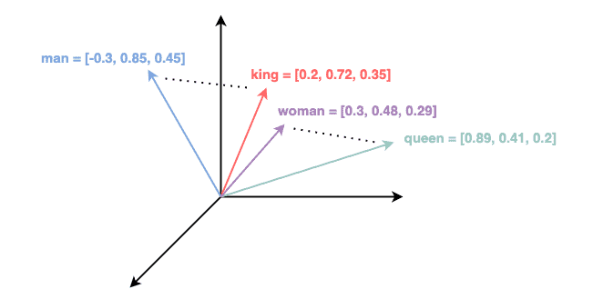
Vector Similarity
Similar objects are close to each other in a vector space
Ex: Semantically similar words in a 3-dimensional vector space:
Source: https://www.baeldung.com/cs/dimensionality-word-embeddings

Slide 11

Purpose of Vector Databases
Store and fetch vector embeddings
Support fast similarity search (with indexes)
Purpose-built for high-performance retrieval

Slide 12




Pure Vector Databases (no SQL)
Chroma (https://www.trychroma.com/)
Pinecone (https://www.pinecone.io)
Weaviate (https://weaviate.io/)
Faiss (https://ai.meta.com/tools/faiss/)
… and more ...

Slide 13
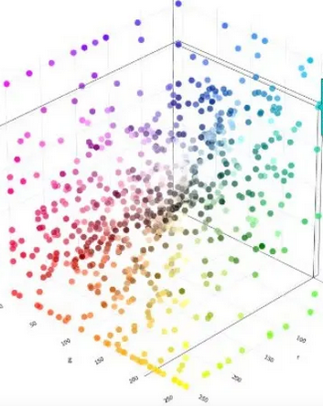
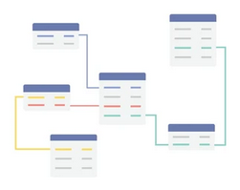
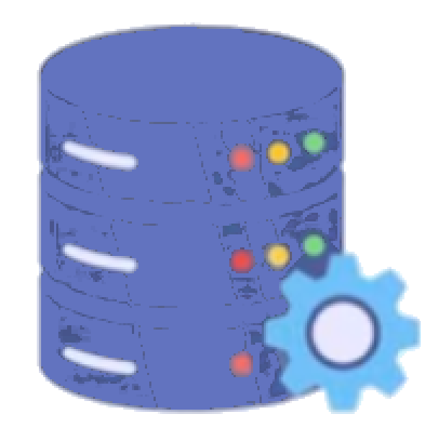
Problem with Vector-only databases
=> Manages only vector data.
Vector Embeddings
SQL Structured Data
Relations
?
Vector Database
SQL Database

Slide 14



SQL Databases with Vector Search
PostgreSQL
+ pgvector / pgvectorscale / pgai
extensions
Oracle 23ai
(native VECTOR type + functions)
Microsoft SQL Server 2025
(native VECTOR type + functions)

Slide 15
Benefits of SQL Integration
Unified Data Management
– Structured data + vector data together
– No need for another software provider
Scalability & Performance
– Battle-tested SQL engines
Data Integrity (ACID database engines)
– Leverage transactional consistency
SQL Structured Data
Vector Embeddings

Slide 16
SQL table with vector column
CREATE TABLE customer (
id INTEGER NOT NULL PRIMARY KEY,
name VARCHAR(50) NOT NULL,
prefs VARCHAR(2000),
prefs_emb VECTOR(1024)
)
___________________________________________________________________________
id name prefs prefs_emb
___________________________________________________________________________
4834 John STORM Chocolate, Lemon, ... [0.363,1.789,...]
7845 Phil Park Coffee, Banana, ... [0.984,-0.399,...]
7934 Judy STARN Apple, Orange, ... [0.254,1.435,...]
... ... ... ...

Slide 17
Powerful similarity search using SQL
Example with PostgreSQL + pgvector extension :
This SQL orders rows by using the <=> operator of pgvector, computing the cosine distance between stored vectors and the vector passed as parameter, to get related / similar rows first.
Note the WHERE clause filtering rows on classical SQL data.
SELECT * FROM customer
WHERE name LIKE 'Bar%'
ORDER BY prefs_emb <=> ?::vector

Slide 18
Chunking
Vector embedding LLMs can only process a limited amount of text.
Ex: OpenAI text-embedding-ada-002 input token limit = 8191
Chunking = Break down large pieces of text into smaller segments (= chunks)
Typically: 1 paragraph or 1 page = 1 chunk of text
Then compute a vector embedding for each chunk of text.

Slide 19
Chunking
Large PDF Document
Embedding
Model
Chunk 1
[ 0.234, -0,1345, … ]
Chunking
Embedding
Model
Chunk 2
[ 1.564, -0,094, … ]
Embedding
Model
Chunk 3
[ 0.546, 0,3695, … ]

Slide 20
SQL Vector Search + LLM
Must have vector embeddings created in your SQL database, bound to your structured or unstructured data.
SQL table with famous quotes made by celebrities
Martin Luther King : “I have a dream … “ => [ 0.234, 0.962, 1.362. …]
Nelson Mandela : “Education is … “ => [ 1.552, 0.842, 1.823, … ]
Take user contextual statement and convert to a vector using same embedding engine that produced stored vectors.
“Famous quotes related to political concerns” => [ 0.111, 0.632, 0.985 ...]
Search similar data with SQL, using vector similarity functions
SELECT … FROM quotes ORDER BY emb <=> ?::context_vector
(here we use the <=> operator to order rows by cosine distance)

Slide 21
SQL Vector Search + LLM
Define the role of the LLM (system prompt)
You are a professor of history…
Provide LLM with the context data found by SQL query (assistant prompt)
Use the following relevant quotes:
Martin Luther King said: ...
Abraham Lincoln said: …
Nelson Mandela said: ...
Ask a question to LLM related to this context data:
Which politicians made a famous quote about racism?
LLM produces relevant answer, using the provided context data.

Slide 22
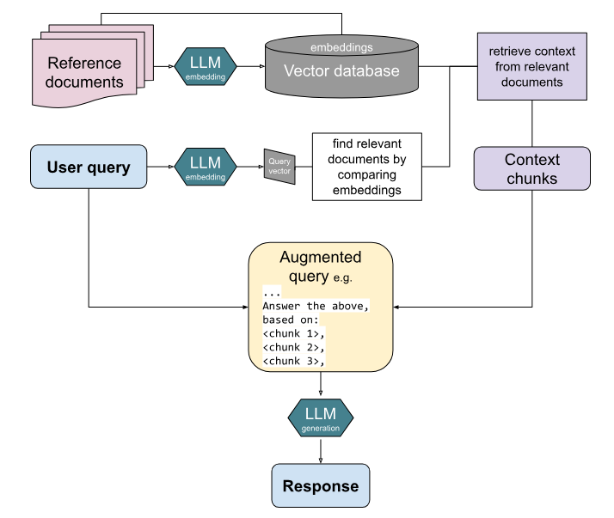
1
4
2
3
5
Source: https://blog.typingmind.com/rag-for-beginners/

Slide 23
Data Security Concerts with RAG
Never send sensitive data to public LLMs like ChatGPT!
Solutions:
Setup your local on-prem LLM (if you have the computing power)
Use private LLM engine provided by a Cloud Service Provider
For ex: Oracle Cloud Infrastructure Generative AI based on Cohere Large Language Model https://docs.oracle.com/en/solutions/oci-generative-ai-llm/index.html

Slide 24
What FGL types for Vector Embeddings?
STRING: To hold small / medium vectors (dim = 1024).
TEXT: To hold very large vectors (dim > 1024)
To compute the size of the string representing a sequence of decimal numbers:
[0.026891274,0.022986012,-0.03174009,0.08214157,…]
< 12 chars >
For a vector with dimension 4096 => (4096 * 12) / 1024 = 48 Kb

Slide 25
Thank you
for watching!
Q/A

