Slide 1
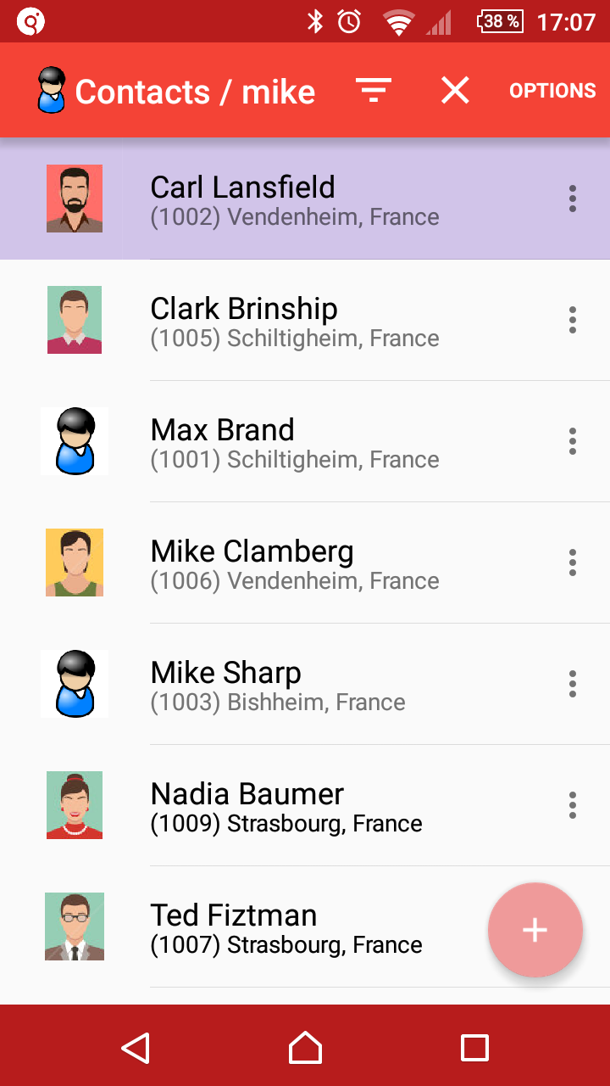
Genero Contacts Demo
Goals of the demo:
Study mobile/server DB synchronization
Test Genero Mobile (GMA/GMI/FGLGWS)
Test GAS + GWS REST API (JSON/XML serialization)

Slide 2
Contacts app purpose and features:
Manage business contacts information (name, phone, photo, address/location)
Share/sync data with other app users
Centralize data on a server (= implicit backup)
Identify and control app users on the server
Filter data by users (ted:Paris, mike:Paris,Berlin)
Localize contacts on a map (shared geolocation)

Slide 3
Components used on mobile devices:
GMA / GMI / FGLGWS
SQLite as database engine
Components used on server side:
GAS to serve mobile device REST requests
FGLGWS to execute the Web Service programs
PostgreSQL as central database server

Slide 4
Software Architecture
M1
INTERNET
GAS
Web Services
(REST)
M2
SV1
SV2
SV3
SV4

Slide 5
Data model overview
Shared data:
contact (id,name,phone,address,photo,…)
contnote (notes about a contact)
city (read-only:used for address info)
Server-only data:
users (app users definition)
datafilter (SQL filters for each app user)

Slide 6
Concurrent data access management:
Uses optimistic locking
Normal cases:
M1 creupdels C1, M1 syncs, M2 syncs (M2 gets C1 changes)
Conflict cases:
M1 creates C1, M1 syncs, M2 creates C1 (same name/city), M2 syncs (M1 wins, M2 informed)
M1 updels C1, M1 syncs, M2 updels C1, M2 syncs (M1 wins, M2 informed)
M1 updels C1, M2 updels C1, M2 syncs, M1 syncs (M2 wins, M1 informed)
Traditional DB cases:
M1 creupdels C1, M1 syncs = Central DB constraint NOT NULL or UNIQUE fails (M1 informed)

Slide 7
Synchronization
Each contact record gets a modification info: timestamp (in UTC), user id (who changed), and modification status: S/U1/U2/D/N/... (for the local mobile DB).
Server program saves last sync timestamp (UTC) for each user
Can handle conflicts based on timestamp, and find central changes since last sync for a user.
New local contacts created with negative ids, get final unique ids after it's created on server.
Deleted local contacts just marked as deleted (D).
Optimized updates: with or without picture data (U1/U2).
Mobile apps use RESTfull HTTP requests:
Data is serialized as JSON or as XML
Local mobile changes sent with HTTP POST
Centralized changes fetched with HTTP GET

Slide 8

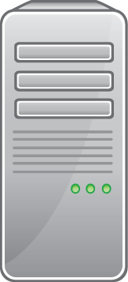
Synchronization
HTTP POST: Full sync
1. M1 first app execution: full sync asked
2. Server saves TS1 for M1 and returns refresh list
Refresh list (ids of C1, C2, C3, ...)
3. M1 asks fresh data for C1
HTTP GET: C1
5. M1 stores new C1 data in local DB, then continue with next in refresh list.
4. Server returns new record data
Returns C1 data
HTTP POST: return receipt
7. Server commits TS1 for M1
6. M1 sends return receipt to server.

Slide 9
Synchronization
1. M1 makes local changes:
modifies C1 (mark = U1),
deletes C2 (mark = D),
changes photo of C3 (mark = U2)
creates new C4 (mark = N)
3. Server saves TS2 for M1 and applies changes and builds result list for posted commands.
2. M1 asks for a sync
HTTP POST: regular sync
(C1 upd1 cmd, C2 delete cmd, C3 upd2 cmd, C4 create cmd)
4. Server searches changes from other users since TS1 and builds refresh list.
6. M1 processes result list (local DB update, and resets modification statuses to “S”), then processes refresh list (GET requests) for other user changes, and sends receipt when done
Result list + Refresh list
5. Server returns result and refresh lists.
HTTP POST: return receipt
7. Server commits TS2

Slide 10
Live Demo
Start server part (show .xcf, start GAS, tail logs)
Open browser to see central DB status
Show server config program (user definitions)
Start contacts app on Android
Show settings form, test com with server
Show contact list, update form, add picture
Start contacts app on iOS
CreUpDel contacts and sync, show conflicts
Show geolocation map

Slide 11
Code walk-through
Common lib: common/dbsync_contact.4gl
Server WS program: server/dbsync_contact.4gl
Mobile app : app/contacts.4gl

Slide 12
Q/A and thanks

