Slide 1

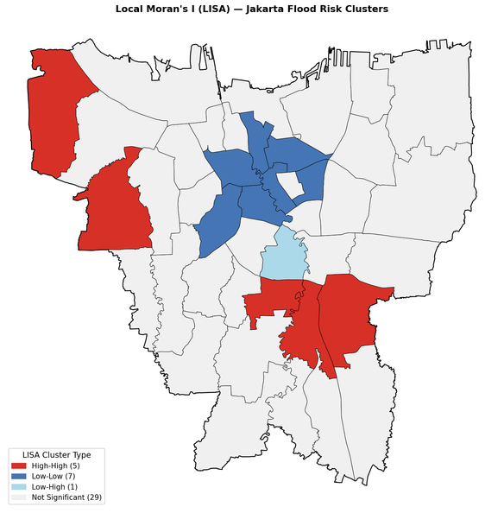
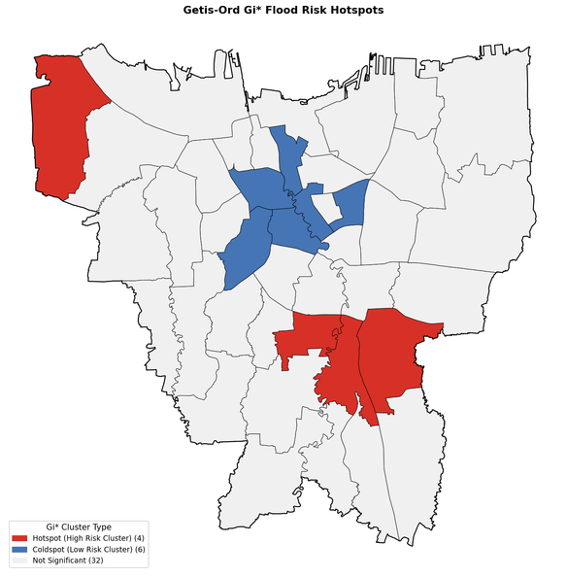
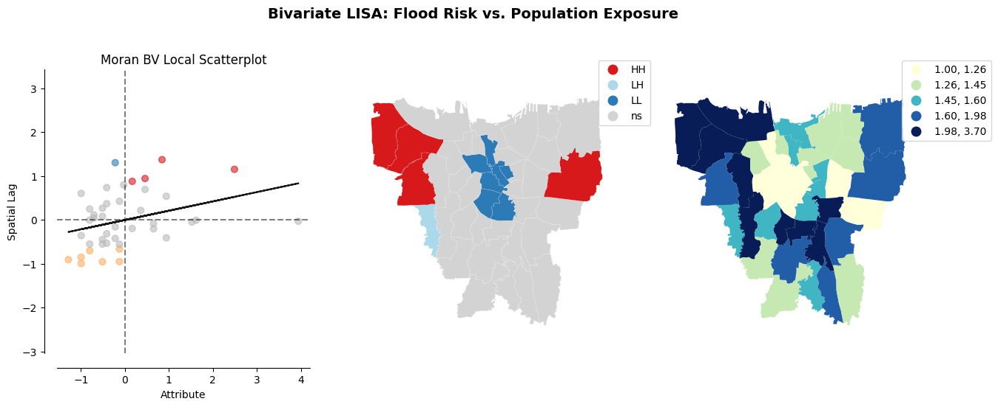
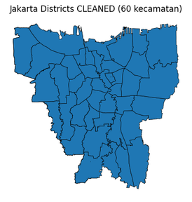
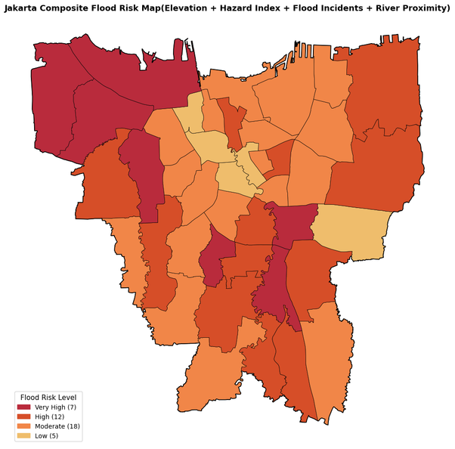
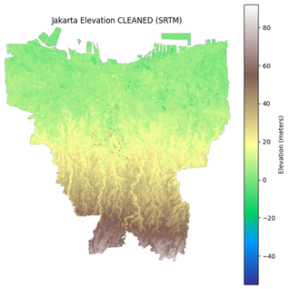
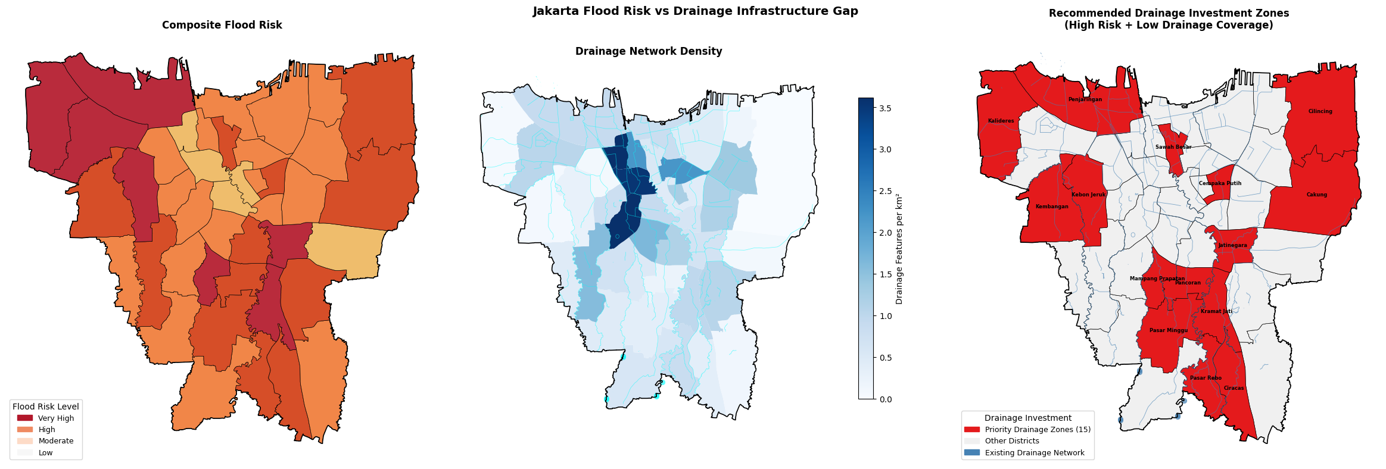
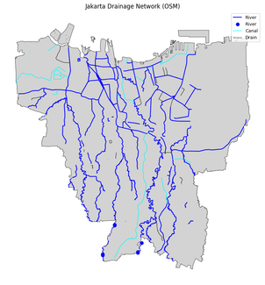
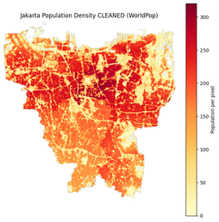


Urban flooding and population exposure analysis in Jakarta
A GIS-Based Assessment of Flood Risk, Drainage Infrastructure Gaps, and Vulnerable Districts
Fouz Ul Azeem (bscs23095)
Session: Spring 2025
Supervisor: Dr. Adnan Siddique
Course: Spatial Data Science
1. Introduction
4. Methodology
Jakarta faces recurring urban flooding due to dense population, river systems, and low-lying terrain.
This project uses GIS and spatial analysis techniques to map flood risk across Jakarta districts.
Multiple spatial factors including flood history, elevation, population, and drainage infrastructure were analyzed.
The study identifies high-risk and infrastructure-deficient areas
Data Collection — Five spatial datasets acquired: SRTM elevation raster (NASA EarthExplorer), WorldPop population raster, flood hazard index and incident records 2016–2020 (DKI Jakarta Open Data), and drainage network (OpenStreetMap via OSMnx)
CRS Alignment — All layers reprojected to a common coordinate reference system for spatial consistency
Raster Processing — Elevation tiles merged, rasters clipped to Jakarta mainland boundary, NoData values removed, zonal statistics extracted per kecamatan
MCE Scoring — Each indicator scored 0–4 against absolute thresholds and weighted: 0.45 × Incidents + 0.30 × Hazard + 0.15 × Elevation + 0.10 × River Proximity
Spatial Weights Matrix — Queen contiguity matrix constructed (n=42, avg 5.1 neighbours), row-standardised
Spatial Autocorrelation — Global Moran's I, Local Moran's I (LISA), and Getis-Ord Gi* applied to detect clusters and hotspots
Spatial Regression — OLS baseline with LM diagnostics, followed by ML Spatial Lag model to account for neighbourhood spillover
Infrastructure Gap Analysis — Drainage density computed per km², overlaid with risk tiers to identify priority investment zones
Shelter Placement — Spatial neighbour algorithm identifies safe adjacent districts for emergency shelter siting
Fig. 2: Left: Google Earth snapshot of the observed area. The yellow line shows the approximate projection of the slant-range vector on ground. Right: An initial PSI solution obtained with IPTA. The dots mark the detected persistent scatterers. Their color represents the estimated deformation in mm/y. The red line shows the extent of an azimuth line whose tomographic inversion is presented in Fig. 5.
2. Problem Statement
Which districts in Jakarta are most vulnerable to urban flooding?
How are flood risk patterns related to population exposure and drainage infrastructure coverage?
Which high-risk districts should be prioritized for future drainage infrastructure and shelter improvements?
3. Data
5. Results & Discussion
SRTM Elevation Raster - NASA EarthExplorer
Population Density Raster - WorldPop
Flood Hazard Index 2023 - DKI Jakarta Open Data Portal
Flood Incident Records 2016–2020 - DKI Jakarta Open Data Portal
District Boundaries - OpenStreetMap via OSMnx
Drainage/River Network - OpenStreetMap via Overpass API
3.1 Cleaning
All datasets were reprojected to the common projected coordinate reference system EPSG:3857 for meter-based distance calculations.
Invalid and NoData raster values were masked and removed using null assignment np.nan values across data arrays.
Continuous topographical parameters were transformed into ordinal multi-criteria evaluation (MCE) vulnerability scores scaled from 0 to 4.
Localized drainage metrics were computed across administrative geometries into a weighted network density index mapping vector features per KM squared
Fig.1 LISA plotting
Fig.2 G* GETIS plotting
Fig.3 BI-LISA plotting
Fig.4 drainage issues and reccomendations plotting
Acknowledgments: Please add acknowledgements here.

