Slide 1
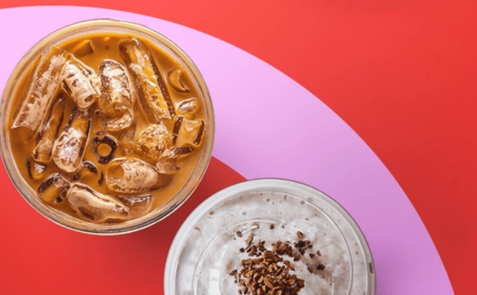
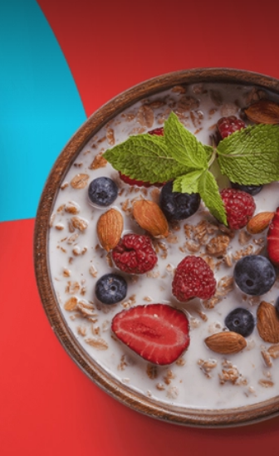


Efood BI Assessment
-Part 2-
George Fovakis
June 2021

Slide 2
Cross sell / Up sell Targeted Campaign
Customer Segmentation

Slide 3





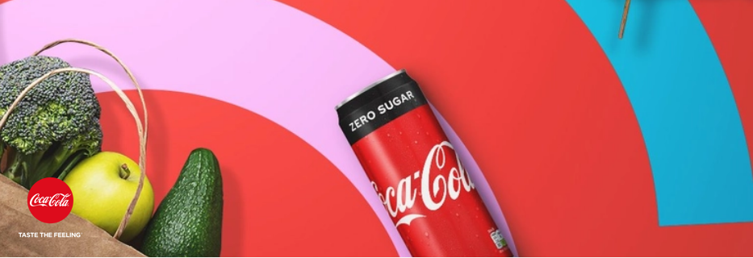
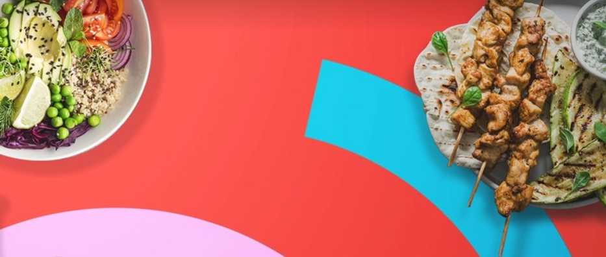
Part 2 – Introduction
Exploring the Dataset
Segmentation
Dataset Key Figures
Methodology
400.000 orders
“ Segmentation allows you to divide customers into distinct groups allowing businesses to talk to them separately.”
It helps answer plenty of questions like:
Are all my customers similar ?
What differentiates them from each other?
Which customer has the potential to buy more ?
€ 3,5 mln total order Basket
162.954 unique users
9 Cuisine Parents
91 Cities
In this project we will use a hybrid version of the RFM model, that helps forecast future behavior based on the past interactions.

Slide 4
Part 2 – Customer Segmentation
Customer Segmentation Summary Page
1
To perform the analysis, we need to transform the dataset in such a way that each row contains figures per customer as below:
The number of made orders (Frequency),
The total amount of spent money (Basket Value).
We create rankings dividing each of the two figures into five groups and assign a score from 1 (the “worst”) to 5 (the “best”).
2
3
As a final step we calculate the “Total Score” for each customer based on the formula¹:
Total Score=0.6*Value_Ranking+ 0.4* Orders_Ranking
4
Based on the “Total Score” we create 5 Segments that we will analyze in details in the next slides.
User_ID | No.Orders | Basket | Orders Segmentation Ranking (1-5) | Value Segmentation Ranking (1-5) | Total Score | Segment
02453 | 15 | 90 € | 5 | 5 | 5 | Champion
071239 | 4 | 30,1 | 4 | 4 | 4 | Loyal
007846 | 3 | 18€ | 3 | 3 | 3 | Potential Loyalist
031259 | 2 | 10,40 € | 2 | 2 | 2 | Promising
001125 | 1 | 5 € | 1 | 1 | 1 | Need Attention
Example
¹ We decided to boost a bit with 0.6 the value factor. There are several options we can use in this formula based on the nature of business.

Slide 5
Part 2 – Customer Segmentation
Orders Segmentation
Orders Segmentation Ranking (1-5) | No_Orders | No_Users | % | Cum %
1 | 1 | 77.367 | 47% | 47%
2 | 2 | 34.924 | 21% | 69%
3 | 3 | 18.711 | 11% | 80%
4 | 4-5 | 17.726 | 11% | 91%
5 | 5+ | 14.226 | 9% | 100%
Total |  | 162.954 | 100%
Comments:
The individual number of orders per user have a few different values, so we will create 5 pre-defined segments
Almost 50% of the users make 1 order and an additional 20% make 2 orders.
For Segmentation purposes in order to target better our client base we created three more segments as shown in the left table.
Segmentation based on No. Orders %
According to the Business needs we can create more Segments if needed (especially for the customers that make more than 5 Orders) ,
in order to make more targeted actions in our customer base.

Slide 6
Part 2 – Customer Segmentation
Value Segmentation
For the Value Segmentation we will not follow the predefined method to create segments that we used in the “Orders Segmentation” , because there are several different values of orders that the users do.
We will divide our customers into 5 value groups of equal sizes. Each group has its own value features as shown in the table below:
Value Segmentation Ranking (1-5) | No_Users | Avg | Min | Max
1 | 32.591 | 4,9 € | 0,0 € | 7,1 €
2 | 32.591 | 9,6 € | 7,1 € | 12,2 €
3 | 32.591 | 15,4 € | 12,2 € | 19,0 €
4 | 32.591 | 24,4 € | 19,0 € | 31,5 €
5 | 32.590 | 52,8 € | 31,5 € | 449,0 €
Total | 162.954

Slide 7
Part 2 – Customer Segmentation
Customer Segmentation
Combing the Orders and Value Ranking that discussed in the previous slides with the formula below, we create 5 Customer Segments.
Customer_Segment | No_Users | AVG_No Orders | AVG Value
Need Attention | 55.159 | 1.1 | 6,8 €
Promising | 43.536 | 1.5 | 15,4 €
Potential Loyalist | 29.696 | 2.5 | 25,9 €
Loyal | 22.669 | 4.3 | 39,8 €
Champions | 11.894 | 8.6 | 65,2 €
Total Score=
0.6*Value_Ranking+ 0.4* Orders_Ranking
Orders # Ranking
5
Potential Loyalist
29.696 (18%)
Loyal
22.669 (14%)
Champions
11.894 (7%)
4
Promising
43.536 (27%)
3
2
Need Attention
55.159 (34%)
1
1
2
3
4
5
Value € Ranking

Slide 8
Cross sell / Up sell Targeted Campaign
Coffee Marketing Campaign

Slide 9

Part 2 – Coffee Marketing Campaign
Understanding the habits of our Customers
In order to understand the customer group where we will focus our campaign, we have to understand the behavior of our base as shown in the table below:
Habit | No_Users | % | Action
Never Order Breakfast | 92.823 | 57% | Cross Sell
Hybrid | 39.909 | 24% | Up Sell
Only Order Breakfast | 30.222 | 19% | Up Sell
Total | 162.954 | 100%
Comments:
The 57% of our base have never made an order of “Breakfast” cuisine within the time frame we make the analysis. These customers make orders of other cuisine types.
It is interesting that the 19% of the base make orders that are 100% of “Breakfast Cuisine”. These customers probably have already made purchases of “Coffee” (if the database provide us detailed analysis about what the “Breakfast” cuisine contains, we can be more targeted to our campaigns)
Also there are 24% of customers that make “Breakfast” cuisine orders as well as other cuisine type orders. We name these customers as “Hybrid”

Slide 10

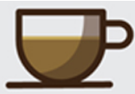
Part 2 – Coffee Marketing Campaign
Cross sell Coffee Campaign
Up sell Coffee Campaign
The customers that never buy a “breakfast” cuisine are the 57% of our base (c.93k customers) based on our previous analysis.
If we take as an assumption that the majority of the people drink a café in their day, we can assume that the majority of this 57% of the base, take a coffee as a take away from a café shop, or they make it on their own.
In order to make an attractive campaign to this group we can try some methods like:
Give them a discount to try a coffee through
efood channel
Provide them an offer 1+1 free
Send them a campaign with a nice description about a special flavor of coffee that efood now promote (maybe they will be triggered to try this unique coffee)
All 5 Segments can be a target for a coffee campaign (bear in mind it is not an expensive product), although we can focus to our lower segments (“Need Attention” and “Promising”) in order to boost their loyalty to the firm.
The customers that either buy only “Breakfast” cuisine at their orders or buy a variety of cuisine products (“Hybrid” customers) represent the 43% of our base (c.70k customers).
In order to make a coffee campaign attractive to this group we can try some methods like:
Give them a discount to try a second coffee (once we
know the hour of the order, for those that take the 1st
coffee of the day in the morning, we can send an offer
in the afternoon)
Send a campaign to try a new coffee that we launch
(its price could be a bit higher than the avg coffee
price that they pay now)
Based on patterns we can find in our dataset we can
send campaigns to the days of the week that a
customers recurrently don’t take a coffee (i.e every
weekend someone is in home so he does not make an
order)
For the up sell campaign all 5 segments can be a target, with a priority to the lower segments as described in the cross sell campaign before.

Slide 11
Cross sell / Up sell Targeted Campaign
Thank you!

