Slide 1
Mayor Cat Adventure Game
Midterm Project Report
Team: Game
Melissa Fowler, Ghazal Hami, and Kayla Meistrell
maf22@hood.edu, gh8@hood.edu, km38@hood.edu
https://github.com/Fowlerma32/cat-adventure

Slide 2

Cat Adventure Game Overview
Mayor Cat
Mini Games(educational)
Taking care of the town
Notes:
Ghazal

Slide 3
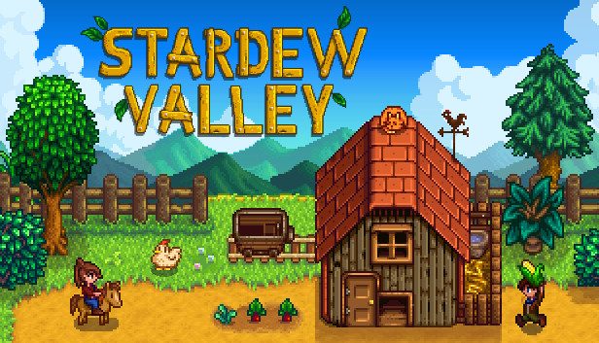
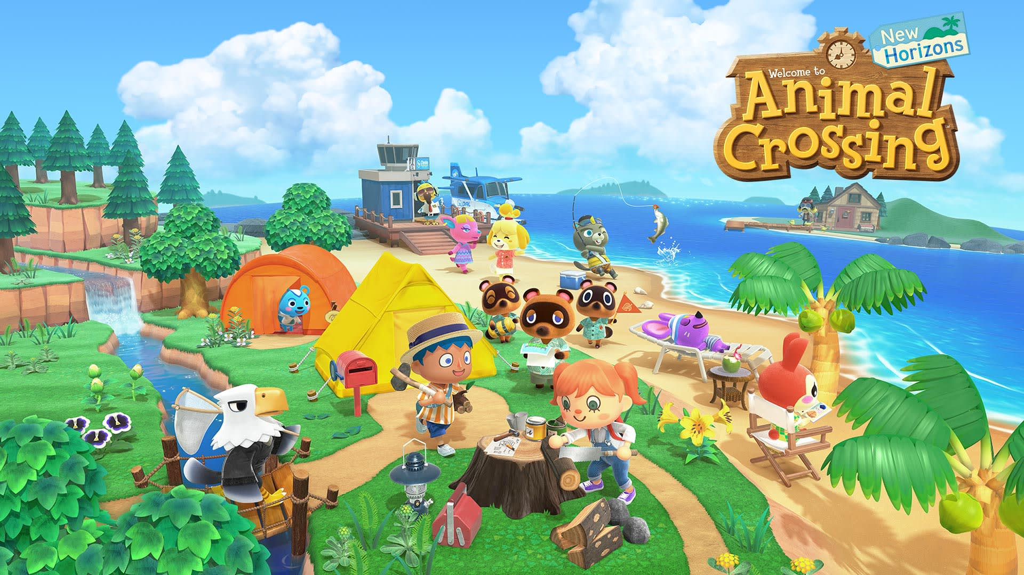
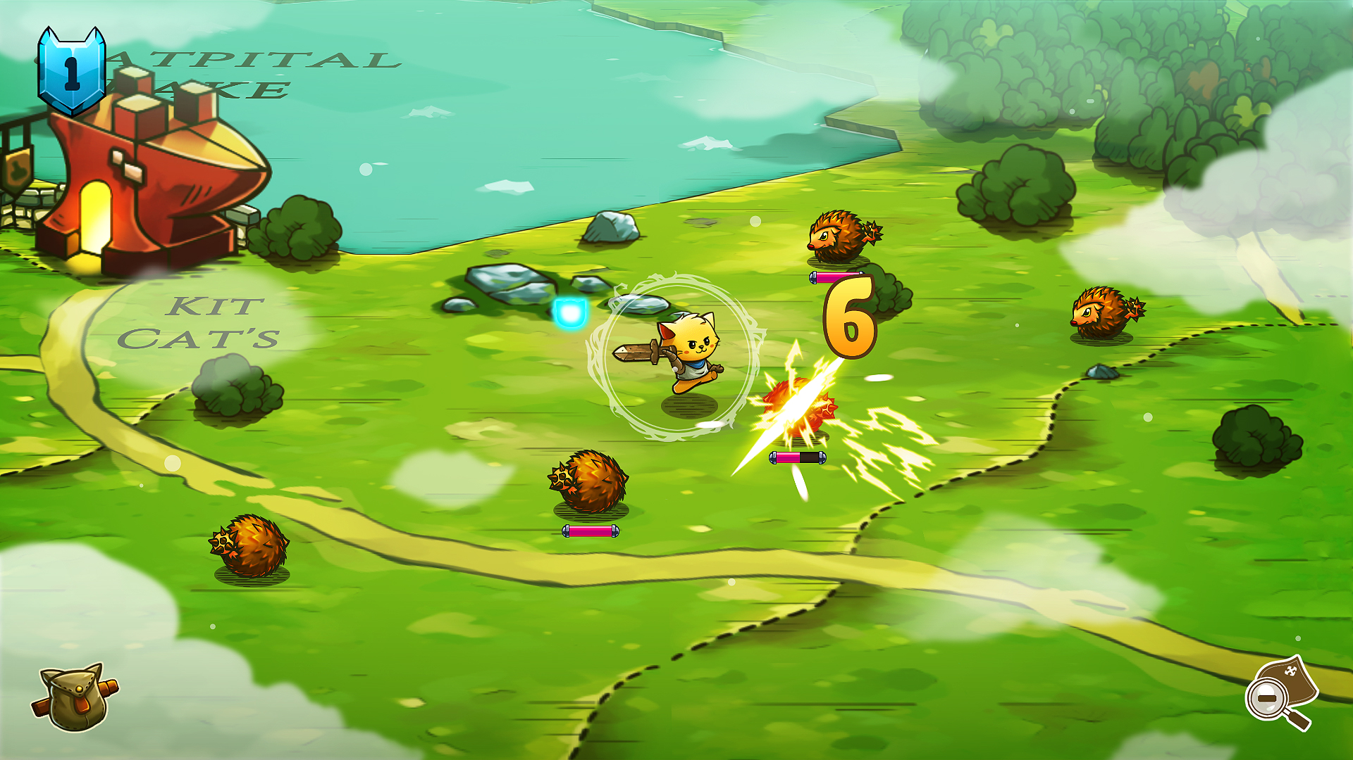
Background and Project Plan
Town improvement system
Lack of story line
Too much combat
Not enough cats
More educational
Notes:
Kayla

Slide 4

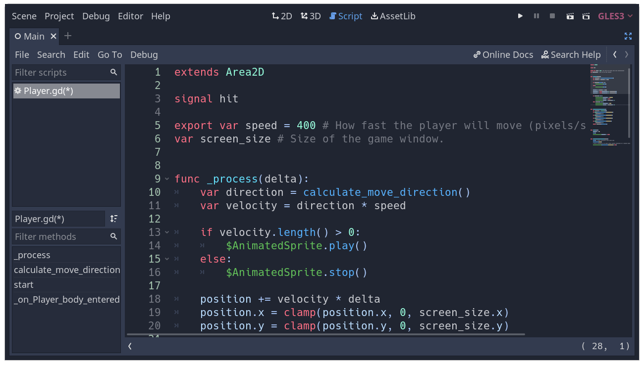


Technical Description
GDscript
Notes:
Ghazal

Slide 5
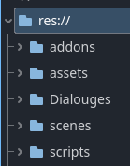
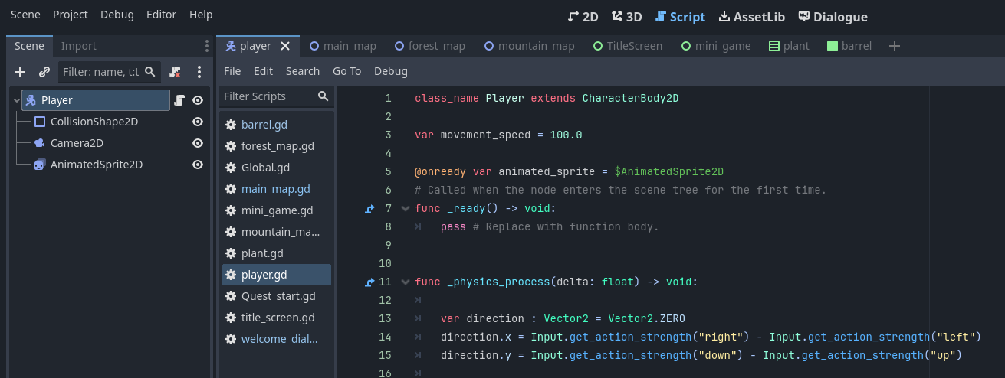
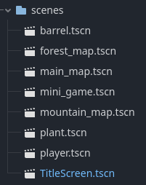
Technical Description Cont.
Notes:
Melissa

Slide 6
Accomplished Work
Collisions
Map Transitions
Basic Minigame
NPC
Beginning Questline
Title screen
Notes:
Melissa
10 scripts, 9 scenes, and about 200 lines of code

Slide 7
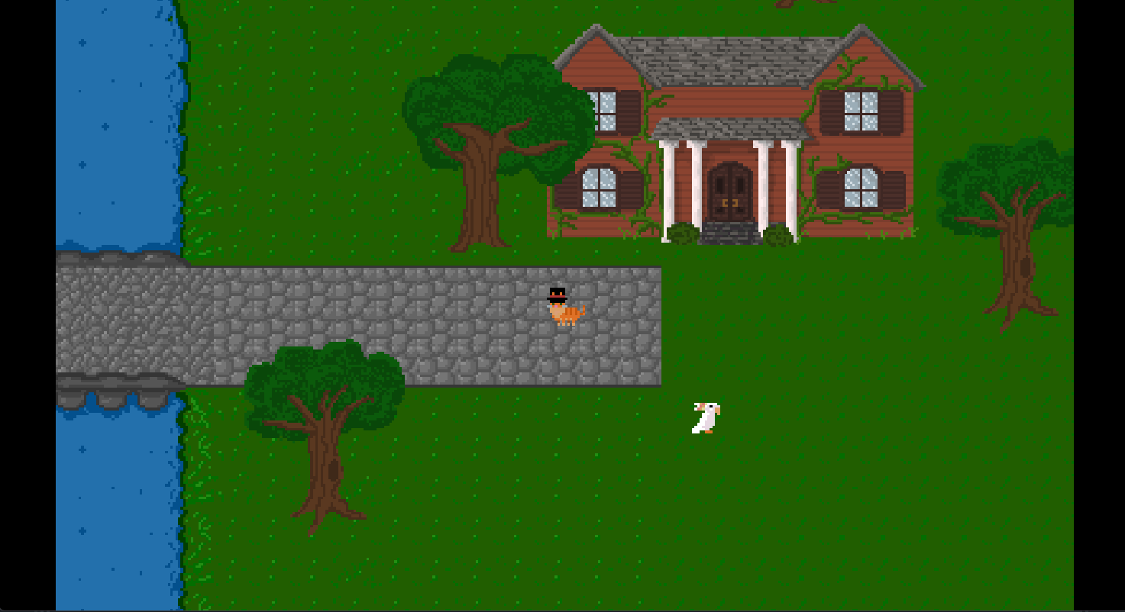
Status
Notes:
Kayla

Slide 8
Team Member Hours
Team Member | Art | Game Design | Music | Total hours
Melissa | 10.5 | 16 | 0 | 26.5
Ghazal | 10.5 | 11 | 0 | 21.5
Kayla | 10.5 | 8.5 | 1 | 20
Notes:
Ghazal

Slide 9
Lessons Learned
Problems with GitHub
Better communication
Notes:
Melissa

Slide 10
What’s Left?
Snow mountain game
Mountain game and dialogues connection
Minor details
Background music
Notes:
Kayla

Slide 11
Demo Time !!!

