Slide 1
6.7 The Delegation Pattern
  Context:
    You are designing a method in a class
    You realize that another class has a method which provides the required service
    Inheritance is not appropriate
      E.g. because the isa rule does not apply
  Problem:
    How can you most effectively make use of a method that already exists in the other class?
  Forces:
    You want to minimize development cost by reusing methods
© Lethbridge/Laganière 2005
Chapter 6: Using design patterns

Slide 2
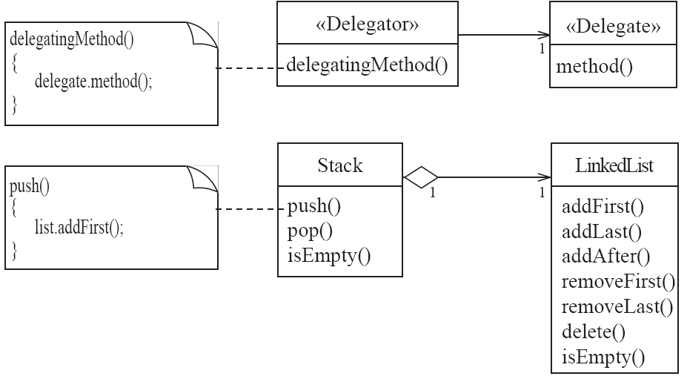
Delegation
  Solution:
© Lethbridge/Laganière 2005
Chapter 6: Using design patterns

Slide 3
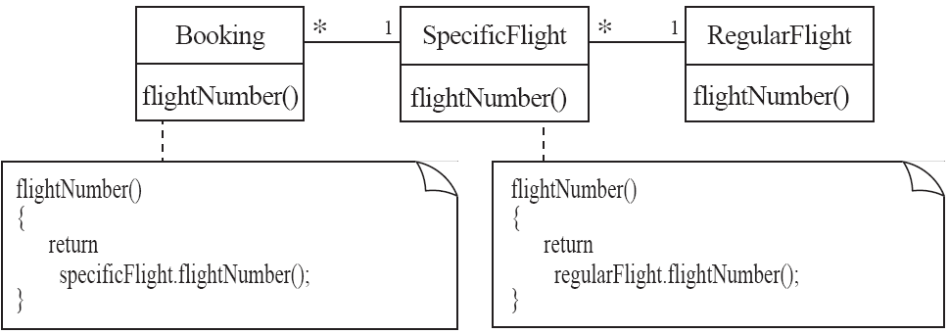
Delegation
Example:
© Lethbridge/Laganière 2005
Chapter 6: Using design patterns

Slide 4
Delegation
Antipatterns
  Overuse generalization and inherit the method that is to be reused
  Instead of creating a single method in the «Delegator» that does nothing other than call a method in the «Delegate
    consider having many different methods in the «Delegator» call the delegate’s method
  Access non-neighboring classes
return specificFlight.regularFlight.flightNumber();
return getRegularFlight().flightNumber();
© Lethbridge/Laganière 2005
Chapter 6: Using design patterns

Slide 5
6.8 The Adapter Pattern
  Context:
    You are building an inheritance hierarchy and want to incorporate it into an existing class.
    The reused class is also often already part of its own inheritance hierarchy.
  Problem:
    How to obtain the power of polymorphism when reusing a class whose methods
      have the same function
      but not the same signature
    as the other methods in the hierarchy?
  Forces:
    You do not have access to multiple inheritance or you do not want to use it.
© Lethbridge/Laganière 2005
Chapter 6: Using design patterns

Slide 6
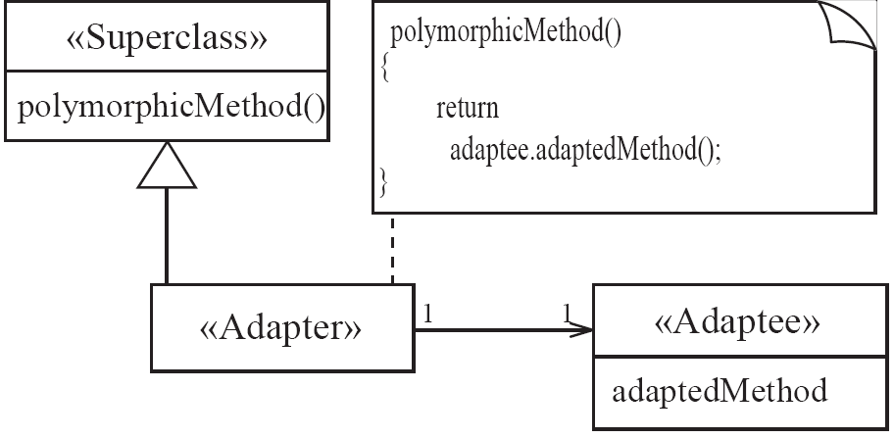
Adapter
  Solution:
© Lethbridge/Laganière 2005
Chapter 6: Using design patterns

Slide 7
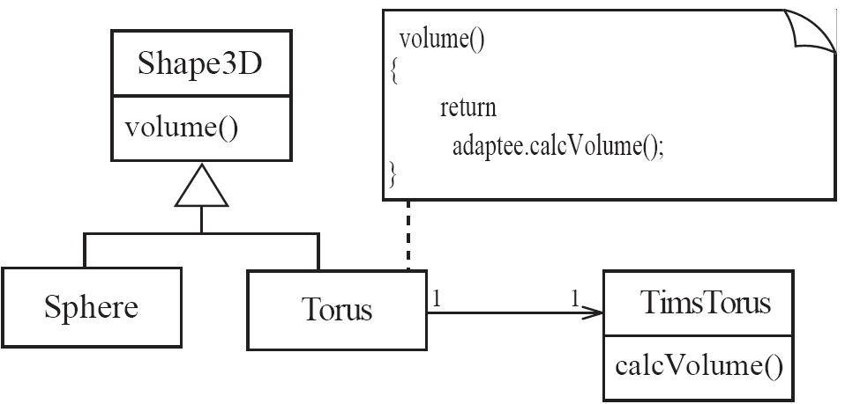
Adapter
Example:
© Lethbridge/Laganière 2005
Chapter 6: Using design patterns

