Slide 1
WHISTLEBLOWING AND THE ENVIRONMENT
Смирнов п.о.
8и52

Slide 2
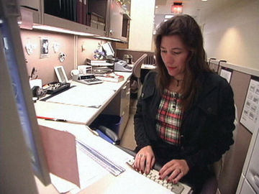
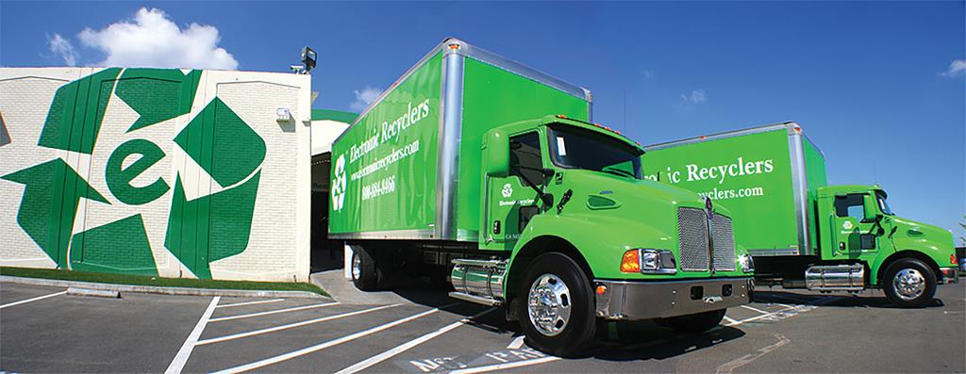
Clare Leroux – our character
Avco Environmental Services

Slide 3
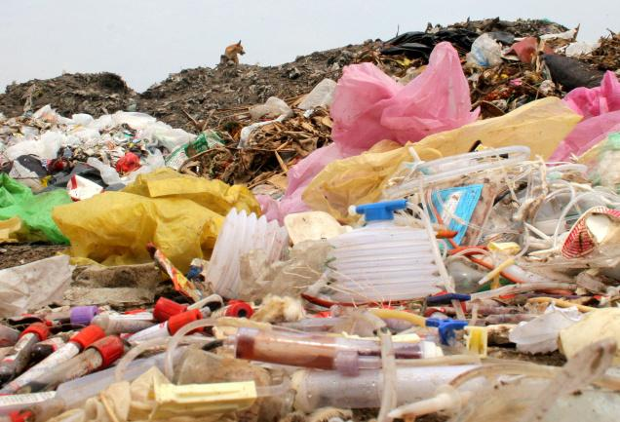
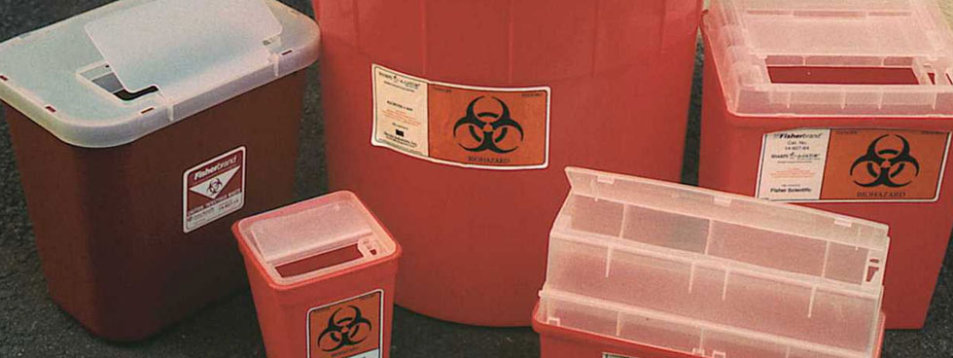

Slide 4


Slide 5
Possible solutions
Tell the truth
Doesn’t do anything
Call in a anonymous hot line
Try regulate the problem within the company

Slide 6


Slide 7
Thank you for attention !

