Slide 1

Zero shot learning
Generative AI and Cybersecurity

Slide 2

Understanding Zero-Shot Learning Making ML More Human

Slide 3
What is Zero Shot Learning ?
Zero-shot learning (ZSL) is a model's ability to detect classes never seen during training. The condition is that the classes are not known during supervised learning.

Slide 4
Motivation: Creation of Models with minimal or no data.
Key Idea: ZSL leverages auxiliary information, such as semantic embeddings or attributes, to transfer knowledge from seen categories to unseen categories.

Slide 5



Applications
NLP
Speech Recognition
Speech Synthesis
CVPR

Slide 6
Caution !!!!
Zero shot learning is not the same as few shot learning.

Slide 7
Zero shot learning in nlp

Slide 8
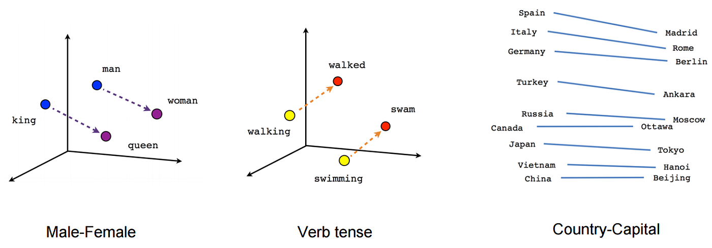
Semantic Embeddings in NLP
Notes:
Zero shot learning is a subdivision of semi-supervised learning.

Slide 9
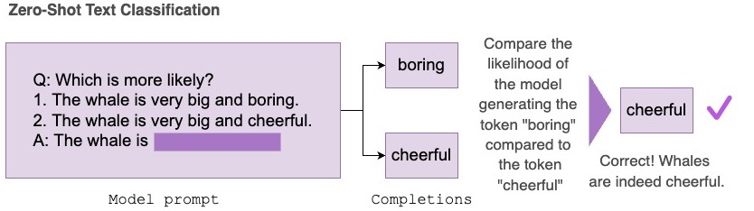
Zero Shot text classification

Slide 10
Making use of transformers for ZERO SHOT TEXT CLASSIFICATION
Will be continued in the linked Jupyter notebook

Slide 11
Applications of zero shot text classification
Sentiment Analysis
Spam Detection

Slide 12
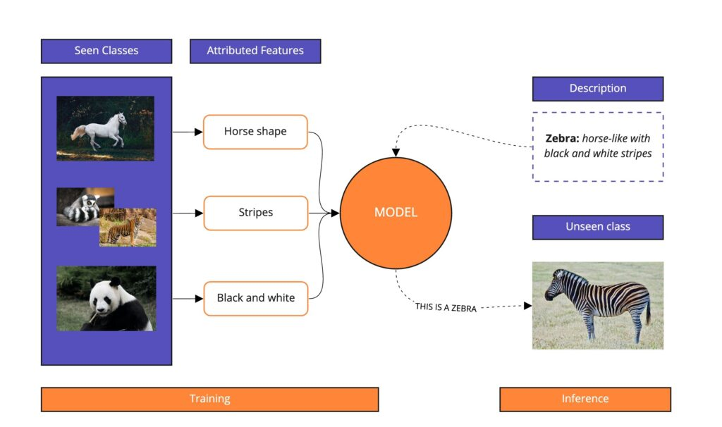
Zero Shot text classification

Slide 13
Zero shot learning in CVPR

Slide 14
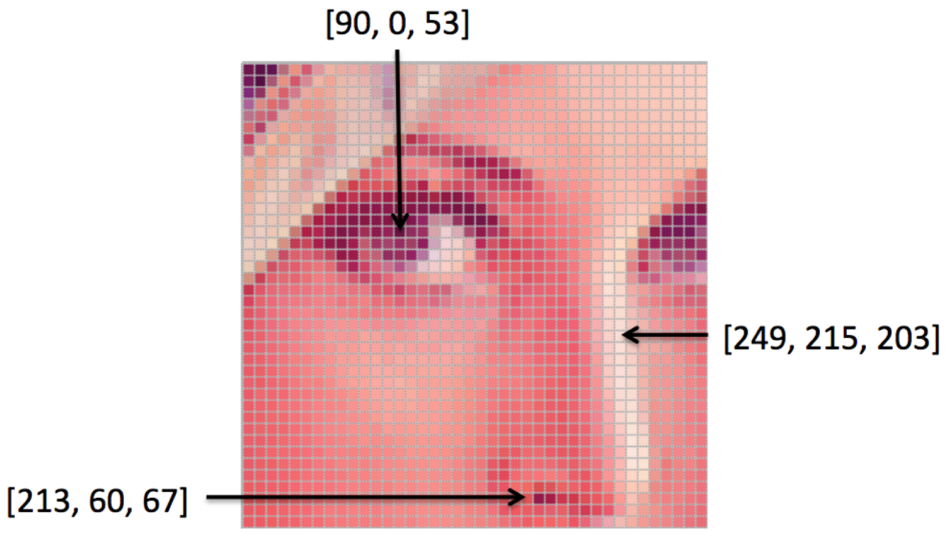
Image representation

Slide 15
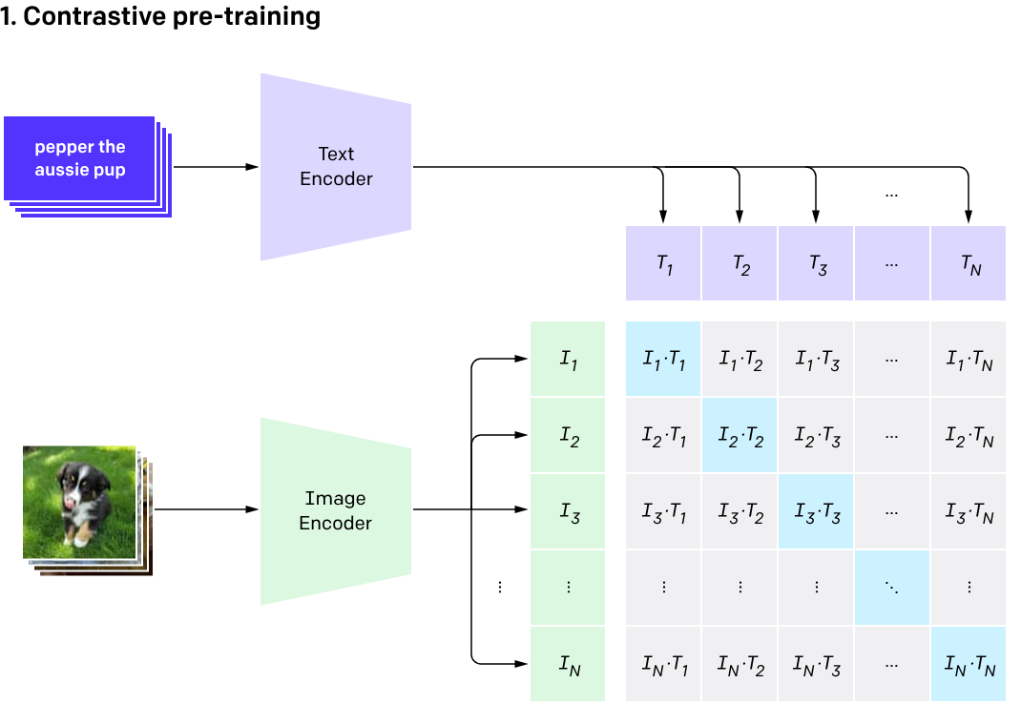
CLIP — An Overview
CLIP stands for Constastive Language-Image Pretraining:
Source : OpenAI

Slide 16
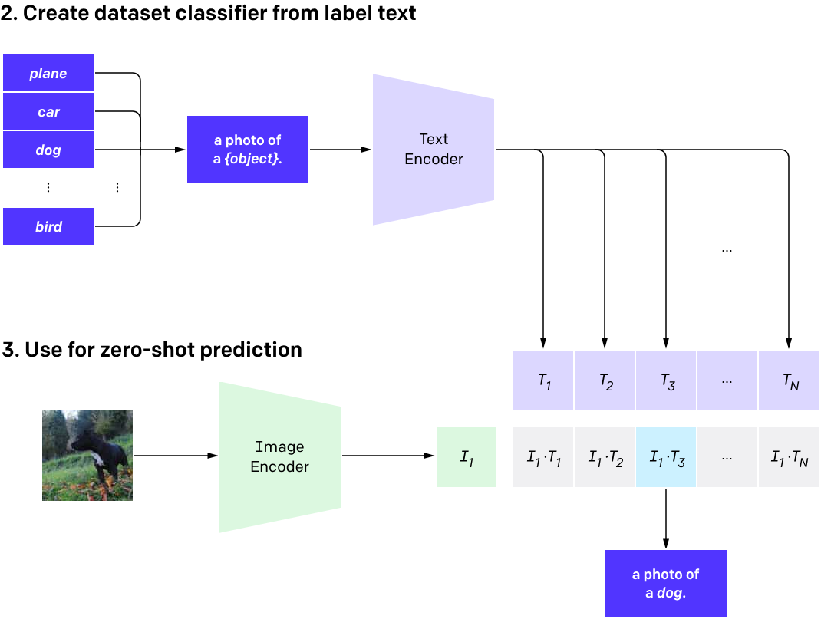

Slide 17
Usage of CLIP for image classification and object detection
Will be continued in the linked Jupyter notebook

Slide 18
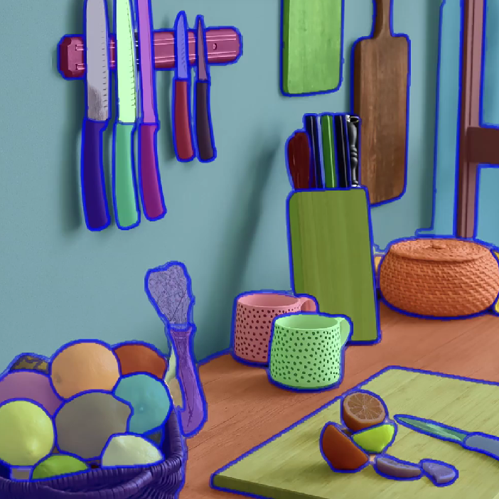
Zero shot Image segmentation
Source : Meta (Previously Facebook) SAM (Segment Anything Model)

Slide 19
Usage of CLIPSeg TO PERFORM IMAGE SEGMENTATION
Will be continued in the linked Jupyter notebook

Slide 20
Challenges and future directions
Bias
Domain shift
Hubness
Semantic loss

Slide 21
Future Directions
Zero Shot learning is becoming more prominent in the field of Audio Processing and Synthesis
Zero Shot object detection and segmentation is quite scalable
ZSL based text models can help reduce the size of current language models, making them more efficient.

Slide 22

Thank You!
ATHREYA.SUDHANVA@HOTMAIL.com

Slide 23
References
https://huggingface.co/datasets/multi_nli
https://huggingface.co/tasks/zero-shot-classification
https://joeddav.github.io/blog/2020/05/29/ZSL.html

