Slide 1


Financial Data Display & Analyze
Team T02
1552635 胡嘉鑫
1552672 吴可菲
1552673 陈明曦
1552674 李 源
Notes:
READ PLEASE!
Before you open this template be sure that you have installed these fonts:
GeosansLight.ttf from: http://www.dafont.com/geo-sans-light.font
New Cicle Semi.ttf from: http://www.dafont.com/new-cicle.font
fontawesome-webfont.ttf from: http://fortawesome.github.io/Font-Awesome
All fonts are free for use in commercial projects!
If you have any problems with this presentation, please contact with me from this page: http://graphicriver.net/user/Bandidos

Slide 2
Contents
1
Project Inspiration
2
Project Profile
3
Project Framework
4
Teamwork

Slide 3
1
Project Inspiration

Slide 4
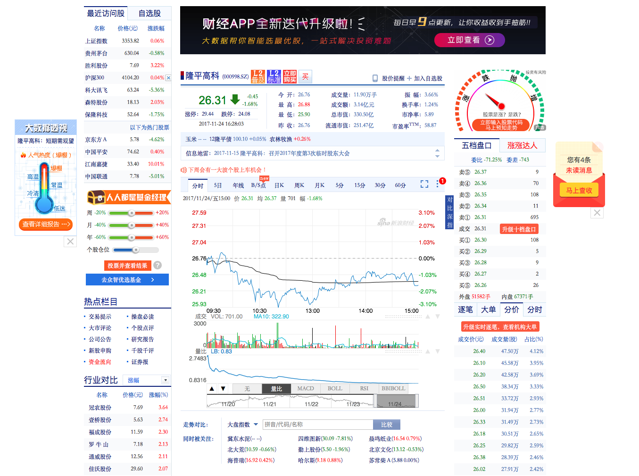
Project Inspiration
Current Financial Data Platform
Current Financial Data Platform
Intricate information
Complex interface

Slide 5
2
Project Profile

Slide 6
Project Profile
Project name & logo

Slide 7
Project Profile
Major Functionalities
Market Condition
News Tracking
Winner list
Fundamental Data
Timely
Accurate
Authority
Comprehensive
Precise
Rich
Hot Spots
Stock Trend
Quickly Found
Timely Update
Intelligent Mining

Slide 8



Project Profile
Project Creativity





Data Mining
Warehouse
Machine Learning

Slide 9
3
Project Framework

Slide 10
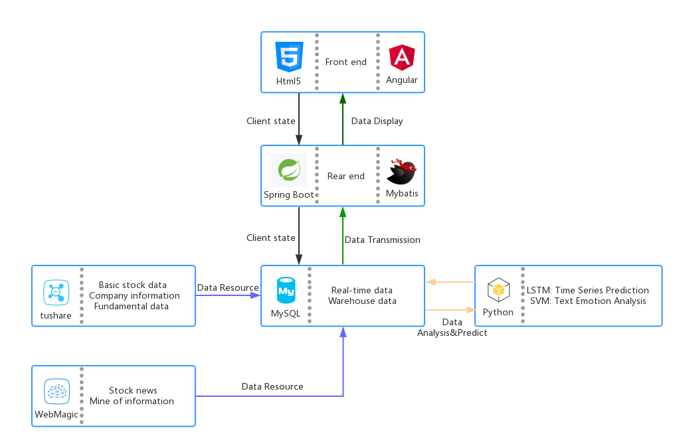
Project Framework
Framework

Slide 11
Project Framework
Workflow
SH&SZ Market
Market Condition
Self-Stocking
News Tracking
Hot Spot
Log in!
Mine of Market
Winner List
Daily Details
Fundamental Data
Five plates

Slide 12
4
Teamwork

Slide 13
Teamwork
Plan & Schedule
01
03
05
07
Preliminary Investigation
Rear-end Front-end
Implement
Data
Analyze & Predict
Document Writing
02
04
06
Historical Data ETL
Real-time Data
Update
Software Testing

Slide 14
Teamwork
Personnel Allocation
李 源: Data Analyze
胡嘉鑫: Rear-end, Database
吴可菲: Front-end, Rear-end
陈明曦: Front-end, Data Analyze

Slide 15



Teamwork
Collaboration

Slide 16
Thanks for Watching

