Slide 1
The Association between Precipitation Intensity and Traffic Speeds
Final Project
Author: W. Logan Downing
GitHub Repository: https://github.com/Foxhound013/CE-597_GDA/tree/master/final_project

Slide 2
Outline
The Problem
Primary Questions of this Analysis
The Data Sources
Interpolation
Analysis
Conclusions

Slide 3
The Problem
According to the Federal Highway Administration (FHWA), of roughly 5.8 million crashes each year,
21 % are related to weather.
46% of weather related crashes occur during rainfall.
That translates to roughly 560 thousand crashes each year that occur during rainfall conditions.
https://ops.fhwa.dot.gov/weather/q1_roadimpact.htm

Slide 4
Primary Questions of this Analysis
What impact does precipitation intensity have on traffic speeds?
How different (if at all) are traffic speeds under precipitation conditions compared to dry conditions and to what extent?
Is there a spatial or temporal relationship between traffic speeds and precipitation intensity?
Are there external factors that influence the traffic speeds that can be determined from the data?

Slide 5
The Data Sources - Traffic
Traffic speeds will be sourced from the INRIX speeds database maintained by Purdue’s JTRP. All speeds are from June 2018.
1-minute resolution down sampled to 2-minutes.
Units of MPH.
These are remotely collected and crowd-sourced average traffic speeds.
300 million data sources (http://inrix.com/research/).
Consist of High, Medium, and Low confidence speed estimates.

Slide 6
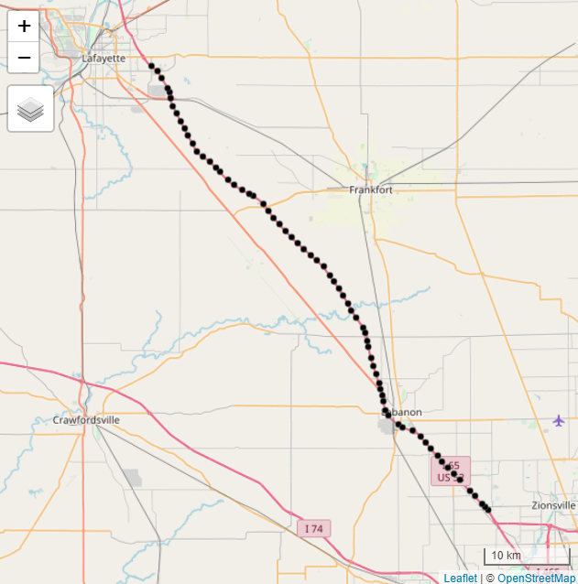
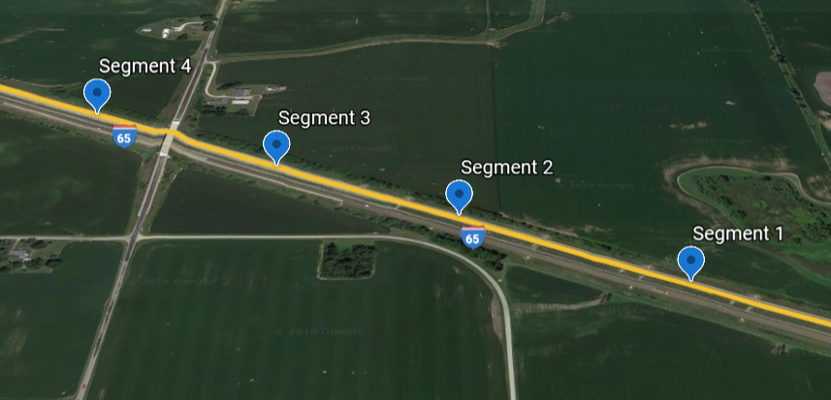
The Data Sources - Traffic
This study will focus on the I-65 North Bound corridor from Zionsville to Lafayette Indiana and consists of 69 segments.
Traffic Direction
Low Confidence | Medium Confidence | High Confidence
0% | 1.25% | 98.75%
Notes:
Confidence score percentages are derived from the 1 minute data.
High confidence is real time data.
Medium confidence data is computed from surrounding segments (likely real time)
Low confidence is historical data.
Takes out the difficult problem of imputation for missing data.

Slide 7
The Data Source – Precipitation Intensity
The weather data comes from the National Severe Storms Laboratory’s Multi-Radar Mutli-Sensor system. The data in this analysis is courtesy of the Iowa Environmental Mesonet. All precipitation data is from June 2018.
1km x 1km grid spacing.
2-minute temporal resolution.
Units of mm/hr.
Derived from a combination of radar, observations (upper-air, satellite, ground), and forecast models.

Slide 8
Interpolation
The first problem to solve: Getting precipitation estimates at the road segment level.
This was accomplished using the interpp function from the akima package.
The function performs bilinear interpolation.
100 | 133 |  | 200
 | 164.3
220 | 180 |  | 100
The x-direction comes first, followed by the y-direction.
2/3 * 100 + 1/3 * 200
2/3 * 220 + 1/3 * 100
2/3 * 180 + 1/3 * 133
Notes:
Process takes roughly 6 hours.
Other methods of interpolation like Kriging were considered but were ultimately deemed entirely too slow for the constraints of this project.
* Missing values in the speed data after interpolation (when a time step was missing) were calculated as a naïve forecast, i.e. the precipitation at the previous time step is forecasted at the missing time step.

Slide 9
The Analysis – Defining Terms
To start analyzing anomalies in the traffic data, it was important to establish a sort of normal. Normal traffic flow was defined as follows.
Greater than or equal to 60 mph is considered normal traffic speeds.
We’re specifically interested in events where traffic slows down and precipitation is non-zero.
Situations where speeds are less than 60 mph and precipitation intensity is above 0 are considered an “Event”

Slide 10
The Analysis – Defining Terms
A temporal component to this relationship is suspected.
Day and Night have been defined based on civil twilight hours for June 2018 in Indiana.
Day: 6:00 am to 8:30 pm (1000 UTC – 0030 UTC)
Night: 8:31 pm – 5:59 am (0031 UTC – 0959 UTC)

Slide 11
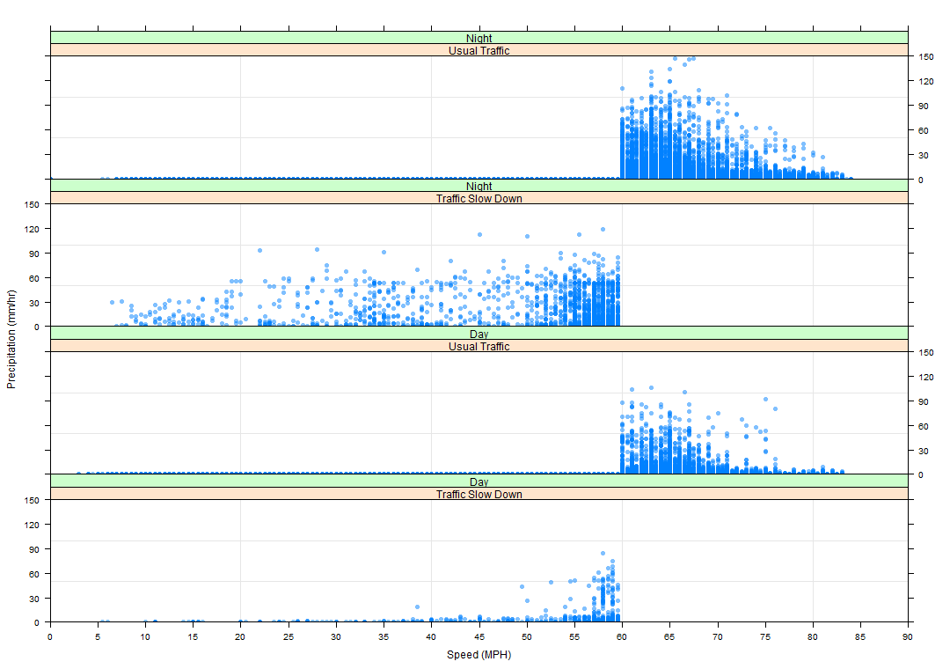
Notes:
Traffic Speeds under Normal Conditions Vs. Slow Downs with Day and Night Highlighted.
The data has been diced up into day and night as well as events with precipitation > 0 and speeds < 60 and usual traffic > 60 mph.
What is revealed in this plot is that the traffic speeds seem to be somewhat resistant to precipitation intensity impacting speeds.
Another notable point of interest is the significant number of events that occur during the night compared to the day time. This goes against the assumption
I originally held that due to low volumes, traffic speeds should be mostly unimpeded by precipitation intensity at night but is somewhat intuitive
Due to visibility constraints.
This answers the question of whether or not there is a temporal component to the relationship between traffic speeds and precipitation intensity as it does
Appear that there is some form of a relationship here. Now to quantify that relationship and see if there is a spatial component as well.

Slide 12
Analysis - Developing Statistics on the Data
Using these day/night and event/non-event criterions, a count of “normal” conditions and “event” conditions were calculated as well as mean speeds for each segment and is summarized as follows.
Sum Normal Conditions Count – Night | Sum Normal Conditions Count – Day | Sum Event Conditions Count – Night | Sum Event Conditions Count – Day
591,308 | 896,393 | 712 | 1,987
Percent Normal Conditions Count – Night | Percent Normal Conditions Count – Day | Percent Event Conditions Count – Night | Percent Event Conditions Count – Day
39.67% | 60.14% | 0.04% | 0.13%
$$\frac{\sum{{count}_{segment}}}{T_{timesteps}×N_{segments}}×100 , Where T=21,600 and N=69$$
Notes:
As with any extreme events, our sample size for these events is extremely limited. You can increase the sample size with more data but the overall percentages would likely stay relatively unchanged.

Slide 13
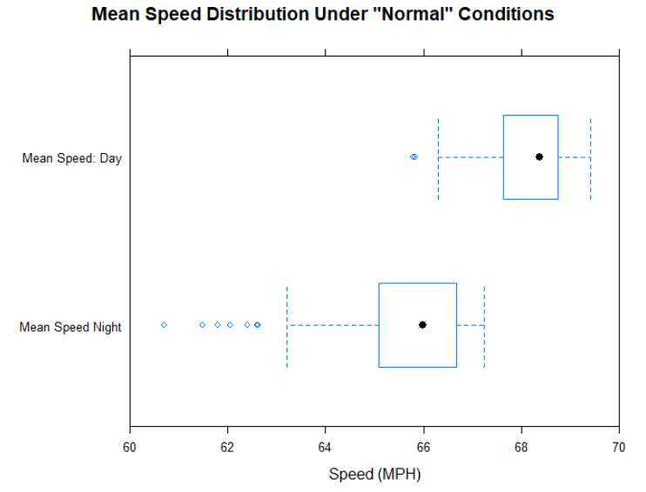
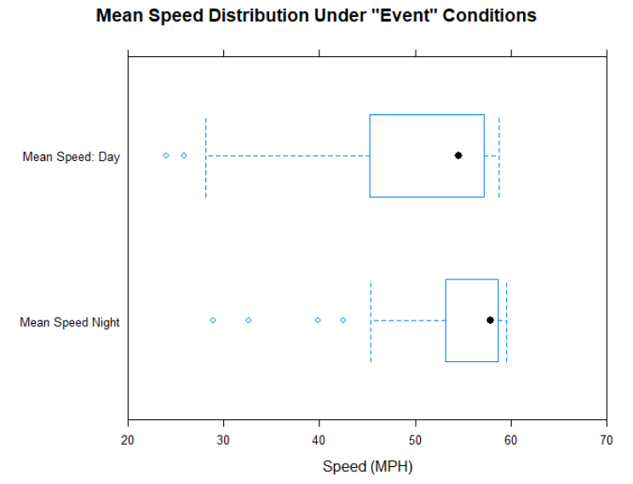
Notes:
Normal conditions
Day time speeds tend to be higher than night time speeds. This is somewhat unintuitive as one would expect lower traffic volumes would equate to higher speeds but this may be a function of
Construction during the day time.
Event conditions
While it appeared that night time events dominated in the previous figure, there are actually much lower speeds that occur during the day time in the case of an event. This is likely due to higher traffic volumes.

Slide 14
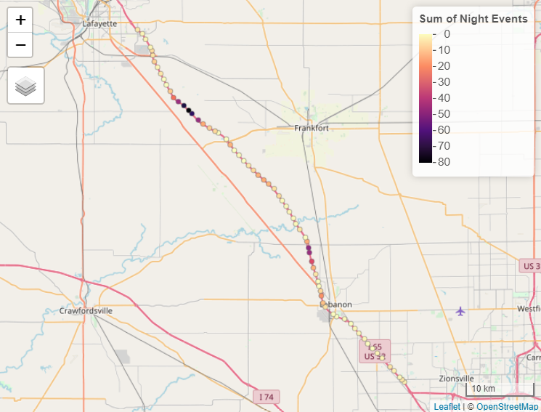
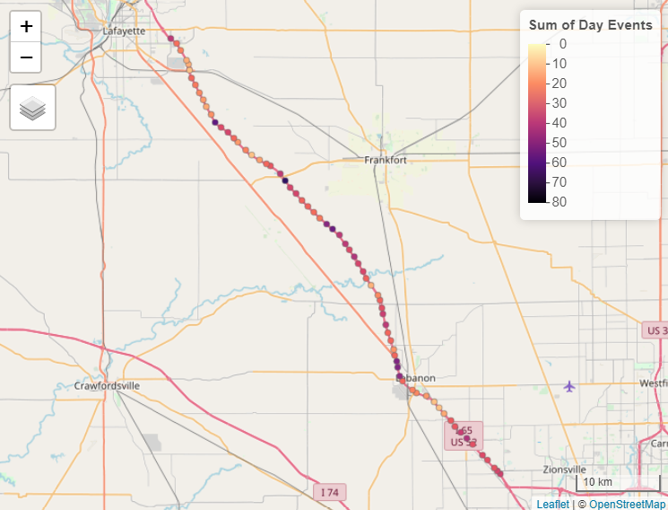
Analysis - Spatial Distribution
Notes:
Night time events show a clustering around on and off ramps.
The data seems to be more homogenous during the day with spikes around ramps and apparent workzones. Higher frequencies may also be due to higher volumes.

Slide 15
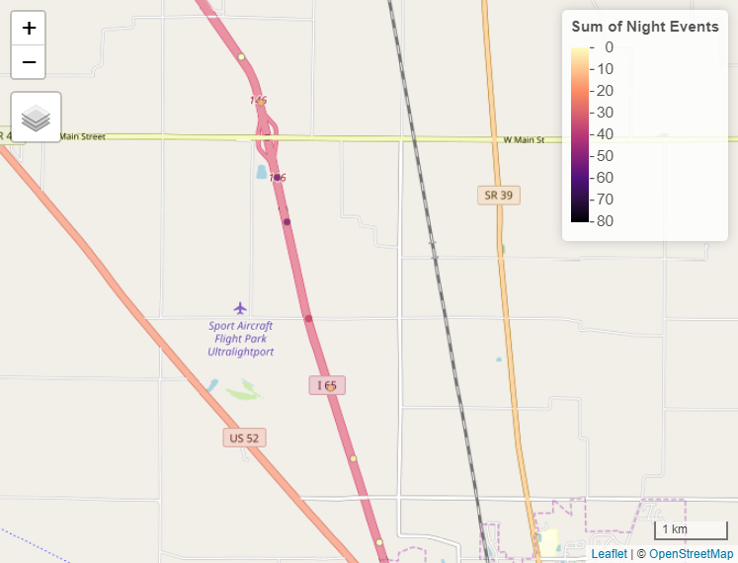
Analysis – Spatial Distribution
Ramps at night (and during the day) tend to display a spike in the number of events for that segment.

Slide 16
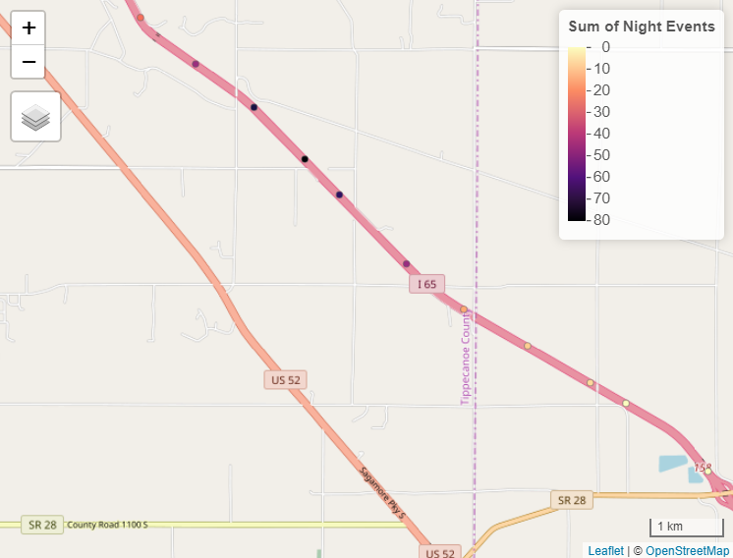
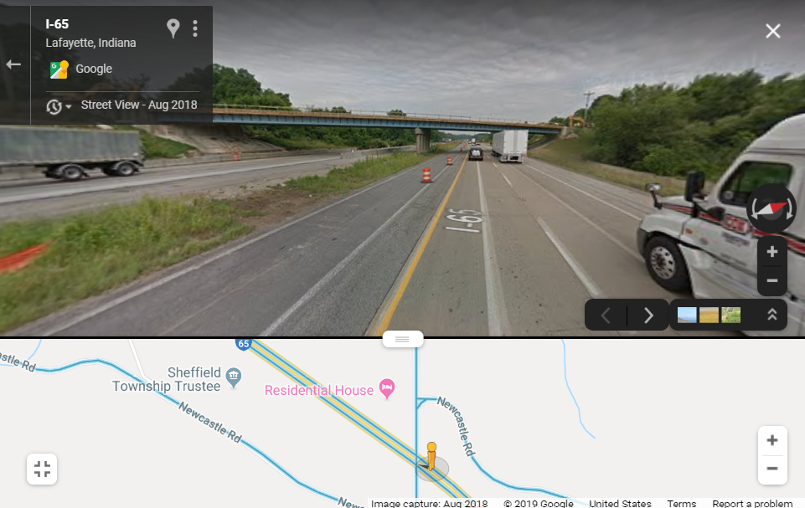
Slow down likely due to a combination of construction and precipitation.
Notes:
This particular spike didn’t seem to be correlated to anything in particular but when looking through google street view imagery, I noticed that the bridge was under construction during this time. Most roadway construction occurs at night, perhaps leading to higher counts for events.

Slide 17
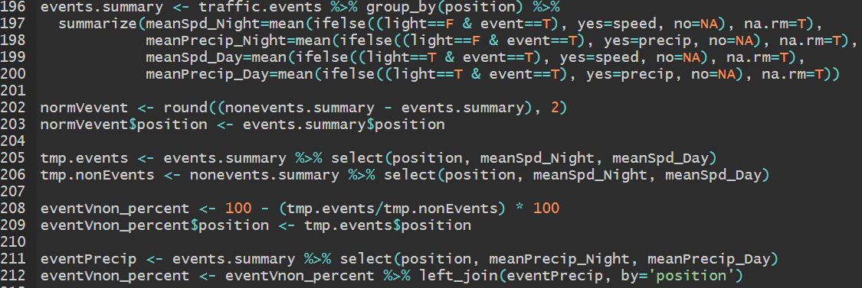
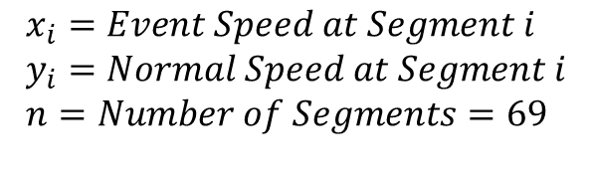
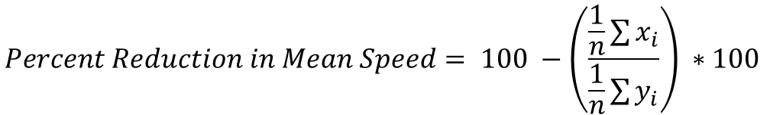
Percent Reductions from Normal Mean Speeds
$$Percent Reduction in Mean Speed= 100 −\left(\frac{\frac{1}{n}\sum{x_{i}}}{\frac{1}{n}\sum{y_{i}}}\right) ∗100$$
$$x_{i}=Event Speed at Segment i \\ y_{i}=Normal Speed at Segment i \\ n=Number of Segments=69$$

Slide 18
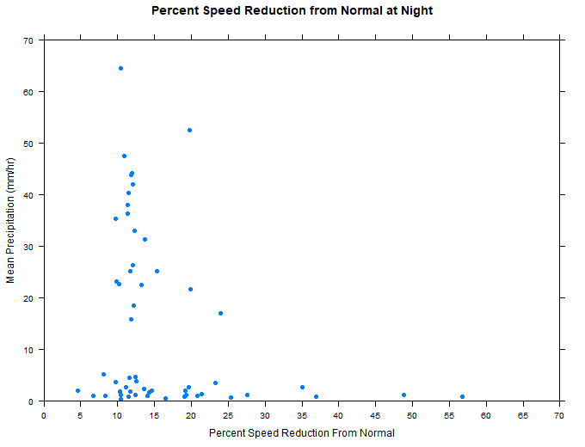
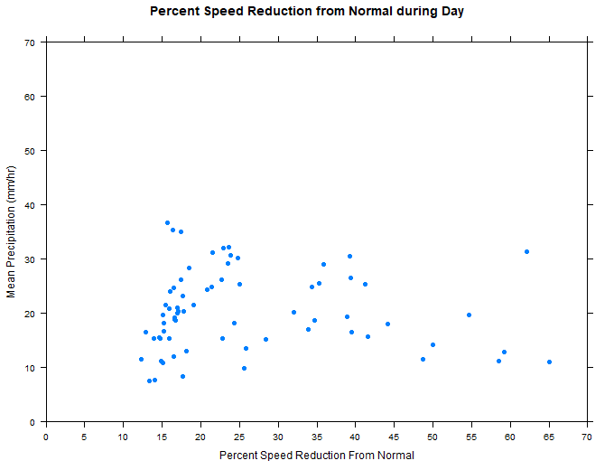
Percent Reductions from Normal Mean Speeds

Slide 19
Conclusions
Traffic speeds are most likely to reduce by 10 to 15 % from normal at night when precipitation intensity is greater than 15 mm/hr.
Traffic speeds are most likely to reduce by 13 to 22% from normal during the day when precipitation intensity is greater than 8 mm/hr.

Slide 20
Conclusions
3. There is a spatial component to this relationship. Ramps and construction seem to impact the speeds more so than precipitation alone.
4. There is a temporal component to this relationship. Most traffic events occur during the day and result in much greater reductions in speed than normal.

Slide 21
Questions?

