Slide 1
Project 3: Thematic Mapping & Clustering
W. Logan Downing

Slide 2
Outline
Data Preparation
Thematic Mapping of Population Density
Develop a Kmeans Clustering Algorithm
Kmeans Comparison with ArcGIS

Slide 3
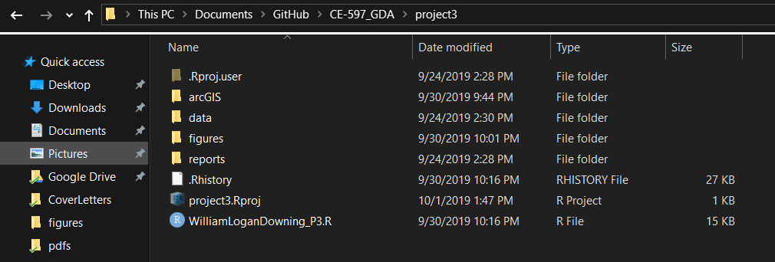
Note
You will see me using the png() command. This is to save my figures and persist them in the project structure that I’ve been using to keep myself organized.
An R Project is used to make R Studio use the source file directory as its working directory.

Slide 4
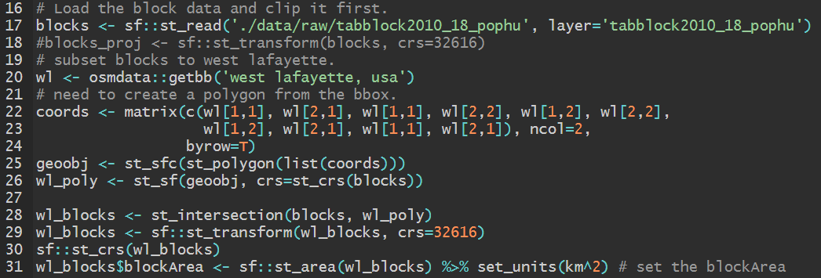
Data Preparation
In this section, I opted to work with the tracts data but I have also chosen to read in and subset West Lafayette from the tracts for practice.

Slide 5
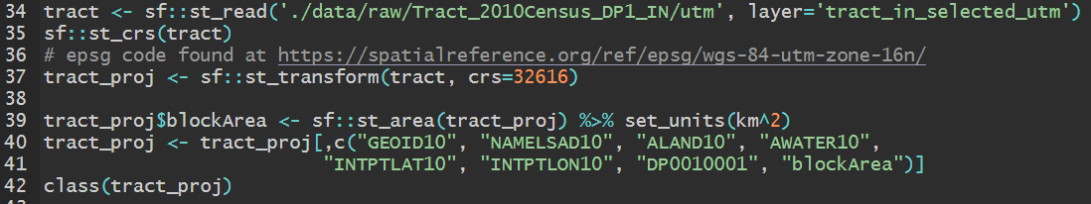
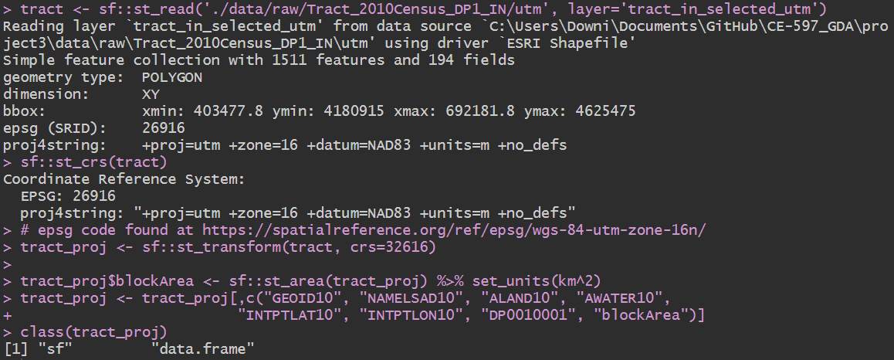
Data Preparation

Slide 6
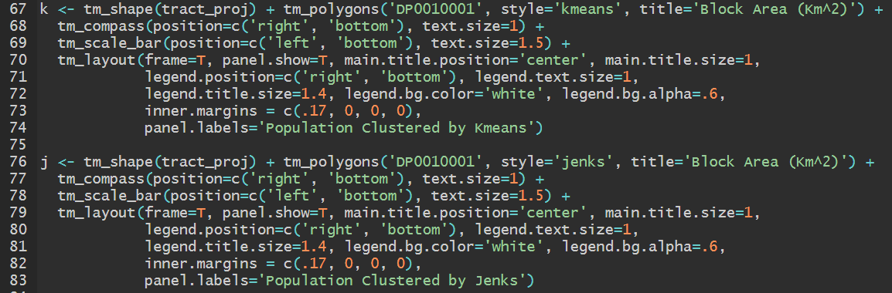
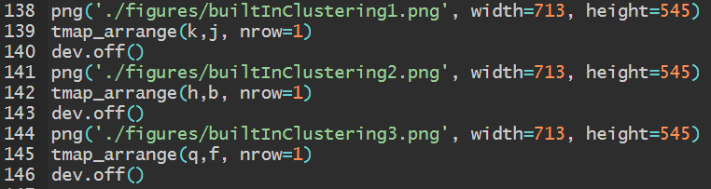
Thematic Mapping of Population Density
For this section, we needed to create thematic maps from the tract population (DP0010001).
The following clustering methods were used Kmeans, Jenks, Hiearchical, Bayesian, Quantile, and Fisher

Slide 7
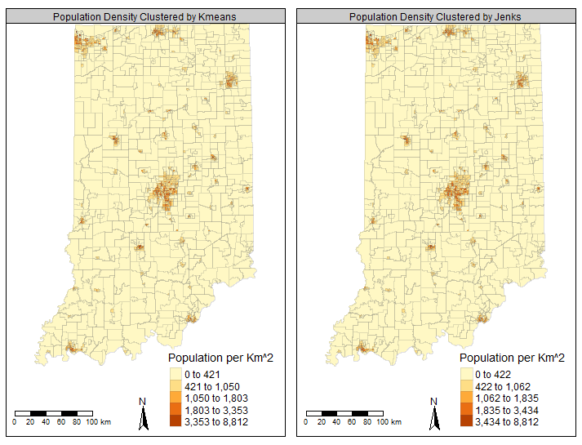

Slide 8
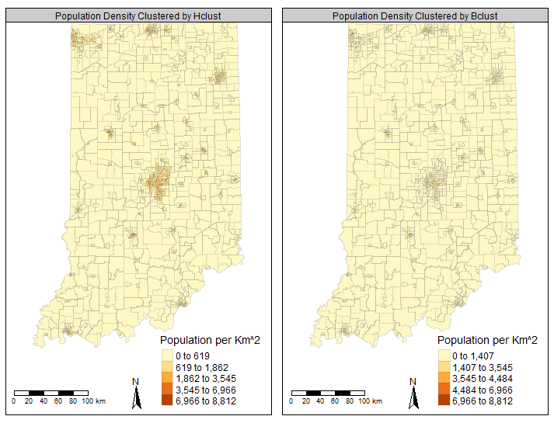

Slide 9
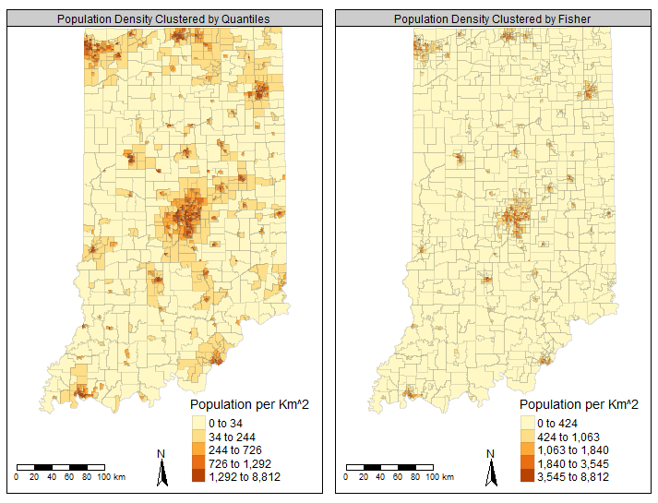

Slide 10
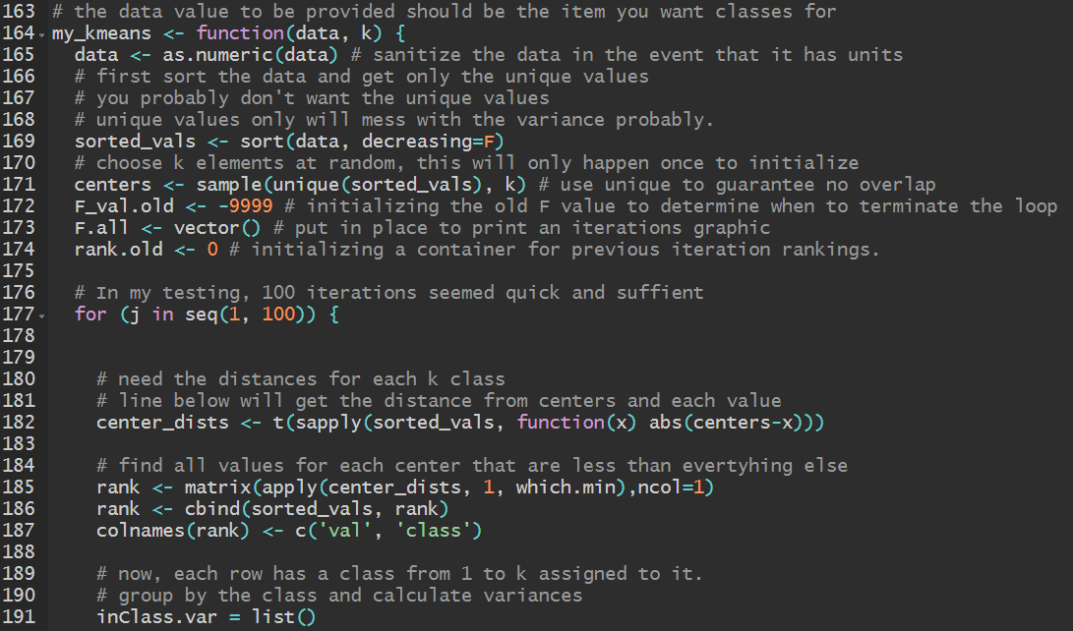
Developing a Kmeans Clustering Algorithm

Slide 11
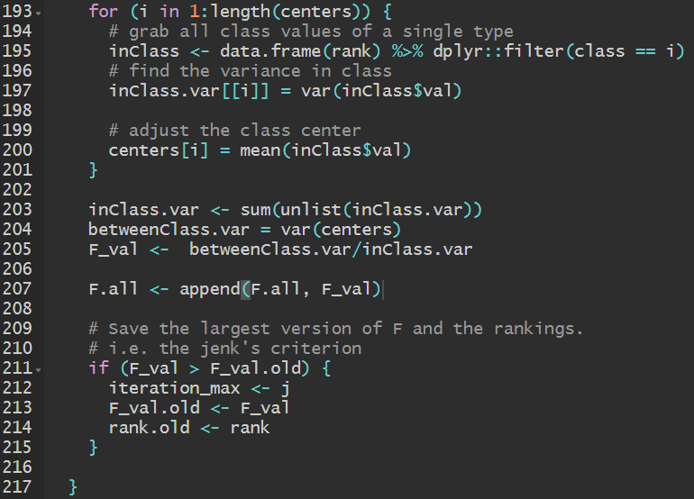
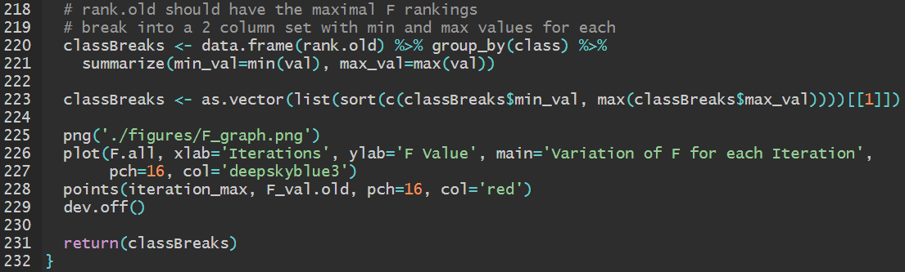
Developing a Kmeans Clustering Algorithm

Slide 12
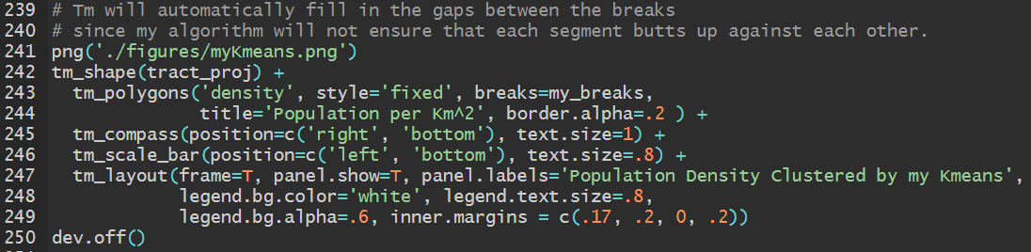
Developing a Kmeans Clustering Algorithm

Slide 13
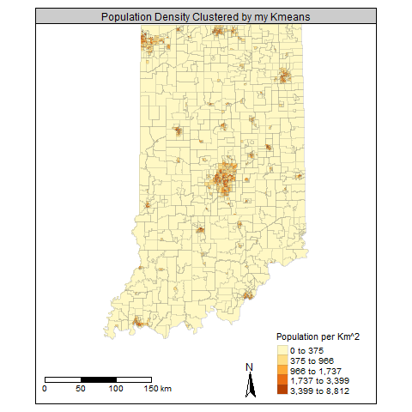
Developing a Kmeans Clustering Algorithm

Slide 14
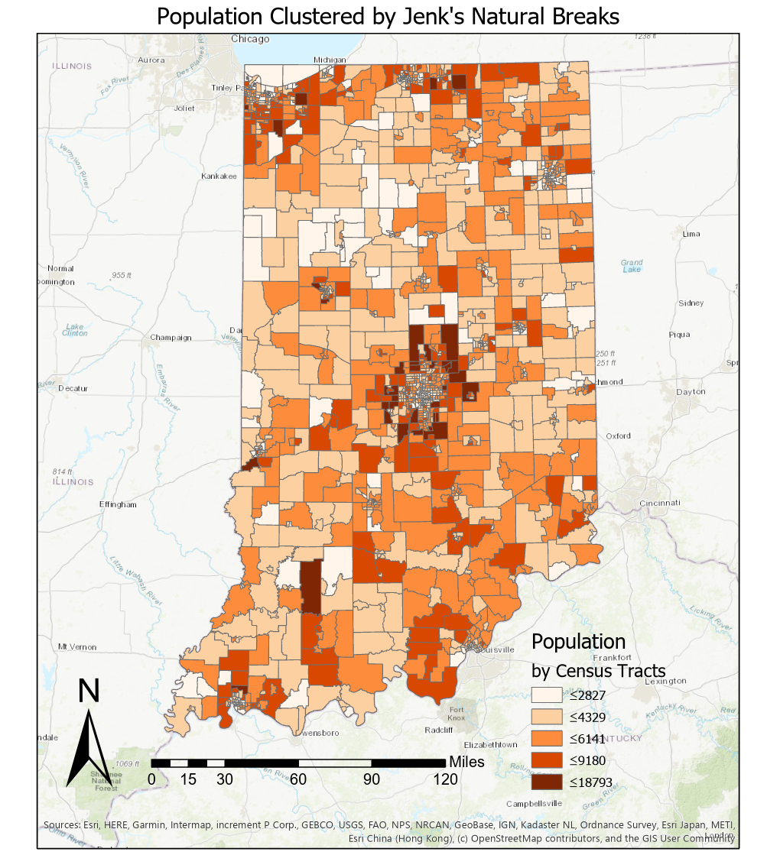
My Kmeans implementation vs ArcGIS
NEED TO UPDATE THIS SLIDE!

