Slide 1
The Association between Precipitation Intensity and Traffic Speeds
Final Project
Author: W. Logan Downing

Slide 2
Outline
Primary Questions of this Analysis
The Data Sources
Interpolation

Slide 3
Primary Questions of this Analysis
What impact does precipitation intensity have on traffic speeds?
How different (if at all) are traffic speeds under precipitation conditions compared to dry conditions and to what extent?
Is there a spatial or temporal relationship between traffic speeds and precipitation intensity?
Are there external factors that influence the traffic speeds that can be determined from the data?

Slide 4
The Data Sources - Traffic
Traffic speeds will be sourced from the INRIX speeds database maintained by Purdue’s JTRP.
1-minute resolution down sampled to 2-minutes.
These are remotely collected and crowd-sourced traffic speeds.
300 million data sources (http://inrix.com/research/).
Consist of High, Medium, and Low confidence speed estimates.

Slide 5
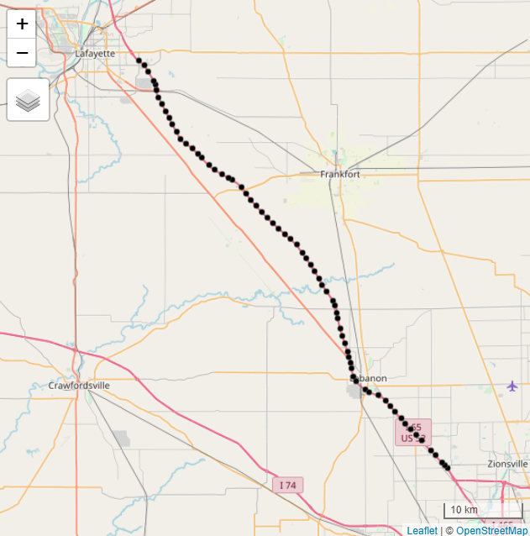
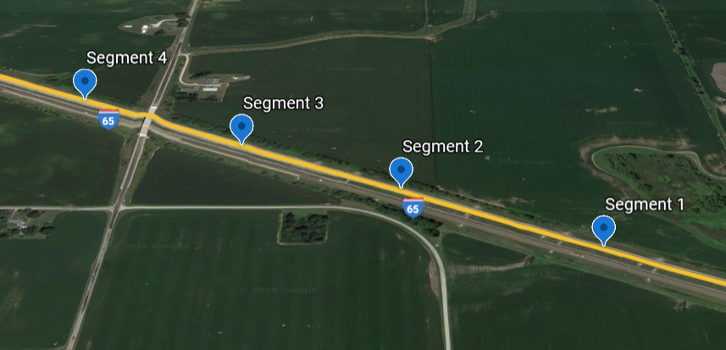
The Data Sources - Traffic
This study will focus on the I-65 North Bound corridor from Zionsville to Lafayette Indiana.
Traffic Direction
Low Confidence | Medium Confidence | High Confidence
0% | 1.25% | 98.75%
Notes:
Confidence score percentages are derived from the 1 minute data.
High confidence is real time data.
Medium confidence data is computed from surrounding segments (likely real time)
Low confidence is historical data.
Takes out the difficult problem of imputation for missing data.

Slide 6
The Data Source – Precipitation Intensity
The weather data comes from the National Severe Storms Laboratory’s Multi-Radar Mutli-Sensor system. The data in this analysis is courtesy of the Iowa Environmental Mesonet.
1km x 1km grid spacing.
2-minute temporal resolution.
Derived from a combination of radar, observations (upper-air, satellite, ground), and forecast models.

